Slide 1
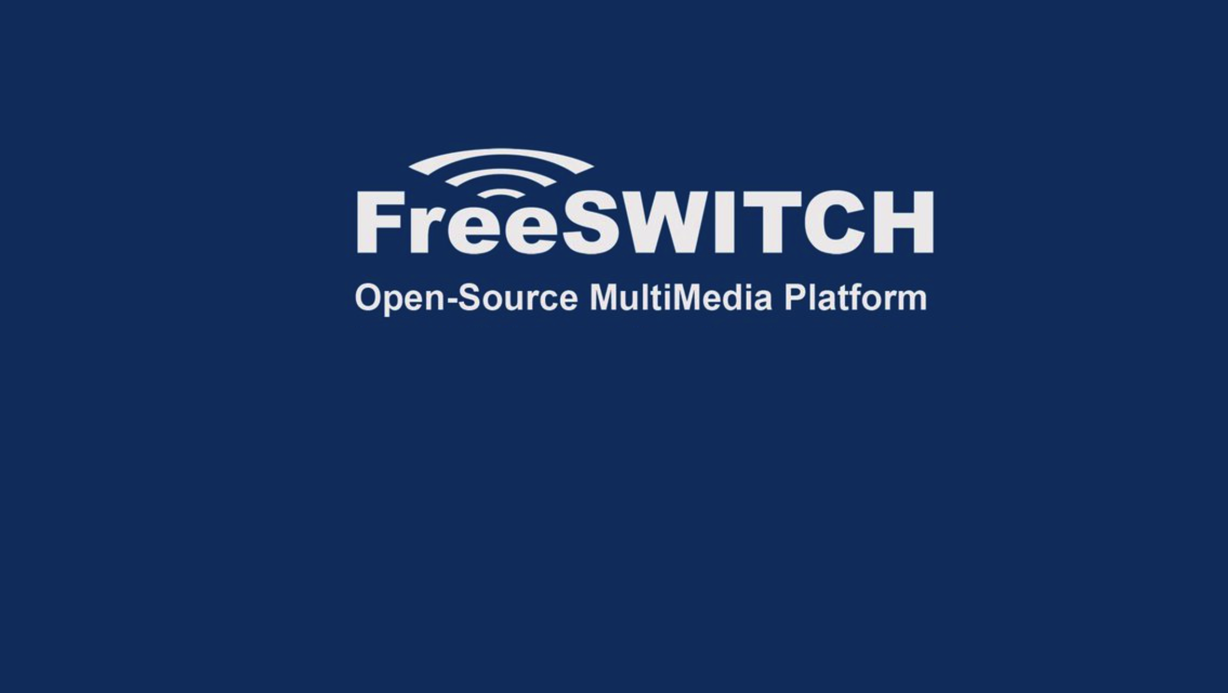
Part 9
Learn
Bridge Application

Slide 2

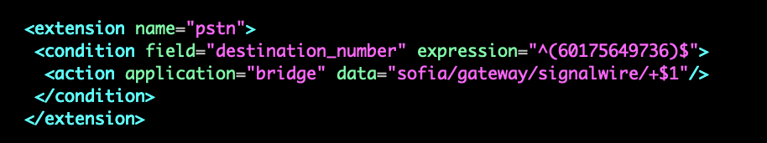
Bridge an incoming call to an external SIP address or termination provider.

Slide 3
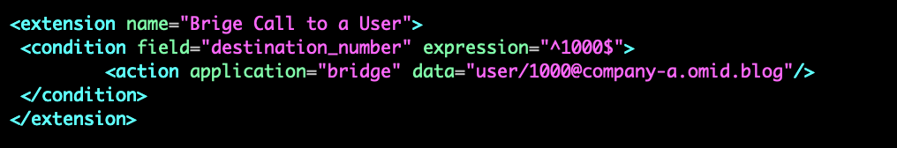
Bridge call to a user

Slide 4
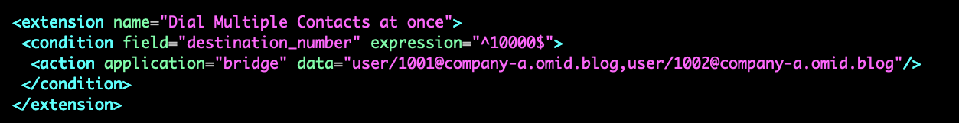
Dial multiple contacts all at once
By using commas to separate the addresses, bridge will dial them simultaneously.
no limit to concurrency, first one to answer wins

Slide 5
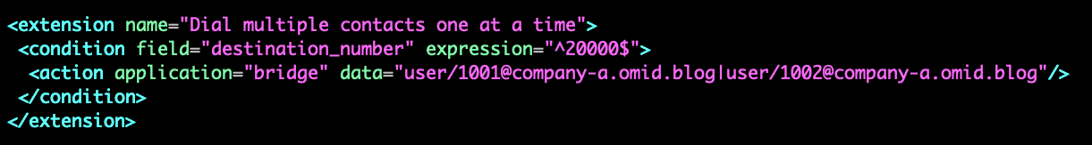
Dial multiple contacts one at a time
Multiple endpoints sequential -- no limit to failover number
Using pipes, it'll dial one at a time.

Slide 6
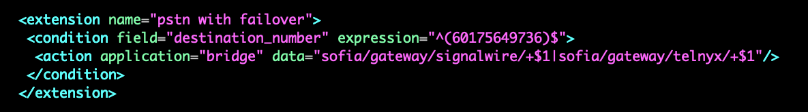
Implementing Failover
Failover for your outbound gateway is easy to implement at bridge time using the | separator

Slide 7
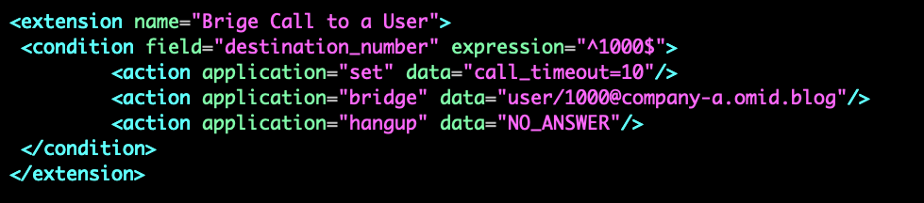
Timeout
The maximum number of seconds to wait for an answer state from a remote endpoint.

Slide 8
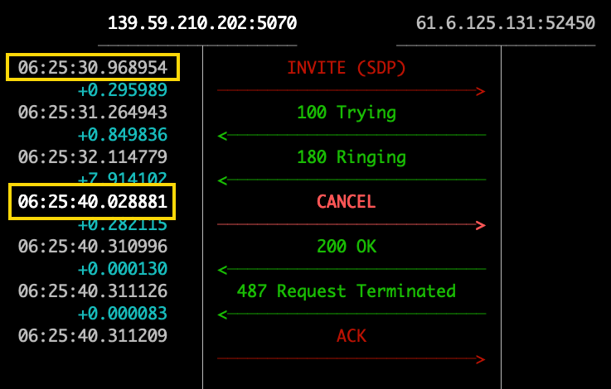
Timeout
Timeout is between INVITE to CANCEL

Slide 9
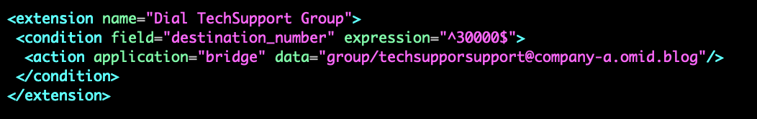
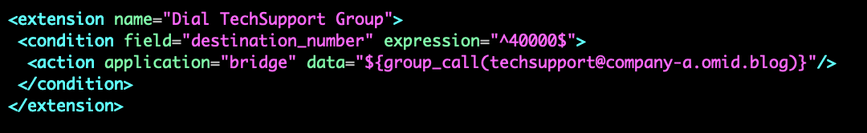
Group
The group special channel will dynamically create a dial string to reach all endpoints defined as part of a group in the directory

Slide 10
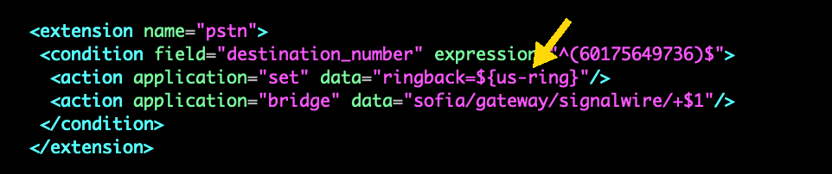
Sending RingBack
You may want to simulate ringback to your internal users while you dial a provider, or you may need to force a ringback back upstream when you are dialing multiple extensions.

Slide 11
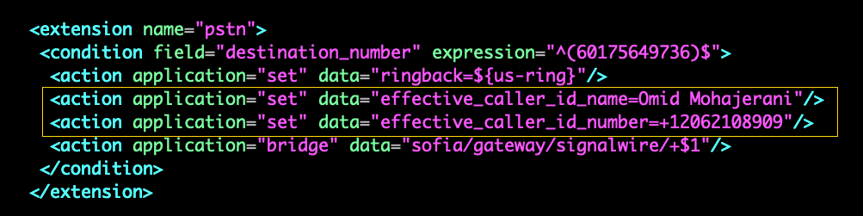
Setting Outgoing CallerID
You can control the outgoing CallerID that is sent to the PSTN or your SIP provider.

Slide 12
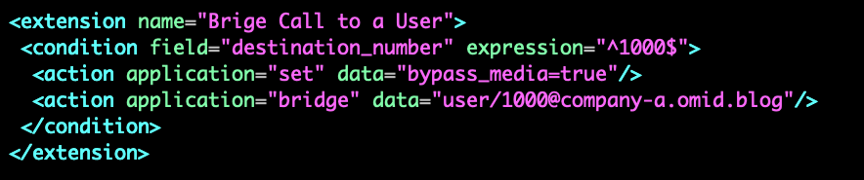
No Media Mode
No media mode is an SDP Passthrough feature that permits two endpoints that can see each other (no N.A.T.) to connect their media sessions directly while FreeSWITCH maintains control of the SIP signaling.
When set, the media (RTP) from the originating endpoint is sent directly to the destination endpoint and vice versa. The signaling (SIP) for both endpoints still goes through FreeSWITCH, but the media is point-to-point.

