Slide 1

Part 7
Learn
GATEWAY
(SIP TRUNK)
Notes:
Welcome to FreeSWITH training part 6
Today We Learn what is a sip profile .
How do we define Users in Directory folder and how to write dialplan .
we will register a softphone in our FreeSWITCH and we call n extension number to test our setup

Slide 2

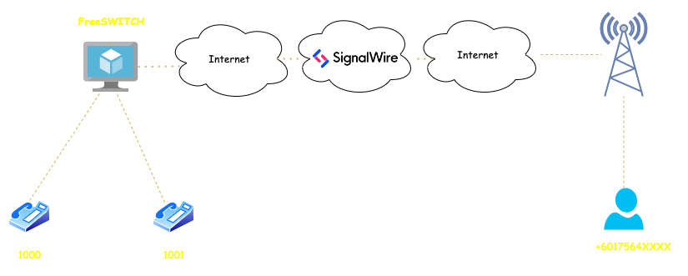
Create a SIP Endpoint in SignalWire
Notes:
Lets start by SIP profiles .
In SIP profiles we define what IP and port , FreeSWITCH should listen to for SIP packets and registartions
SIp profiles are define in you freeswitch configuration folder / sip_profiels
Here I define a SIP profile and I named it Omid.
Configuration are saved in omid.xml and this sip profiles will process all domains
will authenticate all calls and will send them to public context .
We will see later how we use context in dialplan and what is the usage of that .

Slide 3
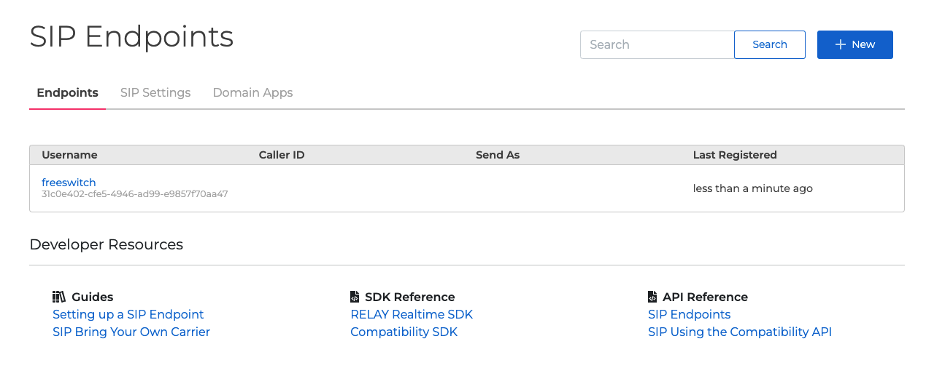
Create a SIP Endpoint in SignalWire
Notes:
Lets start by SIP profiles .
In SIP profiles we define what IP and port , FreeSWITCH should listen to for SIP packets and registartions
SIp profiles are define in you freeswitch configuration folder / sip_profiels
Here I define a SIP profile and I named it Omid.
Configuration are saved in omid.xml and this sip profiles will process all domains
will authenticate all calls and will send them to public context .
We will see later how we use context in dialplan and what is the usage of that .

Slide 4
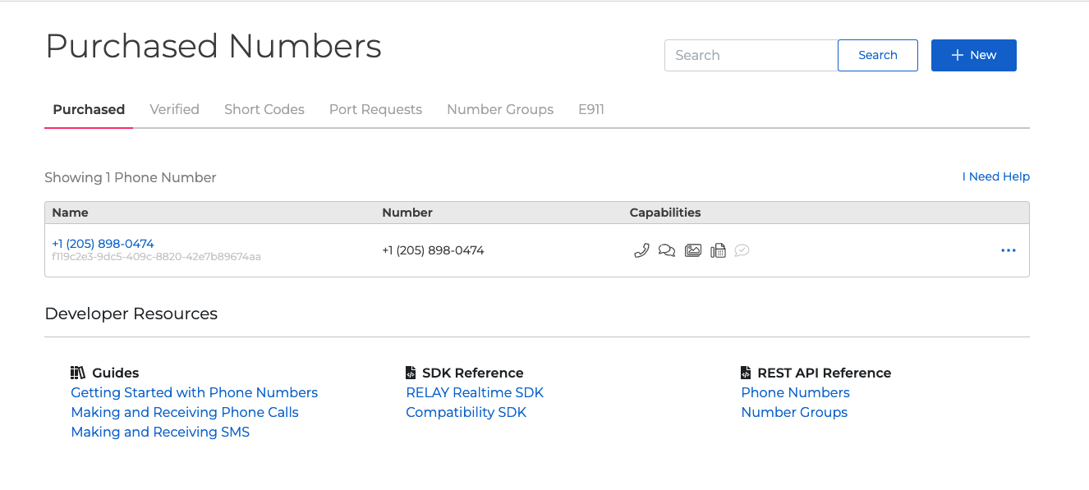
Buy a number
Notes:
Lets start by SIP profiles .
In SIP profiles we define what IP and port , FreeSWITCH should listen to for SIP packets and registartions
SIp profiles are define in you freeswitch configuration folder / sip_profiels
Here I define a SIP profile and I named it Omid.
Configuration are saved in omid.xml and this sip profiles will process all domains
will authenticate all calls and will send them to public context .
We will see later how we use context in dialplan and what is the usage of that .

Slide 5
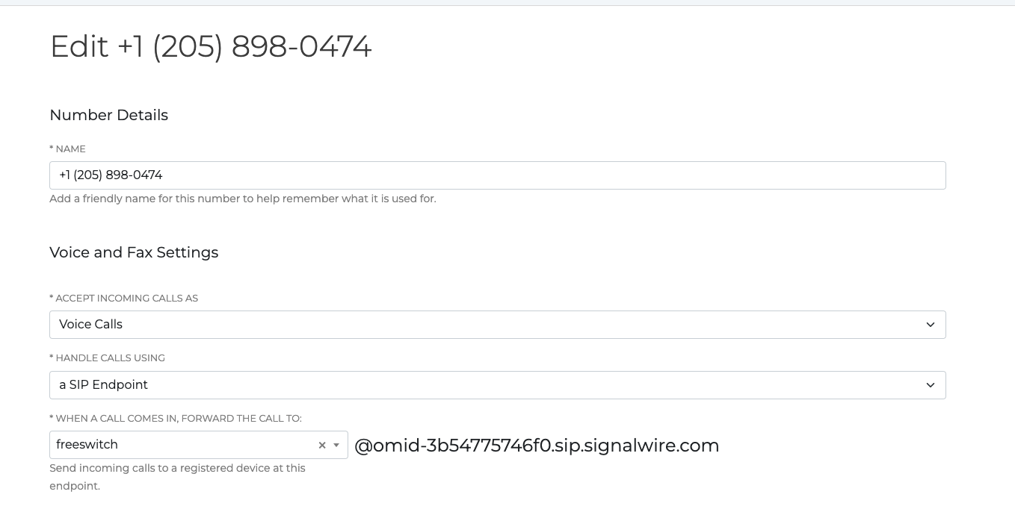
Route number to SIP Endpoint for incoming calls
Notes:
Lets start by SIP profiles .
In SIP profiles we define what IP and port , FreeSWITCH should listen to for SIP packets and registartions
SIp profiles are define in you freeswitch configuration folder / sip_profiels
Here I define a SIP profile and I named it Omid.
Configuration are saved in omid.xml and this sip profiles will process all domains
will authenticate all calls and will send them to public context .
We will see later how we use context in dialplan and what is the usage of that .

Slide 6
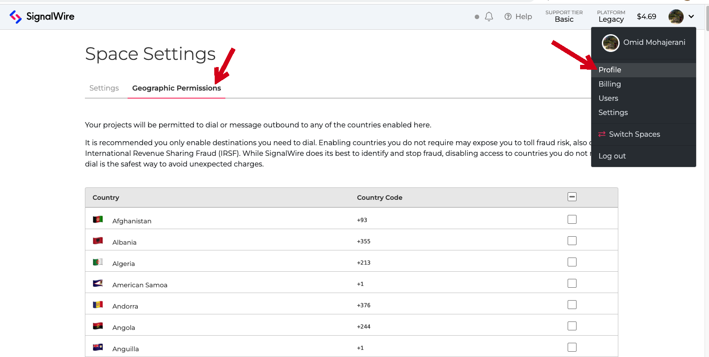
Verify you account and add Geographic permission
Notes:
Lets start by SIP profiles .
In SIP profiles we define what IP and port , FreeSWITCH should listen to for SIP packets and registartions
SIp profiles are define in you freeswitch configuration folder / sip_profiels
Here I define a SIP profile and I named it Omid.
Configuration are saved in omid.xml and this sip profiles will process all domains
will authenticate all calls and will send them to public context .
We will see later how we use context in dialplan and what is the usage of that .

Slide 7
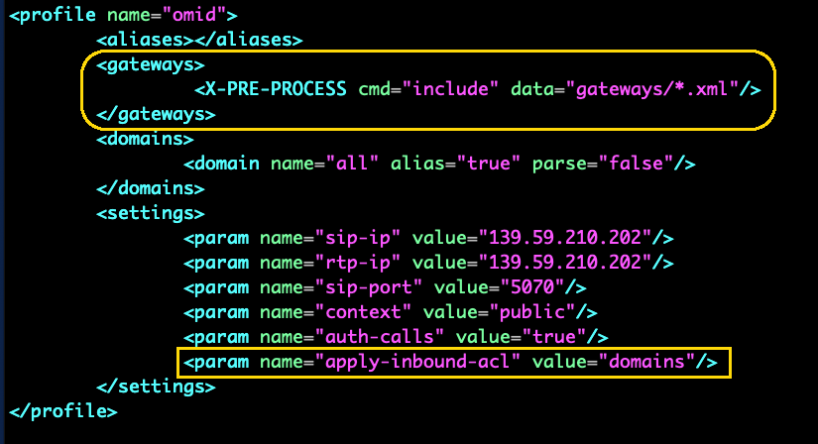
/etc/freeswitch/sip_profiles/omid.xml
Notes:
Lets start by SIP profiles .
In SIP profiles we define what IP and port , FreeSWITCH should listen to for SIP packets and registartions
SIp profiles are define in you freeswitch configuration folder / sip_profiels
Here I define a SIP profile and I named it Omid.
Configuration are saved in omid.xml and this sip profiles will process all domains
will authenticate all calls and will send them to public context .
We will see later how we use context in dialplan and what is the usage of that .

Slide 8
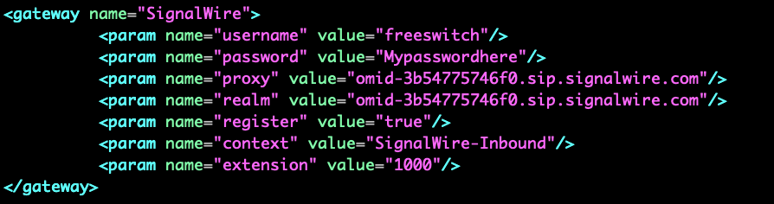
/etc/freeswitch/sip_profiles/gateways/signalwire.xml
Notes:
in order to load the Profile we need to connect to freeswitch CLI using fs_cli command and start omid profile by ysing command
sofia profile omid start .

Slide 9
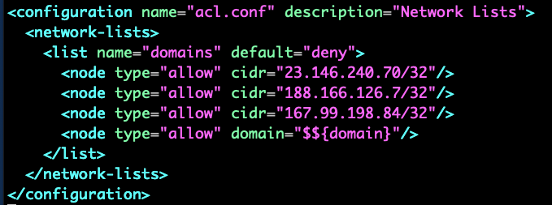
/etc/freeswitch/autoload_configs/acl.conf.xml
Notes:
next step is to define users so that our sip endpoints can authenticate themselves agains our freeswitch
All USers are defined in Directory folder in Free SWITCH
Freeswith is multi tanent telephony system . It means you can use the same server for different domain or companies .
So Here I creatred a file which name is company-a-xml and I specified the dial string . some variables and finally where to look for users .

Slide 10
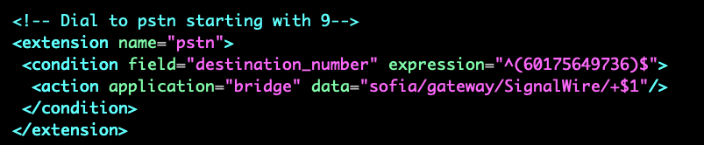
/etc/freeswitch/dialplan/company-a.xml
Under company-a context
Notes:
In dial plan we define what should happen if a sip endpoint calls a number
Here I create company-a.xml file in /etc/freeswitch/dialplan
I defined context = company -a
Amnd I define an extenions hello world
that if some oen calls 123456 it will log some information in freeswithc console and
it will play back a wav file .
Also I write a dialplan for internal call that if a sip endpoint calls any number between 1000 to 1009 it wil bridg the channels or another work it will call the other sip endpoint .

Slide 11
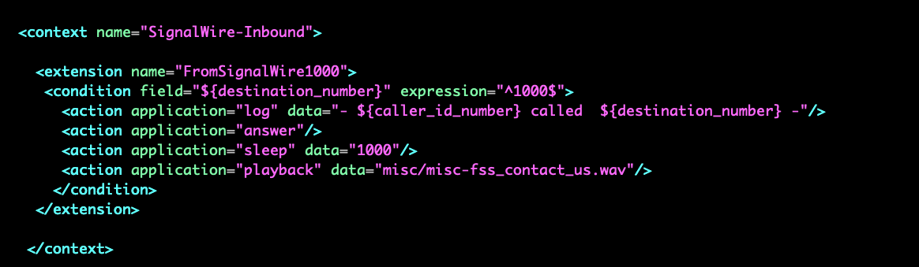
/etc/freeswitch/dialplan/company-a.xml
Notes:
In dial plan we define what should happen if a sip endpoint calls a number
Here I create company-a.xml file in /etc/freeswitch/dialplan
I defined context = company -a
Amnd I define an extenions hello world
that if some oen calls 123456 it will log some information in freeswithc console and
it will play back a wav file .
Also I write a dialplan for internal call that if a sip endpoint calls any number between 1000 to 1009 it wil bridg the channels or another work it will call the other sip endpoint .

Slide 12
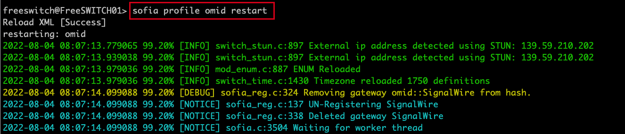
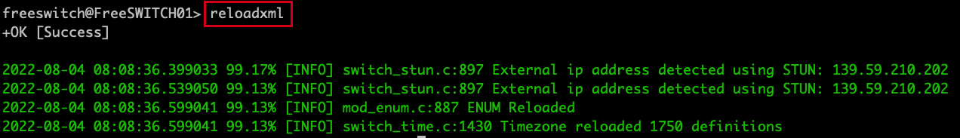
fs_cli
Notes:
In dial plan we define what should happen if a sip endpoint calls a number
Here I create company-a.xml file in /etc/freeswitch/dialplan
I defined context = company -a
Amnd I define an extenions hello world
that if some oen calls 123456 it will log some information in freeswithc console and
it will play back a wav file .
Also I write a dialplan for internal call that if a sip endpoint calls any number between 1000 to 1009 it wil bridg the channels or another work it will call the other sip endpoint .

