Slide 1

Part 8
Learn
SignalWire Connector
Notes:
Ok its time for another FreeSWITCH training . SIP trunks . We call them gateways in FreeSWITCH .
Today we will learn why do we need SIP trunks and how to add one to you FreeSWITCH installation .

Slide 2

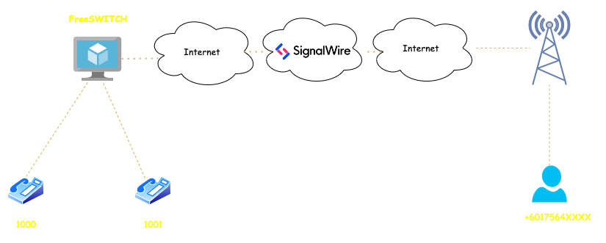
Connect to SignalWire using mod_signalwire
Notes:
in the previous video , Part 6 . we have registerd 2 phones in our freeSWITCH and they were able to call each other . But now I want to call my mobile number .
Also I want to publish a number for my customers so that they can call my phones at 1000 or 10001
This is where we need a sip trunk

Slide 3
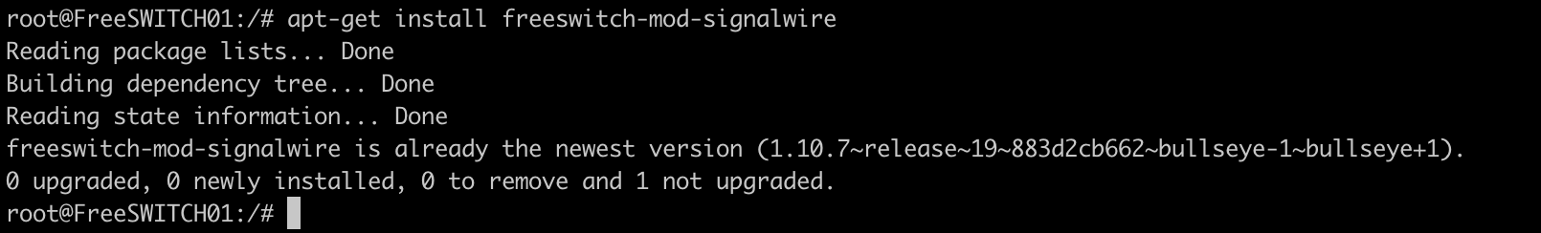
Step 1 – Install mod_signalwire
apt-get install freeswitch-mod-signalwire
Notes:
because they are the wonderfull team behidn the freeswitch and who better than them to support by buying trunk and minutes from them.
Also its very easy to work with . You just need to create an account and create a SIP Endpoint

Slide 4
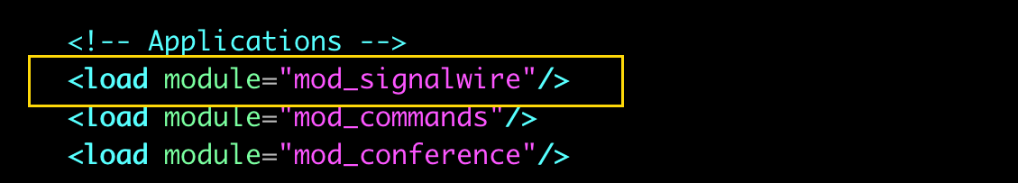
Step 2 – Load mod_signalwire
Notes:
Buy a number

Slide 5
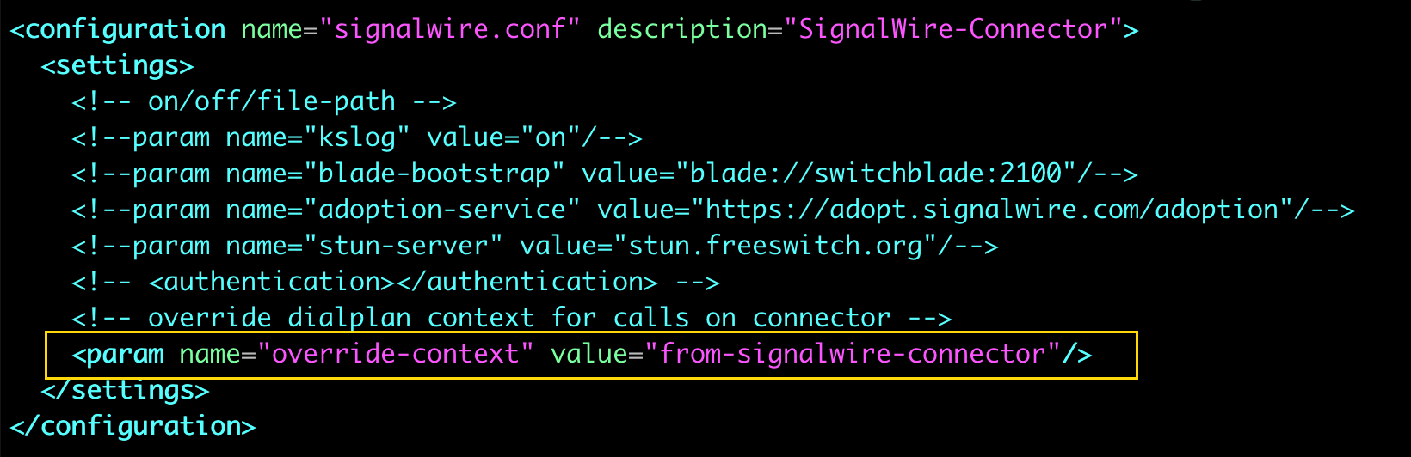
Step 3 – autoload_configs/signalwire.conf.xml
Notes:
Route it to the SIP endpoint that we have created

Slide 6
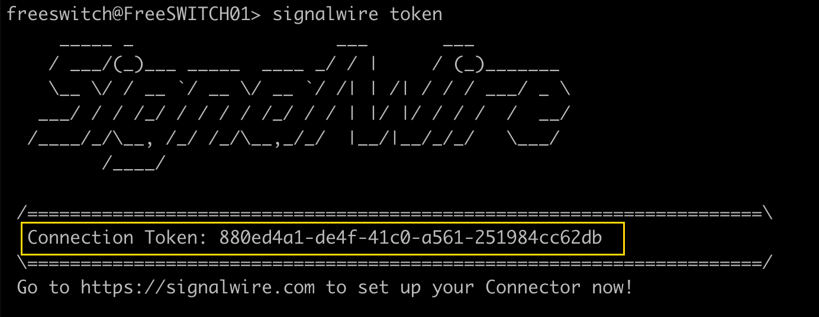
Step 4 – Get SignalWire Connection Token
Notes:
Route it to the SIP endpoint that we have created

Slide 7
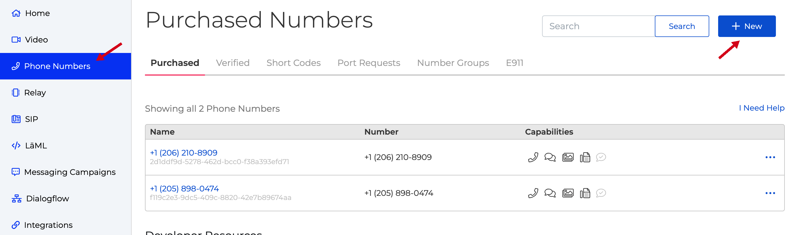
Step 5 – Buy a Number in SignalWire
Notes:
Route it to the SIP endpoint that we have created

Slide 8
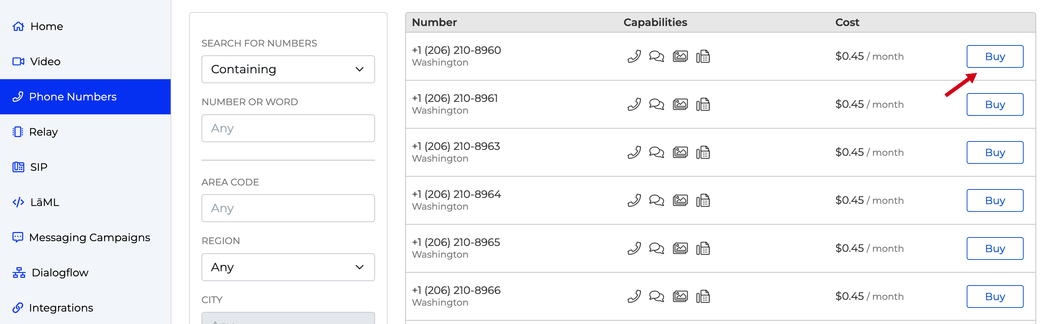
Step 5 – Buy a Number in SignalWire
Notes:
Route it to the SIP endpoint that we have created

Slide 9
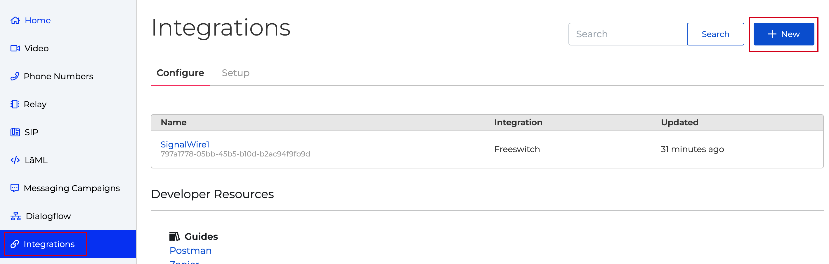
Step 6 – Create a Connector in SignalWire
Notes:
and validate your account so that you are able to call internation numbers.

Slide 10
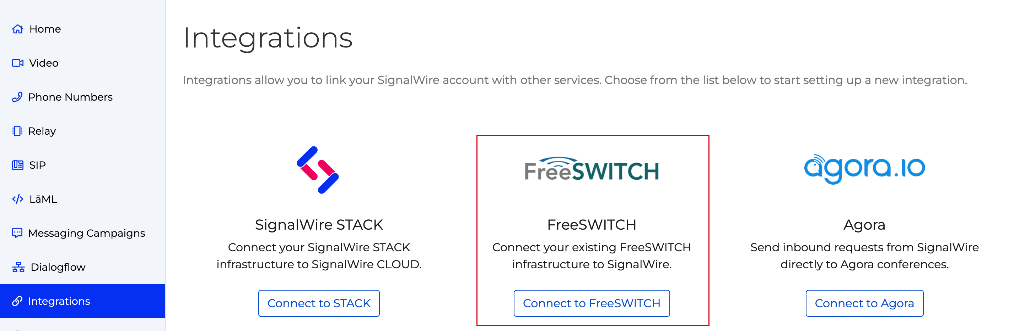
Step 6 – Create a Connector in SignalWire
Notes:
and validate your account so that you are able to call internation numbers.

Slide 11
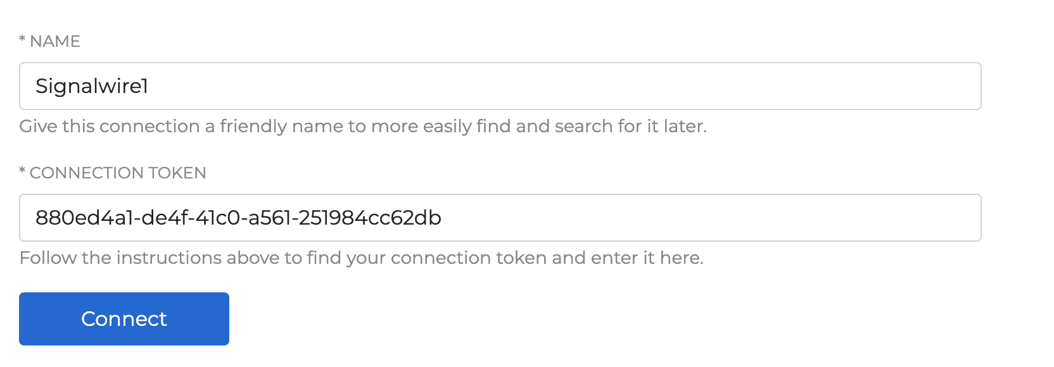
Step 6 – Create a Connector in SignalWire
Notes:
and validate your account so that you are able to call internation numbers.

Slide 12
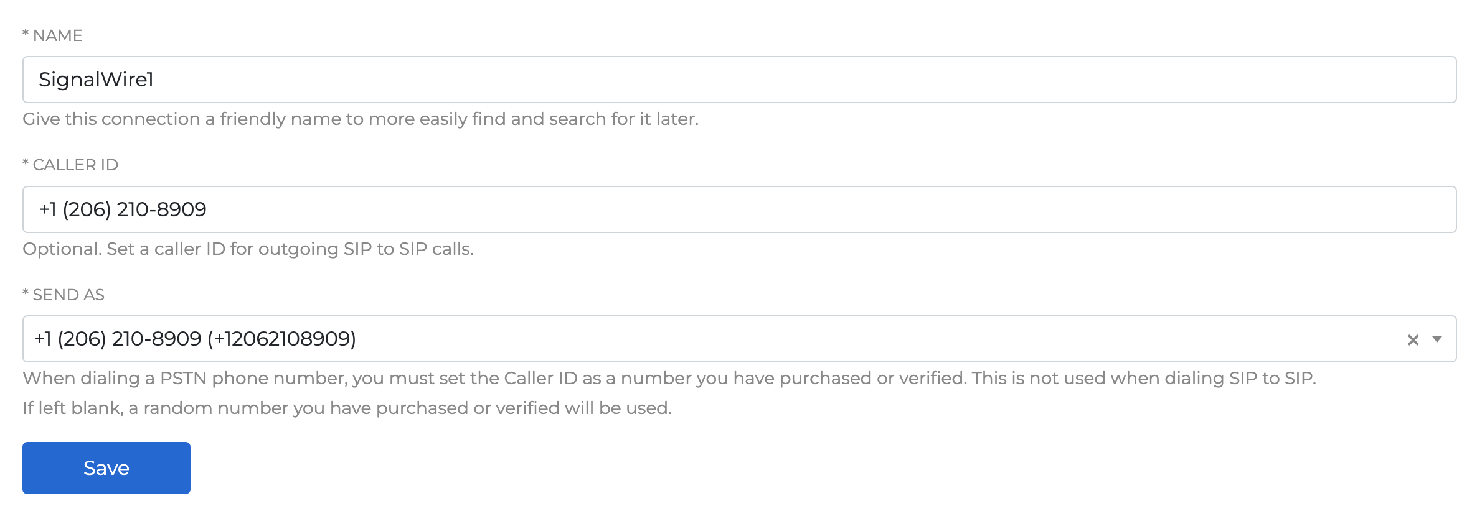
Step 6 – Create a Connector in SignalWire
Notes:
and validate your account so that you are able to call internation numbers.

Slide 13
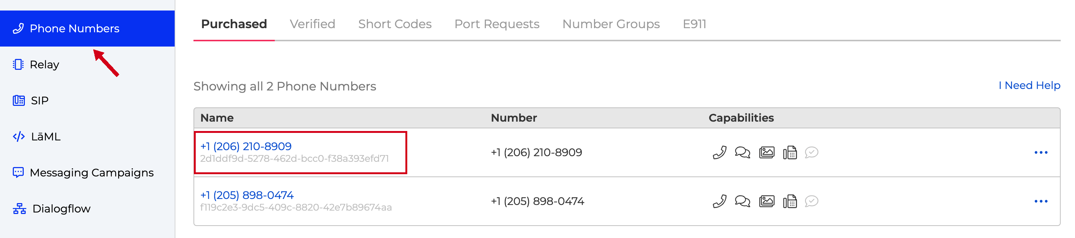
Step 7 – Route DID to connector
Notes:
and validate your account so that you are able to call internation numbers.

Slide 14
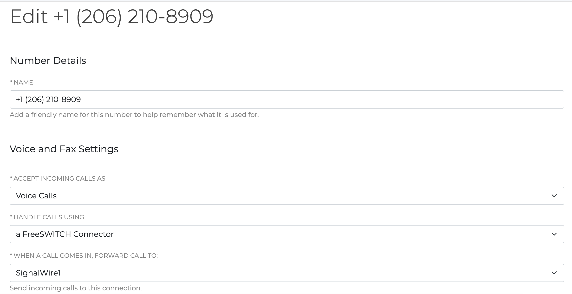
Step 7 – Route DID to connector
Notes:
and validate your account so that you are able to call internation numbers.

Slide 15
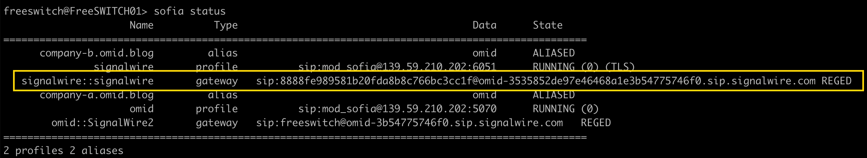
Step 8 – Reload mod_signalwire
Notes:
and validate your account so that you are able to call internation numbers.

Slide 16
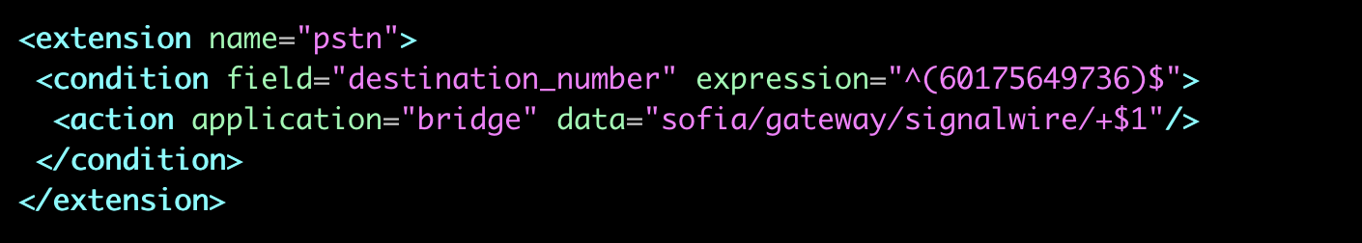
Step 9 – Outgoing Dialplan
Notes:
and validate your account so that you are able to call internation numbers.

Slide 17
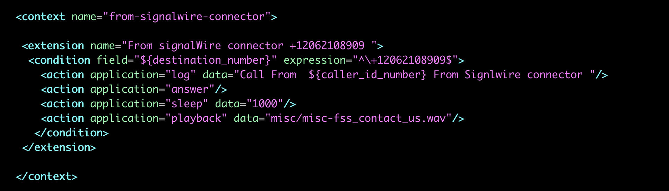
Step 10 – Incoming Dialplan
Notes:
and validate your account so that you are able to call internation numbers.

Slide 18
Dead Gateways
To exclude dead gateways in your dialplan:
<action application="bridge" data="sofia/gateway/${distributor <listname> ${sofia profile <profilename> gwlist down}}/$1"/>
Notes:
So Now its time for FreeSwitch configuration
Gateway are added in sip profile .We had created Omid sip profile in the previous video .
We just need to amend it and add gateways tag to point to gateway folder
and Also add apply-inbound-acl tag for inbound calls.

