Slide 1

Part 9
Learn
Record & Speak
Notes:
We have used bridge application in the previous videos to biridge a user or bridge call to external sip gateways . Today we want to learn more about this important application in Freeswitch

Slide 2

Record Application
Notes:
First Secneario is to bridge a call to an external SIP gateway .
systex is to to bridge to sofia/gateway / gateway name and the destination number that we want to call

Slide 3
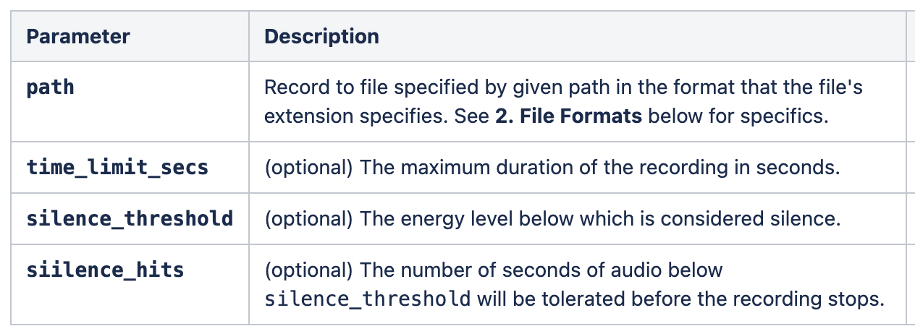
Record is used to record voice messages.
Notes:
First Secneario is to bridge a call to an external SIP gateway .
systex is to to bridge to sofia/gateway / gateway name and the destination number that we want to call

Slide 4
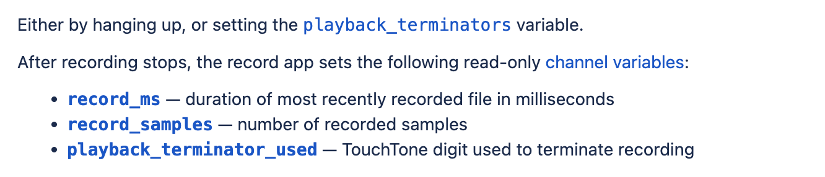
How to stop recording?
Notes:
First Secneario is to bridge a call to an external SIP gateway .
systex is to to bridge to sofia/gateway / gateway name and the destination number that we want to call

Slide 5
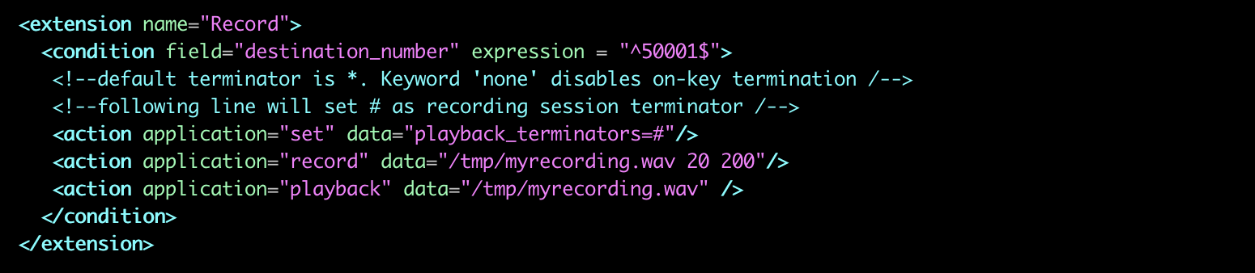
Example
Notes:
First Secneario is to bridge a call to an external SIP gateway .
systex is to to bridge to sofia/gateway / gateway name and the destination number that we want to call

Slide 6
Speak Application
Notes:
First Secneario is to bridge a call to an external SIP gateway .
systex is to to bridge to sofia/gateway / gateway name and the destination number that we want to call

Slide 7
Speaks a string or file of text to the channel using the defined text-to-speech engine.
Notes:
Bridge call to a user .
Here we have registerd user 1000 in company-a.omid.blog domian.
In order to bridge the syntax is user/usernnumber@ domain

Slide 8
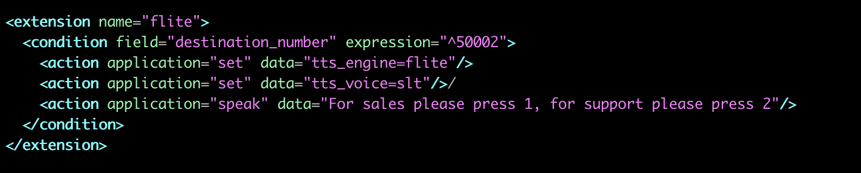
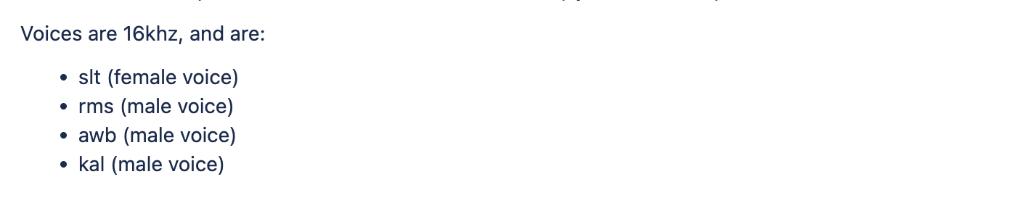
Speaks a string or file of text to the channel using the defined text-to-speech engine.
Notes:
Bridge call to a user .
Here we have registerd user 1000 in company-a.omid.blog domian.
In order to bridge the syntax is user/usernnumber@ domain

