Slide 1
FreeSWITCH
Phrase Macro
Notes:
In FreeSWITCH, It is frequently necessary to piece together smaller sound recordings to create longer ones. For example when you want to create an IVR or interactive voice response. The FreeSWITCH phrase macro system is a very powerful tool for piecing together individual sound files and adding a bit of logic.

Slide 2
Agenda
FreeSWITCH
Phrase Macro Syntax
Phrase Macro by Example
Lab 1 – a basic Phrase Macro
Lab 2 – Match and Nomatch in Phrase Macro
Notes:
We will start by introducing phrase macro syntax and we will learn it by exploring a default FreeSWITCH phrase example
Finally, we will have 2 labs.
In the first one, we will create a basic Phrase Macro and in the second lab, we will learn how to work with phrase macro system input.

Slide 3
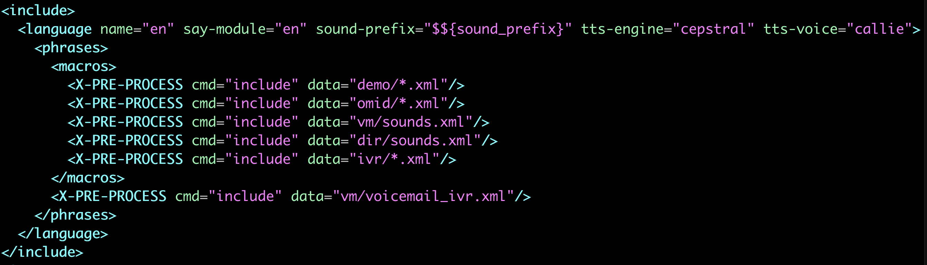
Phrase Macro Usage
FreeSWITCH
Phrase macros definitions are found in files included by FreeSWITCH conf directory /lang/en/en.xml
Notes:
Phrase macros are defined in your FreeSWITCH configuration directory / lang/en .
All files that are included in the en.xml will be processed by FreeSWITCH.

Slide 4
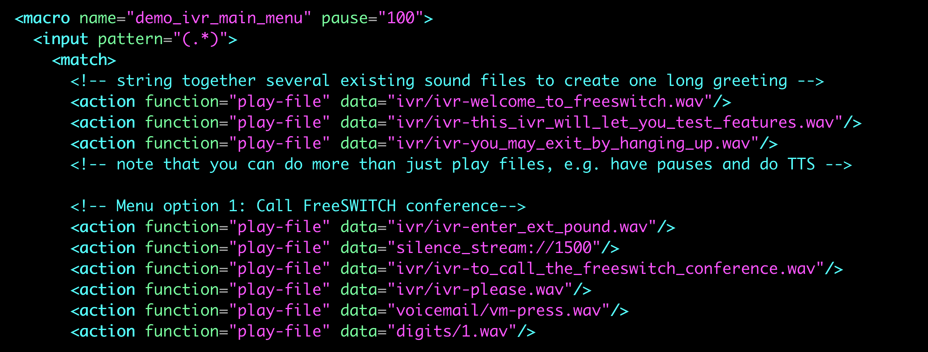
Phrase Macro Example
FreeSWITCH
lang/en/demo/demo-ivr.xml
Notes:
Let's explore one of the famous Phrase Macros in FreeSWITCH that is located in the demo folder.
Demo-ivr.xml.
This phrase macro pieces together some shorter prompts to be used in demo IVR in FreeSWITCH.

Slide 5
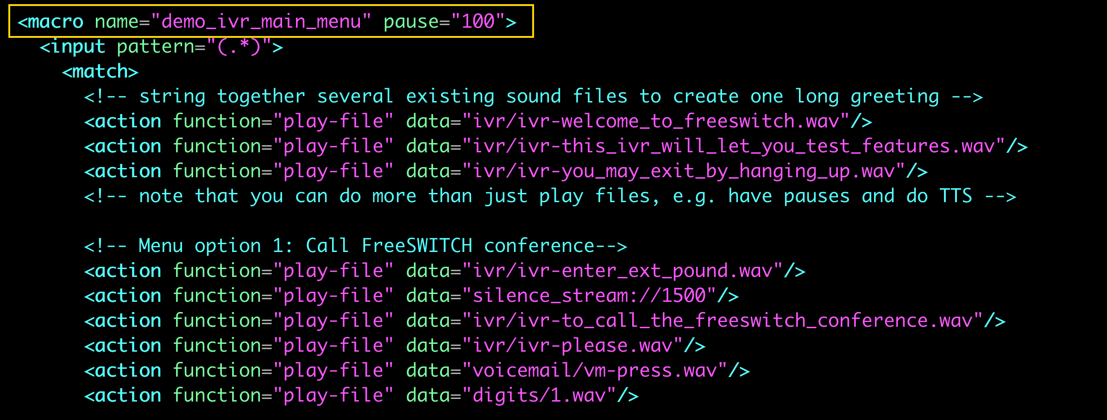
Phrase Macro Example (macro name and pause)
FreeSWITCH
Macro "name" is what we will use in phrase call from dialplan or script.
"pause" will be the number of milliseconds to sleep after playing each individual sound file (optional)
Notes:
The Macro name obviously is the name of Phrase Macro that we will use later in the DialPlan to call this Phrase,
"pause" will be the number of milliseconds to sleep after playing each individual sound file. Ofcourse This is an optional input parameter for the Phrase Macro system.
In this example, we will have 100 ms of silence before playing the next sound file.

Slide 6
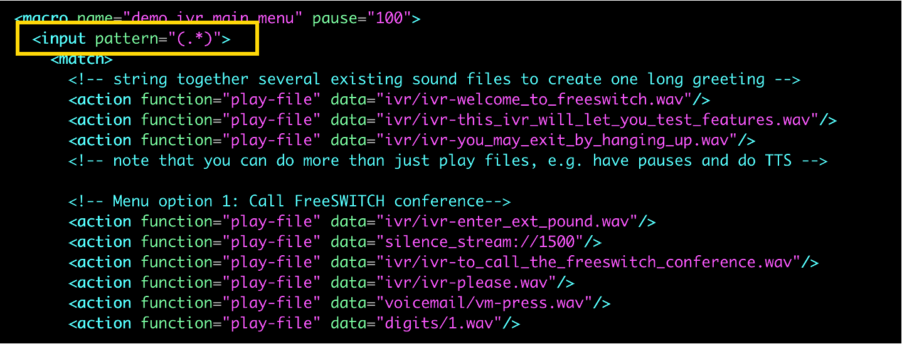
Phrase Macro Example (input pattern)
FreeSWITCH
The regular expression in "input pattern" is checked against the input passed as an argument to "phrase"
If that expression matches, the phrase macro will execute the actions contained in the "match" section, else if the input pattern is not matched, the phrase macro will execute the actions contained in the "nomatch" section
Notes:
Input pattern
The regular expression in "input pattern" is checked against the input passed as an argument to "phrase".
For example here in our Dialplan we called lab1 phrase and we passed 1000 as input that will be checked against the input pattern.
If that expression matches, the phrase macro will execute the actions contained in the "match" section, else if the input pattern is not matched, the phrase macro will execute the actions contained in the "nomatch" section
actions are what we want to do in a Phrase Macro. The most famous one is play-file which simply plays a file.

Slide 7
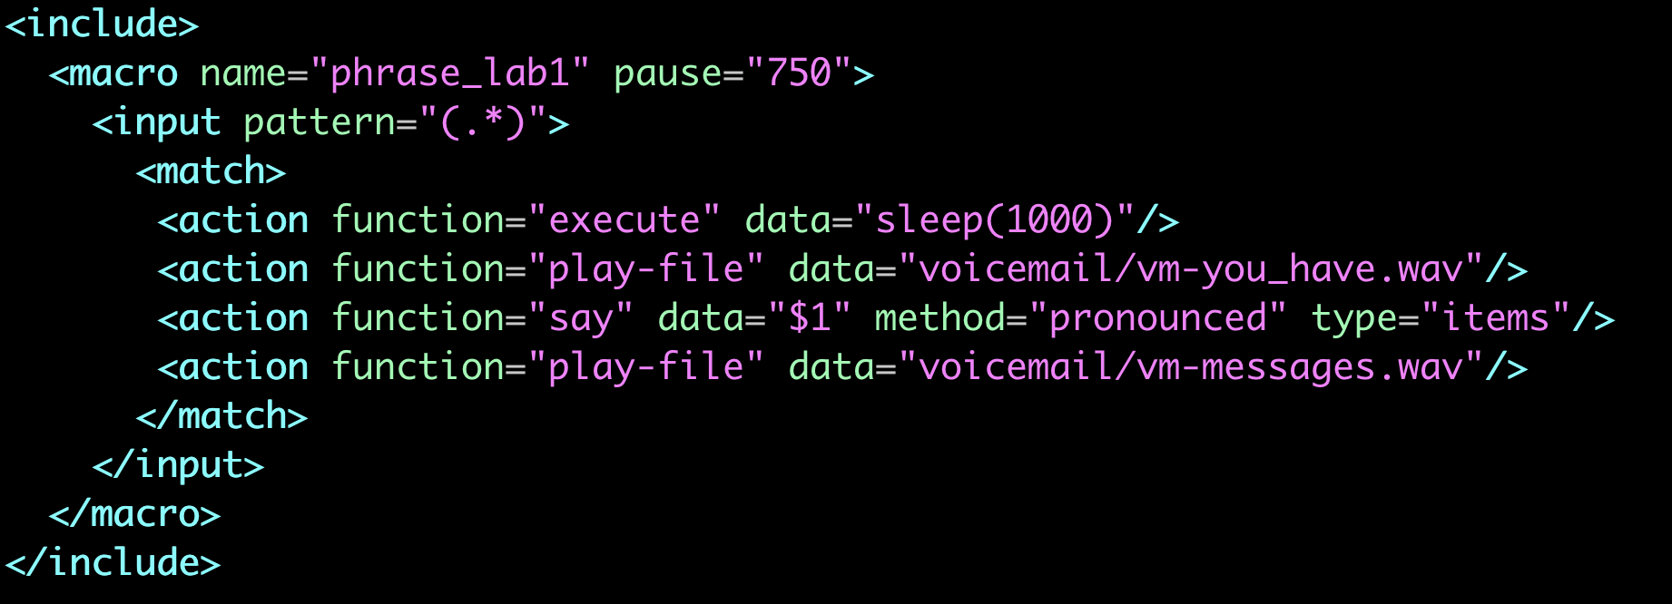
Phrase Macro – Lab 1
FreeSWITCH
Create a Phrase Macro to read the number of messages that we pass as input.
Notes:
Let's get into action by Creating a Phrase Macro to read the number of messages that we pass as input.
Here is the Phrase macro that we will implement and test. Let's explore it first.
We gave the phrase a name. I called it Phrare_lab1 and I set the pause to 750 milliseconds
In this lab, we will accept all inputs so I use dot Star as our input. If you don’t know how regular expression works, I have a video of regular expression in FreeSWITCH that you can find the link in the video description.
I used multiple actions here to execute a sleep app for 1000 ms
Play a pre-recorded file in FreeSWITCH
And I used the say function to pronounce the number that we will pass as Phrase input to the phrase macro
And finally, I again used play-file action to play a pre-recorded FreeSWITCH file
Please pay attention in Phrase Macro we are using the function keyword and not the application keyword.

Slide 8
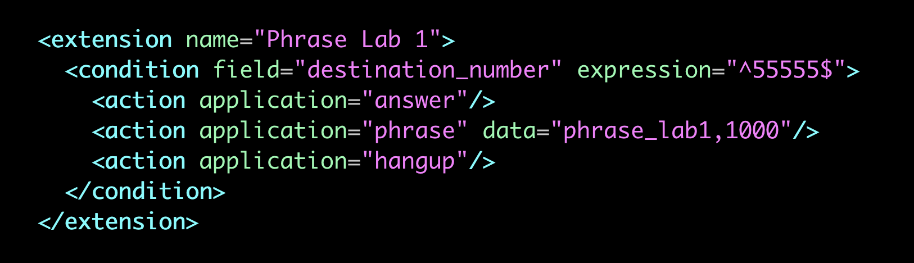
Phrase Macro – Lab 1
FreeSWITCH
Notes:
After the Phrase Macro definition, we need to call it in the FreeSWITCH dialplan.
Here I defined a testing destination number
I answered the channel and called the phrase macro with the application keyword of Phrase and I passed the Phrase Macro name and input ( 1000 ) as data for this phrase macro
And Finally, I will hangup the call .
Now lets test our phrase by calling testing number.

Slide 9
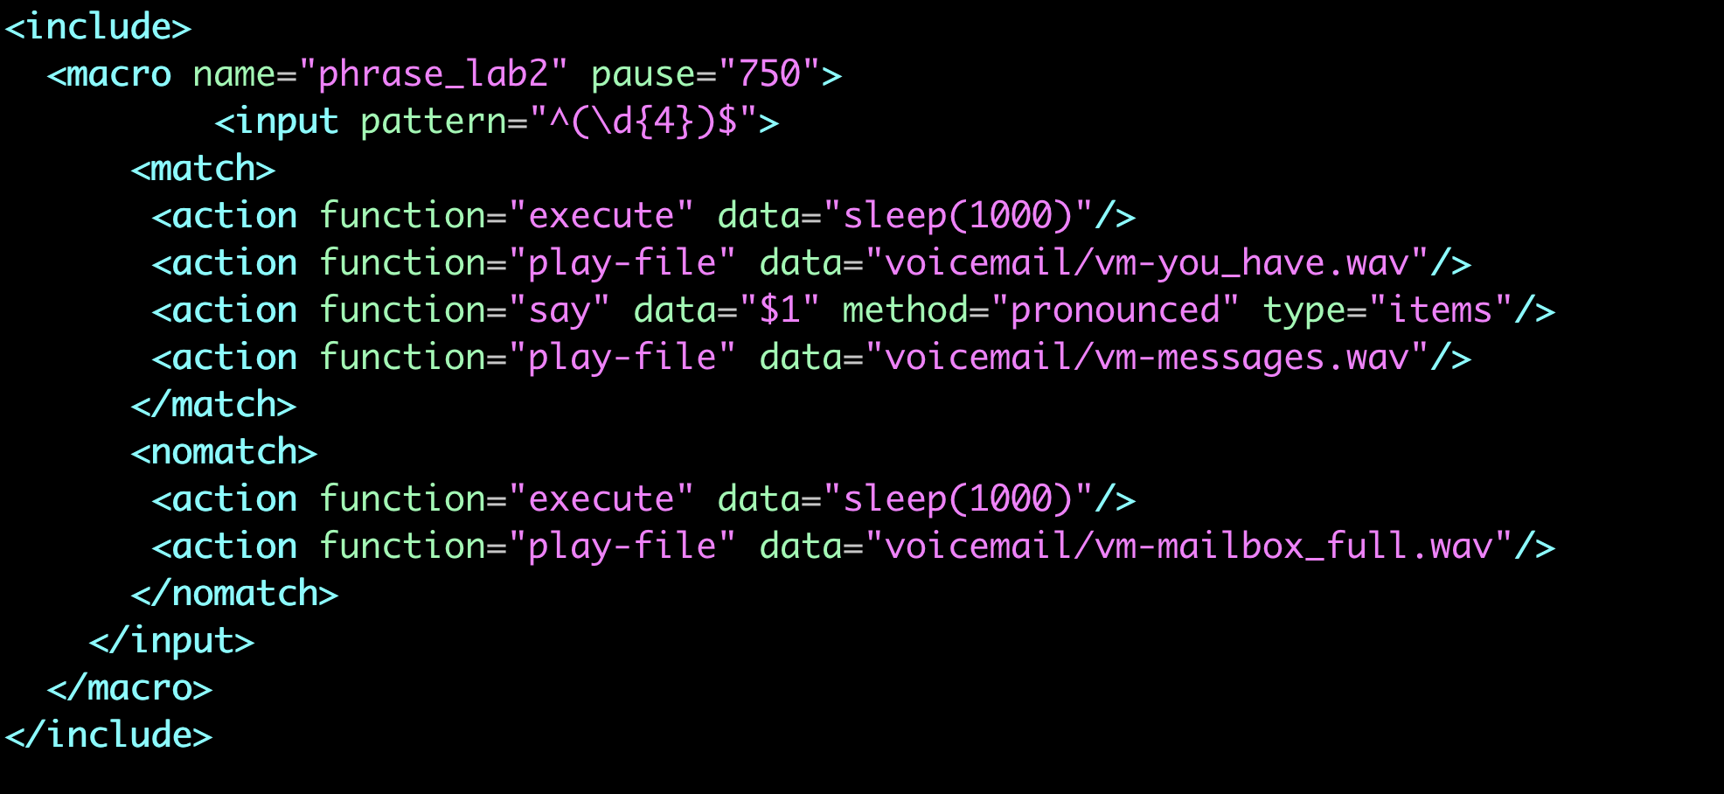
Phrase Macro – Lab 2
FreeSWITCH
Create a Phrase Macro to read the number of messages and if the number of messages is more than 9999, Phrase Macro plays “that mailbox is full, please try the call again later”.
Notes:
Now it's time to learn more advanced phrase Macro with input.
We want to expand the pervious Lab to read the number of messages and if the number of messages is more than 9999, the Phrase macro plays a different message instead of the number of the messages.
In this phrase macro If the input that we pass in dialplan is greater than 9999, the actions in no-mach block will run.

Slide 10
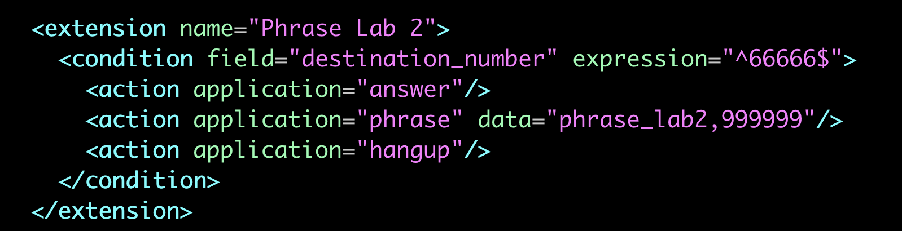
Phrase Macro – Lab 2
FreeSWITCH
Notes:
And as you can imagine we need to call the phrase macro and we pass a number greater than 9999 to test if our no-match blocks run in the phrase macro.
Lets test Lab2 Phrase by caling testing number 66666

