Slide 1
SIPp
Introduction and Installation

Slide 2
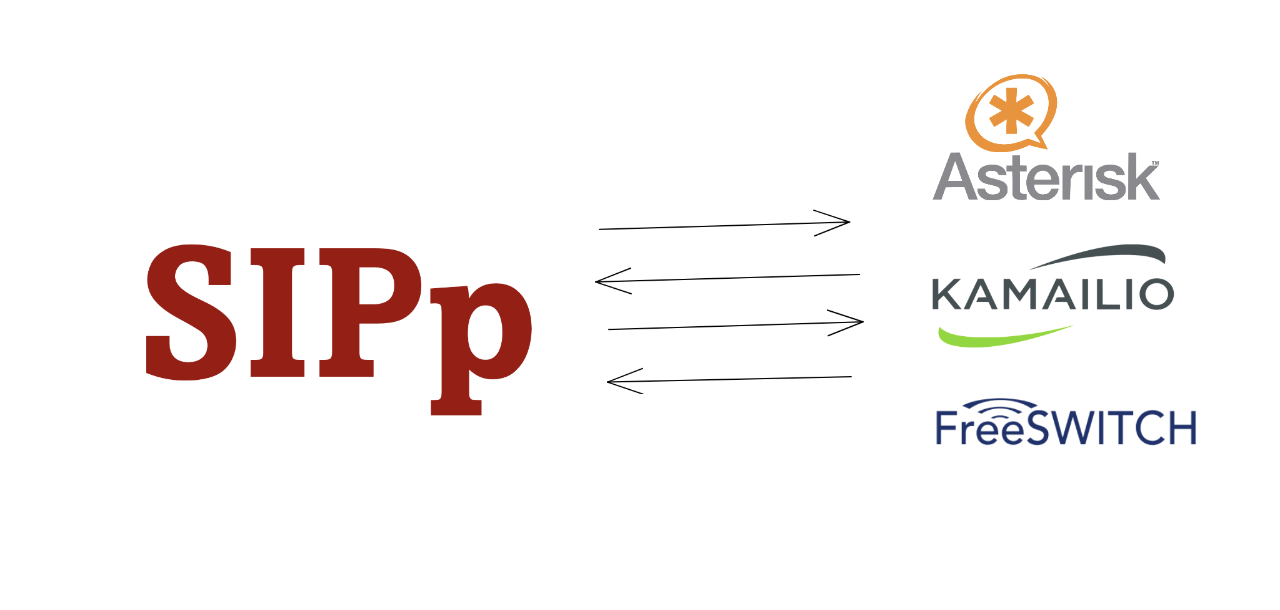

Slide 3
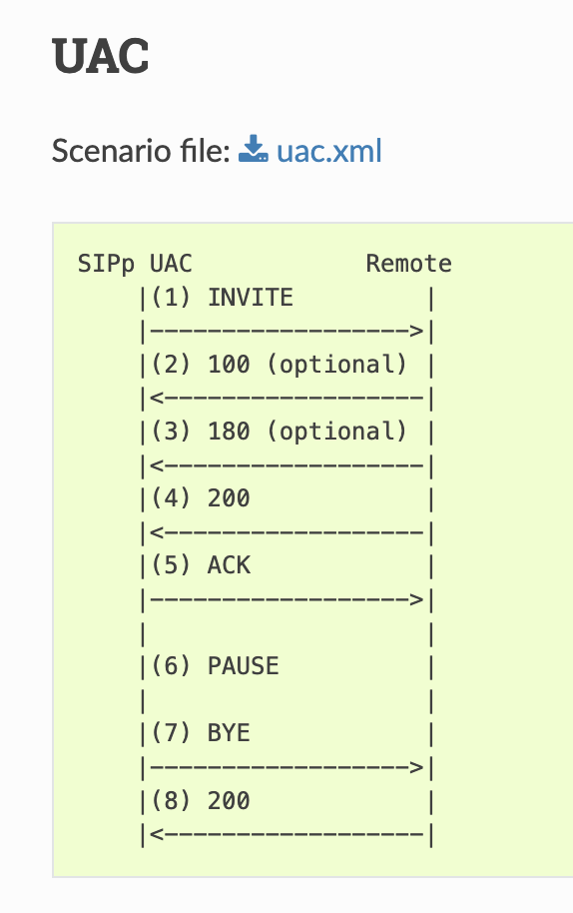
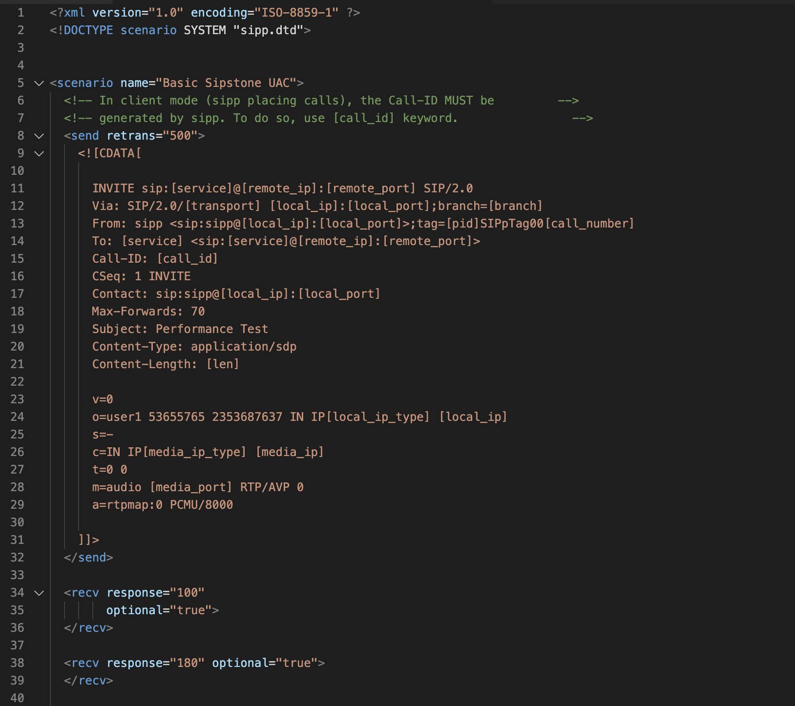
SIPP Integrated Scenarios
https://sipp.readthedocs.io/en/latest/int_scenarios.html

Slide 4
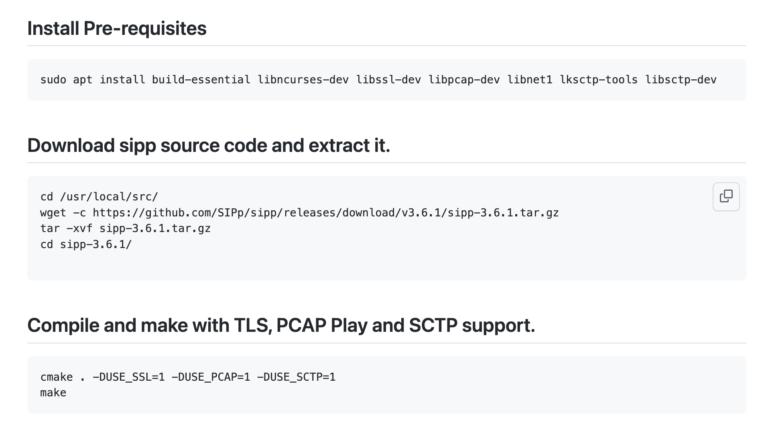
SIPP installation

Slide 5
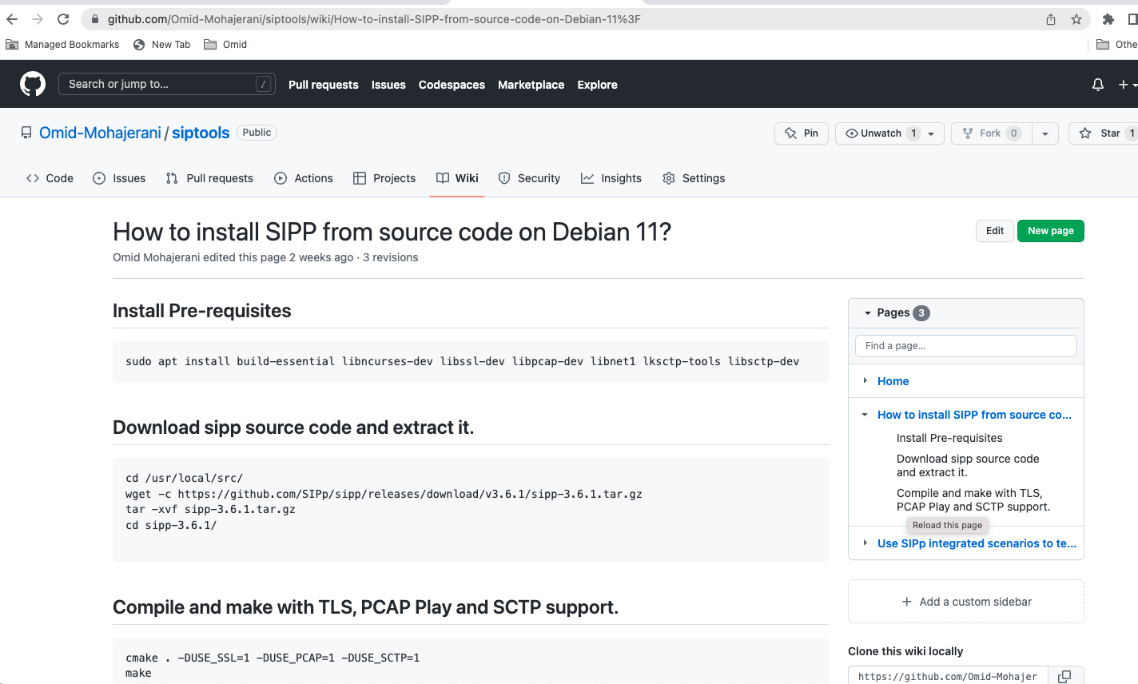
https://github.com/Omid-Mohajerani/siptools

