Slide 1


Introduction to R
Omid Ghasemi, Mahdi Mazidi

Slide 2
What is R?
R is a language and environment for statistical computing and graphical representation of data.
R provides a wide variety of statistical (linear and nonlinear modelling, classical statistical tests, time-series analysis etc…) and graphical techniques, and is highly extensible.

Slide 3
What is RStudio?
RStudio is actually an add-on to R that takes the R software and adds to it a very user-friendly graphical interface.
R may be used without RStudio, but RStudio may not be used without R.
Notes:
Thus, when one uses RStudio, they are still using the full version of R while also getting the benefit of greater functionality and usability due to an improved user interface. As a result, when using R, one should always use RStudio; working with R itself is very cumbersome.
On your computer, you will see R and RStudio as separate installed programs. When using R for data analysis, you will always open and work in RStudio; you must leave R isntalled on the computer for RStudio to work, even though you will likely never open R itself.

Slide 4
Pros and Cons of R
1. State of the art (open source, continuously growing)
2. Exemplary Support for Data Wrangling
3. Becoming increasingly popular
4. The Array of Packages
5. Quality Plotting and Graphing
6. Highly Compatible
7. Eye-Catching Reports (Markdown and Shiny)
8. Highly reproducible (especially helpful for open science)
Notes:
R provides exemplary support for data wrangling. The packages like dplyr, readr are capable of transforming messy data into a structured form.
R has a vast array of packages. With over 10,000 packages in the CRAN repository, the number is constantly growing. These packages appeal to all the areas of industry.
R is highly compatible and can be paired with many other programming languages like C, C++, Java, and Python. It can also be integrated with technologies like Hadoop and various other database management systems as well.
With packages like Shiny and Markdown, reporting the results of an analysis is extremely easy with R. You can make reports with the data, plots and R scripts embedded in them.
R is a constantly evolving programming language. It is a state of the art technology that provides updates whenever any new feature is added.
Basically, it is the most comprehensive statistical analysis package. As new technology and ideas often appear first in R.

Slide 5
Pros and Cons of R
A bit steep learning curve
Lesser Speed in executing complex codes
Spread Across various Packages
In R, quality of some packages is less than perfect.
Note: R is a continuously evolving language. This means that many of the cons will gradually fade away with the future updates of R.
Notes:
The algorithms in R are spread across different packages. Programmers without prior knowledge of packages may find it difficult to implement algorithms.

Slide 6
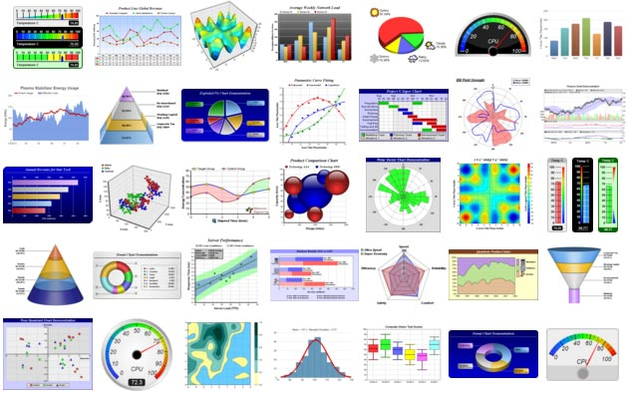

Slide 7
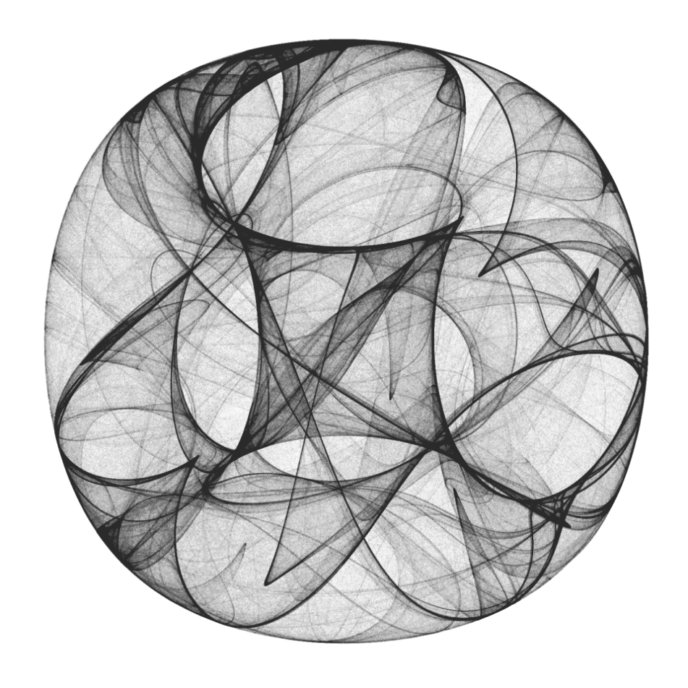

Slide 8
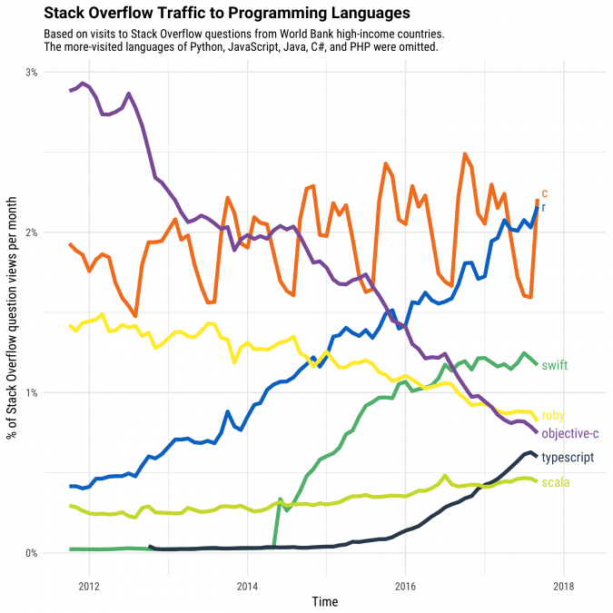
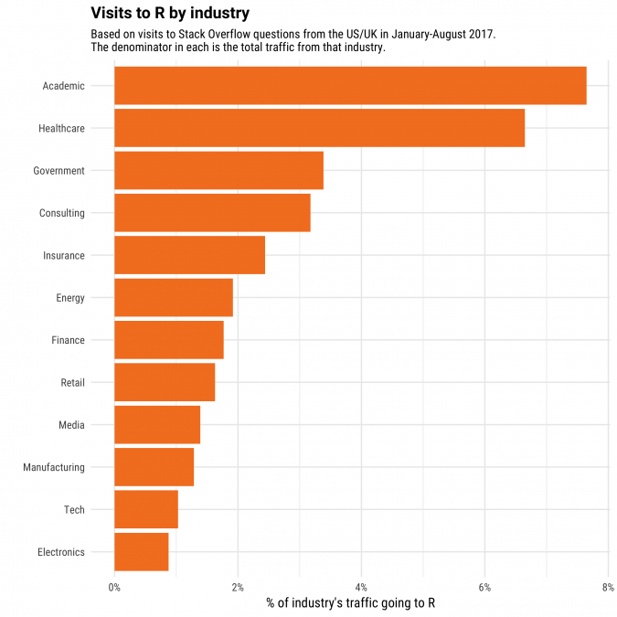
Increasing Popularity

Slide 9
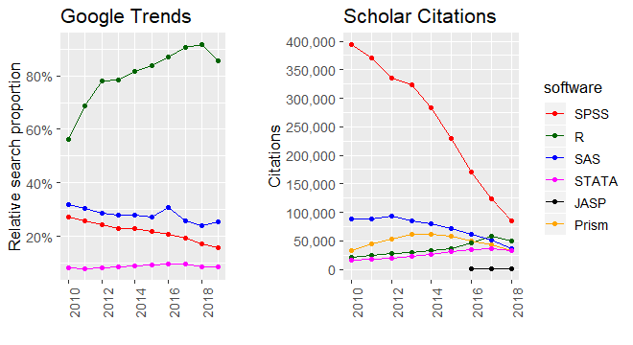

Slide 10
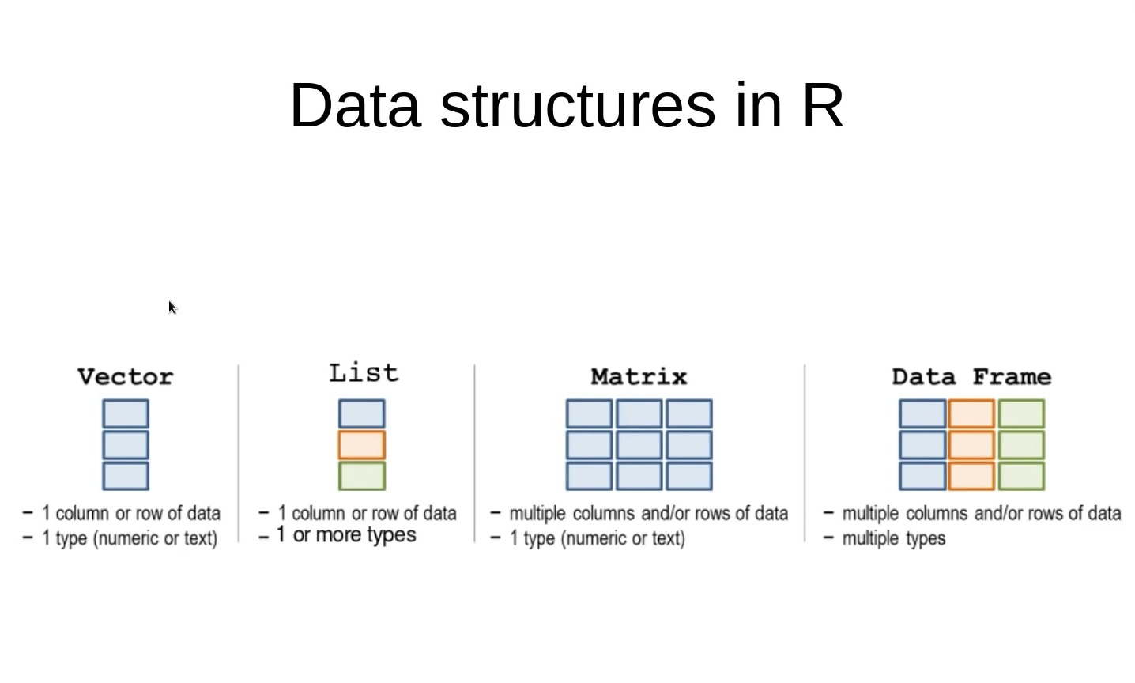

Slide 11
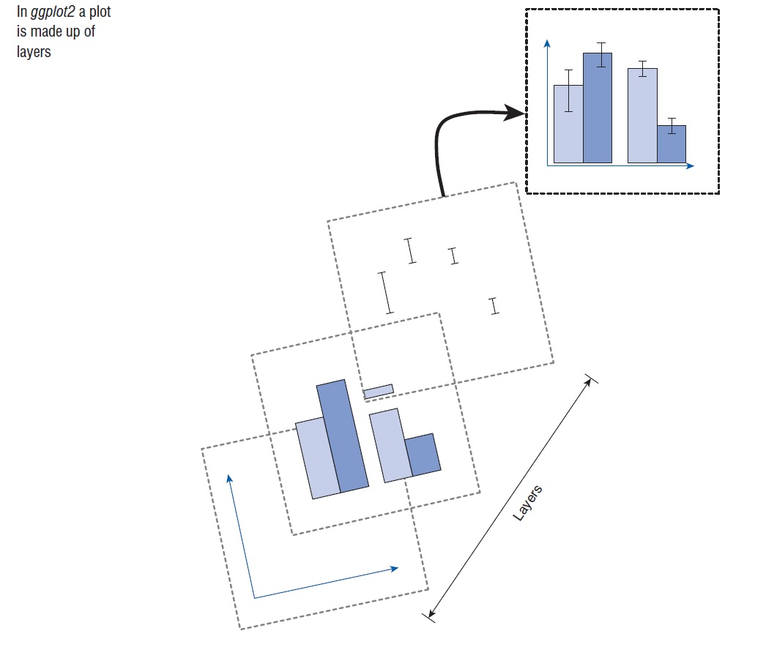

Slide 12
T-test
A t-test examines differences in the mean scores of a parametric dependent variable across two groups or conditions (the independent variable).
Paired sample t-test: examines differences in mean scores across two within-group conditions, measured across a single group.
Independent sample t-test: examines differences between two distinct groups. The differences might be:
directly manipulated (e.g. drug treatment group vs. placebo group)
naturally occurring (e.g. male vs. female)
could be beyond the control of the experimenter (e.g. depressed vs. healthy people)
Notes:
the non-parametric equivalent to the independent t-test = Mann-Whitney U test
the non-parametric equivalent to the paired sample t-test = Wilcoxon signed-rank test

Slide 13
T-test
Other names of independent samples t-test
Between-groups t-test
Independent t-test
Independent measures t-test
Student’s t-test
The defining aspect of the independent t-test is that there are just two groups.
Notes:
An independent t-test assesses whether the observed difference in the mean dependent variable scores between the two groups is large enough, relative to the standard error of differences. The standard error in short is an estimation of the standard deviation in the overall population. The sample standard deviation measures the average variation of scores either side of the mean. To obtain the standard error, we divide the sample standard deviation by the square root of the sample size. The standard error of differences is calculated in a similar way, but outcomes are based on the variance of the scores within each group. So, two factors will determine whether a difference is significant: how much larger the mean difference is than zero and the standard error of differences. This ‘error’ represents how much the observed differences are explained by random chance factors. To calculate significance, we divide the observed ‘mean difference’ by that error. The higher the outcome, the more it will be that the difference is significant.

Slide 14
T-test
Other names for paired-sample t-test
Within-group t-test
Related samples t-test
Related t-test
The defining aspect of the paired sample t-test is that there are just two conditions in a single group.

Slide 15
Paired or independent sample t-tests?
1. A group of UK students are compared with those from the USA on how many hours they watch television.
2. One group of depressed patients are given two different types of drug, at different times, to assess how well their symptoms improve.
3. Several questionnaires are given to one group of people to see how they differ on several outcome measures, but in respect of their nationality, ethnicity and religious belief.
4. A group of students are given two tests: before one of these tests they are given some tips on revision skills. Their test scores are compared.
Notes:
1. Independent;
2. Paired;
3. Independent;
4. Paired

Slide 16
Analysis of Variance (ANOVA)
It covers a series of tests that explores differences between groups or across conditions. The type of ANOVA depends on number and type of independent variables (between- or within-groups); and the number of dependent variables.
A mixed multi-factorial ANOVA explores mean dependent variable across one or more between-group variables (with at least two distinct groups) and one or more within-group variables (with at least two conditions).
The outcome of a single independent variable is a ‘main effect’, while an ‘interaction’ occurs when there is a significant difference in the outcome across one independent variable at different conditions of another independent variable.

Slide 17
Analysis of Variance (ANOVA)
 |  | Within subject factor
 |  | Online class | Face to face class
Between subject factor | Male | 30 | 10
 | Female | 30 | 10
 |  | Within subject factor
 |  | Online class | Face to face class
Between subject factor | Male | 30 | 30
 | Female | 10 | 10

Slide 18
Analysis of Variance (ANOVA)
 |  | Within subject factor
 |  | Online class | Face to face class
Between subject factor | Male | 30 | 10
 | Female | 10 | 30
 | Online | Face to face
Male | Psychology | Psychology
Female
Male | Maths | Maths
Female

Slide 19
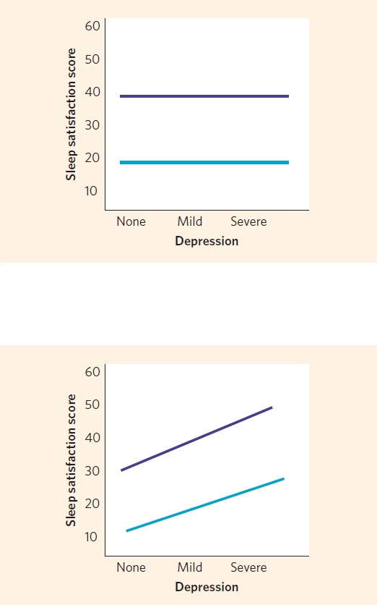
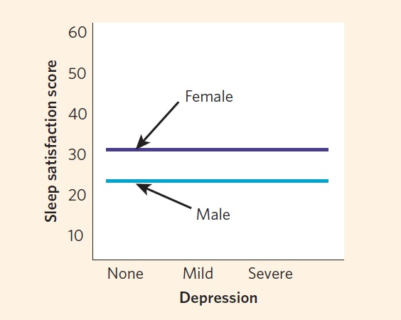
Analysis of Variance (ANOVA)

Slide 20
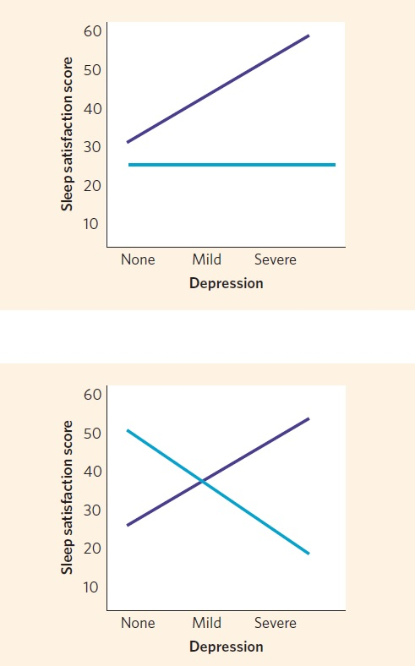
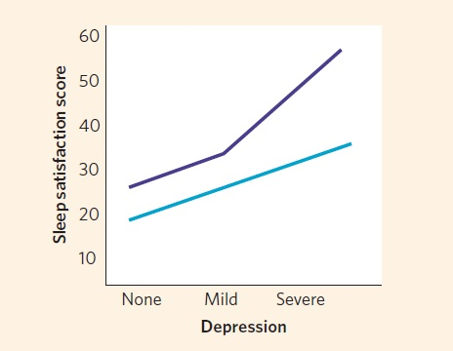
Analysis of Variance (ANOVA)

Slide 21
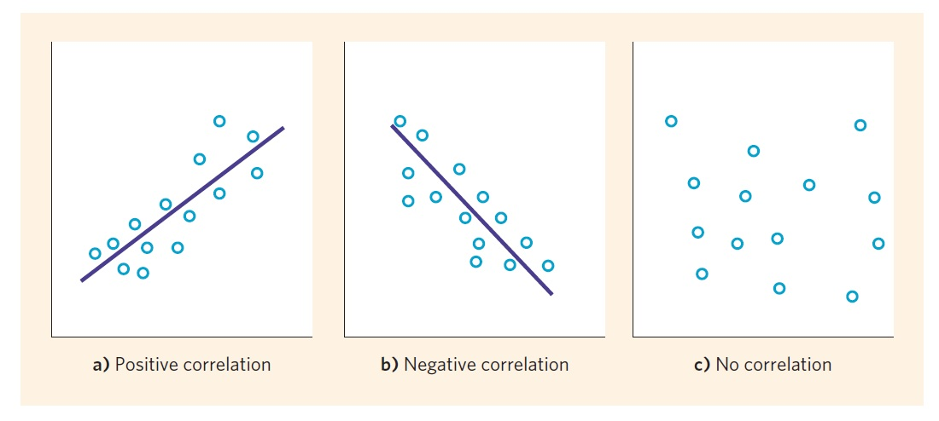
Correlation
Is a series of statistical tests that measures the relationship between two variables.
Correlation between two variables is often presented graphically using scatterplots.
Notes:
We assess that relationship (or association) in terms of a ‘correlation coefficient’, which measures the way in which the ‘values’ in one variable change in relation to ‘values’ in a second variable. A positive correlation coefficient occurs when values change in the same direction. For example, we might expect the sale of ice creams to increase as temperature increases. A negative correlation will exist when
+1 Perfect positive correlation
-1 Perfect negative correlation
0 No correlation

Slide 22
Correlation
Pearson’s correlation: used where both variables are parametric
Spearman’s correlation: used when at least one of the variables is not parametric. But the data must be at least ordinal and not categorical
Point-Biserial correlation: used when one of the variables is categorical, and it must have only two categories. Better to be coded as 0 and 1
Don't put too much emphasis on significance in larger samples; focus on the correlation coefficient. Always report significance with the coefficient in smaller samples.
Notes:
A zero-order correlation is one without controls; it is just basic correlation. A first-order correlation has one controlling variable (for simplicity’s sake, we will focus on that in this chapter), a second-order correlation has two controlling variables, while a third-order correlation has three, and so on.
Also, it is possible to conduct partial correlation where the controlling variable is categorical. So you could examine the relationship between sleep quality perceptions and mood, controlling for gender. However, the controlling categorical variable must be dichotomous (there must be only two levels, such as male vs. female).

Slide 23
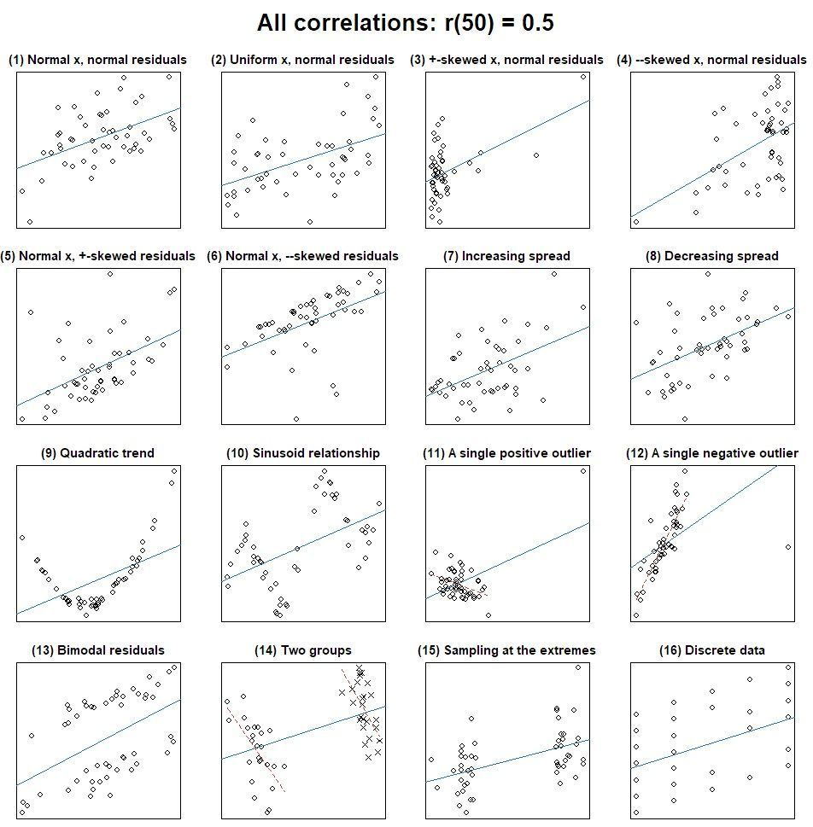
Correlation
Always check the scatterplots for your correlations.

Slide 24
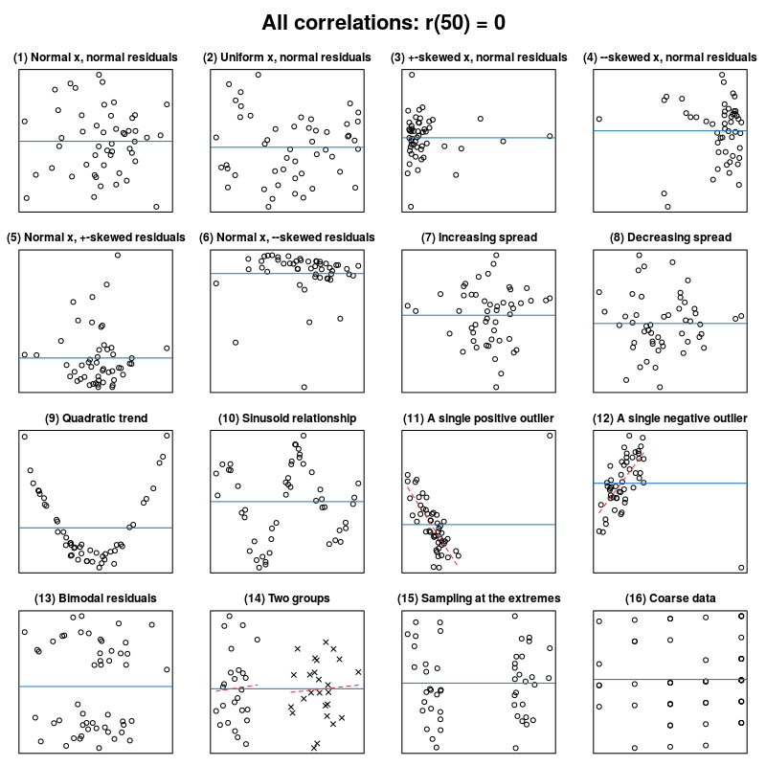
Correlation
Always check the scatterplots for your correlations.

Slide 25
Regression
multiple linear regression investigates the proportion of variance of a dependent variable that several predictors can explain.
Multiple regression also allows you to determine the overall fit (variance explained) of the model and the relative contribution of each of the predictors to the total variance explained.
Notes:
The variable we want to predict is called the dependent variable (or sometimes, the outcome, target or criterion variable).
The predictor variables are sometimes called: the predictor, explanatory or regressor variables.

Slide 26
Regression
How many participants is needed?
The rule of thumbs (like 15 cases per predictor) oversimplify the issue considerably.
The sample size depends on the effect size (i.e., how strong the relationship is that we’re trying to measure) and how much power we want to detect these effects.
The sample size needed to achieve a high power i.e. 0.8 (Miles and Shevlin, 2001):
Large effect size (0.8) a sample size of 80 will always suffice (with up to 20 predictors).
Medium effect size (0.5), a sample of 200 will always suffice (up to 20 predictors), always need a sample of 60 and with 6 or fewer predictors a sample of 100 is fine.
Small effect size (0.2), at least 600 (and more if you have 6 or more predictors).
Notes:
Note the difference between the R2 and adjusted R2. R2 measures how much of the variability in the outcome is explained by the predictor. But the "adjusted R2" shows how the regression model "generalizes" to the population. How much it is representative of the population?

Slide 27
Regression Assumptions
Variable Type: The outcome variable must be quantitative and continuous. It must be measured at the interval level. All predictor variables must be quantitative or categorical (with two categories).
No perfect multicollinearity: The predictor variables should not correlate too highly.
Homoscedasticity: The residuals at each level of the predictor(s) should have the same variance (homoscedasticity); when the variances are very unequal it is said to be heteroscedasticity.

Slide 28
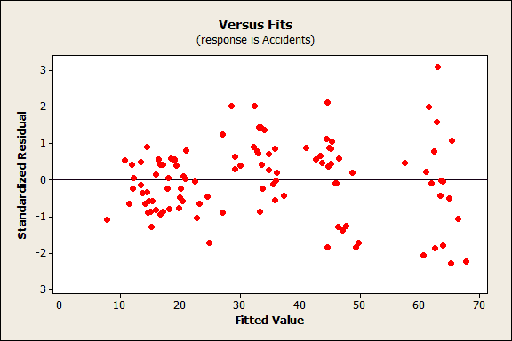
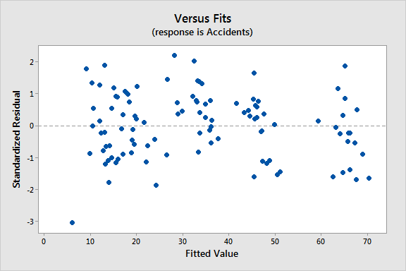
heteroscedasticity
homoscedasticity

Slide 29
Regression Assumptions
Linearity: This means that it is assumed that the relationship we are modelling is a linear one. Modelling a non-linear relationship with linear model obviously limits the generalizability of the findings.
Independent errors: For any two observations the residual terms should be uncorrelated (or independent). Can be tested using the Durbin-Watson test. As a very conservative rule of thumb, values less than 1 or greater than 3 are definitely concerning.
Normally distributed errors: assumes that the residuals in the model are random, normally distributed with a mean of 0.

