Slide 1
HTML with CSS
Unit 4

Slide 2
OBJECTIVES
Recap on HTML
Introduction to CSS
Advantages of CSS
Insert Styles in Web page
Syntax of CSS Styles
Commonly used CSS Styles

Slide 3
Recap on HTML
HTML stands for “Hyper text markup language”.
HTML is made up of a set of elements, or tags, that are used as instructions to tell the browser what should appear on a web page and how.
HTML was developed by Tim Berners-Lee.
HTML documents are text files with HTML tags.
Tags means instructions that tell the browser what to show on the webpage.

Slide 4
HTML editor - It is a software application used to create and save the document.
A web browser - It is used to view the HTML document.
Structure of HTML - The HTML tag for the document head is <HEAD> the tag for the document
body is <BODY>. Every HTML document contains the head and body codes.
Container Element - The elements which have both start and end tags are called container
elements.
Empty Element - The elements which have only start tag and do not need end tag are called as Empty elements.
Head Element - HEAD element is used for specifying the title of an HTML Document
Body Element - Body element form the body of an HTML document.
Attributes defines characteristic of element. Attributes have two parts Name and Value.

Slide 5
HTML Tags - Tags are instructions. Tags are the labels used to mark up the start and end of an HTML.
Heading Tags - HTML has six levels of headings those are
<h1>,<h2>,<h3>,<h4>,<h5>,<h6>.
<h1> is the biggest and <h6> is the smallest.
Paragraph Tag - Paragraph tag helps to structure your text.
The text of a paragraph should be between opening and closing paragraph tag.
Line break Tag - Break tag is used to start from next line. It is an empty element.
Superscript element - It is used to display the text half above the normal line of text.
Subscript - It displays the specified text below the base line.

Slide 6
Marquee Tag - In HTML a Marquee tag is used to scroll piece of text displayed either horizontally or vertically on the webpage depending on the settings.
HTML Comments - HTML comments will be ignored by the browser, although they can be viewed
in the source code.
List Elements - HTML provides a number of list elements that would help in creating different types of lists.
Unordered list - An Unordered list element is used to insert a bulleted list.
Ordered list - An ordered list element is used to insert a numbered list. The start attribute specifies the start value of the first list item in an ordered list.
Nested list - Nested list means a list within a list. Like an ordered list can have unordered list within it.
Scrollable list box - It is used when there are multiple answers to be selected from a list of items.
Image Tag - <Img> the browser supports various image formats.

Slide 7
INTRODUCTION
Cascading Style Sheet(CSS) is one of the commonly used presentational technologies to design the web content written in HTML in a more sophisticated way.
CSS makes the content of the website looks more attractive by increasing the expressive style and creativity.
It works with fonts, layouts, spacing and colors of the text and give it more professional look.
The word cascading in CSS describes a cascading mechanism.
The cascade defines the specific styles that could be applied to different tags or even the same tags appearing more than once in the document.
For example, if two <p> tags appear in the document, then using CSS, we can cascade different colors for the text appearing with each <p> tag.

Slide 8
Advantages of CSS
1. The CSS document can be written once and can be reused in multiple HTML pages.
2. Modification of the document is really easy. The changes are done in the CSS file and the entire website takes the changes automatically.
3. With CSS, we need not write the attributes of the HTML tags again and again. The same style can be applied to multiple occurrences of the same attribute of the tag.
4. CSS can store web applications offline. So, we can view the websites offline too.

Slide 9
Ways to insert styles in a web page There are three prime ways to insert styles in a web page. They are: 1. Inline: The styles are added with the html tags as attributes. 2. Internal: The styles are added in the beginning of the document within the <head> tag. 3. External: The styles are added in a separate file which is further linked to the HTML document.

Slide 10

Syntax Basically, a CSS style is made up of three parts: Selector: It is an HTML tag on which a style will be applied. Example: <p>, <U> etc. Property: A property is a type of CSS style which will be applied to the text associated with the HTML tag. Value : Values are assigned to properties. For example, color property can have value red.

Slide 11
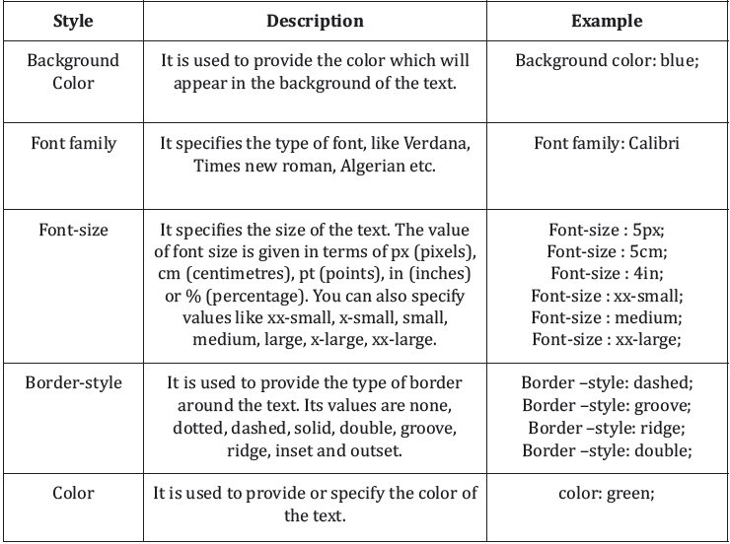
Some of the styles which we will refer to in the examples are specified in the given table.

Slide 12
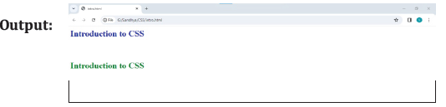
Inline CSS You can use inline CSS to embed your CSS in line with HTML elements. The style tag is added to the tag as an attribute along with the name of the CSS style. In the given example, font color is associated with the text. For example, <p style= “color: blue”> It uses CSS to specify that text in the current paragraph is blue Example: <html> <body> <h1><p style="color: blue"> introduction to CSS </p></h1><br> <h1><p style="color: green"> introduction to CSS </p></h1> </body> </html>

Slide 13
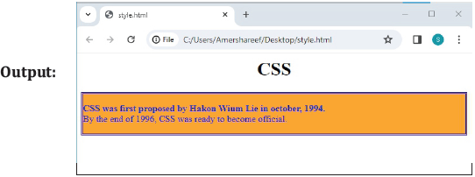
Use of <DIV> tag When we need to apply styles to a particular portion or block of text in an HTML document then we use <DIV> tag. The style attribute is used in the similar manner as used in the above case. Here is an example to show the use of the <DIV> tag. We can use other HTML tags within the <DIV> tag. Example: <html> <head> <h1><center> CSS </center></h1></head> <body> <div style="color:blue;border:double;background:orange"> <p><b> CSS was First proposed by Hakon Wium Lie in October, 1994. <Br></b> By the end of 1996, CSS was ready to become official. </div> </body> </html>

Slide 14

Use of <span> tag This tag is used to delimit an arbitrary piece of text. In other words, It is used to provide style to a part of text with an existing tag. Look at the given example. Example: <html> <body> <h1 style="color: blue"> "health is wealth" <span style="color: orange"> happiness comes from having good health. </Span></h1> </body> </html>

Slide 15
Internal CSS
The internal style sheet is used to add a unique style for a single document. It is defined in <head>
section of the HTML page inside the <style> tag.
Syntax:
<html>
<head>
<style type=”text/css ”>
………..Styles are specified here………..
</style>
</head>
<body>

Slide 16
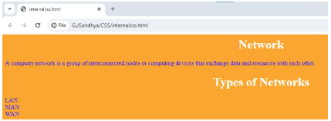
Example:
<html>
<head>
<style>
body {background-color: Orange;}
h1 {color: white;}
p {color: blue;}
</style> </head>
<body>
<h1><center> Network </h1></center>
<p>A computer network is a group of interconnected
nodes or computing devices that exchange data and
resources with each other.</p>
<h1><center>Types of Networks</h1></center>
<p> LAN<br>MAN <Br> WAN </p>
</body>
</html>

Slide 17
External CSS
The external style sheet is generally used when you want to make changes on multiple pages.
It is ideal for this condition because it facilitates you to change the look of the entire website by changing just one file.
It uses the <link> tag on every pages and the <link> tag should be put inside the head section.
The external style sheet may be written in any text editor but must be saved with a .css extension.
This file should not contain HTML elements.
Following are the three attributes of the <link> tag.
Rel: It specifies that the relation between the css and the html file is of the type style sheet.
Type: It is used to indicate the browser that the type of style sheet available for the text is CSS.
This is required as there are other style sheets available for HTML besides CSS.
Href: The name of the CSS file is mentioned here.
Syntax: <link rel= “stylesheet” type= “text/css” href= “path to stylesheet.css”>

Slide 18
Example:
a. Create a CSS file and name it code.css using the following code:
H1{color:blue;border:double;background:orange}
H2{color :white ;background :green}
H3{background :pink; border :dashed; color: black}
b. Create an HTML document and link the above created CSS file using the <link> tag.
<html>
<head>
<link rel="stylesheet" type= "text/css " href= "external.css">
</head>
<body>
<h1><center>The Ant and The Grasshopper</center></h1>
The ant and the grasshopper were good friends. In the summer, the ant works hard to ?ill his
storage with food. While the grasshopper was enjoying the fine weather and playing all day.
<h2> When winter came, the ant was lying cozily in his home, surrounded by the food he stored
during the summer. While the grasshopper was in his home, hungry and freezing. He asked the
ant for food, and the ant gave him some. But it wasn’t enough to last the entire winter.</h2>
<h3> When he tried to ask the ant again, the latter replied: “I’m sorry my friend but my food is
just enough for my family to last until the end of winter. If I give you more, we too will starve. We
had the entire summer to prepare for the winter but you chose to play instead.”</h3>
</body>
</html>

Slide 19
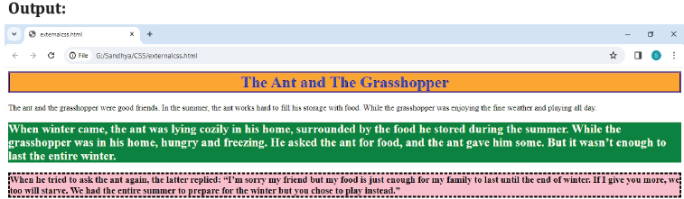
CSS Classes
We know that a single tag can be used more than once in an HTML document. Sometimes, it is
required to apply different styles to the same tag as it appears at different places in the same
HTML document. We use CSS classes for this purpose.
<html>
<body>
<h1> First section </h1> - We need to apply red color to the text with dotted border.
<h1> Second section </h1> - We need to apply blue color to the text with double border.
<h1> Third section </h1> - We need to apply purple color to the next with outset border
</body>
</html>

Slide 20
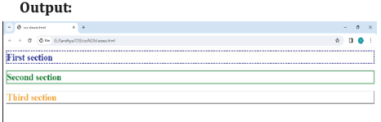
To meet the above requirement, we will use CSS classes. Look at the examples below.
<html>
<head>
<style type="text/css ">
h1.one{color :blue ;border : dotted}
h1.two{ color: green; border: double} h1.three{color :orange ;border :outset }
</style>
</head>
<body>
<h1 class=one> First section </h1>
<h1 class=two> Second section </h1>
<h1 class=three> Third section </h1>
</body>
</html>

Slide 21
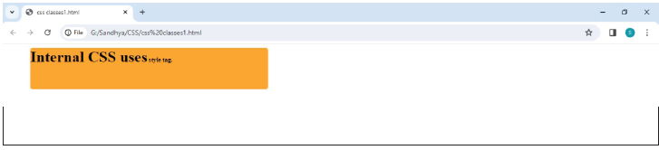
Adding same styles to multiple tags: Following is the way to add the same style to multiple tags.
B, h1, p{color :White ; background: black} color and background styles will be applicable to the
three tags, <B> ,<H1>,<P>.
<html>
<head>
<style type="text/ css">
B{background : orange ; font-family:
<body>
cooper; font-size:xx-large;color:black;border-radius:5px; margin:50px; padding-right:200px;
padding-bottom: 50px}
</style>
</head>
<B> Internal CSS uses<span style="font-size: small"> style tag. </span>
</span>
</B>
</body>
</html>

Slide 22
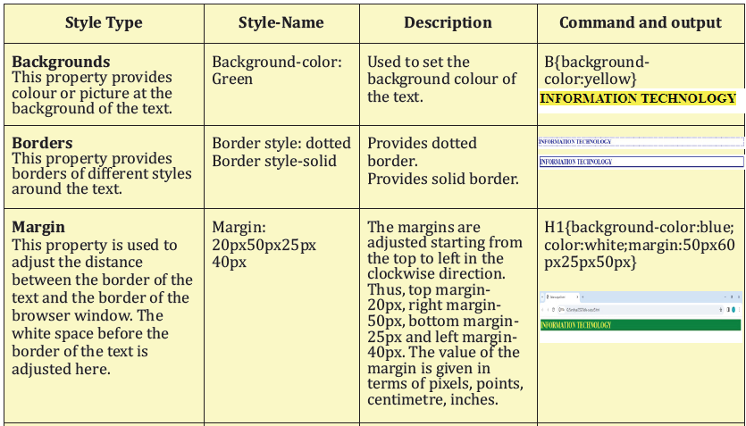
CSS Styles
There are a lot of styles provided by CSS to handle the text in the website. Some of the most
commonly used styles are listed in the given table.

Slide 23
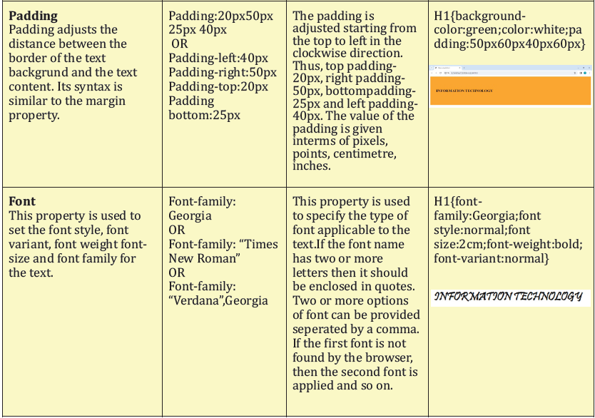

Slide 24
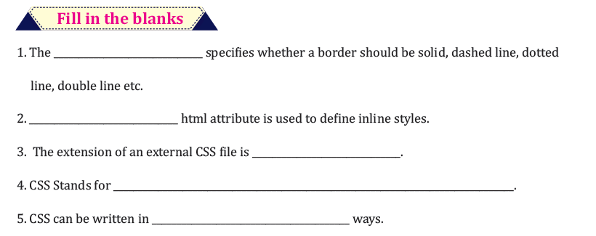
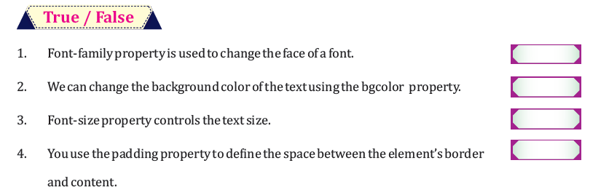
INTELLECTUAL SKILL SHEEt

Slide 25
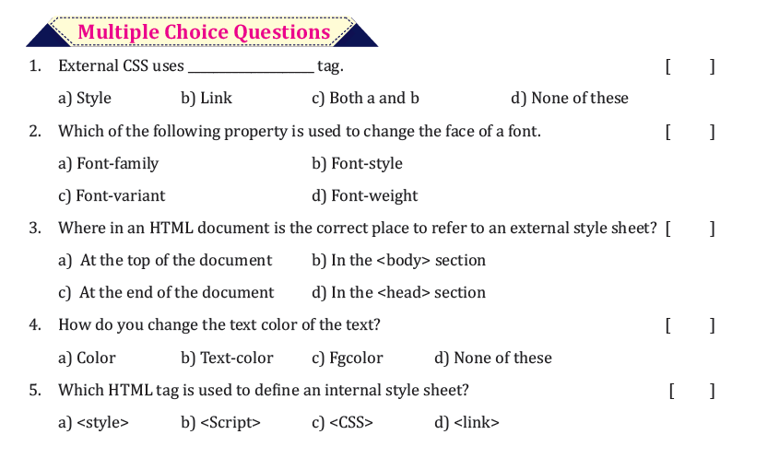

Slide 26
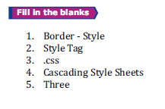
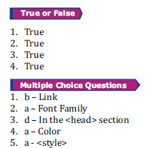
SKILL SHEET KEYS

Slide 27
thank you

