Slide 1
Grade 10 – IT 402
Introduction
to
IT-ITeS Industry

Slide 2
Objectives
1
Introduction to IT
2
Applications of IT
3
IT Enabled Services

Slide 3
Introduction
Information and Communication Technology (ICT) is a broad field that encompasses the use of technology to manage and process information. It plays a crucial role in our modern, interconnected world. The goal is to equip students with essential skills and knowledge to navigate and contribute effectively to the digital age. ICT refers to the technologies used to handle telecommunications, broadcast media, audio-visual processing, and network-based control and monitoring functions. ICT refers to the technologies used to handle telecommunications, broadcast media, audio-visual processing, and network-based control and monitoring functions.
Recognizing the evolving nature of technology, students are encouraged to stay informed about emerging trends and adapt to changes in the ICT landscape.

Slide 4
The Key components of ICT are Hardware, Software, Networking, Data and People.
The Basic ICT Skills are Computer Literacy, Internet Skills, Typing and Keyboard Skills, Digital Citizenship.
Applications of ICT are Communications, Productivity tools, Research and Information Retrieval, Creativity and Multimedia, Programming and Coding.

Slide 5
Advantages of learning ICT Skills
Improved communication: ICT makes it easy to stay in touch with people near and far, fostering collaboration and teamwork.
Enhanced creativity: ICT tools like graphic design software and music production apps allow us to express ourselves in new and exciting ways.
Lifelong learning: With access to online resources and educational platforms, learning can happen anytime, anywhere.
Better career opportunities: Many jobs today require ICT skills, and knowing how to use technology can open doors to a wider range of career paths.

Slide 6
Information Technology
Information Technology is the subset of Information and Communication Technology (ICT) that involves the use of Computers, networks, software, process, transmit, and retrieve information.
Key Features of Information Technology
Hardware: Computers, servers, networking devices, and other physical equipment.
Software: Applications, operating systems, and programming languages.
Networks: Infrastructure for connecting and facilitating communication between devices.
Databases: Storage systems for organizing and retrieving data efficiently.

Slide 7
Basic IT Skills
Computer Operations: Understanding the basic functions of computers, including turning them on/off, using peripherals, and managing files and folders.
Software Applications: Proficiency in using common software like word processors, spreadsheets, and presentation tools.
Internet Navigation: Efficient use of web browsers, search engines, and online resources.
Troubleshooting: Basic problem-solving skills for identifying and resolving common hardware and software issues.
Easy to change colors.

Slide 8
Applications of IT
It is used in Business and Enterprise Systems, Communication and Collaboration, Data Management and Analytics, E- Commerce, Healthcare Informatics, Education Technology, Financial Technology, Government and Public Services, Entertainment and Media, Cybersecurity, Robotics and Animation.
IT in home
IT has revolutionized home computing by providing more powerful and user-friendly devices,
connectivity options, and a wide range of applications and services that cater to various needs
and preferences. The integration of smart technologies and the expansion of cloud computing
have further enhanced the overall home computing experience.
IT in Banking
Information Technology, is like the backbone of modern banking. It's the technology that keeps
things running smoothly and helps banks thrive in today's world.

Slide 9
IT in Medical Science & Health Care
Information Technology (IT) plays a tremendously important role in both medical science and
healthcare. It has revolutionized how we research, diagnose, treat, and manage health, impacting various aspects of the medical field.
IT in E-Governance & Public Sector
Digital India and E-Governance initiatives of the government have helped many government
services to be online. Linking of Pan Card to bank account, collection of taxes, processing of documents like License, Passports, Voter Id Card etc.
IT in Medical Science & Health Care
Information Technology Enabled Services (ITeS) refer to the application of Information Technology to deliver various services that support business, processes and operations. These services are often delivered remotely using technology, and they play a significant role in today’s globalized economy. The skills required in ITeS are Communication Skills, Technical Proficiency, Problem Solving, Data Management.

Slide 10
Key Components of ITeS
Customer Support: Providing assistance to customers through various channels, such as phone,
email, chat, or social media.
Data Entry and Processing: Handling and processing data efficiently and accurately.
Technical Support: Assisting users with technical issues related to software, hardware, or other IT Products
Business Process Outsourcing (BPO): Outsourcing specific business processes to external service providers.

Slide 11
Common ITeS Functions
Call Centers: Handling inbound and outbound calls to address customer queries, provide information, or offer support.
Data Entry Services: Inputting, processing, and managing data in digital formats..
Tech Support Services: Resolving technical issues faced by customers or end-users.
Back Office Operations: Supporting internal business processes such as finance, HR and administrative tasks.

Slide 12
Role of ITeS in Business
Efficiency: ITeS can improve the efficiency of business operations by outsourcing non-core functions, allowing companies to focus on their core competencies.
Cost Savings: Outsourcing ITeS functions can lead to cost savings for businesses.
Globalization: ITeS allows companies to access a global talent pool, enabling them to operate on a
larger scale.

Slide 13
Intellectual Skill Sheet

Slide 14
Multiple Choice Questions
The Key Components of ICT are __________ [ ]
Hardware b. Software c. Networking d. All of these
Information Technology is used in _______________________ [ ]
a. Cyber Security b. E-Commerce c. Health Care d. All of these
Which of the following are the categories of ITeS? [ ]
a. BPO b. BPM c. MNC d. ISP
The skills required in ITeS are ___________________ [ ]
a. Problem Solving b. Technical Proficiency c. Communication Skills d. All of these
The outsourced services mainly focusing on knowledge based activities such as data analytics,
marketing research etc. are known as [ ]
a. BPO b. RPO c. KPO d. CRM

Slide 15
Fill in the Blanks
The full form of ITeS _____________________________________.
_________________ plays an important role in both medical sciences and Health Care.
_________________ is used to equip students with essential skills and knowledge to contribute efficiently to digital age.
The full form of BPO ______________________________.
______________________ is the backbone of modern banking.
True or False
Information Technology (IT) means creating, managing, storing and exchanging
information. [ ]. 2. ICT Stands for Information Communication and Technology. [ ]
3. Information Technology is not a subset of ICT. [ ]

Slide 16
Answer the following Questions
What is Ites?
List some applications of IT.
How is IT useful in home computing.
What is the role of ITeS in business.
How are IT and IteS interrelated.

Slide 17
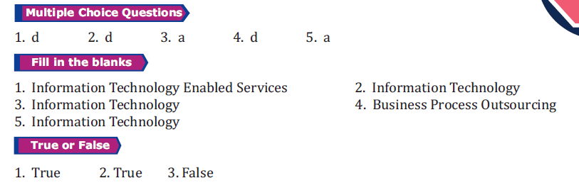
SKILL SHEET KEYS

Slide 18
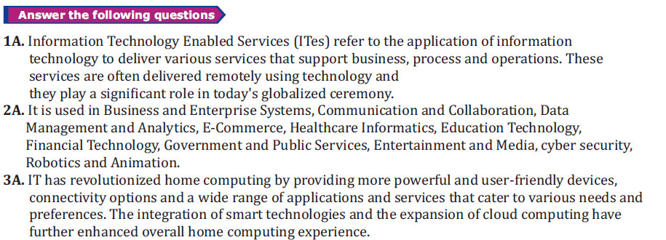
SKILL SHEET KEYS

Slide 19
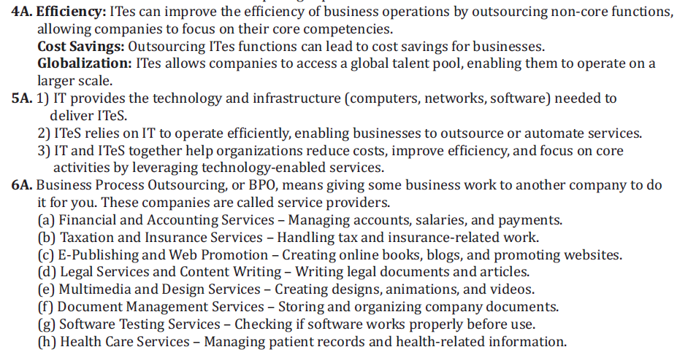
SKILL SHEET KEYS

Slide 20
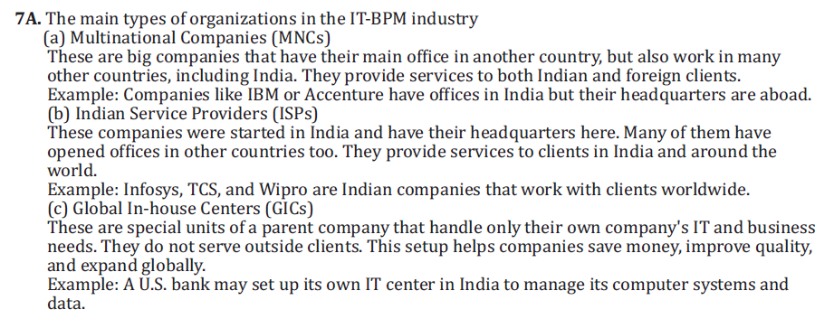
SKILL SHEET KEYS

Slide 21
THANK YOU

