Slide 1


kAISE dIYA
For those that work in acres not in hours!
Nirwan
Landge Omkar Prakash
Preetham D

Slide 2


Current Scenario

Slide 3
Current Scenario

Slide 4

Current Scenario

Slide 5
Current Scenario
@ Govt. Prices

Slide 6
Current Scenario
@ Govt. Prices

Slide 7

Current Scenario
Private Vendor
@ Govt. Prices

Slide 8
Current Scenario
Private Vendor
@ < Govt. Prices
@ Govt. Prices

Slide 9
Current Scenario
Private Vendor
@ < Govt. Prices
@ Govt. Prices

Slide 10
Current Scenario
Private Vendor
@ << Govt. Prices
@ Govt. Prices

Slide 11
Current Scenario
Selling in other Mandi Increases Logistics Cost
Private Vendor
@ << Govt. Prices
@ Govt. Prices

Slide 12
Solution
Sell from
Site of Production
Information on different Mandi Prices
Comprehensive Comparison of Alternatives

Slide 13
Solution
How it Works?
Farmer
Daily Fuel Cost
Road Network
Mandi/Market
Vendor
Location
Location
Commodity
Minimum Support Price
Quantity
Expected Date of Sale/Harvest
Daily Price
Collected from User
Expected Price
Government Institution
Logistic Cost
Private User
Compare Alternatives
Logistic Cost
Analysis
API

Slide 14
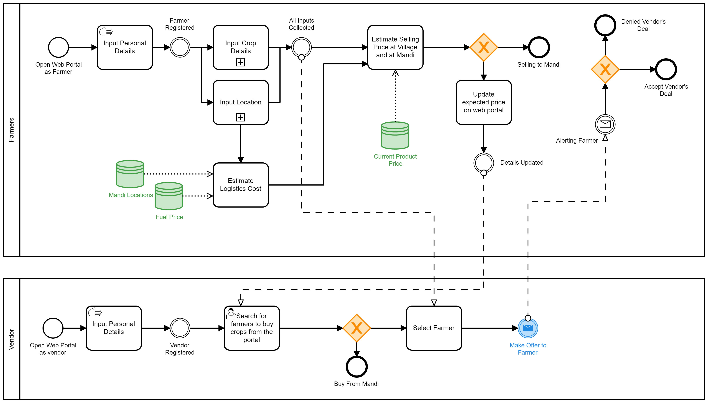
Solution
Business Process Modelling Notation

Slide 15


Solution
Django Framework
It is REST Framework written in Python to develop backend for an application
Addresses User Information Transactions and saves and calls needful data in database
PostgreSQL
For Spatial and Non-Spatial Database Creation

Slide 16


Solution
API Calling and Data Frame Management
Farm Produce API
Dependent Navigation through:
State
District
Commodity
Markets
Fuel Price API
Daily Average District Fuel Price
MapQuest API
Route Estimation and Visualisation

Slide 17
Solution
API Calling and Data Frame Management
Farm Produce API
Dependent Navigation through:
State
District
Commodity
Markets
Fuel Price API
Daily Average District Fuel Price
MapQuest API
Route Estimation and Visualisation

Slide 18

kAISE dIYA

