Slide 1
Data-Driven Prediction of Customer Turnover in the Telecommunications Sector: A Case Study of SyriaTel
Presented by: Kelvin Omina
28th October, 2025

Slide 2
Why Customer Turnover Matters
High competition and customer acquisition costs in telecom industry
Churn = customers leaving for competitors
Retaining customers is 5× cheaper than acquiring new ones
SyriaTel aims to predict and prevent churn using data analytics

Slide 3
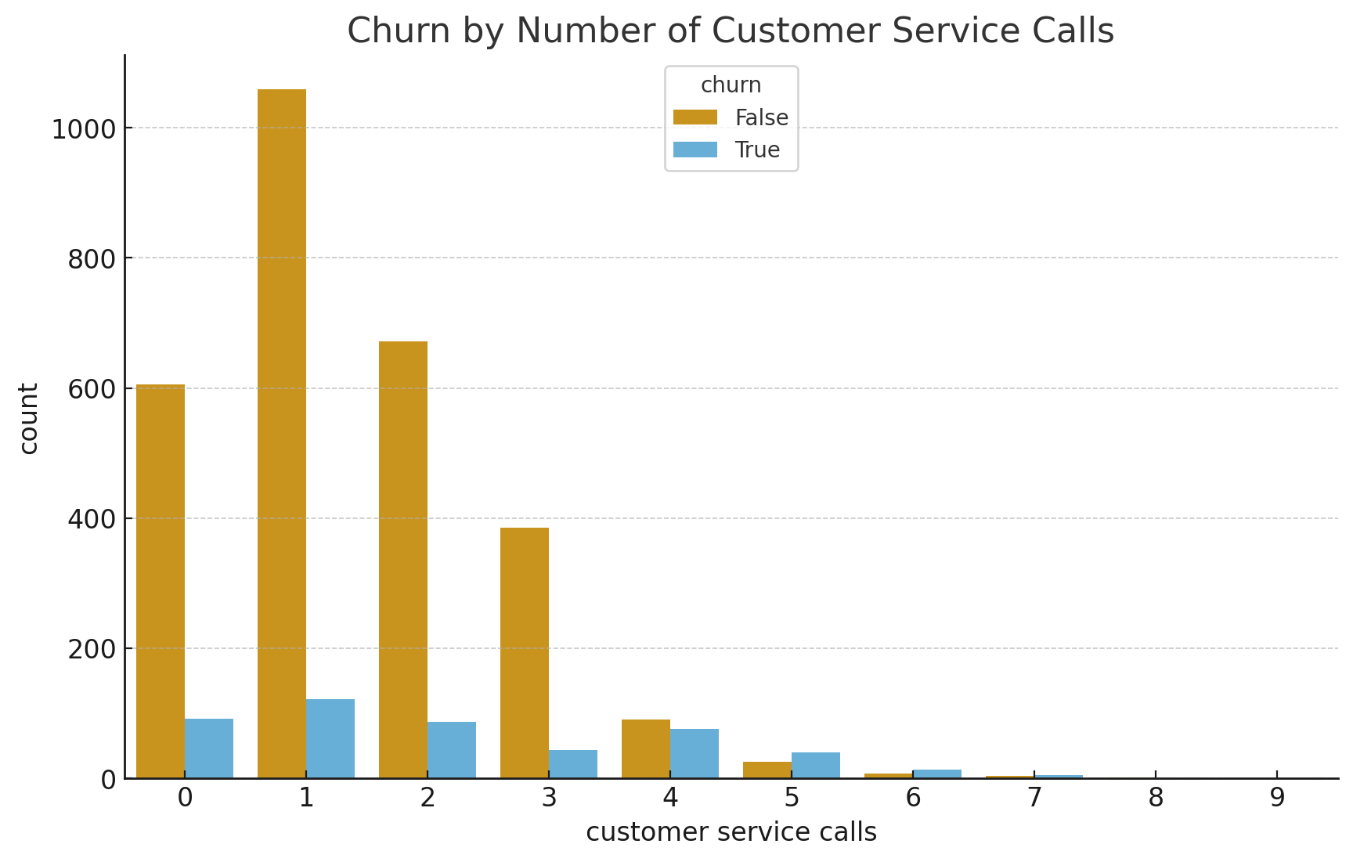
Churn vs Customer Service Calls

Slide 4
Project Objective
Goal: Build a predictive model to identify likely churners
Enable proactive retention actions
Objectives: Analyze data, build models, generate insights

Slide 5
Data Overview
Source: SyriaTel customer database (CSV)
Records: 3,333 customers
Features: 21 (usage, plans, calls, charges, demographics)
Target: churn (True = left, False = retained)

Slide 6
Data Preparation
Removed duplicates and missing values
Encoded categorical variables
Scaled numerical features
Split data: 80% training / 20% testing

Slide 7
Exploratory Data Analysis (EDA)
Churn is imbalanced (most customers retained)
High churn among international plan users and frequent callers
Strong correlations between total charges and total minutes

Slide 8
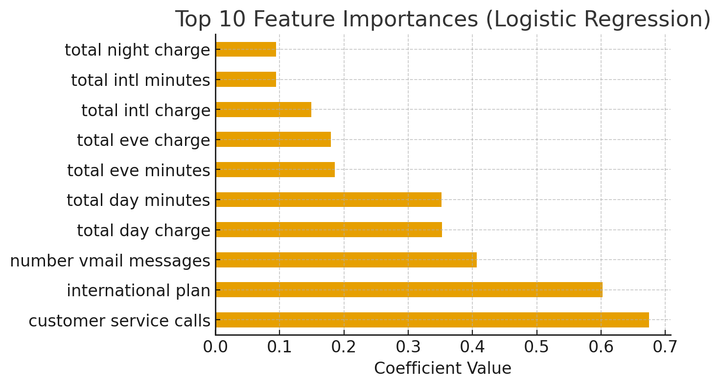
Top Feature Importances

Slide 9
Modeling Approach
Models: Logistic Regression, Ridge Regression (L2), Lasso Regression (L1)
Evaluation metrics: Accuracy, Precision, Recall, F1-score
All achieved Accuracy = 0.856

Slide 10
Key Insights
Ridge Regression showed best stability
Lasso highlighted most important predictors
Top predictors: customer service calls, international plan, total charges

Slide 11
Conclusion
Predictive churn model achieved 85.6% accuracy
Identified behavioral and service factors influencing churn
Supports data-driven customer retention for SyriaTel

Slide 12
Recommendations
Proactive Retention: loyalty offers for high-risk customers
Improve Customer Service: reduce repeat calls
Monitor churn indicators regularly

