Slide 1
Assembly Language for x86 Processors 7th Edition
Kip R. Irvine
Chapter 5: Procedures
Slides prepared by the author
Revision date: 1/15/2014
(c) Pearson Education, 2015. All rights reserved. You may modify and copy this slide show for your personal use, or for use in the classroom, as long as this copyright statement, the author's name, and the title are not changed.

Slide 2
Chapter Overview
Stack Operations
Defining and Using Procedures
Linking to an External Library
The Irvine32 Library
64-Bit Assembly Programming

Slide 3
Stack Operations
Runtime Stack
PUSH Operation
POP Operation
PUSH and POP Instructions
Using PUSH and POP
Example: Reversing a String
Related Instructions

Slide 4
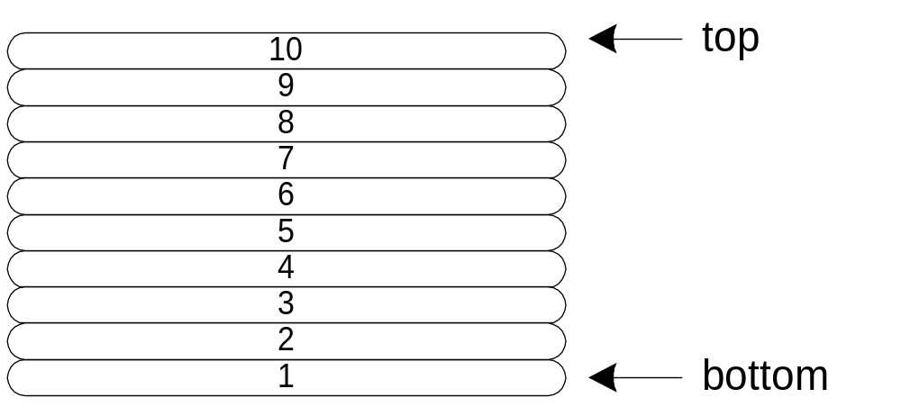
Runtime Stack
Imagine a stack of plates . . .
  plates are only added to the top
  plates are only removed from the top
  LIFO structure

Slide 5
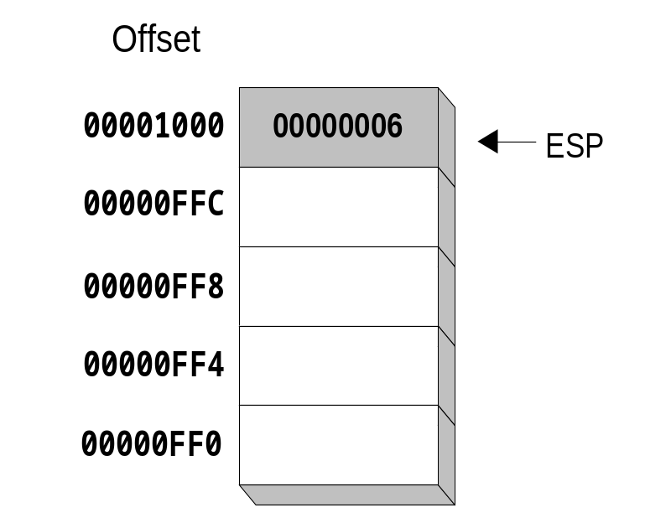
Runtime Stack
Managed by the CPU, using two registers
  SS (stack segment)
  ESP (stack pointer) *
* SP in Real-address mode

Slide 6
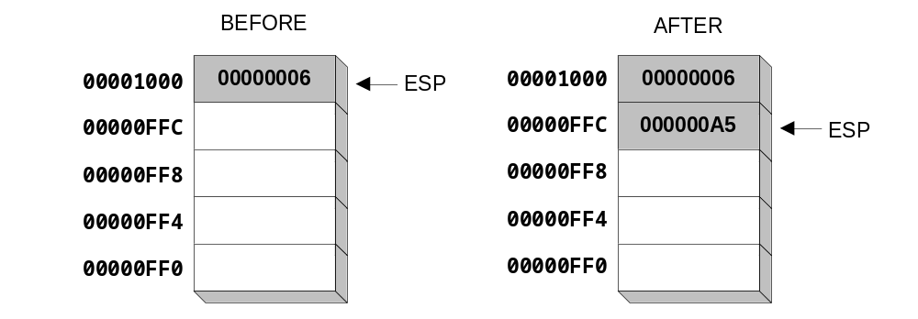
PUSH Operation (1 of 2)
A 32-bit push operation decrements the stack pointer by 4 and copies a value into the location pointed to by the stack pointer.

Slide 7
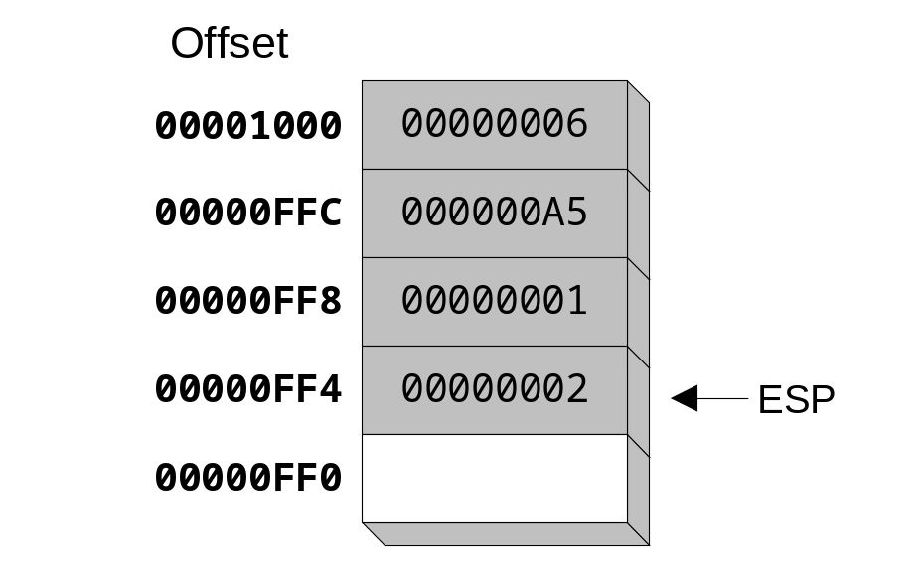
PUSH Operation (2 of 2)
Same stack after pushing two more integers:
The stack grows downward. The area below ESP is always available (unless the stack has overflowed).

Slide 8
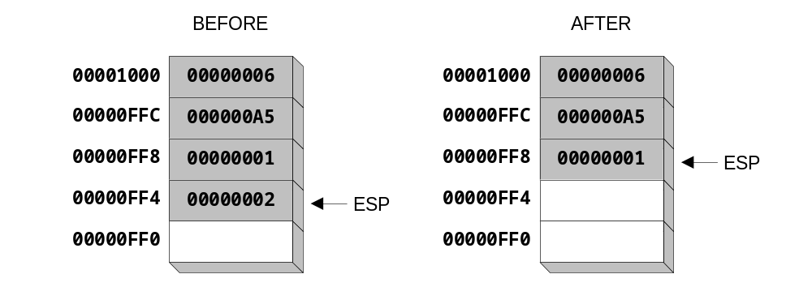
POP Operation
Copies value at stack[ESP] into a register or variable.
Adds n to ESP, where n is either 2 or 4.
  value of n depends on the attribute of the operand receiving the data

Slide 9
PUSH and POP Instructions
PUSH syntax:
  PUSH r/m16
  PUSH r/m32
  PUSH imm32
POP syntax:
  POP r/m16
  POP r/m32

Slide 10
Using PUSH and POP
Save and restore registers when they contain important values. PUSH and POP instructions occur in the opposite order.
push esi ; push registers
push ecx
push ebx
mov esi,OFFSET dwordVal ; display some memory
mov ecx,LENGTHOF dwordVal
mov ebx,TYPE dwordVal
call DumpMem
pop ebx ; restore registers
pop ecx
pop esi

Slide 11
What's Next
Stack Operations
Defining and Using Procedures
Linking to an External Library
The Irvine32 Library
64-Bit Assembly Programming

Slide 12
Defining and Using Procedures
Creating Procedures
Documenting Procedures
Example: SumOf Procedure
CALL and RET Instructions
Nested Procedure Calls
Local and Global Labels
Procedure Parameters
Flowchart Symbols
USES Operator

Slide 13
Creating Procedures
Large problems can be divided into smaller tasks to make them more manageable
A procedure is the ASM equivalent of a Java or C++ function
Following is an assembly language procedure named sample:
sample PROC
  .
  .
  ret
sample ENDP

Slide 14
CALL and RET Instructions
The CALL instruction calls a procedure
  pushes offset of next instruction on the stack
  copies the address of the called procedure into EIP
The RET instruction returns from a procedure
  pops top of stack into EIP

Slide 15
CALL-RET Example (1 of 2)
main PROC
  00000020 call MySub
  00000025 mov eax,ebx
  .
  .
main ENDP
MySub PROC
  00000040 mov eax,edx
  .
  .
  ret
MySub ENDP
0000025 is the offset of the instruction immediately following the CALL instruction
00000040 is the offset of the first instruction inside MySub

Slide 16
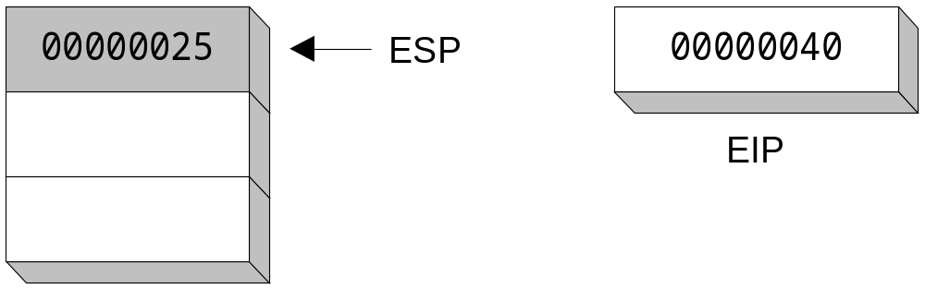
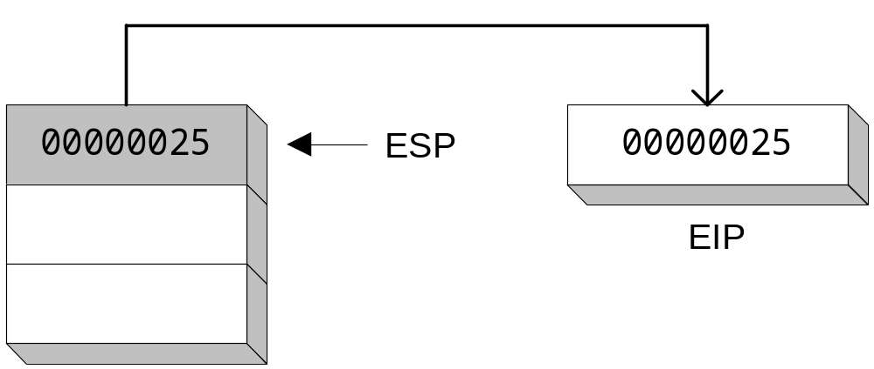
CALL-RET Example (2 of 2)
The CALL instruction pushes 00000025 onto the stack, and loads 00000040 into EIP
The RET instruction pops 00000025 from the stack into EIP
(stack shown before RET executes)

Slide 17
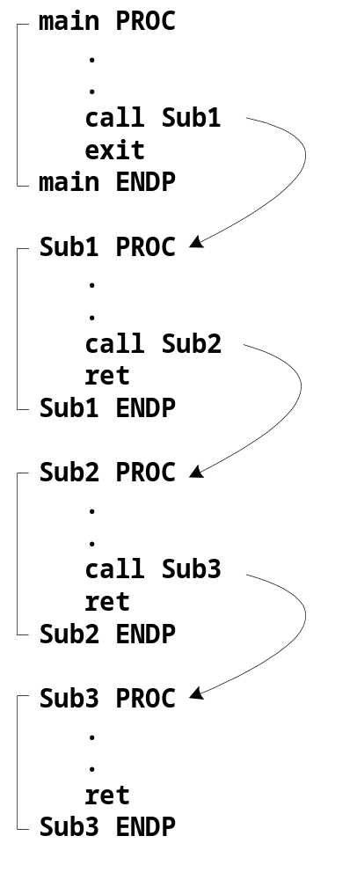
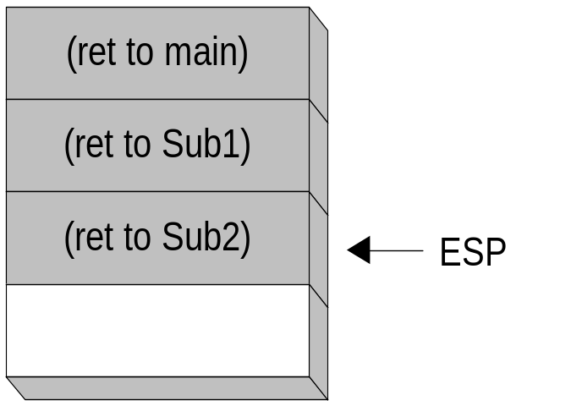
Nested Procedure Calls
By the time Sub3 is called, the stack contains all three return addresses:

Slide 18
Local and Global Labels
A local label is visible only to statements inside the same procedure. A global label is visible everywhere.
main PROC
jmp L2 ; error
L1:: ; global label
exit
main ENDP
sub2 PROC
L2: ; local label
jmp L1 ; ok
ret
sub2 ENDP

Slide 19
Procedure Parameters (1 of 3)
A good procedure might be usable in many different programs
  but not if it refers to specific variable names
Parameters help to make procedures flexible because parameter values can change at runtime

Slide 20
Procedure Parameters (2 of 3)
The ArraySum procedure calculates the sum of an array. It makes two references to specific variable names:
ArraySum PROC
  mov esi,0 ; array index
  mov eax,0 ; set the sum to zero
mov ecx,LENGTHOF myarray ; set number of elements
L1: add eax,myArray[esi] ; add each integer to sum
  add esi,4 ; point to next integer
  loop L1 ; repeat for array size
  mov theSum,eax ; store the sum
ret
ArraySum ENDP
What if you wanted to calculate the sum of two or three arrays within the same program?

Slide 21
Procedure Parameters (3 of 3)
This version of ArraySum returns the sum of any doubleword array whose address is in ESI. The sum is returned in EAX:
ArraySum PROC
; Receives: ESI points to an array of doublewords,
; ECX = number of array elements.
; Returns: EAX = sum
;-----------------------------------------------------
  mov eax,0 ; set the sum to zero
L1: add eax,[esi] ; add each integer to sum
  add esi,4 ; point to next integer
  loop L1 ; repeat for array size
ret
ArraySum ENDP

Slide 22
USES Operator
Lists the registers that will be preserved
ArraySum PROC USES esi ecx
mov eax,0 ; set the sum to zero
etc.
MASM generates the code shown in gold:
ArraySum PROC
push esi
push ecx
.
.
pop ecx
pop esi
ret
ArraySum ENDP

Slide 23
When not to push a register
The sum of the three registers is stored in EAX on line (3), but the POP instruction replaces it with the starting value of EAX on line (4):
SumOf PROC ; sum of three integers
  push eax ; 1
  add eax,ebx ; 2
  add eax,ecx ; 3
  pop eax ; 4
  ret
SumOf ENDP

Slide 24
What's Next
Stack Operations
Defining and Using Procedures
Linking to an External Library
The Irvine32 Library
64-Bit Assembly Programming

Slide 25
Linking to an External Library
What is a Link Library?
How the Linker Works

Slide 26
What is a Link Library?
A file containing procedures that have been compiled into machine code
  constructed from one or more OBJ files
To build a library, . . .
  start with one or more ASM source files
  assemble each into an OBJ file
  create an empty library file (extension .LIB)
  add the OBJ file(s) to the library file, using the Microsoft LIB utility

Slide 27
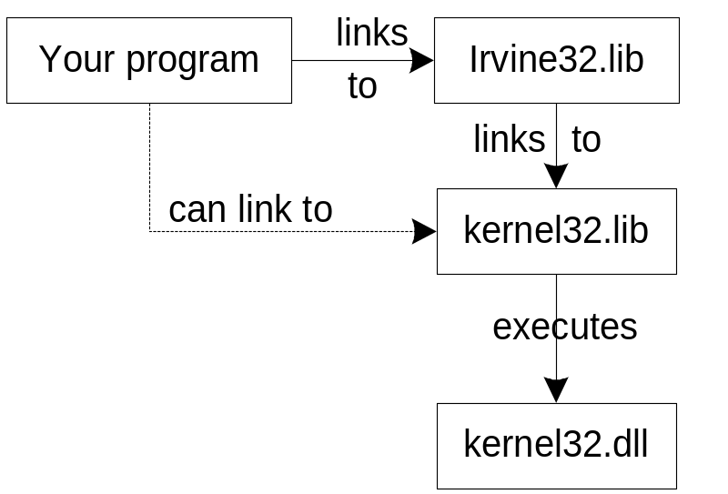
How The Linker Works
Your programs link to Irvine32.lib using the linker command inside a batch file named make32.bat.
Notice the two LIB files: Irvine32.lib, and kernel32.lib
  the latter is part of the Microsoft Win32 Software Development Kit (SDK)

Slide 28
What's Next
Stack Operations
Defining and Using Procedures
Linking to an External Library
The Irvine32 Library
64-Bit Assembly Programming

Slide 29
Calling Irvine32 Library Procedures
Call each procedure using the CALL instruction. Some procedures require input arguments. The INCLUDE directive copies in the procedure prototypes (declarations).
The following example displays "1234" on the console:
INCLUDE Irvine32.inc
.code
mov eax,1234h ; input argument
call WriteHex ; show hex number
call Crlf ; end of line

Slide 30
Library Procedures - Overview (1 of 4)
CloseFile – Closes an open disk file
Clrscr - Clears console, locates cursor at upper left corner
CreateOutputFile - Creates new disk file for writing in output mode
Crlf - Writes end of line sequence to standard output
Delay - Pauses program execution for n millisecond interval
DumpMem - Writes block of memory to standard output in hex
DumpRegs – Displays general-purpose registers and flags (hex)
GetCommandtail - Copies command-line args into array of bytes
GetDateTime – Gets the current date and time from the system
GetMaxXY - Gets number of cols, rows in console window buffer
GetMseconds - Returns milliseconds elapsed since midnight

Slide 31
Library Procedures - Overview (2 of 4)
GetTextColor - Returns active foreground and background text colors in the console window
Gotoxy - Locates cursor at row and column on the console
IsDigit - Sets Zero flag if AL contains ASCII code for decimal digit (0–9)
MsgBox, MsgBoxAsk – Display popup message boxes
OpenInputFile – Opens existing file for input
ParseDecimal32 – Converts unsigned integer string to binary
ParseInteger32 - Converts signed integer string to binary
Random32 - Generates 32-bit pseudorandom integer in the range 0 to FFFFFFFFh
Randomize - Seeds the random number generator
RandomRange - Generates a pseudorandom integer within a specified range
ReadChar - Reads a single character from standard input

Slide 32
Library Procedures - Overview (3 of 4)
ReadDec - Reads 32-bit unsigned decimal integer from keyboard
ReadFromFile – Reads input disk file into buffer
ReadHex - Reads 32-bit hexadecimal integer from keyboard
ReadInt - Reads 32-bit signed decimal integer from keyboard
ReadKey – Reads character from keyboard input buffer
ReadString - Reads string from stdin, terminated by [Enter]
SetTextColor - Sets foreground/background colors of all subsequent text output to the console
Str_compare – Compares two strings
Str_copy – Copies a source string to a destination string
Str_length – Returns the length of a string in EAX
Str_trim - Removes unwanted characters from a string.

Slide 33
Library Procedures - Overview (4 of 4)
Str_ucase - Converts a string to uppercase letters.
WaitMsg - Displays message, waits for Enter key to be pressed
WriteBin - Writes unsigned 32-bit integer in ASCII binary format.
WriteBinB – Writes binary integer in byte, word, or doubleword format
WriteChar - Writes a single character to standard output
WriteDec - Writes unsigned 32-bit integer in decimal format
WriteHex - Writes an unsigned 32-bit integer in hexadecimal format
WriteHexB – Writes byte, word, or doubleword in hexadecimal format
WriteInt - Writes signed 32-bit integer in decimal format

Slide 34
Library Procedures - Overview (5 of 4)
WriteStackFrame - Writes the current procedure’s stack frame to the console.
WriteStackFrameName - Writes the current procedure’s name and stack frame to the console.
WriteString - Writes null-terminated string to console window
WriteToFile - Writes buffer to output file
WriteWindowsMsg - Displays most recent error message generated by MS-Windows

Slide 35
Summary
Procedure – named block of executable code
Runtime stack – LIFO structure
  holds return addresses, parameters, local variables
  PUSH – add value to stack
  POP – remove value from stack
Use the Irvine32 library for all standard I/O and data conversion
  Want to learn more? Study the library source code in the c:\Irvine\Examples\Lib32 folder

