Slide 1
Assembly Language for x86 Processors 6th Edition
Kip R. Irvine
Chapter 6: Conditional Processing
(c) Pearson Education, 2010. All rights reserved. You may modify and copy this slide show for your personal use, or for use in the classroom, as long as this copyright statement, the author's name, and the title are not changed.

Slide 2
Chapter Overview
Boolean and Comparison Instructions
Conditional Jumps
Conditional Loop Instructions
Conditional Structures
Application: Finite-State Machines
Conditional Control Flow Directives

Slide 3
Boolean and Comparison Instructions
CPU Status Flags
AND Instruction
OR Instruction
XOR Instruction
NOT Instruction
Applications
TEST Instruction
CMP Instruction

Slide 4
Status Flags - Review
The Zero flag is set when the result of an operation equals zero.
The Carry flag is set when an instruction generates a result that is too large (or too small) for the destination operand.
The Sign flag is set if the destination operand is negative, and it is clear if the destination operand is positive.
The Overflow flag is set when an instruction generates an invalid signed result (bit 7 carry is XORed with bit 6 Carry).
The Parity flag is set when an instruction generates an even number of 1 bits in the low byte of the destination operand.
The Auxiliary Carry flag is set when an operation produces a carry out from bit 3 to bit 4

Slide 5
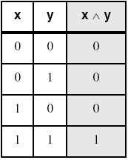
AND Instruction
Performs a Boolean AND operation between each pair of matching bits in two operands
Syntax:
    AND destination, source
  (same operand types as MOV)
AND

Slide 6
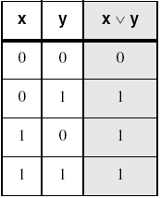
OR Instruction
Performs a Boolean OR operation between each pair of matching bits in two operands
Syntax:
    OR destination, source
OR

Slide 7
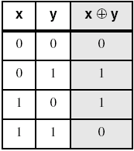
XOR Instruction
Performs a Boolean exclusive-OR operation between each pair of matching bits in two operands
Syntax:
    XOR destination, source
XOR
XOR is a useful way to toggle (invert) the bits in an operand.

Slide 8
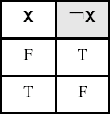
NOT Instruction
Performs a Boolean NOT operation on a single destination operand
Syntax:
    NOT destination
NOT

Slide 9
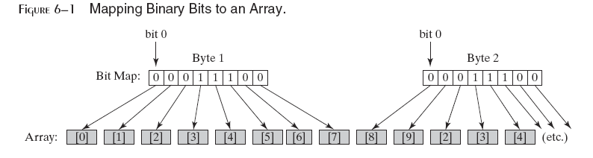
Bit-Mapped Sets
Binary bits indicate set membership
Efficient use of storage
Also known as bit vectors

Slide 10
Bit-Mapped Set Operations
Set Complement
    mov eax,SetX
    not eax
Set Intersection
    mov eax,setX
    and eax,setY
Set Union
    mov eax,setX
    or eax,setY

Slide 11
TEST Instruction
Performs a nondestructive AND operation between each pair of matching bits in two operands
No operands are modified, but the Zero flag is affected.
Example: jump to a label if either bit 0 or bit 1 in AL is set.
test al,00000011b
jnz ValueFound
Example: jump to a label if neither bit 0 nor bit 1 in AL is set.
test al,00000011b
jz ValueNotFound

Slide 12
CMP Instruction (1 of 3)
Compares the destination operand to the source operand
  Nondestructive subtraction of source from destination (destination operand is not changed)
Syntax: CMP destination, source
Example: destination == source
mov al,5
cmp al,5 ; Zero flag set
Example: destination < source
mov al,4
cmp al,5 ; Carry flag set

Slide 13
What's Next
Boolean and Comparison Instructions
Conditional Jumps
Conditional Loop Instructions
Conditional Structures
Application: Finite-State Machines
Conditional Control Flow Directives

Slide 14
Conditional Jumps
Jumps Based On . . .
  Specific flags
  Equality
  Unsigned comparisons
  Signed Comparisons
Applications
Encrypting a String
Bit Test (BT) Instruction

Slide 15
Jcond Instruction
A conditional jump instruction branches to a label when specific register or flag conditions are met
Specific jumps:
  JB, JC - jump to a label if the Carry flag is set
  JE, JZ - jump to a label if the Zero flag is set
  JS - jump to a label if the Sign flag is set
  JNE, JNZ - jump to a label if the Zero flag is clear
  JECXZ - jump to a label if ECX = 0

Slide 16
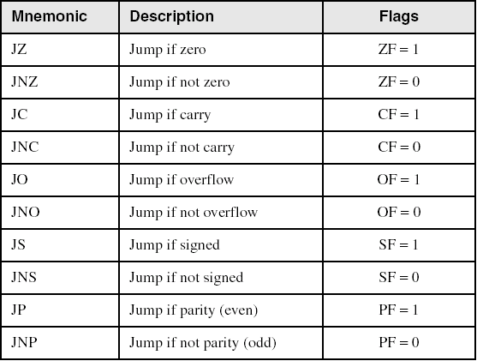
Jumps Based on Specific Flags

Slide 17
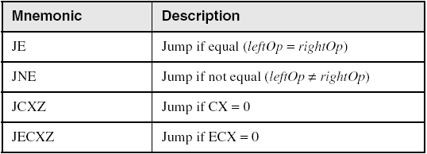
Jumps Based on Equality

Slide 18
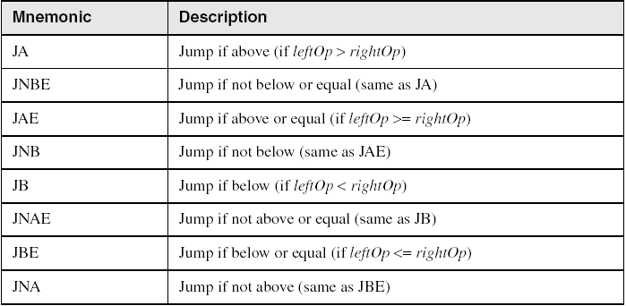
Jumps Based on Unsigned Comparisons

Slide 19
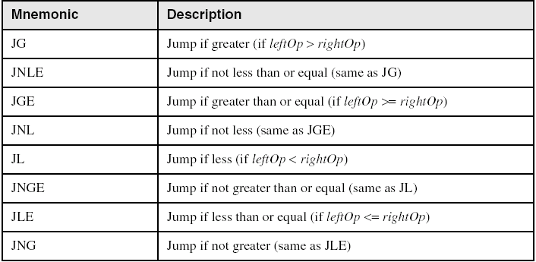
Jumps Based on Signed Comparisons

Slide 20
String Encryption Program
Tasks:
  Input a message (string) from the user
  Encrypt the message
  Display the encrypted message
  Decrypt the message
  Display the decrypted message
View the Encrypt.asm program's source code. Sample output:
Enter the plain text: Attack at dawn.
Cipher text: «¢¢Äîä-Ä¢-ïÄÿü-Gs
Decrypted: Attack at dawn.

Slide 21
Encrypting a String
The following loop uses the XOR instruction to transform every character in a string into a new value.
KEY = 239 ; can be any byte value
BUFMAX = 128
.data
buffer BYTE BUFMAX+1 DUP(0)
bufSize DWORD BUFMAX
.code
  1: mov ecx,bufSize ; loop counter
  2: mov esi,0 ; index 0 in buffer
L1:
  xor buffer[esi],KEY ; translate a byte
  inc esi ; point to next byte
  loop L1
Notes:
Buffer byte “this is the string to be encoded” 0x0; esi in the beginning is pointing to the character ‘t’ of the word “this”
t XOR 239d
H XOR 239d
I XOR 239d

Slide 22
Encrypting a String
The following loop uses the XOR instruction to transform every character in a string into a new value.
KEY = 239 ; can be any byte value
.data
buffer BYTE “Attack at Dawn” 0x0
.code
  1: mov ecx,size of buffer ; loop counter
  2: mov esi,0 ; index 0 in buffer
L1:
  3: xor buffer[esi],KEY ; translate a byte
  4: inc esi ; point to next byte
  5: loop L1

Slide 23
BT (Bit Test) Instruction
Copies bit n from an operand into the Carry flag
Syntax: BT bitBase, n
  bitBase may be r/m16 or r/m32
  n may be r16, r32, or imm8
Example: jump to label L1 if bit 9 is set in the AX register:
bt AX,9 ; CF = bit 9
jc L1 ; jump if Carry

Slide 24
What's Next
Boolean and Comparison Instructions
Conditional Jumps
Conditional Loop Instructions
Conditional Structures
Application: Finite-State Machines
Conditional Control Flow Directives

Slide 25
Conditional Loop Instructions
LOOPZ and LOOPE
LOOPNZ and LOOPNE

Slide 26
LOOPZ and LOOPE
Syntax:
  LOOPE destination
  LOOPZ destination
Logic:
  ECX ← ECX – 1
  if ECX > 0 and ZF=1, jump to destination
Useful when scanning an array for the first element that does not match a given value.
In 32-bit mode, ECX is the loop counter register. In 16-bit real-address mode, CX is the counter, and in 64-bit mode, RCX is the counter.

Slide 27
LOOPNZ and LOOPNE
LOOPNZ (LOOPNE) is a conditional loop instruction
Syntax:
LOOPNZ destination
LOOPNE destination
Logic:
  ECX ← ECX – 1;
  if ECX > 0 and ZF=0, jump to destination
Useful when scanning an array for the first element that matches a given value.

Slide 28
LOOPNZ Example
The following code finds the first positive value in an array:
.data
array SWORD -3,-6,-1,-10,10,30,40,4
sentinel SWORD 0
.code
  mov esi,OFFSET array
  mov ecx,LENGTHOF array
next:
  test WORD PTR [esi],8000h ; test sign bit
  pushfd ; push flags on stack
  add esi,TYPE array
  popfd ; pop flags from stack
  loopnz next ; continue loop
  jnz quit ; none found
  sub esi,TYPE array ; ESI points to value
quit:

Slide 29
What's Next
Boolean and Comparison Instructions
Conditional Jumps
Conditional Loop Instructions
Conditional Structures
Application: Finite-State Machines
Conditional Control Flow Directives

Slide 30
Table-Driven Selection (1 of 4)
Table-driven selection uses a table lookup to replace a multiway selection structure
Create a table containing lookup values and the offsets of labels or procedures
Use a loop to search the table
Suited to a large number of comparisons

Slide 31
Case Table
Case (x)
A: Call Process_A
  B: Call Process_B
  C: Call Process_C
  D: Call Process_D
End Case

Slide 32
Step 1 a: Set of Procedures that will be called
Process_A PROC
mov edx,OFFSET msgA
ret
Process_A ENDP
Process_B PROC
mov edx,OFFSET msgB
ret
Process_B ENDP

Slide 33
Set of Procedures
Process_C PROC
mov edx,OFFSET msgC
ret
Process_C ENDP
Process_D PROC
mov edx,OFFSET msgD
ret
Process_D ENDP

Slide 34
Table-Driven Selection (2 of 4)
Step 1a: Messages that the procedures will display
msgA BYTE "Process_A",0
msgB BYTE "Process_B",0
msgC BYTE "Process_C",0
msgD BYTE "Process_D",0

Slide 35
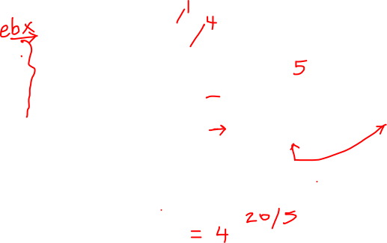


Table-Driven Selection (2 of 4)
Step 1: create a table containing lookup values and procedure offsets:
.data
CaseTable BYTE 'A' ; lookup value
DWORD Process_A ; address of procedure
EntrySize = ($ - CaseTable)
BYTE 'B'
DWORD Process_B
BYTE 'C'
DWORD Process_C
BYTE 'D'
DWORD Process_D
NumberOfEntries = ($ - CaseTable) / EntrySize

Slide 36
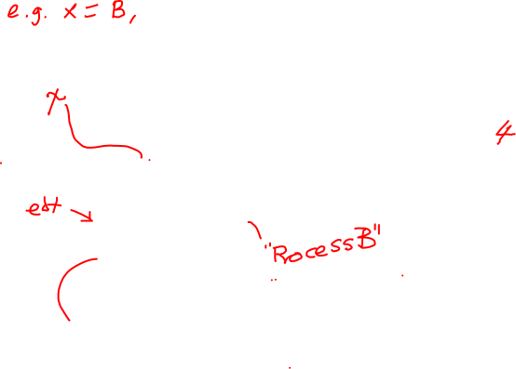
Table-Driven Selection (4 of 4)
Step 2: Use a loop to search the table. When a match is found, call the procedure offset stored in the current table entry:
mov ebx,OFFSET CaseTable ; point EBX to the table
mov ecx,NumberOfEntries ; loop counter
L1: cmp al,[ebx] ; match found?
jne L2 ; no: continue
call NEAR PTR [ebx + 1] ; yes: call the procedure
call WriteString ; display message
call Crlf
jmp L3 ; and exit the loop
L2: add ebx,EntrySize ; point to next entry
loop L1 ; repeat until ECX = 0
L3:
required for procedure pointers

Slide 37
Table-Driven Selection (3 of 4)
Table of Procedure Offsets:

Slide 38
Summary
Bitwise instructions (AND, OR, XOR, NOT, TEST)
  manipulate individual bits in operands
CMP – compares operands using implied subtraction
  sets condition flags
Conditional Jumps & Loops
  equality: JE, JNE
  flag values: JC, JZ, JNC, JP, ...
  signed: JG, JL, JNG, ...
  unsigned: JA, JB, JNA, ...
  LOOPZ, LOOPNZ, LOOPE, LOOPNE
Flowcharts – logic diagramming tool
Finite-state machine – tracks state changes at runtime

