Slide 1

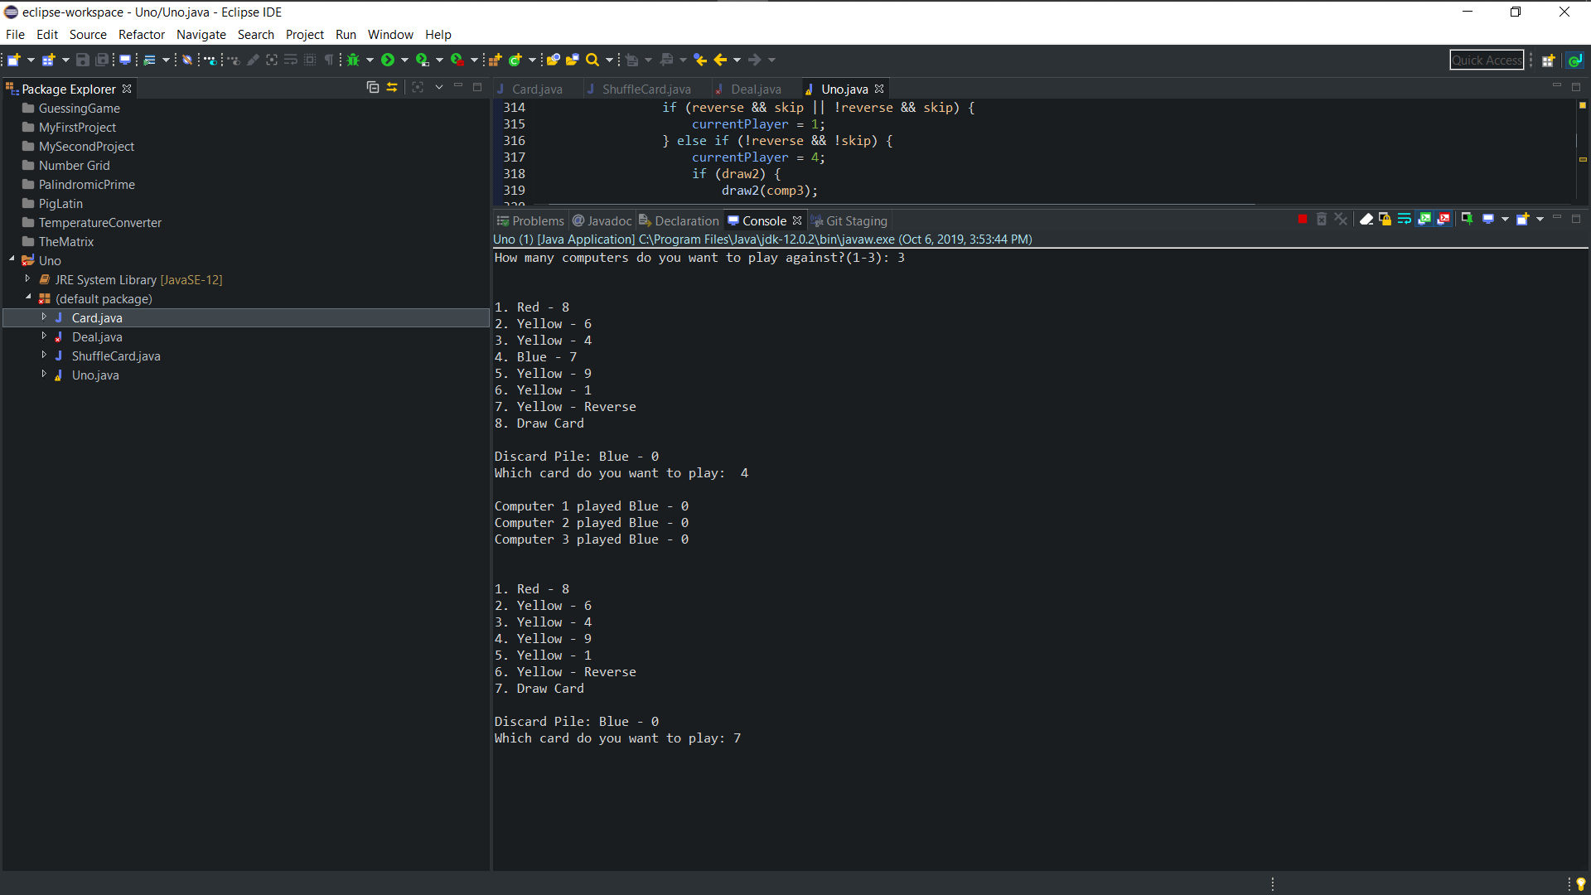
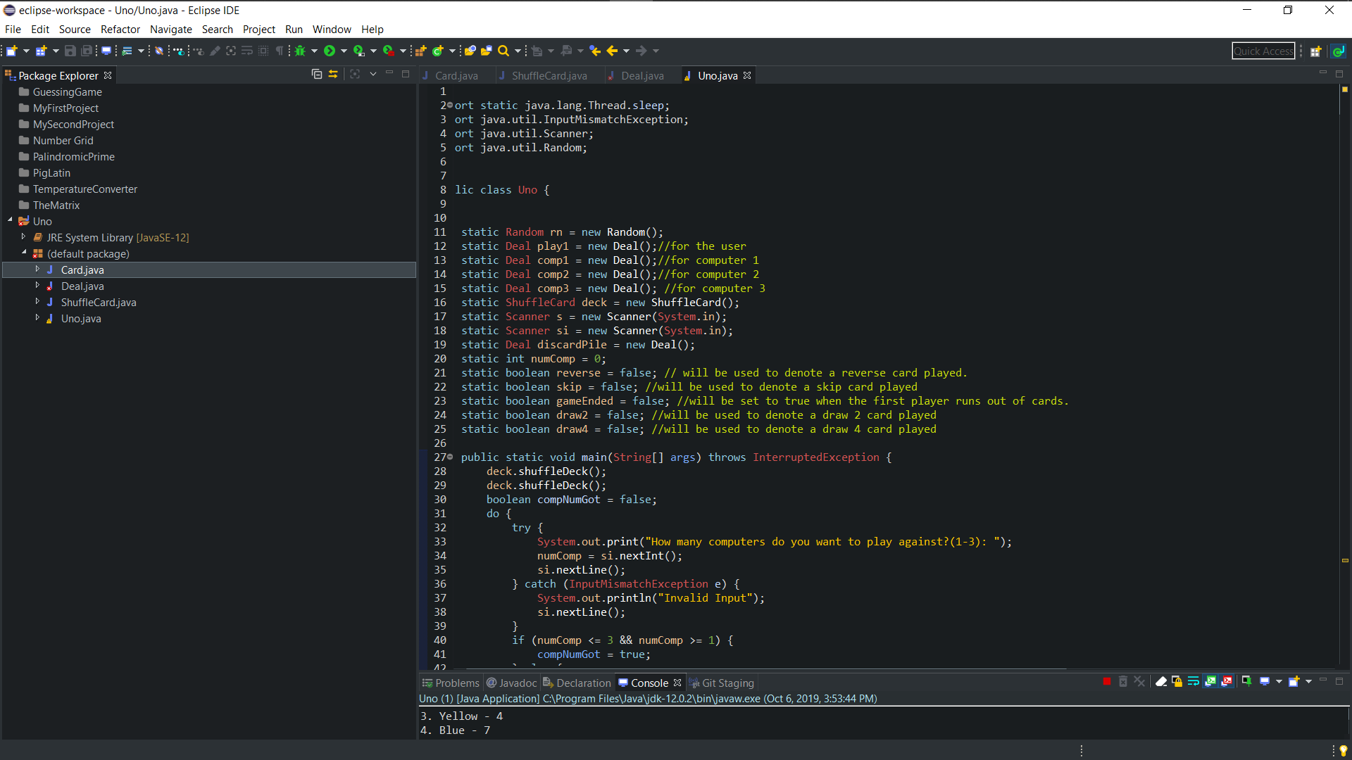
UNO GAME
Sydney M. Porter| Saleh. M| GCU
Problem / Question
Methods
Results
How do you build an automated game of Uno in Java?
deck.shuffleDeck(); | public int getCardNumber()
public Card getLast() | public Deal()
 | Amount
Item | Amount
Item | Amount
Item | Amount
Item | Amount
Plan
Start by outlining the fundamental rules of the game from start to finish.
Project Overview
Procedure
A console game of UNO
Build a console version of the game Uno using basic java skills.
Classes
Conclusion
Uno/Driver Class
Card Class
Creates the Uno cards
Deal Class
The main class that runs the program.
Deals the cards to the players.
Building a console game of Uno is an infuriating yet rewarding task.
Notes:
To change this poster, replace our sample content with your own. Or, if you'd rather start from a clean slate, press the New Slide button on the Home tab to insert a new page. Now enter your text and pictures in the empty placeholders. If you need more placeholders for titles, subtitles or body text, copy any of the existing placeholders, then drag the new one into place.

