Slide 1
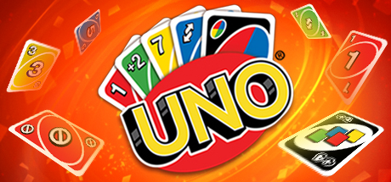

Slide 2
Setup Game
Begin by getting a deck of Uno cards
You’ll need 2-4 players to play

Slide 3
Shuffle the Cards

Slide 4
Deal the Cards
Deal 7 cards to each player

Slide 5
Begin the game
After dealing cards, the dealer flips the top card and the first card is added to the discard pile.

Slide 6
Player one’s turn
Player one either plays a card of the same color or value and places it in the discard pile. Player two’s turn begins.
If player one does not have a card of the same color or value, player one will draw a card.
If player one does not pull a card of the same color or value their turn is over and player two’s turn begins.
If player one plays a skip, player two is skipped and player three’s turn begins.
If player one plays a draw two or draw four, player two must draw the amount shown on the card and their turn is forfeited, Player three’s turn begins.
If player one plays a reverse, the order in which the player’s take their turns is reversed and player four become the new player one.

Slide 7
Player Two’s turn
Player two either plays a card of the same color or value and places it in the discard pile. Player three’s turn begins.
If player two does not have a card of the same color or value, player two will draw a card.
If player two does not pull a card of the same color or value their turn is over and player three’s turn begins.
If player two plays a skip, player three is skipped and player four’s turn begins.
If player two plays a draw two or draw four, player three must draw the amount shown on the card and their turn is forfeited, Player four’s turn begins.
If player two plays a reverse, the order in which the player’s take their turns is reversed and player one’s turn begins.

Slide 8
Player three’s turn
Player three either plays a card of the same color or value and places it in the discard pile. Player four’s turn begins.
If player three does not have a card of the same color or value, player three will draw a card.
If player three does not pull a card of the same color or value their turn is over and player four’s turn begins.
If player three plays a skip, player four is skipped and player one’s turn begins.
If player three plays a draw two or draw four, player four must draw the amount shown on the card and their turn is forfeited, Player one’s turn begins.
If player three plays a reverse, the order in which the player’s take their turns is reversed and player two becomes the new player one.

Slide 9
Player four’s turn
Player four either plays a card of the same color or value and places it in the discard pile. Player one’s turn begins.
If player four does not have a card of the same color or value, player four will draw a card.
If player four does not pull a card of the same color or value their turn is over and player one’s turn begins.
If player four plays a skip, player one is skipped and player two’s turn begins.
If player four plays a draw two or draw four, player one must draw the amount shown on the card and their turn is forfeited, Player two’s turn begins.
If player four plays a reverse, the order in which the player’s take their turns is reversed and player three becomes the new player one.

Slide 10
Repeat
The players continue to place cards in the discard pile in accordance with the instructions until a player is down to a single card.

Slide 11
Uno!
Once a player has one card in their hand they call “UNO!”

Slide 12
Uno out
Once a player discards their last card from their hand they call “UNO OUT!” and the game is won.

Slide 13
LoOm Video
https://www.loom.com/share/576e32be033a4de5a6b1d34d7666c1d1

