Slide 1



Chess Unity
Aldel Education Trust’s
St. John College of Engineering and Management, Palghar
NAAC Accredited with Grade A+ (2023-2024)
DEPARTMENT OF COMPUTER ENGINEERING
Omkar Shigvan (62 | B ) (EU2212005)
Jay Patil (64 | B ) (EU2212010)
Sakshi Patil (65 | B ) (EU2212001)
Meet Patil (67 | B ) (EU2212015)
Mrs. Aditi Raut | Project Guide
10th Nov, 2023

Slide 2
Contents
Abstract
Introduction
Motivation
Problem Statement
Scope of the project
Literature Survey
Proposed System
Architecture/ Framework
Application Flow
Use case Diagram
Tools and Technology used
Experiment and Results
Conclusion
References
2

Slide 3
Abstract
ChessUnity is the online chess platform that allows players to compete against each other. The system is designed to be accessible to players of all skill levels, with a variety of features to make it challenging and engaging for everyone.
The system offers a versatile gaming experience, featuring both single-player and multiplayer modes. Additionally, Chess Unity empowers users with the capability to initiate video calls while actively participating in chess games, irrespective of their user status whether they are guest users or authenticated users.
The system seamlessly integrates tournament hosting. Chess Unity offers remarkable flexibility by facilitating various tournament formats, including classic, rapid, and blitz modes. Moreover, Chess Unity introduces a puzzle feature, complete with a user-friendly and adaptable interface, enhancing the overall gaming experience and further extending the application's appeal.
3

Slide 4
Motivation
Chess has grown in popularity in India, with a growing interest among young people to play and study the game. The complexity of chess can be overwhelming to someone who is just starting. This spike of interest has prompted us to establish a specialized chess hub - a complete platform where chess admirers of all ages can meet.
The system act as a stepping stone for a chess beginner, providing a thriving community where players can engage with one another, play chess games, expand their knowledge through interactions with fellow enthusiasts, solve puzzles to sharpen their skills, compete in tournaments, watch live chess games of other players, and enjoy a variety of other chess-related activities.
4

Slide 5
Problem Statement
In the past few years, chess has gained immense popularity in India. To tap into this growing interest and establish a flourishing chess community in the country, there is a need for comprehensive online chess platform.
This system aims to be the ultimate destination for chess lovers, offering a range of thrilling features such as multiplayer games, challenging computer opponents, hosting and participating in tournaments, and solving puzzles.
The main objective is to create a platform that meets the special needs of the Indian chess community while providing a seamless and pleasurable experience for all users.
5

Slide 6
Scope of the Project
The scope of the Chess Unity Application encompasses the development of a web application. This application offers a versatile gaming experience
Dual Modes.
>Singleplayer: Users can engage in chess matches against computer opponents. >Multiplayer: Enables users to compete with others, with or without the need to log in to the application.
Empowers users with the capability to initiate video calls while actively participating in chess games irrespective of their user status whether they are guest users or authenticated users.
Tournament hosting, accommodating up to 100 participants. Streaming of live tournaments
Introduces a puzzle feature
A user-friendly and adaptable interface, enhancing the overall gaming experience and further extending the application's appeal.
6

Slide 7
Literature Survey
Sr. No. | Paper Title [Ref.] | Author names | Conclusion | Research Gaps
1 | A method for Estimating Online chess game player ratings with decision tree [1] | Habuki Yamada,Nobuko Kishi, Masato Oguchi, Miyuki Nakano | Players are not ranked solely on their past tournament performances. Instead, a method has been devised to assess player skills based on their game logs. This method utilizes a decision tree to distinguish between skilled and unskilled players. | No accuracy in identifying high rated players. Multiple game data is not used for analyzation.
2 | Digitization of Chess Board and Predication of Next Move [2] . | Preet Karia,Vaibhav Jain,Monik Shah,Sarika Rane | Creating Digital Board in Forsyth Edwards Notation
7

Slide 8
Literature Survey
Sr. No. | Paper Title [Ref.] | Author names | Conclusion | Research Gaps
3 | Cheat Detection on Online Chess Game Using Convolutional and Dense Neural Network [3]. | Reyhan Patria,Sean Favian,Anggoro Caturdewa, Derwin Suhartono | Convolutional Neural Network is better than Dense Neural Network | The Accuracy is less while validating score
4 | Enhancing Chess Engine with a Personalized Quantitative Database [4]. | Jiasen Liu | Considered human’s perspective of playing chess game. | Players are not competing in accordance with their Elo ratings
8

Slide 9
Literature Survey
Sr. No. | Paper Title [Ref.] | Author names | Conclusion | Research Gaps
5 | An Algorithm for Automatically Updating a Forsyth-Edwards Notation String Without an Array Board Representation [5]. | Azlan Iqbal | It provides a direct way to update the fence string using string manipulation and with the help of special data structure. | Requires additional data structure for manipulating fen string.
9

Slide 10
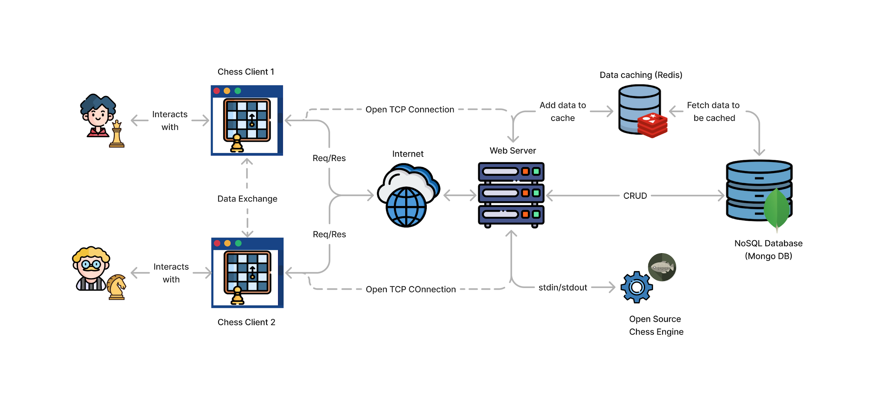
Proposed System
Fig.1 System Architecture
10

Slide 11
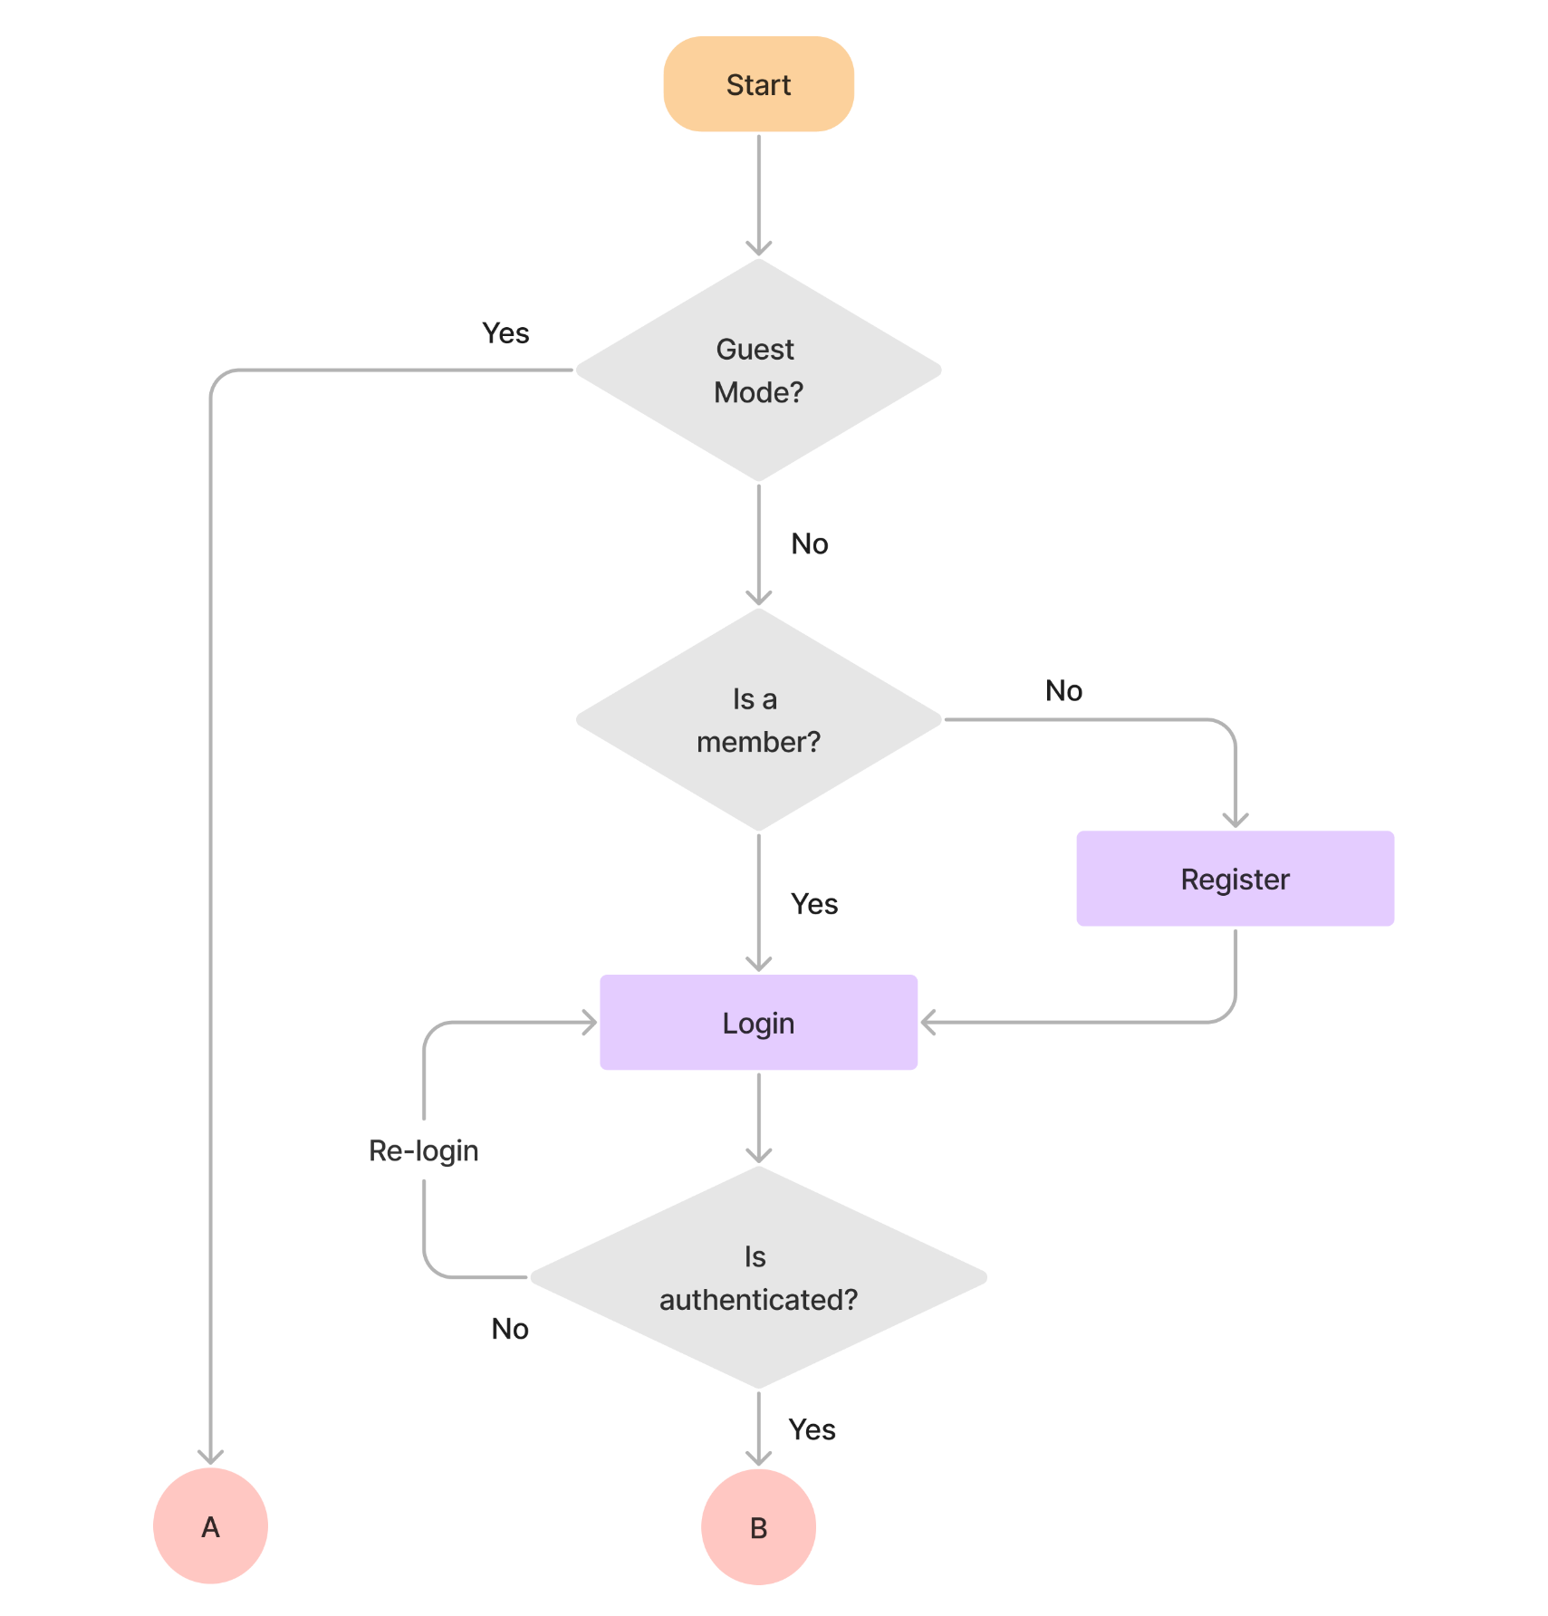
Proposed System

Slide 12
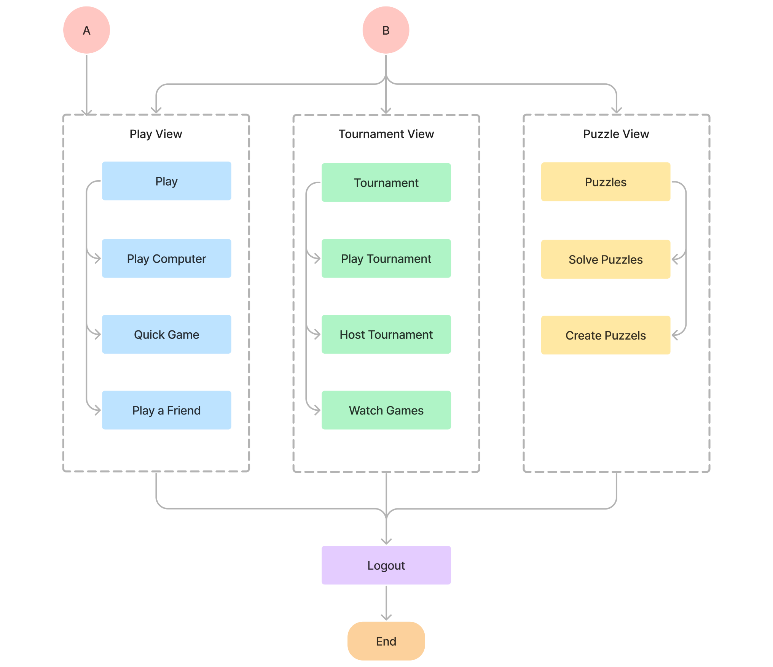
Proposed System
Fig.2 Application / Process Flow

Slide 13
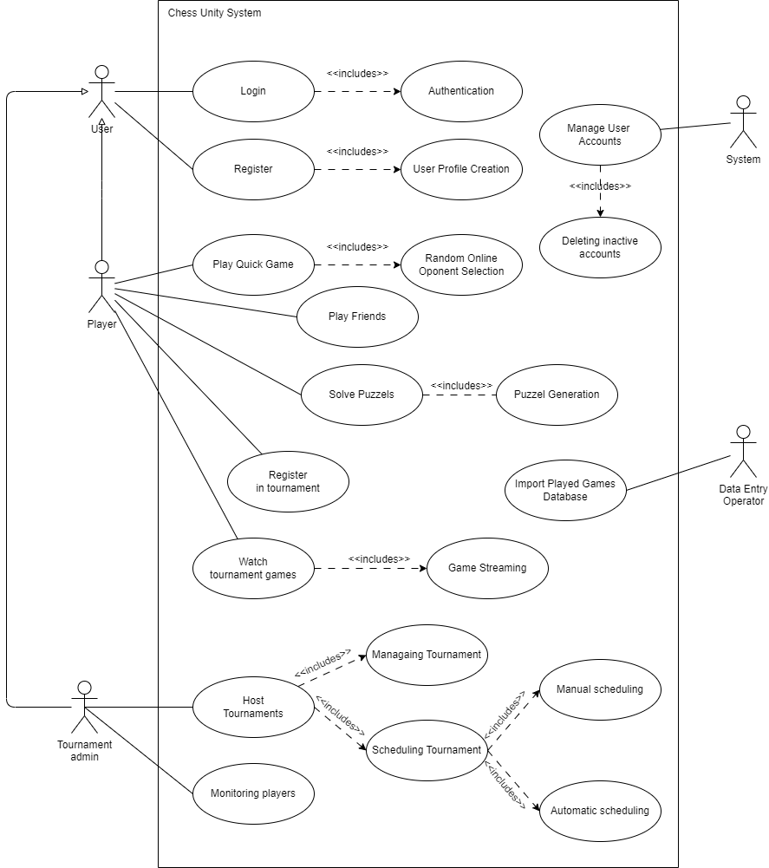
Proposed System
Fig. 3 Use Case Diagram

Slide 14
Tools and Technology Used
Frontend | React JS, Gsap, Ant Design
Backend | Node JS, Express JS, Socket.io, MongoDB, Redis
Tools | VS code, Github, PostMan
14

Slide 15
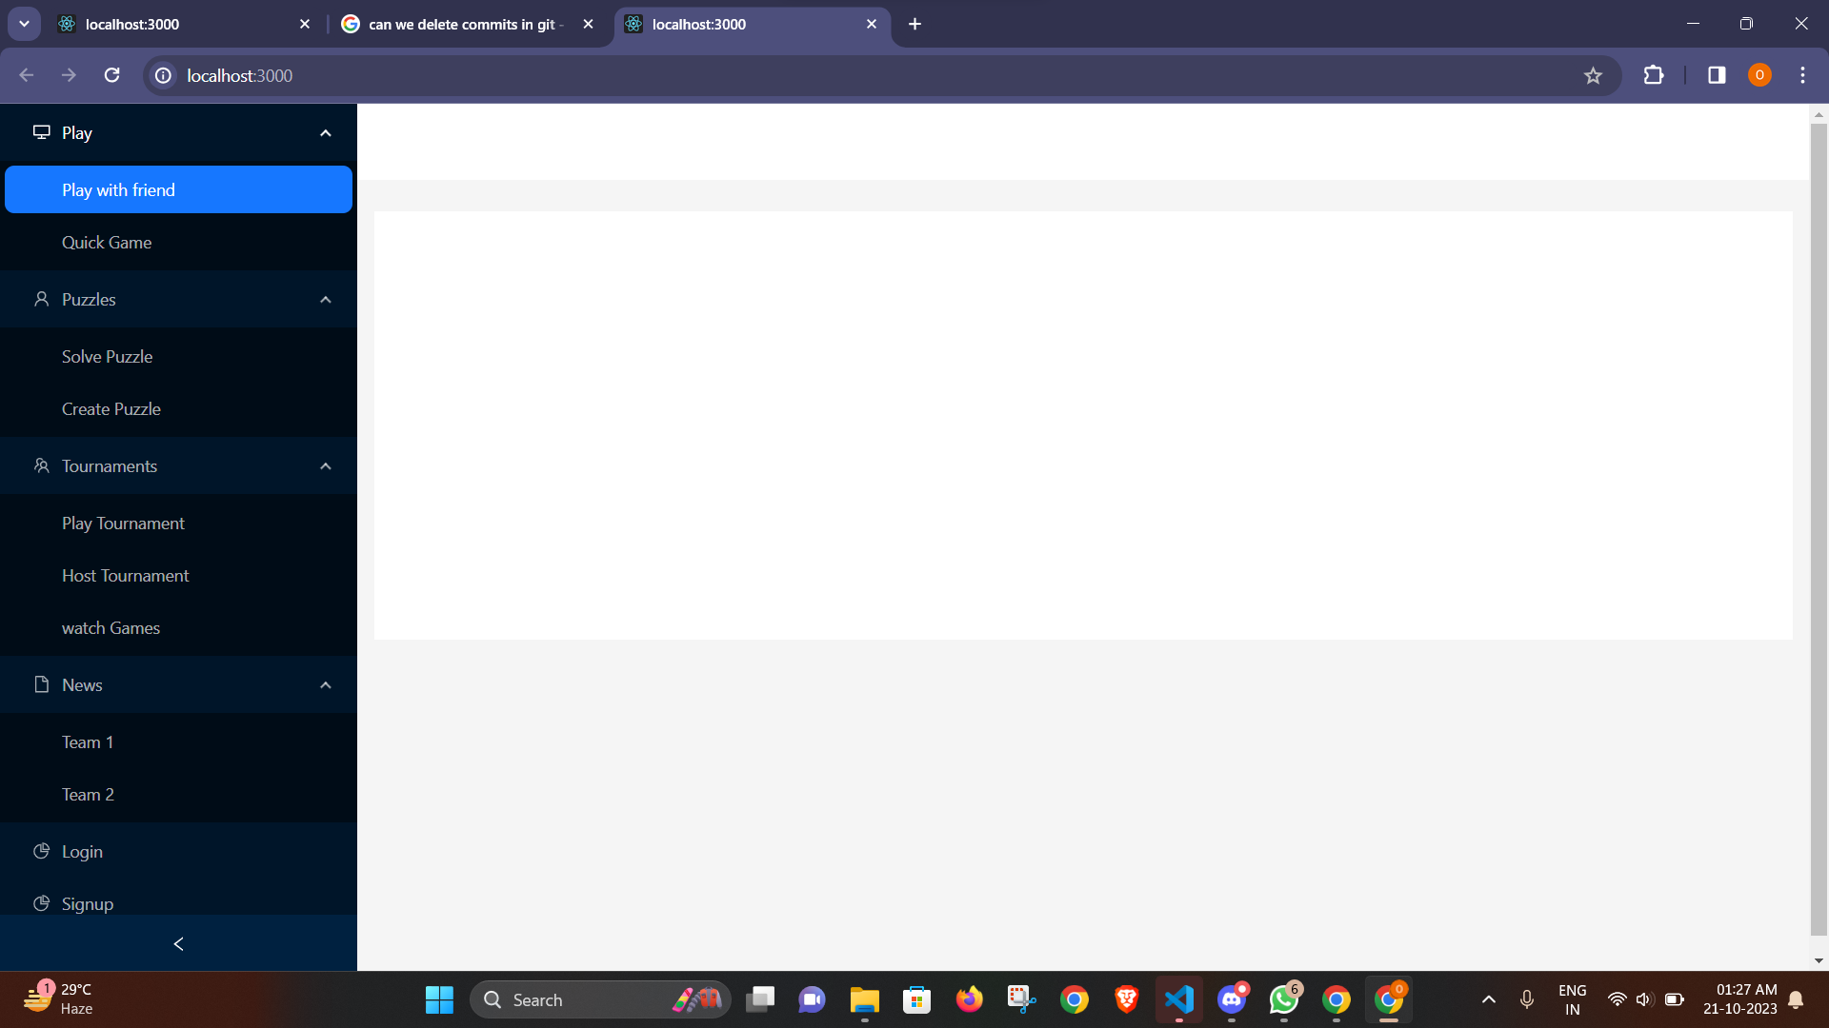
Experiments & Results
Fig.2 Application / Layout

Slide 16
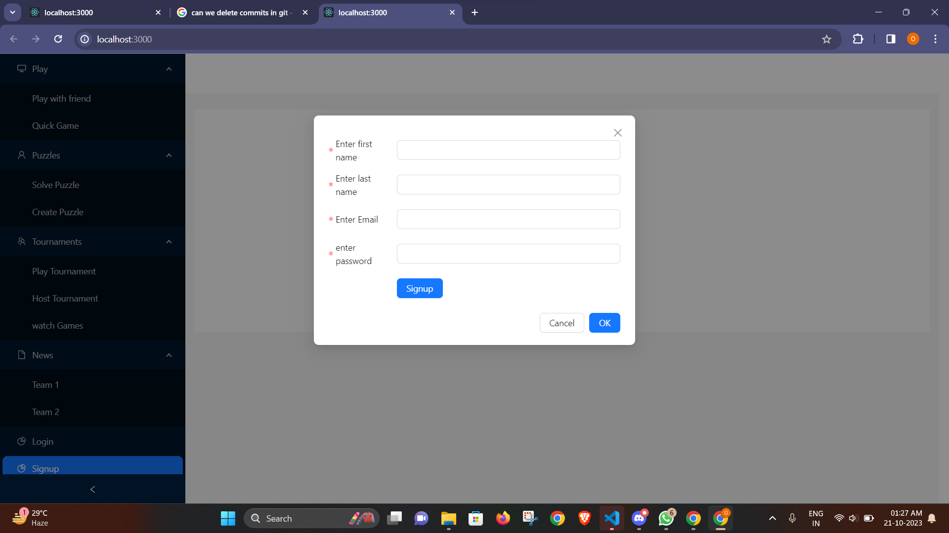
Experiments & Results
Fig.2 Application / Registration Layout

Slide 17
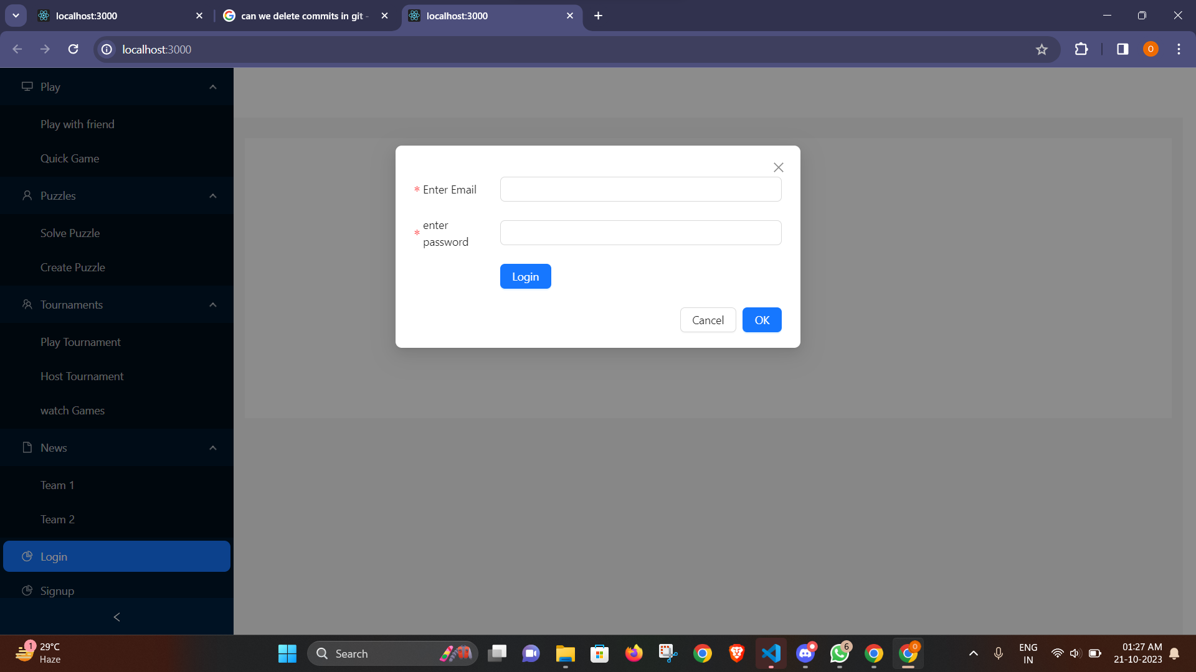
Experiments & Results
Fig.2 Application / Login Layout

Slide 18
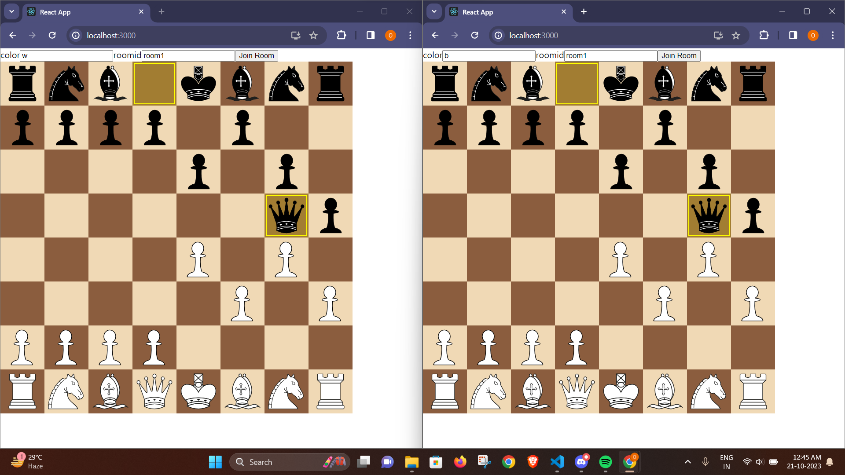
Experiments & Results

Slide 19
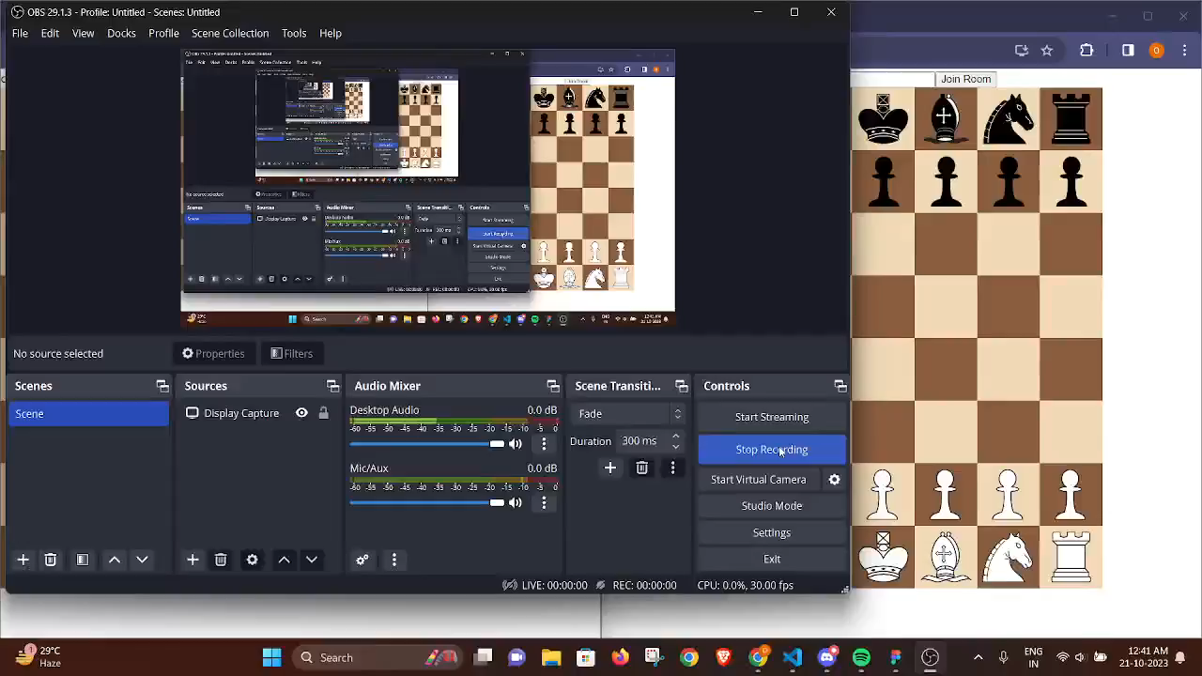
Simulation

Slide 20
Conclusion
In conclusion, ChessUnity stands as a dynamic and inclusive online chess platform, designed with a keen focus on accessibility and engagement for players of all skill levels. With its versatile gaming options, seamless integration of tournament hosting, and innovative features like video calls and puzzles.
Chess Unity not only enriches the chess-playing experience but also extends its reach to a diverse and enthusiastic gaming community. Chess Unity offers a comprehensive and enjoyable chess experience that goes beyond traditional boundaries.
20

Slide 21
References
[1] Yamada Habuki, Nobuka Kishi, Masato Oguchi, Miyuki Nakano, “A Method for Estimating Online Chess Game Player Ratings with Decision Tree.” IEEE International Conference on Big Data and Smart Computing (BigComp), Feb 2023, DOI:10.1109/BigComp57234.2023.00066
[2] Preet Karia, Vaibhav Jain, Monik Shah, Sarika Rane “Digitization of Chess Board and Predication of Next Move” IEEE International Conference for Convergence in Technology (I2CT) , July 2022, DOI: 10.1109/I2CT54291.2022.9825379
[3] Reyhan Patria , Sean Favian, Anggoro Caturdewa , Derwin Suhartono “Cheat Detection on Online Chess Game Using Convolutional and Dense Neural Network” International Seminar on Research of Information Technology and Intelligent Systems (ISRITI) , February 2022, DOI: 10.1109/ISRITI54043.2021.9702792
21

Slide 22
References
[4] Liu Jiasen, “Enhancing Chess Engine with a Personalized Quantitative Database.” IEEE Integrated STEM Education Conference (ISEC), March 2021, DOI:10.1109/ISEC52395.2021.9763951
[5] Azlan Iqbal, “An Algorithm for Automatically Updating a Forsyth-Edwards Notation String Without an Array Board Representation”, 8th International Conference on Information Technology and Multimedia (ICIMU), November 2020, DOI:10.1109/ICIMU49871.2020.9243487

Slide 23
Thank You !!!
23

