Slide 1
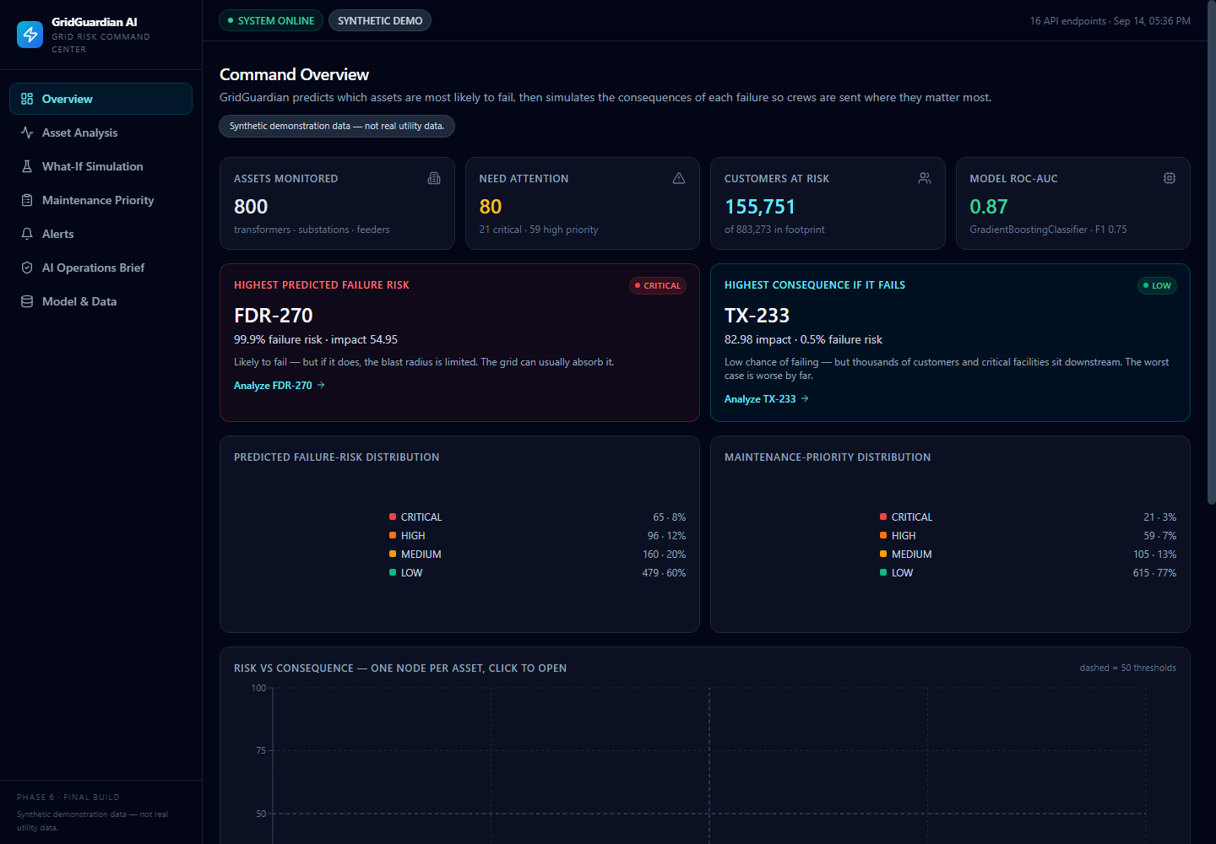
IBM BoB AI Innovation Hackathon 2026
GRIDGUARDIAN AI
Predict. Simulate. Prioritize. Respond.
A decision copilot for grid operators — predict failure risk, simulate the cascade, then tell the crew exactly what to fix first.
TEAM VOLTVISION
Live product view — GridGuardian operations dashboard
Aum Vaja — Team Lead
Vrunda Kotadiya Tarang Prajapati Riza Bhatt
GridGuardian AI · VoltVision · IBM BoB AI Innovation Hackathon 2026
01

Slide 2
02 — THE PROBLEM
Operators know what might fail. Not what to do about it.
Utility networks stream sensor data for every asset — load, temperature, vibration, age. The backlog dwarfs the crew:
WHEN DOES IT HAPPEN?
WHAT BREAKS WHEN IT FAILS?
WHAT DO WE FIX FIRST?
Predicting *when* a unit fails is only the first step.
A transformer can take down zones, hospitals, whole suburbs.
Three crews. 800 assets. The work order comes last.
THE DANGEROUS DEFAULT
Risk-only thinking sends the crew to the wrong transformer.
TX-104 risks failing at 98.32% but affects ~3,060 customers. TX-233 has 0.52% risk — yet its failure would hit 5,377 customers and a hospital.
GridGuardian AI · VoltVision · IBM BoB AI Innovation Hackathon 2026
02

Slide 3
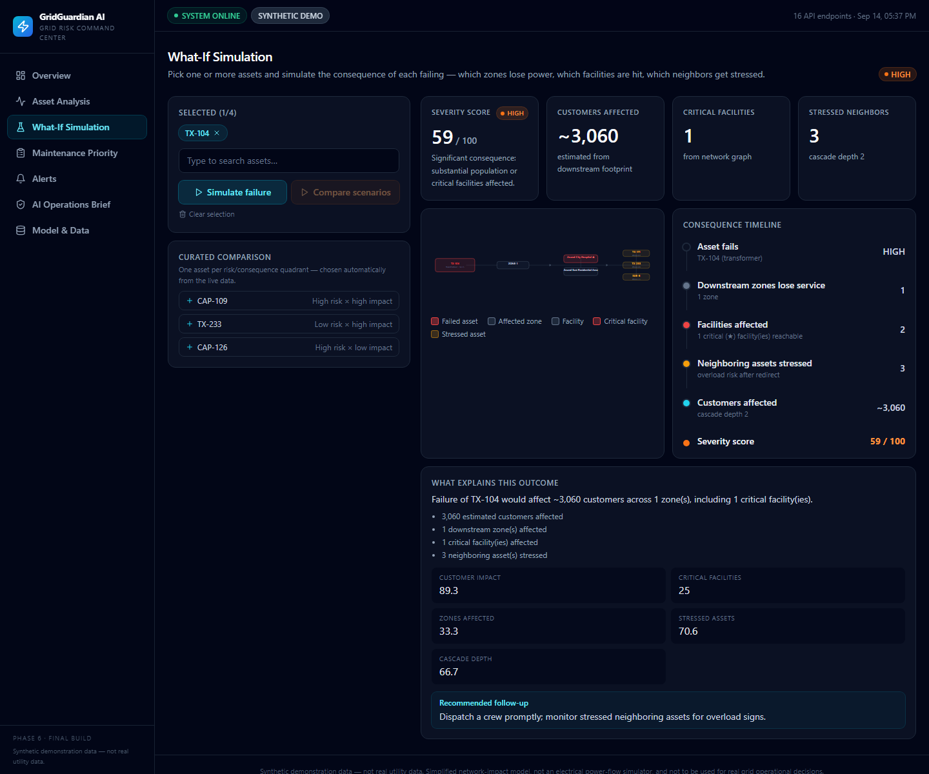
03 — THE PRODUCT
A decision copilot that chains four honest systems
DATA
→
PREDICT
→
SIMULATE
→
PRIORITIZE
→
EXPLAIN
gradient-boosted failure probability per asset
deterministic cascade — what breaks next?
risk × impact × urgency + crew allocation
LLM narrates a brief — from backend numbers only
• Failure probability (0–100) and risk category for every asset — not a black box.
• Graph-based impact: zones, critical facilities, customers, stressed neighbors.
• What-if on any asset, or compare four scenarios side by side.
• Transparent priority score and crew allocation that shows the uncovered gap.
• AI-ops brief generated strictly from structured backend facts.
Live — what-if simulation of TX-104 failure
GridGuardian AI · VoltVision · IBM BoB AI Innovation Hackathon 2026
03

Slide 4
04 — ENGINEERING
A strict, testable pipeline end to end
DATA
BACKEND — FastAPI + uvicorn
800 scored assets · sensors · network graph
↓
• Thin routers; logic only in tested services.
• Strict error contract: 400 / 404 / 422 / 500.
• pydantic-validated request/response models.
ML FAILURE PREDICTION
GradientBoostingClassifier · 21 features
↓
GRID IMPACT ASSESSMENT
networkx blast-radius walk
↓
ML & SIMULATION — deterministic
WHAT-IF SIMULATION
• scikit-learn + pandas; seed 42, reproducible.
• networkx 3.3 graph cascade for what-if.
• metrics.json + refs to split (640 / 160).
cascade: zones · facilities · customers
↓
PRIORITY ENGINE
risk × impact × urgency + crew allocation
↓
STRUCTURED RESULTS
JSON contract enforced by API tests
FRONTEND — React dashboard
↓
• 8 operator pages with risk views.
• Recharts visuals, dark operator theme.
• Deep-linkable what-if: /simulate?ids=…
AI OPERATIONS BRIEF
anthropic narration — key-gated
↓
OPERATIONS DASHBOARD
React · Vite · Tailwind · Recharts
GridGuardian AI · VoltVision · IBM BoB AI Innovation Hackathon 2026
04

Slide 5
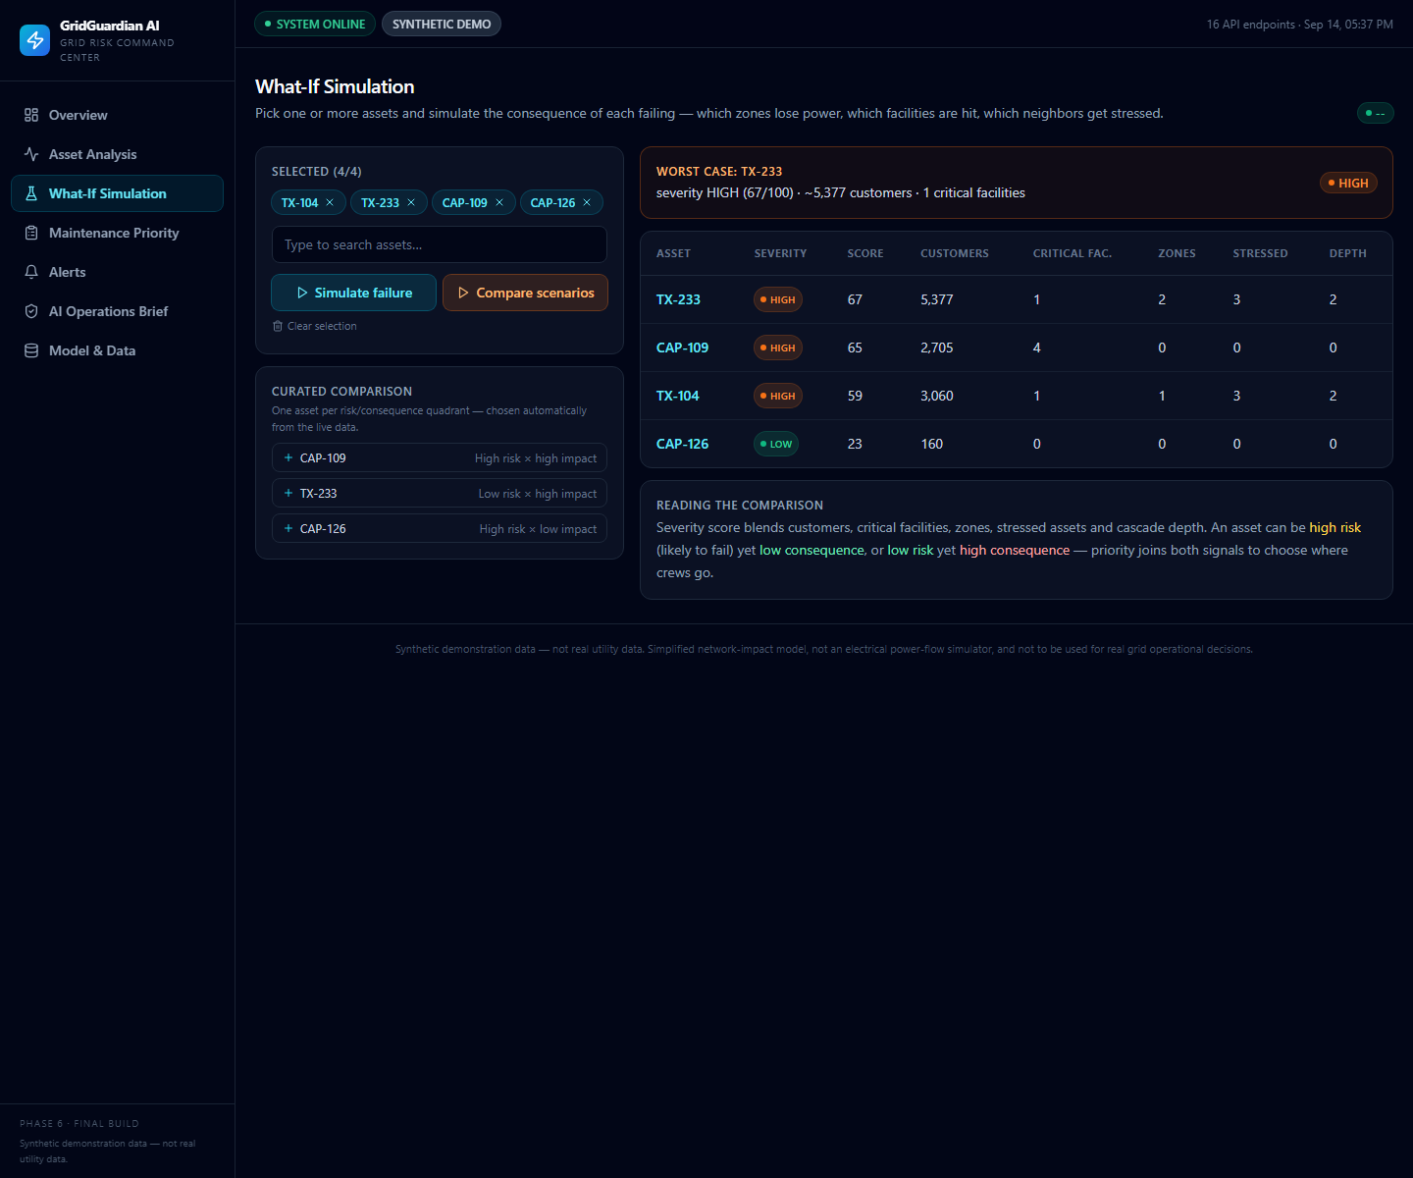
05 — KEY INSIGHT
Failure risk is not the same as operational impact
Metric
TX-104 — transformer
TX-233 — transformer
Predicted failure risk
98.32% HIGH
0.52% LOW
Grid impact score
70.97
82.98
Maintenance priority
71.29 HIGH
0.44 LOW
Simulated severity (if failed)
HIGH — 58.62
HIGH — 66.97
Customers affected (if failed)
~3,060
~5,377
Live — four what-if scenarios compared side by side
Critical facilities downstream
HOSP-1
HOSP-4 (ZONE-7/8)
Risk says “watch TX-104”. Consequence says “protect TX-233”.
GridGuardian AI · VoltVision · IBM BoB AI Innovation Hackathon 2026
05

Slide 6
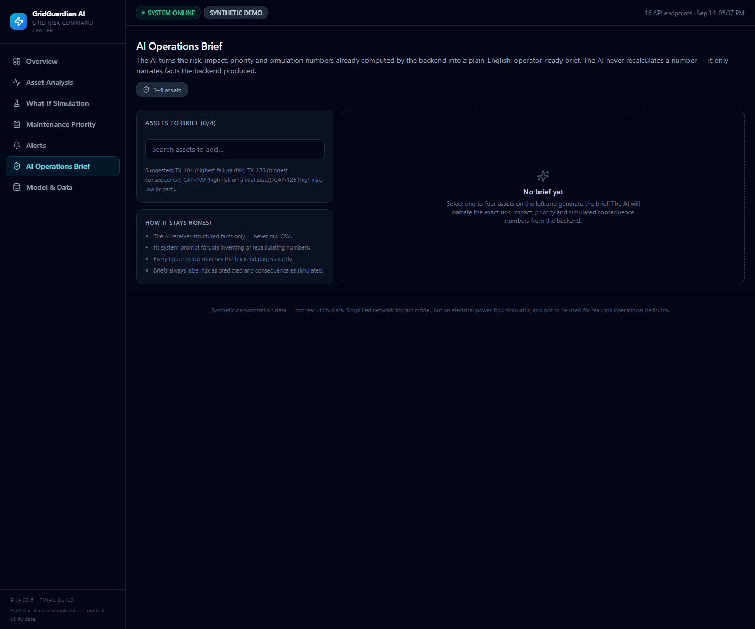
06 — INTELLIGENCE
Five layers, each with a named output
ML FAILURE PREDICTION — how likely
Gradient boosting probability per asset — the “when”.
GRID IMPACT ASSESSMENT — how big
Deterministic blast-radius across the network — the “blast”.
WHAT-IF SIMULATION — what breaks next
Cascade walk: zones, facilities, customers, severity score.
MAINTENANCE PRIORITY — what to fix first
Risk × impact × urgency score + crew allocation — the “call”.
GENERATIVE AI BRIEF — so anyone can act
Live — AI operations brief with the facts used
LLM narration built from structured facts only.
Generative AI is a narration / decision-support layer — it never calculates ML risk or impact.
GridGuardian AI · VoltVision · IBM BoB AI Innovation Hackathon 2026
06

Slide 7
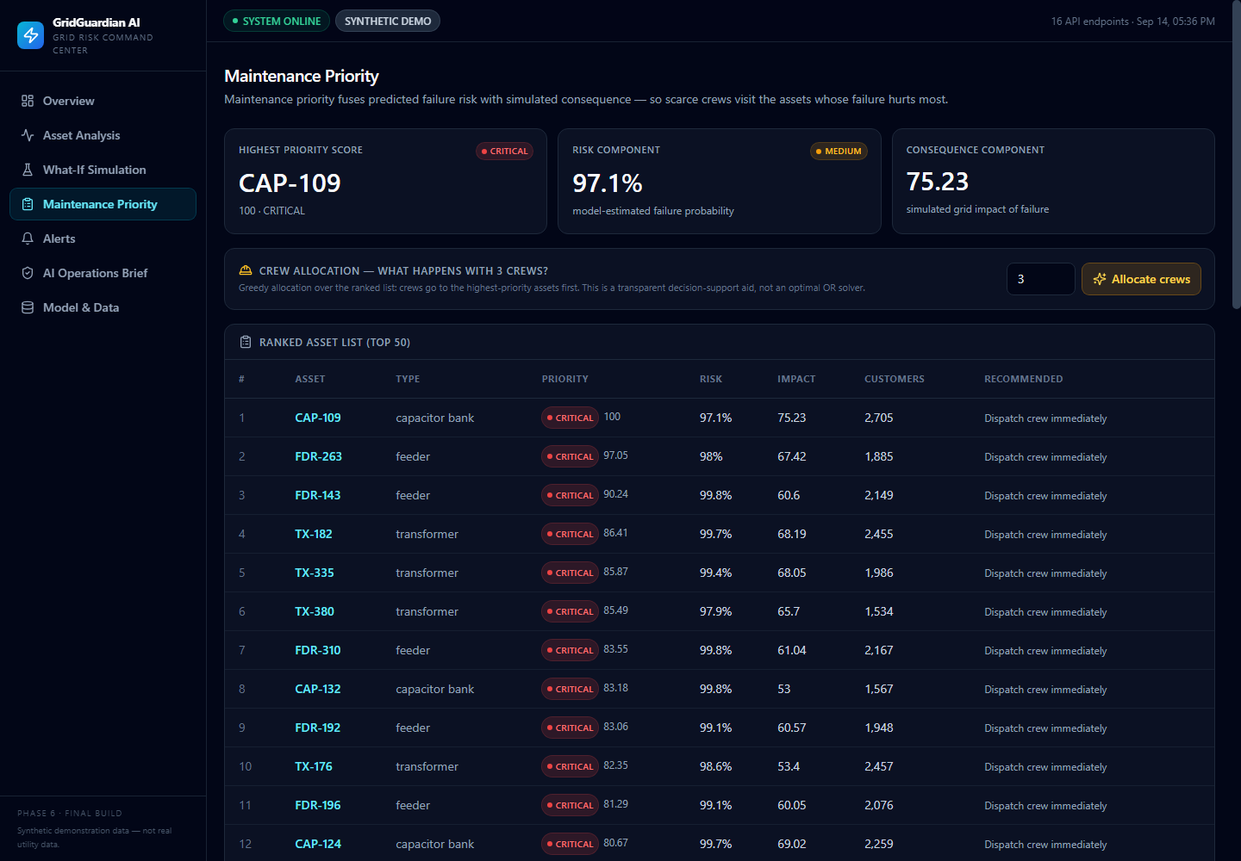
07 — EVIDENCE
Measured on the scoring engine's own output
800
0.8672
60
80
grid assets monitored
ROC-AUC on the 160-asset holdout
open alerts — 8 critical
critical / high-priority assets
RISK DISTRIBUTION ACROSS ALL ASSETS
● CRITICAL 65 ● HIGH 96 ● MEDIUM 160 ● LOW 479
MAINTENANCE PRIORITY ● CRITICAL 21 ● HIGH 59 ● MEDIUM 105 ● LOW 615
HONEST LIMITATIONS
• Synthetic, seeded demonstration data — labeled in-app, not real utility data.
• Cascade simulation is a deterministic graph walk — not a power-flow solver.
• Without an API key the app still works and says what to do.
Supports 155,751 customers behind critical / high-priority assets.
GridGuardian AI · VoltVision · IBM BoB AI Innovation Hackathon 2026
07

Slide 8
TEAM
WHY IT MATTERS
VOLTVISION · AI Track
“The grid doesn’t give operators more time — it gives them more data. GridGuardian turns that data into a decision, before the grid forces one.”
Aum Vaja — Team Lead
Vrunda Kotadiya — Member
Predict the risk. Simulate the failure. Prioritize the crew. Respond — before it happens.
Tarang Prajapati — Member
Riza Bhatt — Member
Synthetic demonstration data — not real utility data. Hackathon prototype.
GridGuardian AI · VoltVision · IBM BoB AI Innovation Hackathon 2026
08

