Slide 1
Make it Juicy!
10 easy methods to make your games more engaging
(An educational presentation for game devs)

Slide 2
What is Juice?
“Juice” was our wet little term for constant and bountiful user feedback. A juicy game element will bounce and wiggle and squirt and make a little noise when you touch it. A juicy game feels alive and responds to everything you do – tons of cascading action and response for minimal user input. It makes the player feel powerful and in control of the world, and it coaches them through the rules of the game by constantly letting them know on a per-interaction basis how they are doing.
- Kyle Gray, Kyle Gabler, Shalin Shodhan, Matt Kucic
http://www.gamasutra.com/view/feature/130848/how_to_prototype_a_game_in_under_7_.php

Slide 3
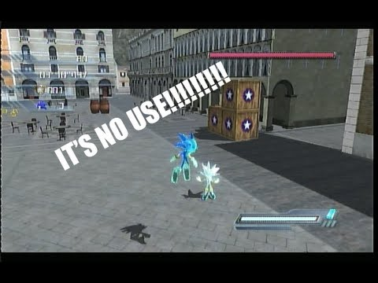
Important Note
Juice can only help good games

Slide 4
Start Demonstration
Make it fast
Give it audio
Animate it
More particles
Add physics
Shake that camera
Hand out those scores
Interactive background
Post-processing effects
Know when not to use juice

Slide 5
Make it faster!
Too much clicking to stay level
  Not giving enough control to the player
Make the bird fall faster
  Need to balance out new upward force
  Plus, Unity default gravity settings suck, anyways
Make the obstacles come faster
  Too much waiting

Slide 6
Give it sound!
Add sound per action & reaction
  Creates a new stimulus
Change the sound effect for frequent actions often
  Randomize pitch
  Keeps sound from getting to repetitive
Add background music
  Great for mood

Slide 7

Animate it!
Move everything!
  Gives a sense of context
  Also makes it look speedy
Animate the character
  Gives the character personality
  Immediate feedback
Animate the stalagmites and stalactites
  Indicates what you hit

Slide 8
More particles!
Add particles to emphasize every action
  More feedback!
  Also, it looks cool
Make the stalagmites and stalactites collapse
  Reward passing through barriers
Add background particles
  Makes things more interesting

Slide 9
Camera shakes!
Camera shakes are awesome, but deadly
  Any effect that take up the whole screen is deadly
  Make sure they're used sparingly
  If the user made the shake happen, it's much more tolerable
Good for clearing obstacles
  Gives context to the physics effect
Awesome for getting hurt
  Something that needs immediate attention

