Slide 1


SANDIP FOUNDATION’S
SANDIP POLYTECHNIC, NASHIK. [2024-25]
A Report on MSBTE Implant Training Completed at
Industry Name
AN IMPLANT TRAINING REPORT SUBMITTED IN PARTIAL FULFILLMENT OF THE REQUIREMENTS FOR THE
DIPLOMA IN Computer Engineering (CO).
SUBMITTED BY
Om Jagannath Kakulte
UNDER THE SUPERVISION OF
Industrial Supervisor name

Slide 2
INTERNSHIP REPORT PRESENTATION
By:-Om Jagannath Kakulte
TYCO student

Slide 3

V3 Data Solutions
V3 Data Solutions is a top software and data management firm. This company excel at turning your specific needs into custom projects using the latest technologies. This company focuses on delivering high-quality, innovative solutions tailored to your unique requirements. Serving various industries, It ensure each solution is well-designed and effective. Committed to quality and excellent customer service, we take pride in supporting your IT projects and helping you succeed.
This company was established around 12 years ago and has been providing customers with the software they need ever since.
3

Slide 4

Overview of 45-Day Web Development Internship Program
Title: 45 Days Implant Internship in Web Development
Overview of the internship program focused on
web development
Duration: 45 days of intensive learning and practical application
Topics covered: HTML, CSS, C, C++and project- based learning
Objective: To equip participants with the skills necessary to develop functional and visually appealing websites

Slide 5

Slide 2 : Objectives
+ Title: Objectives
To provide hands-on experience in web development
To introduce participants to essential programming
languages: C, C++, HTML, CSS, and SQL
To develop a strong understanding of frontend and
backend development
To complete a comprehensive web development project by the end of the internship
To foster problem-solving skills and teamwork in a real- world environment

Slide 6

Slide 3 : Steps Followed
+
Title: Steps Followed
Introduction to Programming: Basics of C and C++ languages
Introduction to Web Development: Understanding HTML and CSS
Hands-on Practice: Writing and testing code, building simple web pages
Advanced Topics: Delving deeper into CSS styling, SQL databases, and dynamic content
Project Work: Collaborative web development project to apply learned skills
Final Review and Submission: Revisiting all topics, finalizing the project, and submitting reports

Slide 7

Slide 4 : HTML Structure
+
Title: HTML Structure
Overview of HTML as the backbone of
web development
Basic Elements: Tags, attributes, and document structure
HTML5 Features: New elements and
APIs for modern web development
Practical Application: Creating structured and semantically correct web pages

Slide 8

Slide 5 : CSS Styling
+ Title: CSS Styling
Introduction to Cascading Style Sheets for web design
Styling Methods: Inline, internal, and external CSS
Selectors and Properties: How to target HTML elements and apply styles
Responsive Design: Using media queries to ensure
compatibility across devices
Advanced Techniques: Animations, transitions, and transformations for dynamic user interfaces

Slide 9
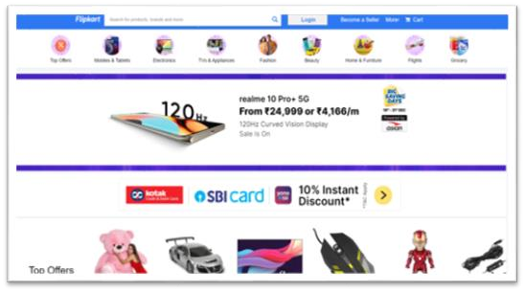
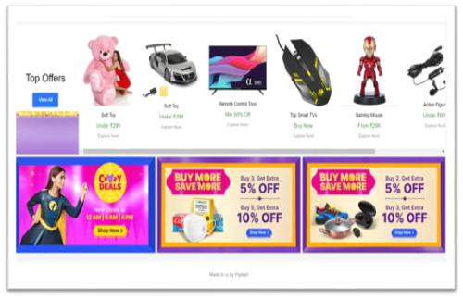
Slide 6 :output of flipkart clone

Slide 10


Slide 6 : Key Features
+ T
Title: Key Features
HTML: Structure and content organization for web pages
CSS: Visual styling and layout management
C/C++: Understanding of fundamental programming
concepts
SQL: Managing and interacting with databases
Project Work: Application of all learned skills in a comprehensive project
Team Collaboration: Working in groups to simulate a real-world development environment

Slide 11
Slide 7: Problems Faced
+ Title: Problems Faced
Learning Curve: Adjusting to new programming languages and technologies
Debugging Issues: Identifying and fixing errors in code
Responsive Design Challenges: Ensuring consistent appearance across different devices and browsers
Project Coordination: Managing time and responsibilities within the team
Database Integration: Handling data efficiently using SQL

Slide 12
Slide 8: Conclusion
+ Title: Conclusion
The 45-day internship provided a comprehensive introduction to web development
Participants gained valuable hands-on experience with HTML, CSS, SQL, and more
Successfully completed a project that demonstrated their skills and learning
The internship laid a strong foundation for
further exploration in web development

Slide 13
Slide 9 : Learning Outcomes
+
Title: Learning Outcomes
Technical Skills: Mastery of web development technologies Problem-Solving: Enhanced ability to debug and optimize code
Project Management: Experience in handling a complete project
from start to finish
Collaboration: Improved teamwork and communication skills within a
development environment
Career Readiness: Equipped with the skills to pursue further
education or employment in web development

