Slide 1
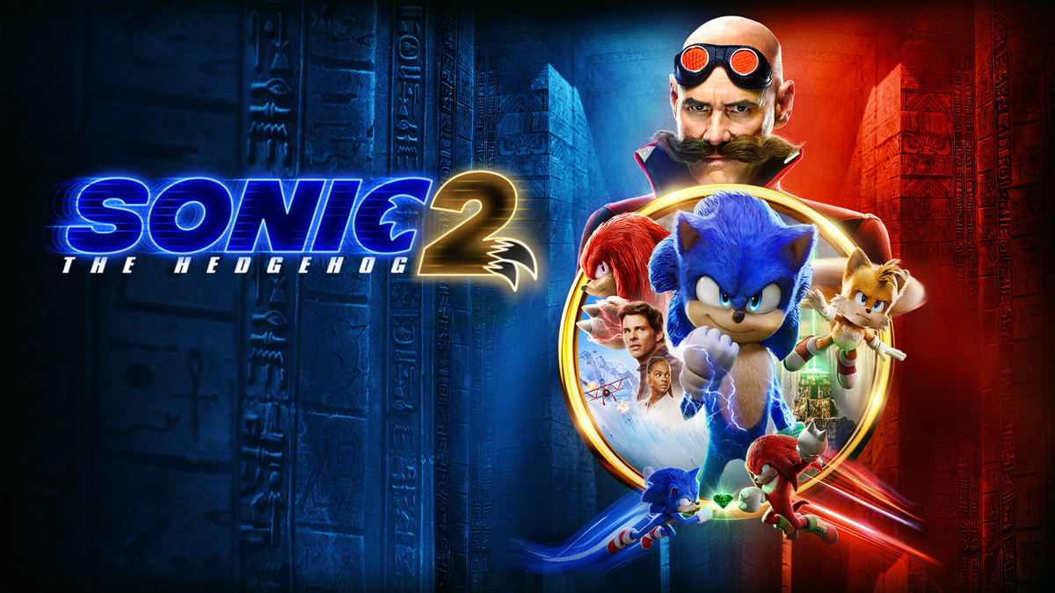
SONIC 2
Anarkulov Omurbek 11-24

Slide 2
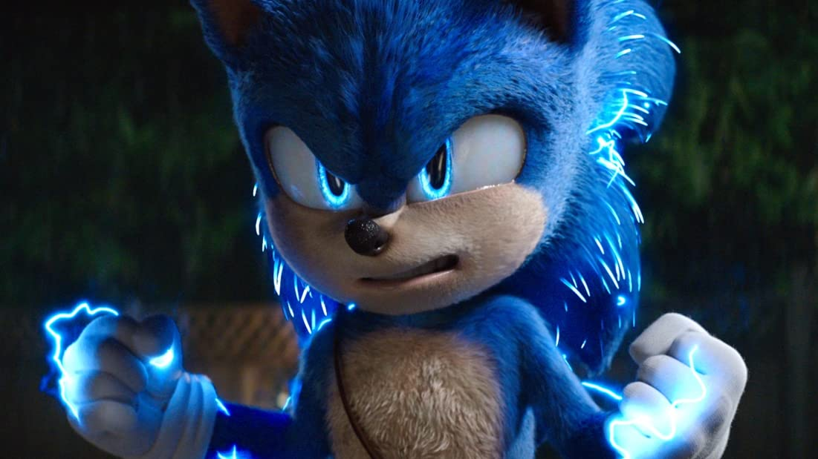
Briefly about the film
In this movie, Sonic is a guy who can run really fast. He has a friend named Tails. Together, they try to stop Dr. Robotnik, who wants to take over the world.

Slide 3
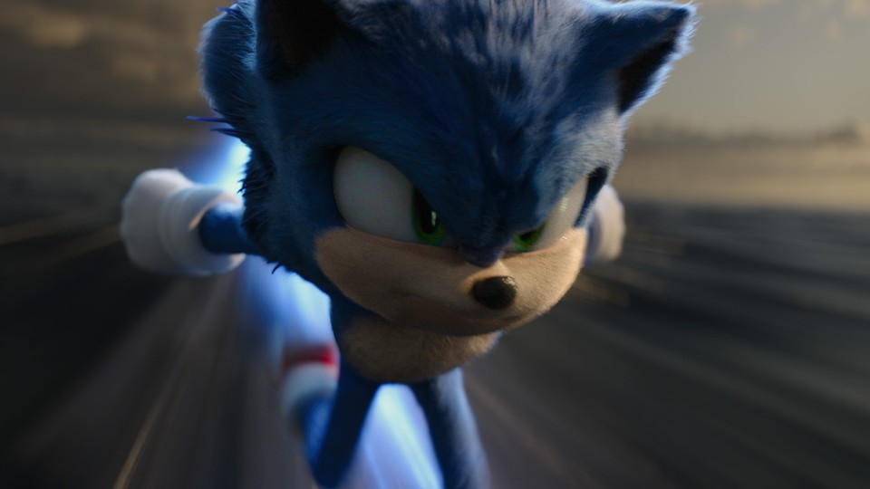
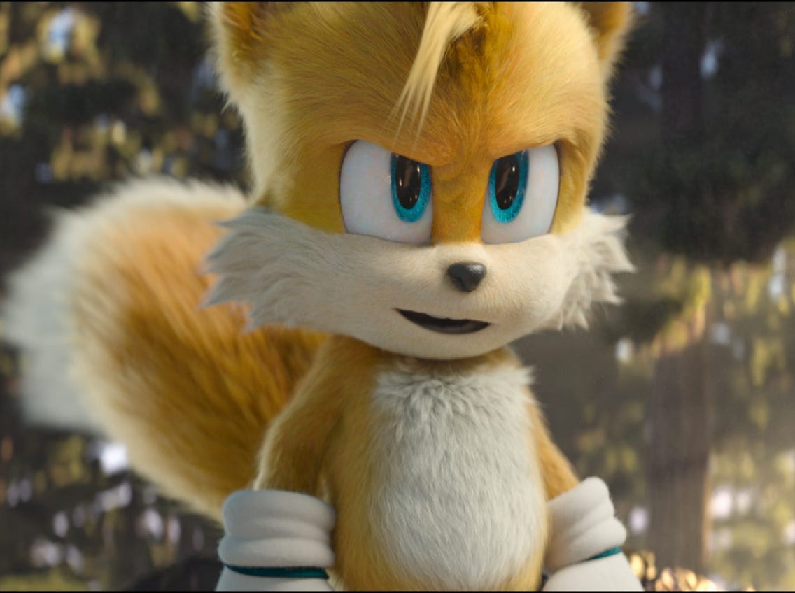
My favorite Characters
Tails : Sonic’s best friend. He is smart
Sonic :The main character
Fast and Brave

Slide 4
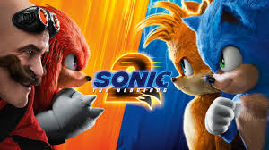
What I understood
The movie teaches us about friendship and teamwork

Slide 5
Thank you for your attention

