Slide 1




DEPARTMENT OF INFORMATION TECHNOLOGY
B.Tech. (Information Technology)
Semester VI –Community Engagement PBL-Major Project
Project title : Intelligent AI-Assisted Trading Simulation System
Team Members:
Bhumi Khona 44
Nandan Khatod 43
Omkar Kulkarni 47
Under the guidance of :
Dr. Seema Yadav

Slide 2
INTRODUCTION
Financial markets are highly dynamic and complex.Traditional trading relies on human analysis, which can be slow and error-prone.With the rise of Artificial Intelligence (AI), trading systems can now analyze large datasets quickly.
An AI-assisted trading simulation system allows users to test strategies in a risk-free environment.It helps traders make data-driven decisions without real financial loss.

Slide 3
OBJECTIVES
Objectives
  To develop an intelligent trading simulation platform
  To analyze stock market data using AI algorithms
  To provide real-time decision support
  To simulate trading strategies without financial risk
  To improve accuracy using machine learning models

Slide 4
METHODOLOGY
Data Collection: Stock market data is collected using APIs.
Data Preprocessing: The collected data is cleaned and normalized to remove inconsistencies.
Model Application: Machine learning and deep learning models are applied to analyze patterns.
Strategy Generation: Based on model outputs, buy/sell signals are generated.
Trade Simulation: Trades are executed in a virtual environment to mimic real market conditions.
Performance Evaluation: The system evaluates profit/loss and other performance metrics.

Slide 5
TECH STACK
  Frontend developed using React (MERN stack)
  Backend using Node.js & Express
  ML algorithms implemented using Python
  Order matching engine using C++

Slide 6
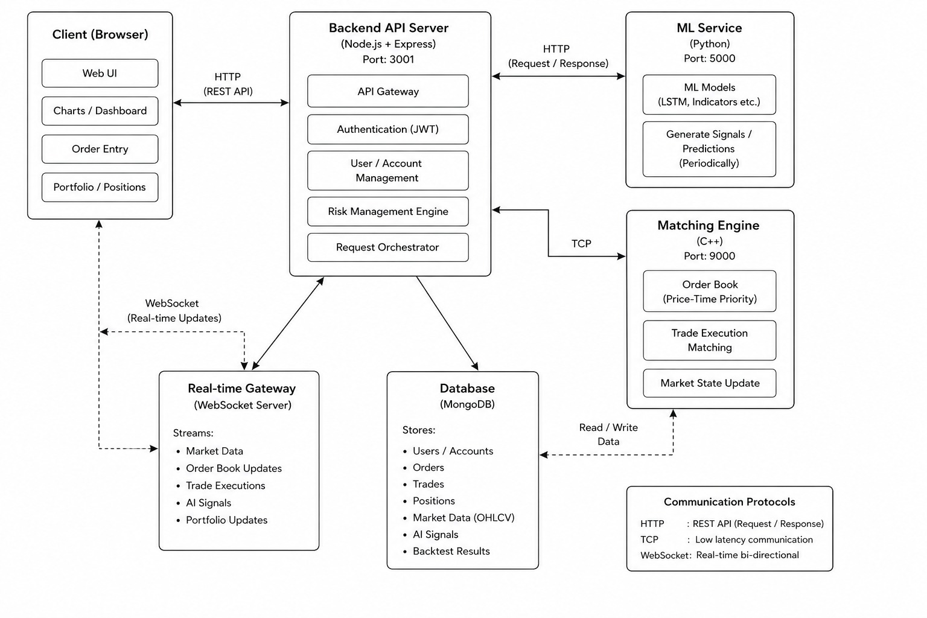
SYSTEM ARCHITECTURE DIAGRAM

Slide 7
LITERATURE SURVEY
Sr. No. | Literature | Published | Key Findings
1 | Stock Price Prediction using LSTM Networks | Fischer & Krauss (2018) | Demonstrated LSTM’s ability to capture time-series dependencies in stock data for better forecasting.
2 | Sentiment Analysis for Financial Markets | Bollen et al. (2011) | Used sentiment to predict stock market movements; showed correlation between mood and market trends.
3 | AI in Financial Trading Systems: A Survey | Zhang et al. (2020) | Provided overview of AI techniques in trading including ML, NLP, and RL; highlighted challenges like volatility and risk.
4 | Simulation-Based Trading Systems using AI | Li et al. (2021) | Proposed trading simulators for testing AI strategies without real risk; useful for training and validation.

Slide 8
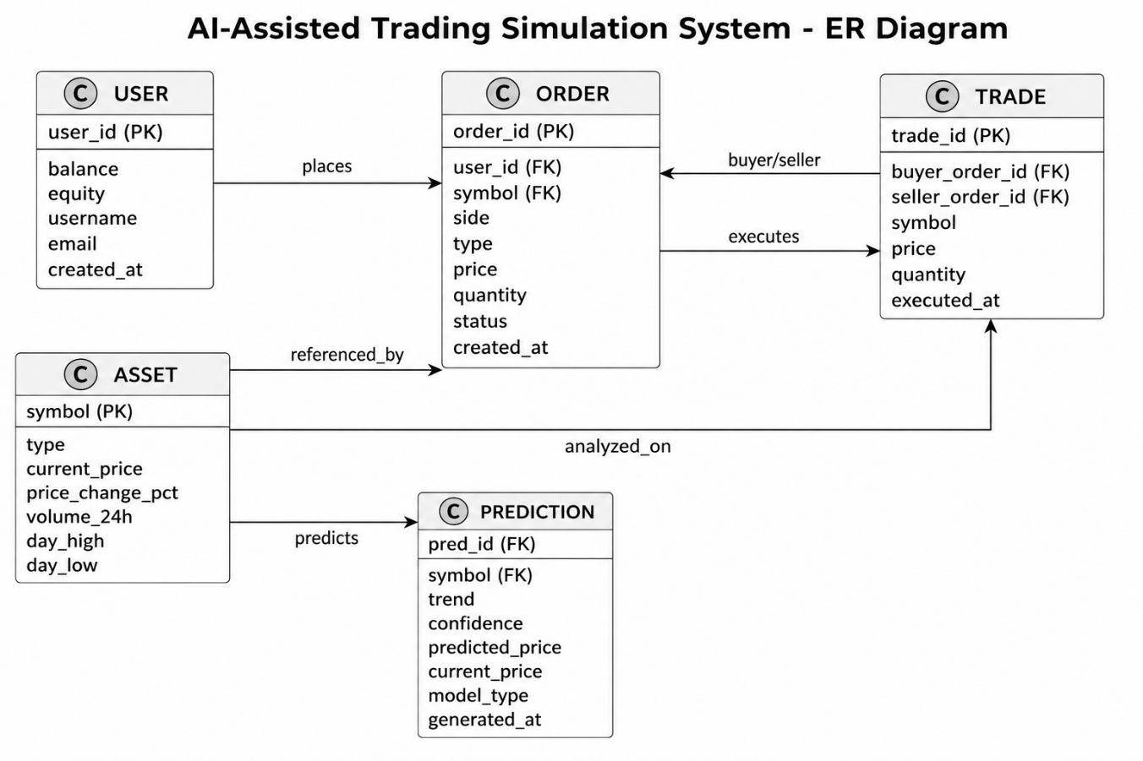
ER DIAGRAM

Slide 9
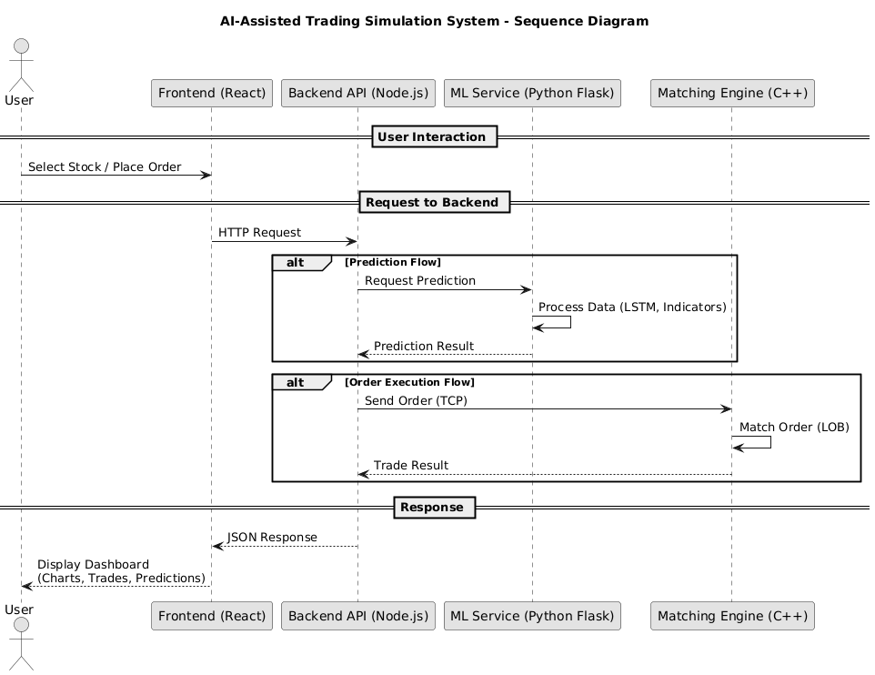
SEQUENCE DIAGRAM

Slide 10
RESULT
  Created a working interface where users can explore trading options in an easy and interactive way
  The system gives basic suggestions like “Hold” with a confidence level to guide user decisions
  Allows users to place buy and sell orders to understand how trading works
  Helps beginners learn trading concepts in a safe environment without any financial risk
  Builds a base for adding smarter predictions and real-time features in the future

Slide 11
CONCLUSION
The system integrates prediction with a full-stack trading architecture to simulate real-world market behavior. It enables users to analyze trends and execute trades through a matching engine in a risk-free environment. The platform can be further improved using real-time data integration and advanced techniques like reinforcement learning and sentiment analysis.

Slide 12
REFERENCES
[1] J. Patel, S. Shah, P. Thakkar, and K. Kotecha,
“Predicting stock and stock price index movement using trend deterministic data preparation and machine learning techniques,”
Expert Systems with Applications, vol. 42, no. 1, pp. 259–268, 2015.
[2] M. Dixon, D. Klabjan, and J. H. Bang,
“Classification-based financial markets prediction using deep neural networks,”
Algorithmic Finance, vol. 6, no. 3–4, pp. 67–77, 2017.
[3] J. Moody and M. Saffell,
“Learning to trade via direct reinforcement,”
IEEE Transactions on Neural Networks, vol. 12, no. 4, pp. 875–889, 2001.
[4] T. Fischer and C. Krauss,
“Deep learning with long short-term memory networks for financial market predictions,”
European Journal of Operational Research, vol. 270, no. 2, pp. 654–669, 2018.

Slide 13
Thankyou

