Slide 1


A Quantitative Methodology for Forecasting Electric Vehicle Proliferation and its Implications for Infrastructure Provisioning
Name : Om Kiran Kadam
Student ID : 2124UDSM2013
AICTE ID : STU670e8cec090da1729006828

Slide 2

Learning Objectives
Proficiency in the Machine Learning Lifecycle: This covers the entire process of a machine learning project from beginning to end. It includes cleaning and preparing the data, creating new, informative features from that data, and scientifically tuning the model's settings to ensure it performs as accurately as possible.
Development of a RandomForestRegressor for Time-Series Forecasting: This refers to the specific skill of building a powerful type of machine learning model called a RandomForestRegressor. This model is particularly good at understanding complex, non-linear patterns in data that changes over time, making it ideal for forecasting future trends.
Deployment of a Predictive Model via an Interactive Web Application: This objective demonstrates the ability to take a completed, complex machine learning model and make it accessible and useful to a non-technical audience. This was achieved by building a web application with Streamlit, which provides a user-friendly interface for interacting with the model's predictions.
GOAL
Source :
www.freepik.com/

Slide 3
Tools and Technology used
Core Programming Language: Python: Selected for its status as the industry standard for data science and its extensive ecosystem of powerful libraries.
Core Data Science and Machine Learning Libraries:
Pandas and NumPy for efficient data manipulation and structuring.
Scikit-learn for its comprehensive suite of robust ML algorithms, including RandomForestRegressor and RandomizedSearchCV.
Joblib for model persistence, enabling efficient storage and retrieval.
Data Visualization Libraries: Plotly and Seaborn: Utilized to generate interactive and informative data visualizations that effectively communicate complex data trends.
Web Application Framework: Streamlit: Selected for its efficiency in transforming Python scripts into shareable, interactive web applications, which accelerated the delivery of the final solution.

Slide 4
Methodology
Data Preprocessing and Purification: The initial phase involved loading the historical EV dataset and executing a meticulous data purification process, including handling missing values and managing statistical outliers using the IQR method. This formed a solid foundation for model training.
Feature Engineering and Model Construction: Critical time-series features, such as monthly lags and rolling averages, were engineered to provide the model with essential temporal context. A RandomForestRegressor was then trained on this enriched dataset and optimized using RandomizedSearchCV with three-fold cross-validation to prevent overfitting.
Model Evaluation and Deployment: The model's performance was rigorously evaluated on a held-out test dataset. Upon confirming a high R-squared score, the finalized model was serialized and integrated as the core predictive engine of the interactive Streamlit application.

Slide 5
Problem Statement:
Sub-optimal Allocation of Resources: Resulting in either inadequate public charging infrastructure in high-demand areas or the costly overbuilding of underutilized assets in regions with slower adoption.
Potential for Grid Destabilization: Arising from unanticipated surges in localized electricity demand from concentrated vehicle charging, which can strain local transformers and distribution networks.
Ineffective Policy and Incentive Planning: Governments and municipalities struggle to design and target financial incentives, such as rebates and tax credits, without a clear understanding of which regions require the most encouragement to accelerate EV adoption.
Unrealized Commercial Opportunities: Automotive dealerships, service centers, and related businesses may fail to identify emergent high-growth regions, leading to poor inventory management and missed market share.
Environmental Impact Miscalculation: Accurate forecasting is essential for estimating the true environmental benefits of electrification, such as reductions in greenhouse gas emissions at a local level, which is critical for policy reporting and climate goal tracking.

Slide 6
Solution:
The Predictive Engine: At the core of the solution resides a highly-tuned Random Forest model. This sophisticated ensemble model was algorithmically trained to recognize and extrapolate complex, non-linear growth patterns from extensive historical county-level data. By aggregating the predictions of hundreds of individual decision trees, the model effectively captures the nuanced interplay of seasonal trends, growth momentum, and other latent factors, providing a forecast that is both robust and sensitive to local conditions.
The Interactive Dashboard: This powerful model is encapsulated within a user-friendly Streamlit web application that serves as the primary interface for stakeholders. This approach democratizes access to predictive insights, removing technical barriers and empowering users to conduct their own exploratory analysis. By selecting a county from a simple dropdown menu, a user can instantly visualize its historical EV adoption trajectory alongside a clear and intuitive 24-month forward-looking projection, transforming abstract data points into a compelling narrative for strategic discussion and decision-making.
GitHub Repo : https://github.com/Omkadam01/AICTE-Internships/tree/main/Shell-Edunet-Skills4Future-AI

Slide 7
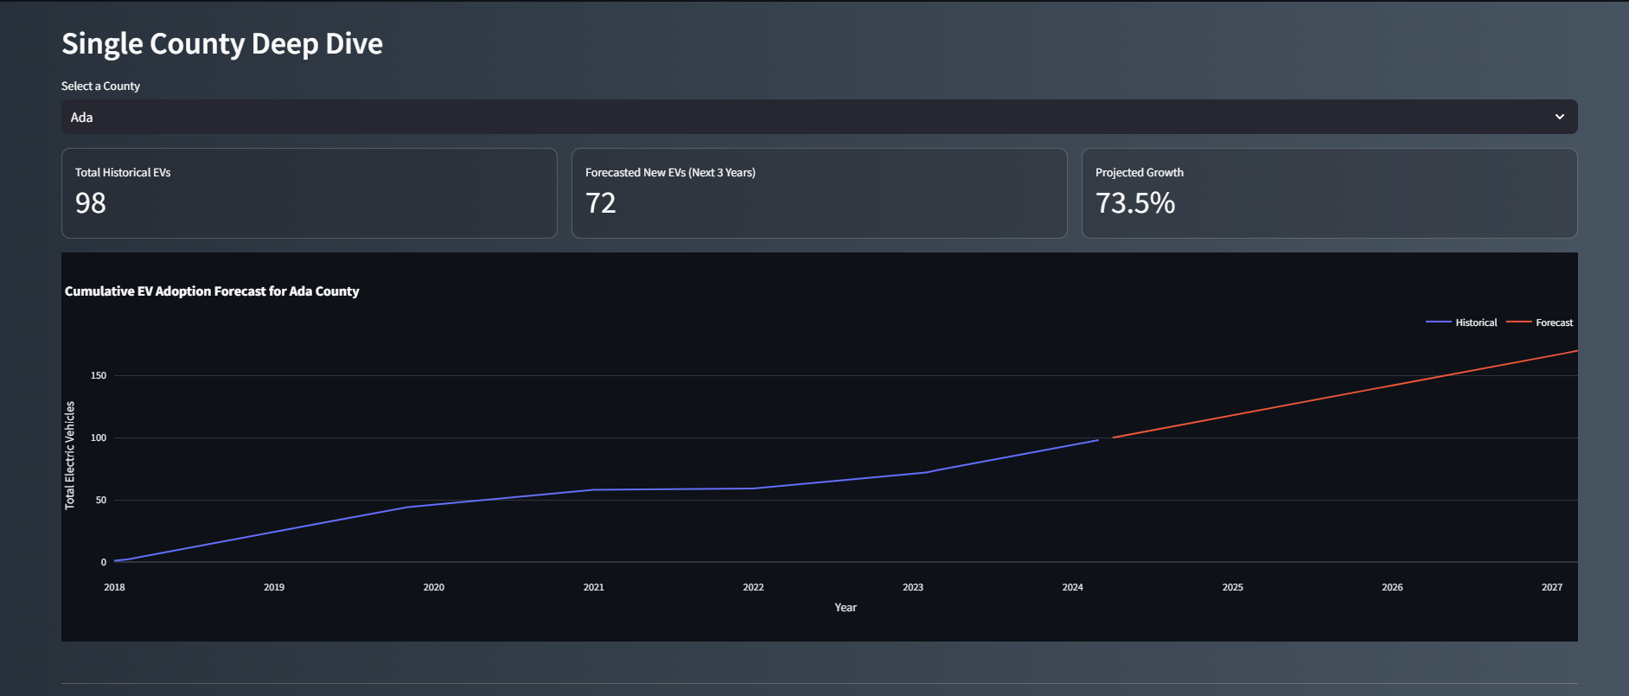
Screenshot of Output:
Figure 1: Single-County Forecast Visualization

Slide 8
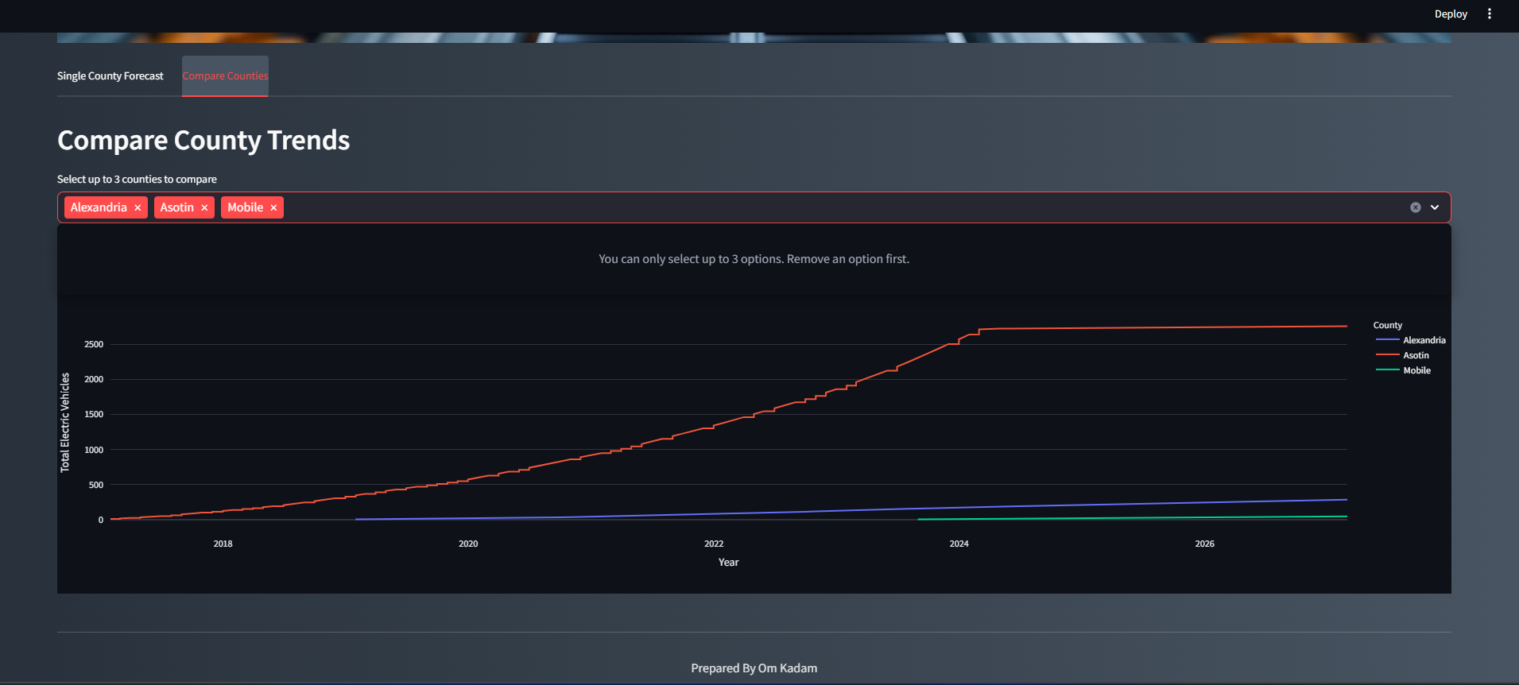
Screenshot of Output:
Figure 2: Multi-County Comparative Analysis

Slide 9
Conclusion:
In summary, a forecasting model of high predictive accuracy was successfully developed, attaining an R-squared of 0.99 on the test dataset. This result indicates the model can account for 99% of the variance in the historical data, instilling high confidence in its predictive capabilities. This project substantiates the utility of applied machine learning in de-risking strategic planning for a sustainable future.
Recommendations for Future Research:
Integration of Exogenous Data: Model accuracy could be improved by incorporating external datasets, such as econometric or demographic data.
Evaluation of Alternative Modeling Paradigms: A formal exploration of specialized time-series models, such as LSTMs, is warranted to potentially capture more subtle, long-term dependencies.
Augmentation of Application Functionality: The introduction of a "what-if" scenario analysis module would represent a significant enhancement, evolving the tool from a predictive instrument to a strategic simulator.

