Slide 1
GUESS COMPANY LOGOS

Slide 2


Slide 3
ACCENTURE

Slide 4


Slide 5
ADIDAS

Slide 6


Slide 7
CAFÉ COFFEE DAY

Slide 8


Slide 9
CAP GEMINI

Slide 10


Slide 11
COGNIZANT

Slide 12


Slide 13
DABUR

Slide 14


Slide 15
LENS KART

Slide 16
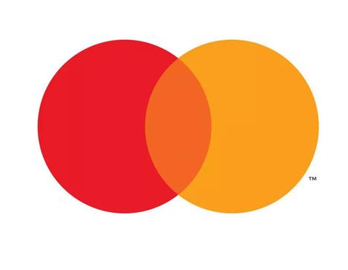

Slide 17
MASTER CARD

Slide 18


Slide 19
SBI

Slide 20


Slide 21
VODAFONE

Slide 22
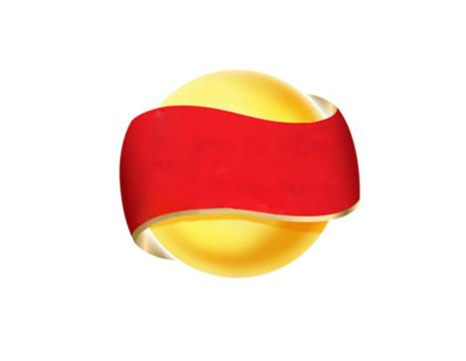

Slide 23
LAYS

Slide 24


Slide 25
SKYPE

Slide 26


Slide 27
MC DONALDS

Slide 28


Slide 29
HP

Slide 30


Slide 31
FAST TRACK

Slide 32


Slide 33
HINDUSTHAN PETROLEUM

Slide 34


Slide 35
NESTLE

Slide 36


Slide 37
Mercedes Benz

Slide 38



Slide 39
Walmart

Slide 40


Slide 41
Microsoft

Slide 42


Slide 43
SHELL

Slide 44


Slide 45
TARGET

Slide 46


Slide 47
Unilever

Slide 48


Slide 49
Cisco

Slide 50


