Slide 1
CAPSTONE PROJECT 2 – ANN CLASSIFICATION – BANK CHURN RATE PROBABLITY PREDICTION USING VS CODE and STREAMLIT APP
By Omkar Gadade (PGA28) THANE

Slide 2
TOOLS USED:
VS CODE
STREAMLIT (For Website Creation)
STREAMLIT Cloud (For Deployment purpose via GitHub Repo)
LIBRARIES: Pandas, Numpy, TensorFlow, Keras, ipykernel, TensorBoard, Scikit-learn
Excel

Slide 3
Data:
Input Features
O/P
I/P Features:10

Slide 4
Procedure
Pickle (.pkl) and (.h5) file
Loss
HL1
HL2
CHURN Modelling Dataset .csv
I/P Features
STREAMLIT WEB APP
BASIC F.E.
(One Hot Encoding Label Encoding)
(Standardization)
HL1, HL2 : Relu
Output: Sigmoid
Optim: Adam Optimizer
Deployment to Streamlit Cloud

Slide 5
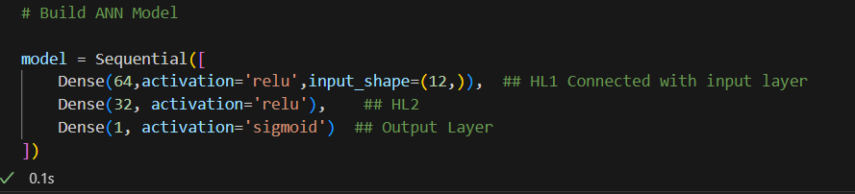
ANN Model Parameters:

Slide 6
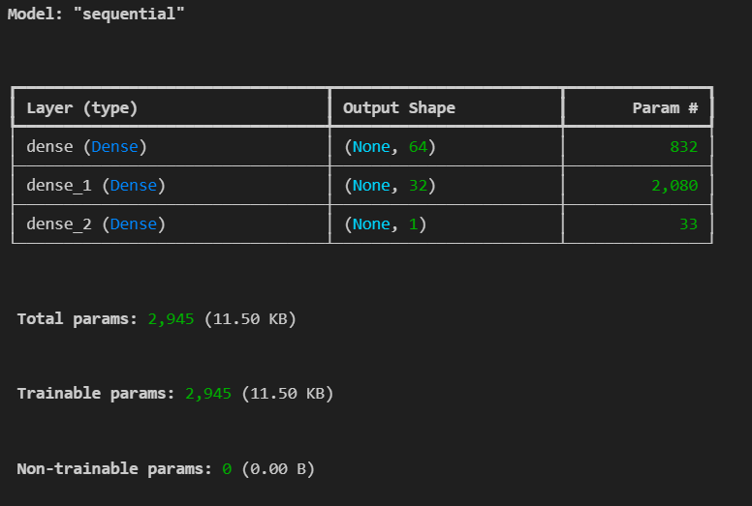
ANN Model Parameters:

Slide 7
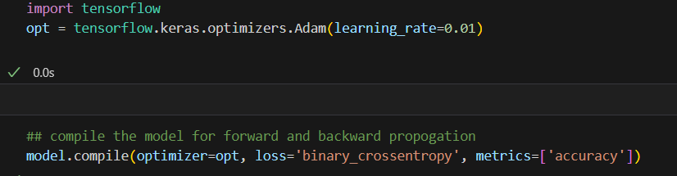
ANN Model Optimizer, Learning Rate and Loss:

Slide 8
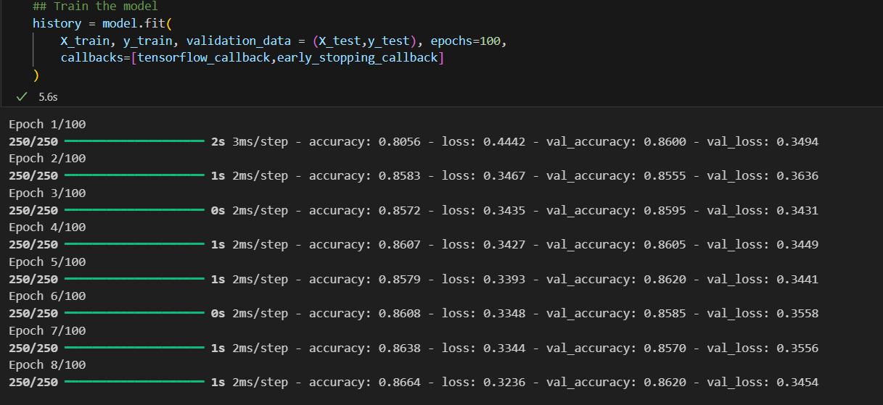
Training the model:

Slide 9
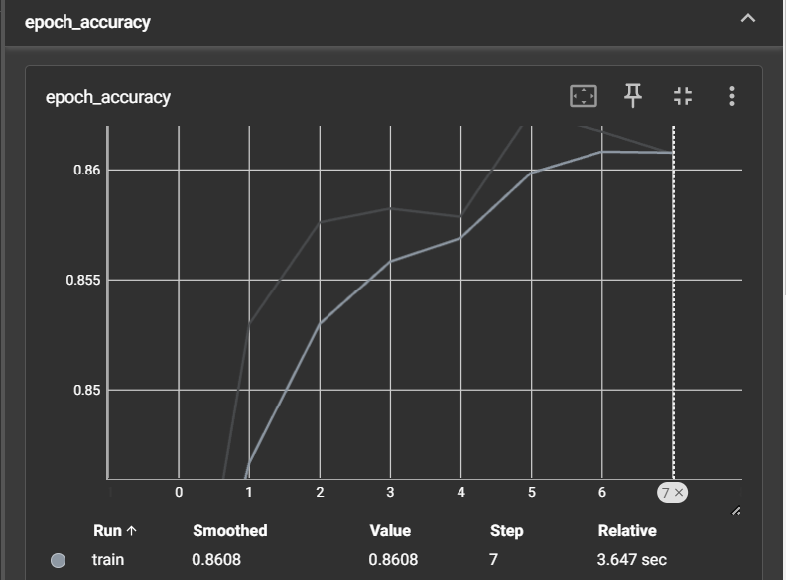
Tensorboard Visualization for Epoch Accuracy and Loss

Slide 10
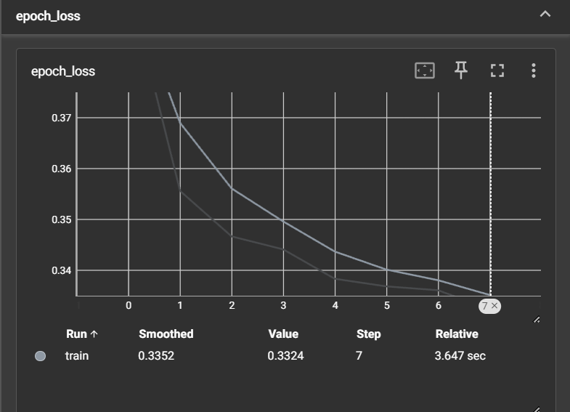
Tensorboard Visualization for Epoch Accuracy and Loss

Slide 11
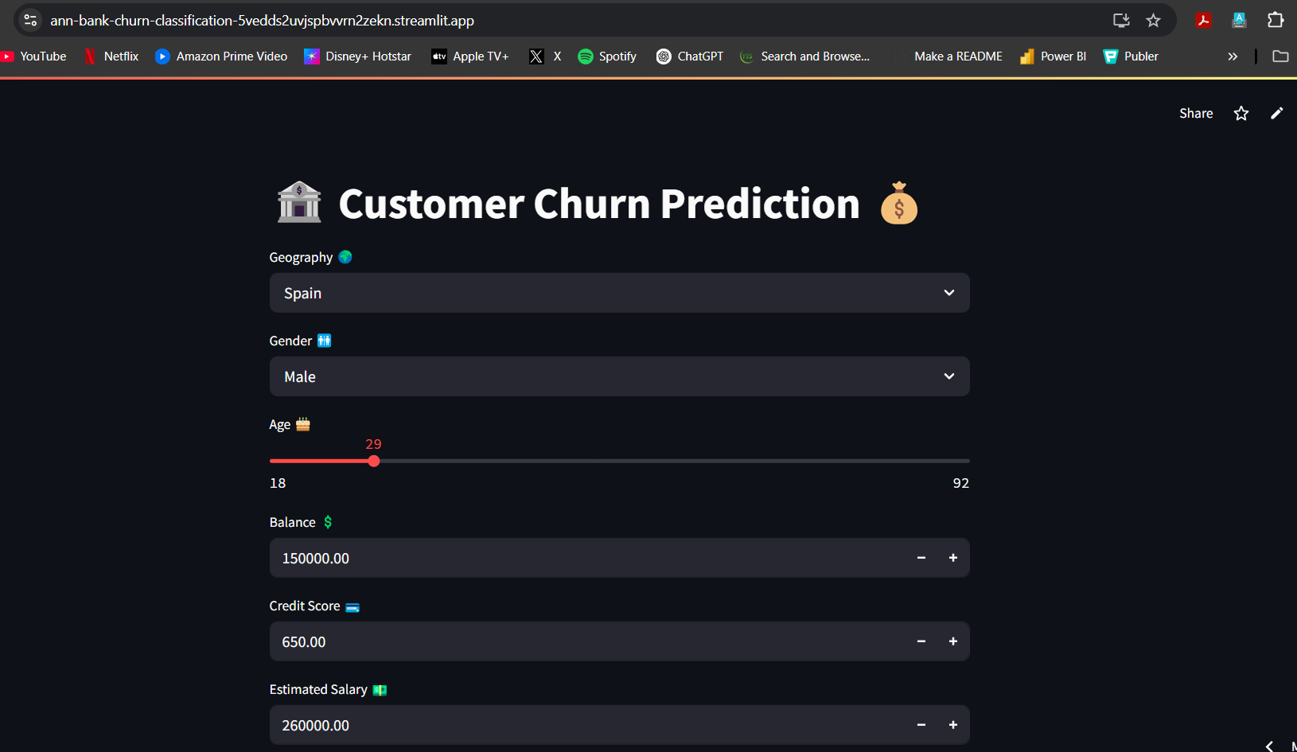
Streamlit APP Deployment

Slide 12
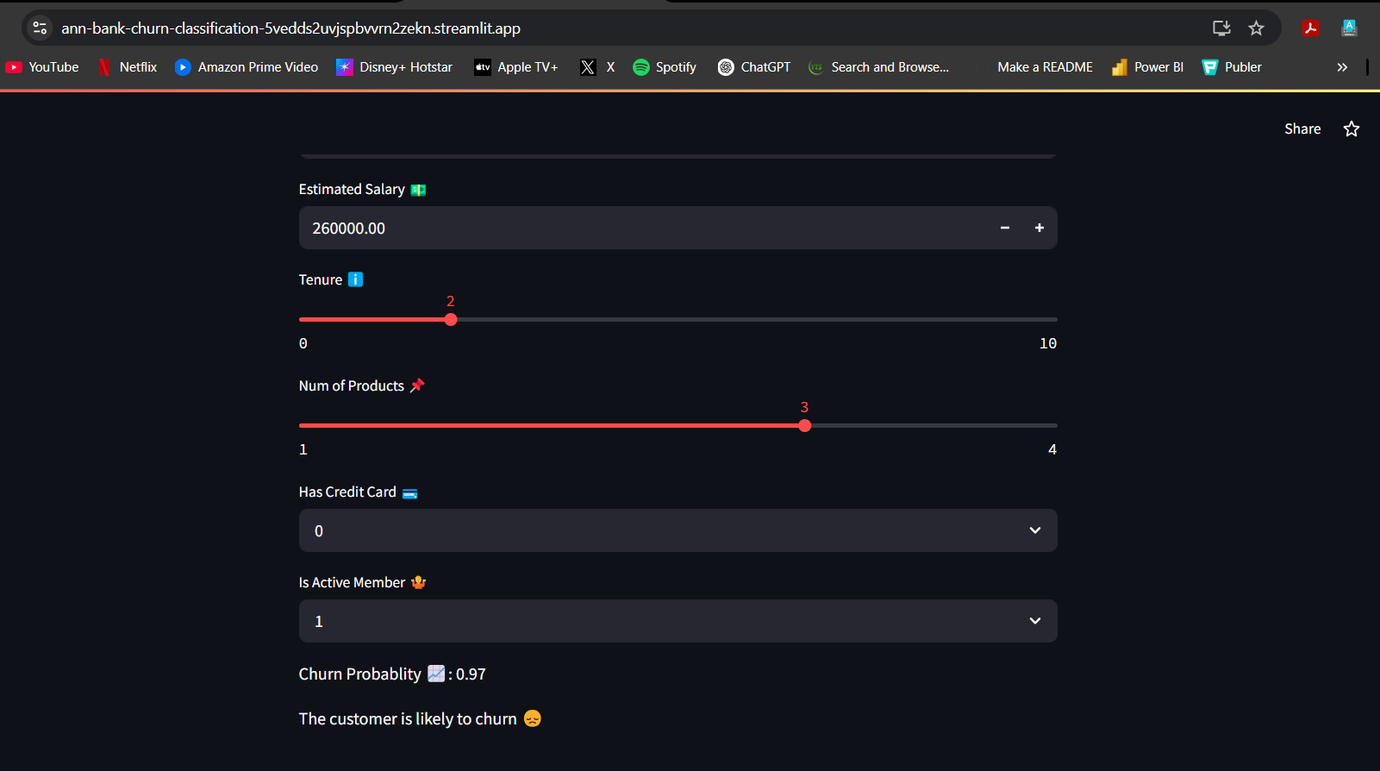
Streamlit APP Deployment

Slide 13
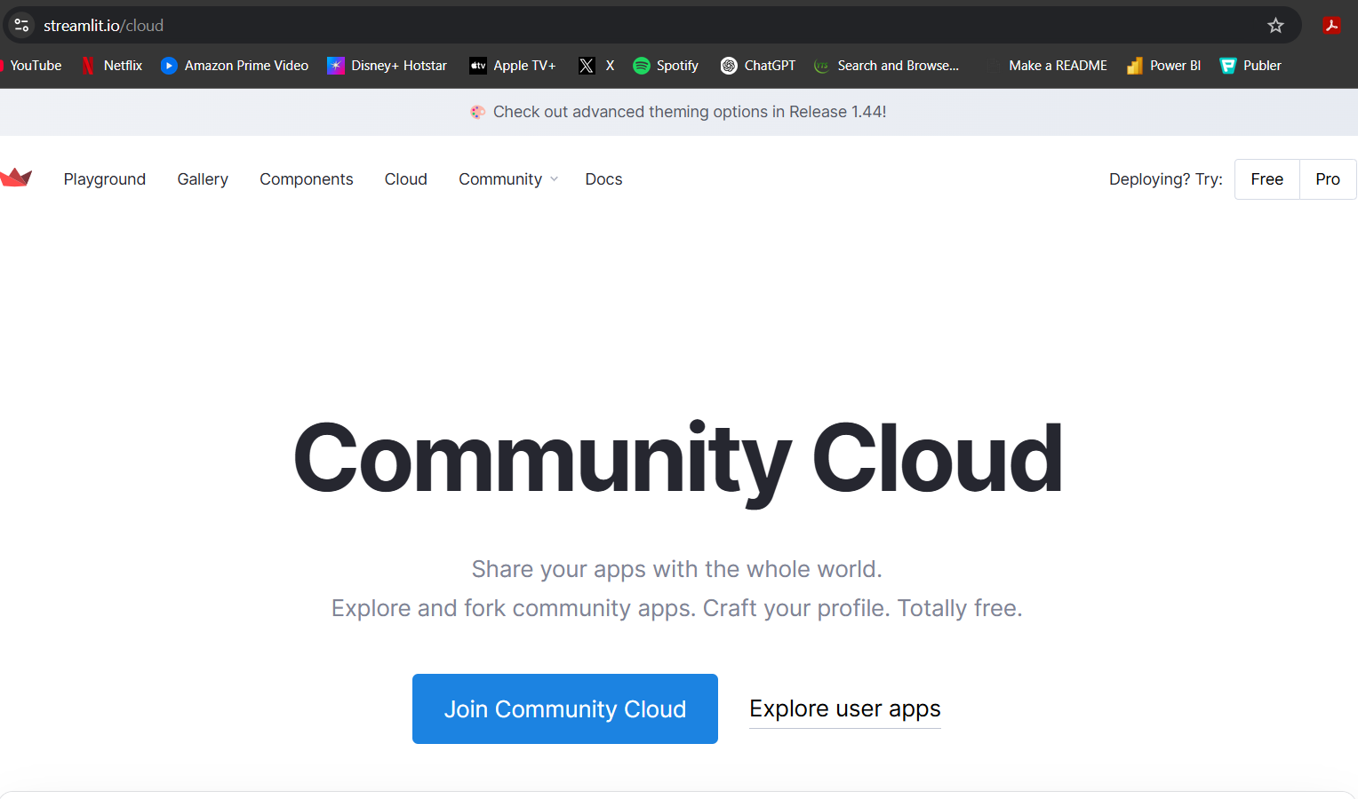
Streamlit APP Deployment
URL: https://ann-bank-churn-classification-5vedds2uvjspbvvrn2zekn.streamlit.app/
GitHub Repo: https://github.com/Omkar-Gadade/ANN-Bank-Churn-Classification

