Slide 1
Outline of the Presentation:
Introduction
Problem Statement
Aim and Objectives
Block Diagram
Software Stack
Methodology
Results
Work Plan (Timeline Chart) for the Semester
References

Slide 2
INTRODUCTION
Fake ID Protection for Companies: We’re building a User Authenticity Module that helps companies, especially FinTech firms, check if someone’s PAN ID is real or fake. This way, businesses can avoid fraud and stay safe from fake users.
Safety Check for Users: Another part of our project helps regular users know if it’s safe to share their personal info with a website or company. It will give a simple "safe or not safe" indication, making it easier for people to protect their data.
Secure Data Handling: We use advanced encryption to lock down sensitive data like mobile numbers and Aadhar details, keeping them safe at every step—from storing to sharing. Your data stays protected, no matter where it goes.Following
Global Privacy Laws: Our project also respects international data privacy rules to ensure that personal information is handled responsibly and safely across countries, just like it should be.

Slide 3
PROBLEM STATEMENT
Companies Falling Victim to Fake IDs: FinTech firms and businesses lose revenue and trust due to fraudulent transactions with fake PAN IDs, causing financial losses and damaging reputations.
Users Exposed to Unsafe Platforms: Millions of users unknowingly share Aadhar details with unverified sites, risking data theft, breaches, and identity fraud.
Insecure Handling of Sensitive Data: Without encryption, sensitive data like mobile numbers and IDs remain unprotected, exposing it to hackers and causing real-time data leaks, leading to personal and financial harm.

Slide 4
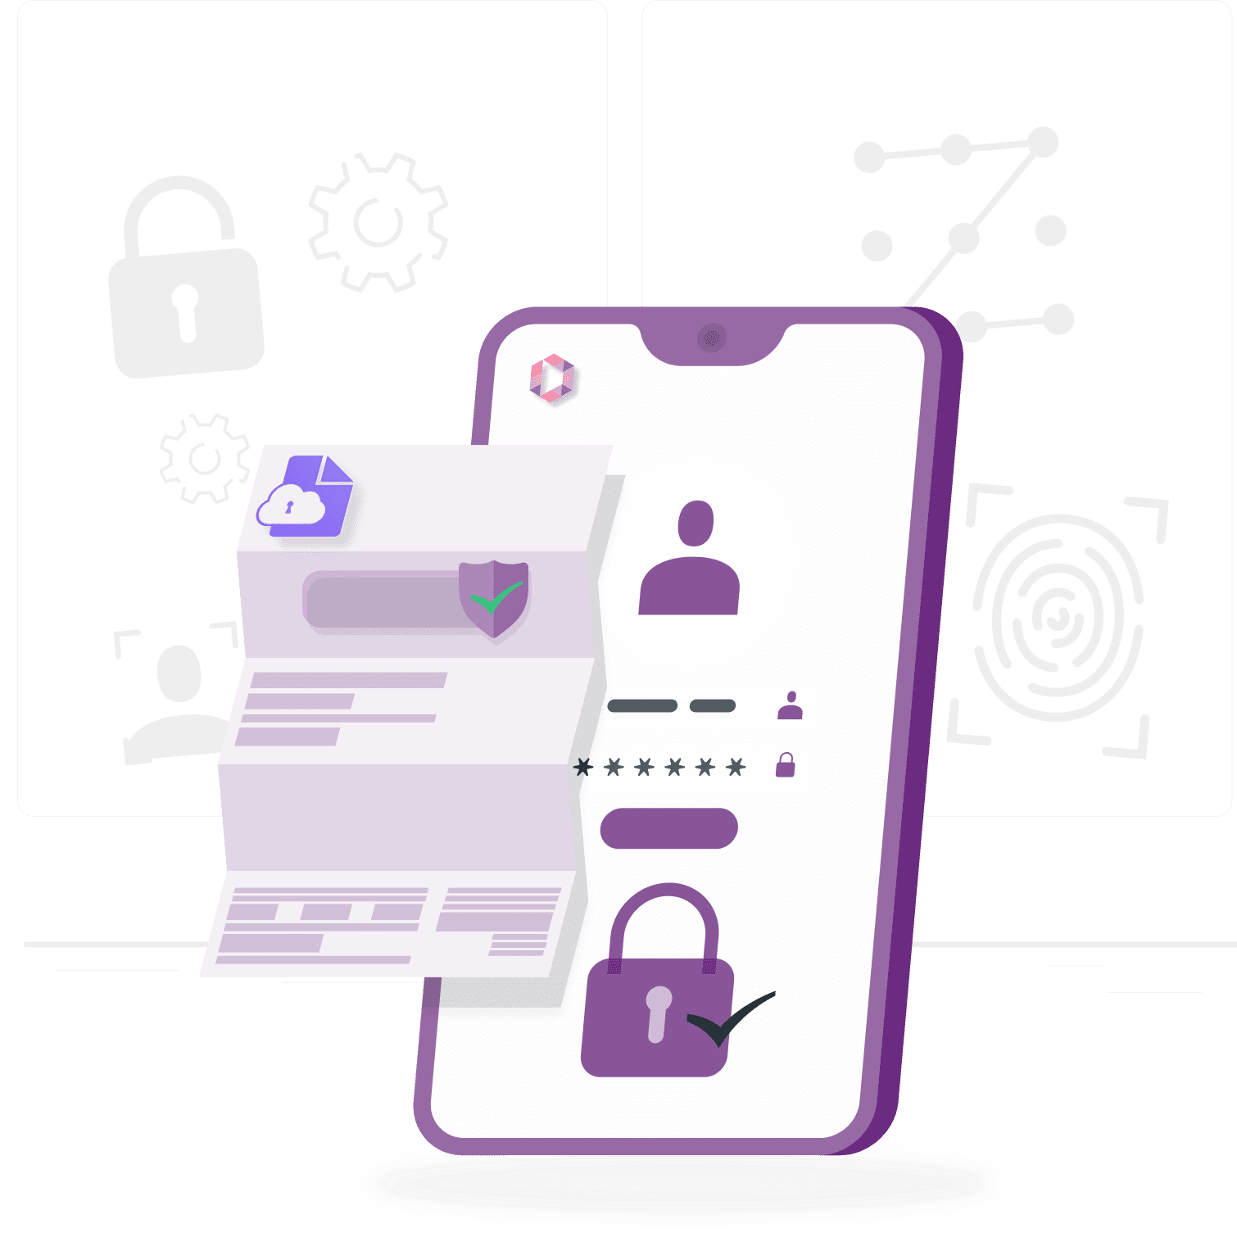
AIM AND OBJECTIVES
The goal is to establish a unified data protection framework by:
Secure User Data with Advanced Encryption
Verify User Authenticity to Prevent Fraud
Enhance Data Privacy for Safe Sharing

Slide 5
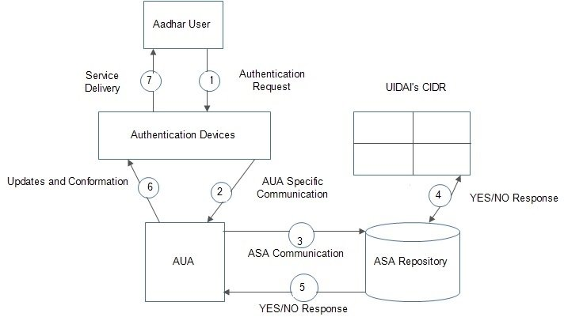
BLOCK DIAGRAM

Slide 6
SOFTWARE STACK
Technologies Used:
- Java: A powerful programming language for backend development.
- MERN Stack: A versatile framework for building web applications.
- APIs: Facilitate secure data exchange with third-party services.
- SQL: Enables efficient CRUD operations on databases.
Software Utilized:
- Visual Studio: Integrated development environment for coding.
- JDK (Java Development Kit): Essential toolkit for Java development.
- Official API Platform for Government ID Verification: For reliable identity validation.

Slide 7
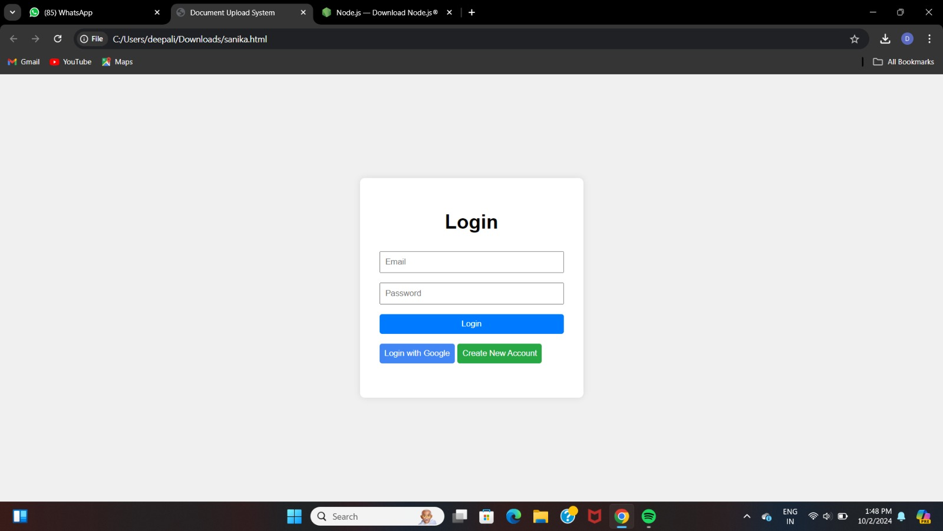
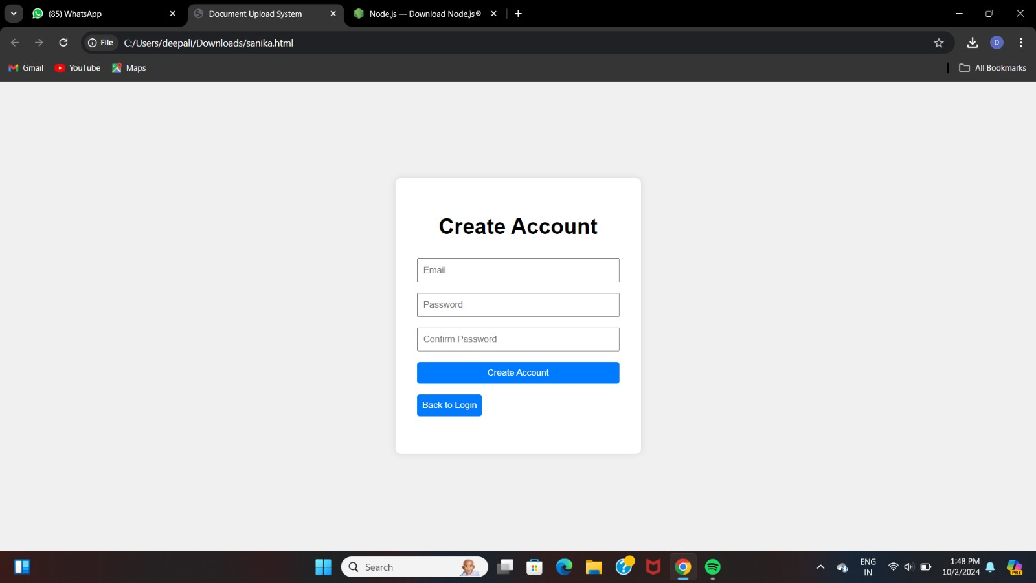
RESULT

Slide 8
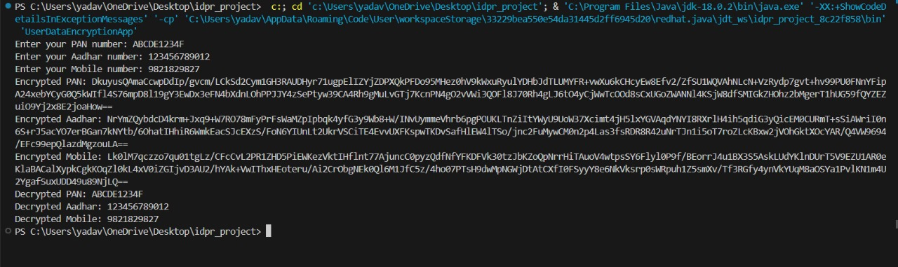
Advance Encryption Algorithm in Java Backend

Slide 9
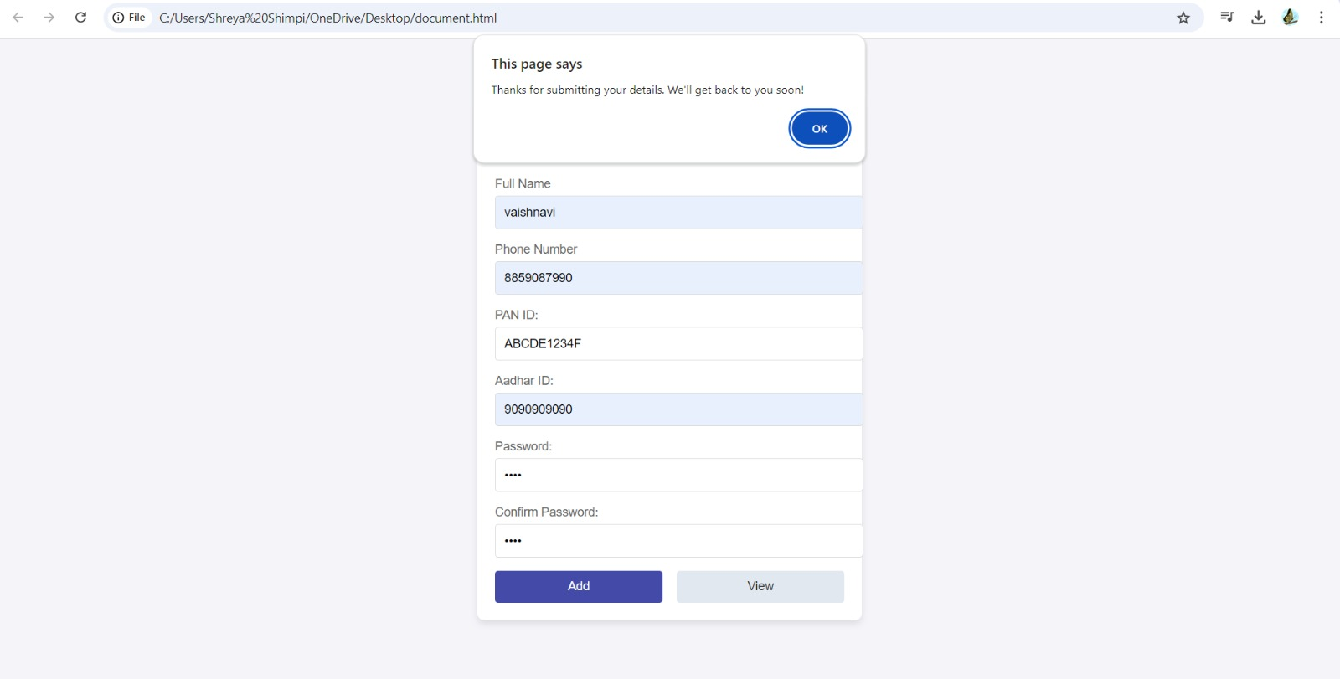
End-User Credentials Input

Slide 10
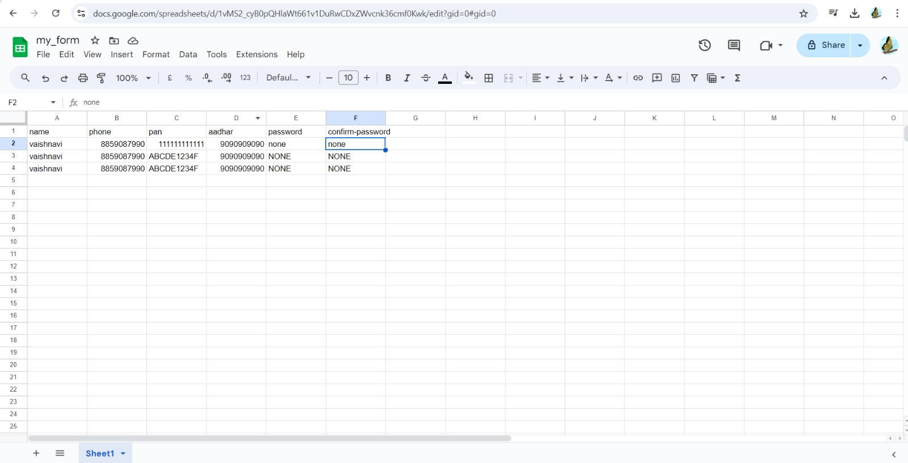
Easier Data Storing with Sheets App Script

Slide 11
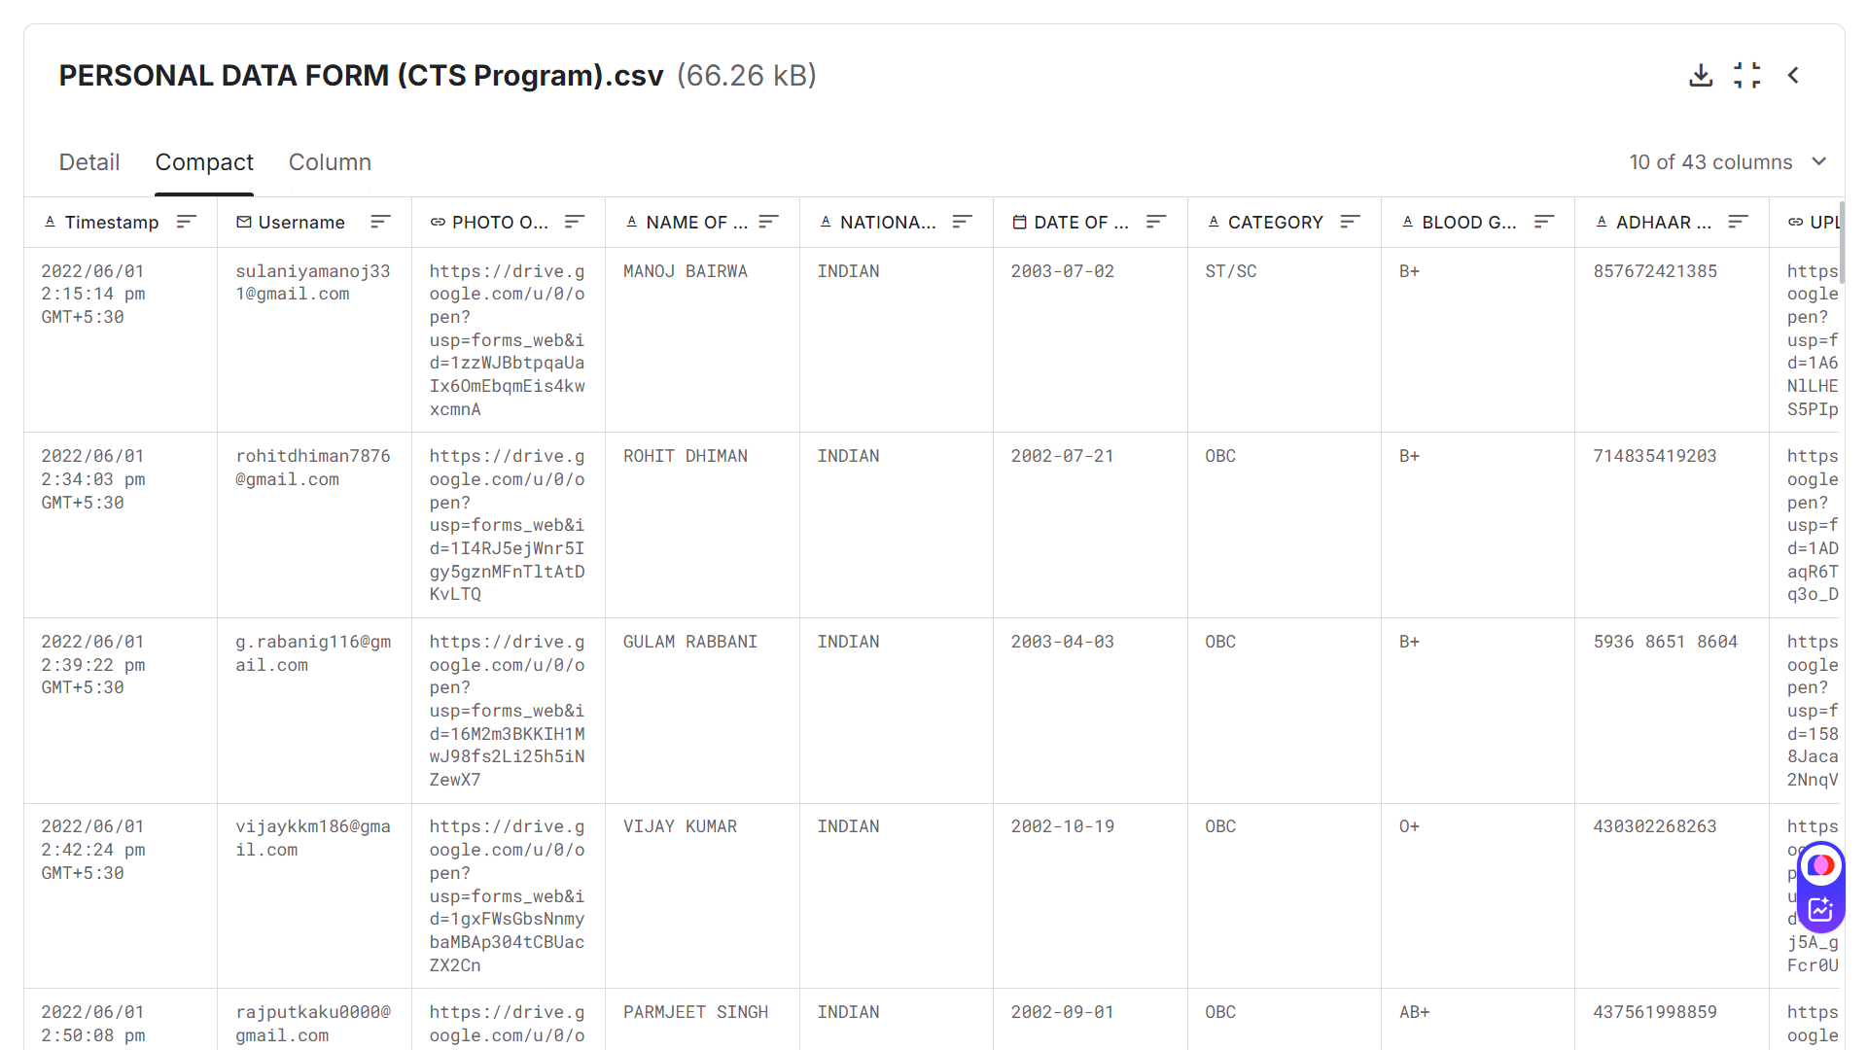
Inspiration from Realtime Data-Set

Slide 12
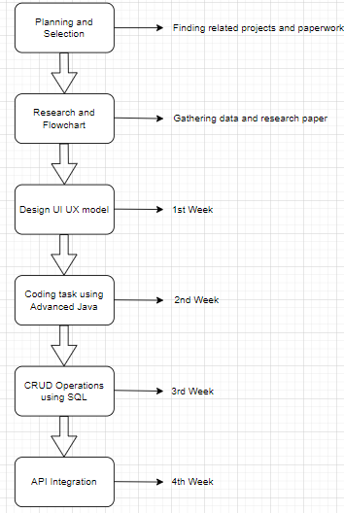
TIMELINE CHART

Slide 13
CONCLUSION
Our project focuses on protecting personal data like mobile numbers and identity details by following global privacy laws. We are building a secure framework to handle and share this data accurately, keeping it safe from unauthorized access.
By working on coding, interface design, and database management, we aim to create an effective and user-friendly system. Ultimately, our goal is to harmonize global data protection laws, enhance privacy rights, and ensure compliance, addressing the critical issues of data breaches and identity theft.

