Slide 1
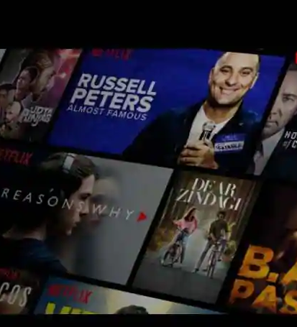
MACHINE LEARNING
MATHELETS
GROUP-16
CONTENT BASED MOVIE RECOMMENDATION SYSTEM
01

Slide 2

Presentation Outline
Contents of the Talk
--Brief Introduction
--Problem Statement
--Our results
--Conclusions
--Contributions
--References
02

Slide 3
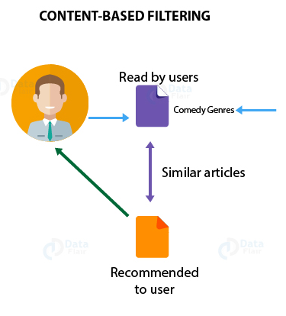
BRIEF INTRODUCTION
Recommendation systems are algorithms that scan all of the alternatives and generate a personalized list of items that are of interest to the consumer.
The primary goal of the recommendation system is to find content that is relevant to a certain person’s area of interest.
Furthermore, it takes into account a variety of characteristics in order to build customized lists of fascinating information tailored to an individual.
03

Slide 4
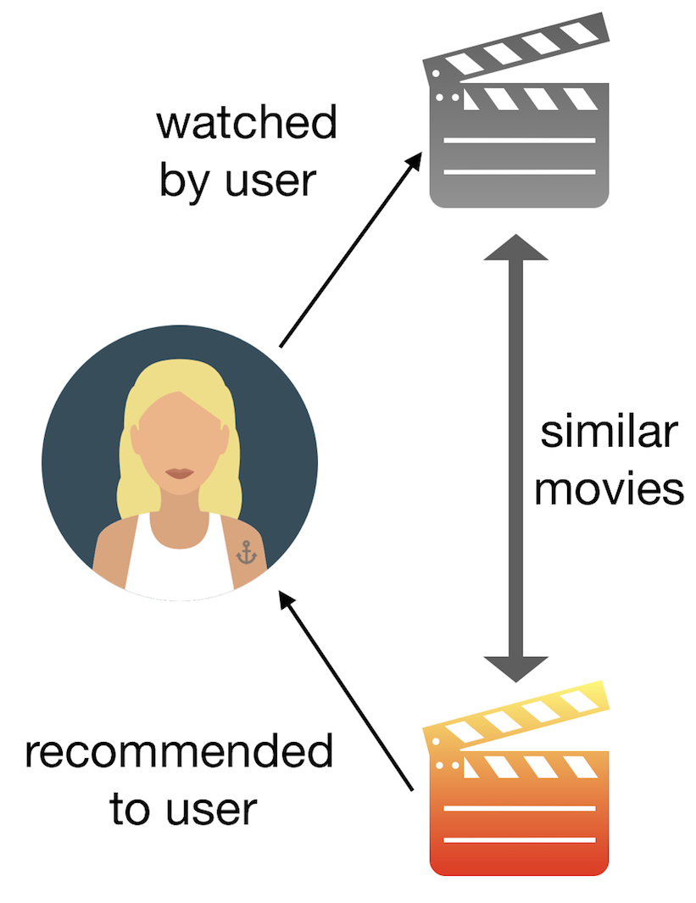
PROBLEM STATEMENT
A Brief Definition
How to make movie recommendations when no user information is available?
What types of movie features may the content based movie recommendation system use?
How to figure out how similar two films are?
Is it possible to give each feature a different weight?
04
01

Slide 5


Our results:
Clean and usable data
A matrix with movies as rows and keywords as coloumns
05
05

Slide 6


Our results:
A matrix with 5 movies and keywords suggested on the basis of similarities with the selected movie.
A website with local host for the content based movie recommendation system
06
05

Slide 7
Our results:
So finally, in this recommendation system when a user selects a movie, our system recommends 5 movies that are similar to the selected movie. The recommendations of the movie are based on variety of factors such as genre, overview, keywords, cast, and crew of that entered movie.
07

Slide 8
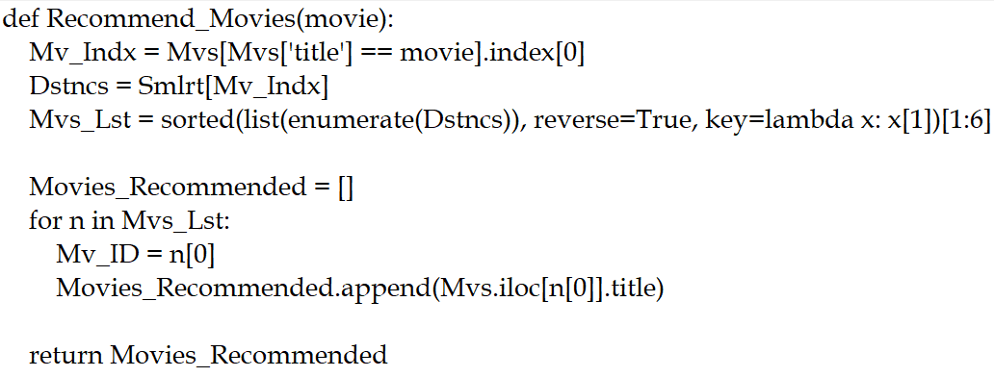
Result-Driving code:
Function for Recommending Movies :
LANGUAGE OF CODE:
PYTHON
08

Slide 9

Result - Driving code:
Code for Text Vectorisation :
LANGUAGE OF CODE: PYTHON
09

Slide 10
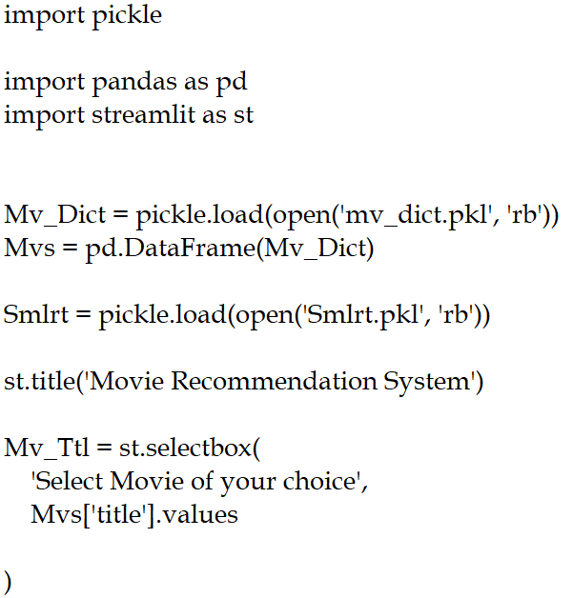
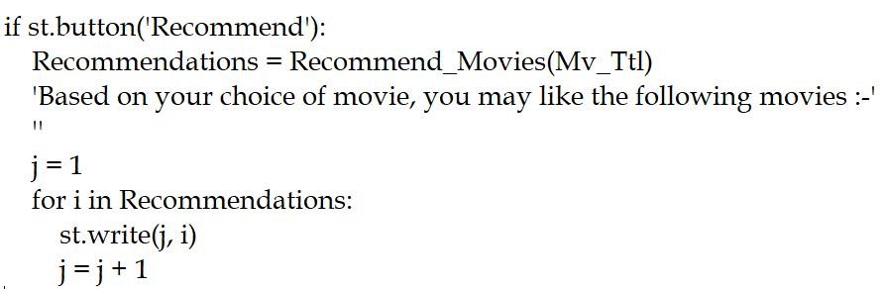
Result - Driving code:
Code for making the website :
LANGUAGE OF CODE:
PYTHON
10

Slide 11
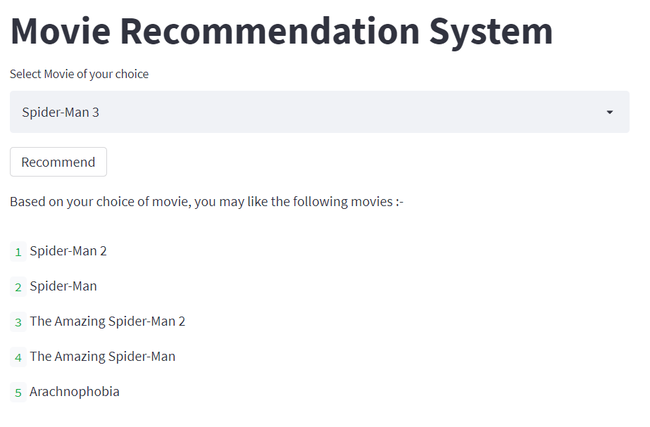
Output:
When a user selects a movie then the system would recommend 5 movies that will be similar to the selected movie.
As we can see in the attached picture, System recommended a movie similar to the selected one.
11

Slide 12
Conclusion
Our Recommendation system learns choice of the user and recommends them a list of movies according to their choice. This is also useful for companies to generate more sales by providing people with contents they are interested in.
The suggestions are personalized to each user, thus there is no requirement of any sort of data about users. This feature makes it easier to grow to a bigger number of customers.
In this movie recommendation system the recommendations are mainly based on factors like genre, overview, keywords, cast, and crew of that movie.
12

Slide 13

CONTRIBUTIONS
KINAL KAGATHARA-Research on the topic, Background, Problem Statement, Reproduced Work, Designing of PPT, Coding of the program
OMKAR PANDYA- Literature Survey, Reproduced Work, Plan of Action, Designing of PPT, Coding of the program
DHRUVI SHAH- Motivation, Plan of Action, Designing of PPT
FENIL VITHLANI- Project Domain, Problem Statement, Ideation, Designing of PPT, Research on the Topic
13

Slide 14

REFERENCES
https://aircconline.com/acii/V3N1/3116acii03.pdf
https://www.cse.iitk.ac.in/users/nsrivast/HCC/Recommender_systems_handbook.pdf
https://analyticsindiamag.com/singular-value-decomposition-svd-application-recommender-system/
https://machinelearningmastery.com/calculate-principal-component-analysis-scratch-python/
https://data-flair.training/blogs/data-science-at-netflix/
14
01

Slide 15

THANK YOU

