Slide 1
ONLINE RETAIL
A Year of Online Retail Performance
Sales, geography & customer behavior across 524,878 transactions
December 2010 – December 2011 | UK-based online retailer

Slide 2
The Year at a Glance
Six headline metrics across the full transaction history
£10.64M
19,960
4,338
TOTAL REVENUE
TOTAL ORDERS
UNIQUE CUSTOMERS
5.57M
£533
38
UNITS SOLD
AVG ORDER VALUE
COUNTRIES SERVED
Online Retail Sales Analysis · Dec 2010 – Dec 2011
2

Slide 3
Revenue Climbed Sharply into Peak Season
Monthly revenue, Dec 2010 – Dec 2011 · November 2011 was the strongest month at £1.50M
Online Retail Sales Analysis · Dec 2010 – Dec 2011
3

Slide 4
The UK Dominates, but 37 Other Markets Contribute
United Kingdom generates 85% of revenue (£9.00M of £10.64M)
Top Non-UK Markets by Revenue
Online Retail Sales Analysis · Dec 2010 – Dec 2011
4

Slide 5
A Handful of SKUs Drive Outsized Revenue
Top 6 products by revenue · postage and giftware lead the list
Online Retail Sales Analysis · Dec 2010 – Dec 2011
5

Slide 6
Orders Peak on Weekday Mornings
Revenue by day of week and hour of day · no orders recorded on Saturdays
By Day of Week
By Hour of Day
Online Retail Sales Analysis · Dec 2010 – Dec 2011
6

Slide 7
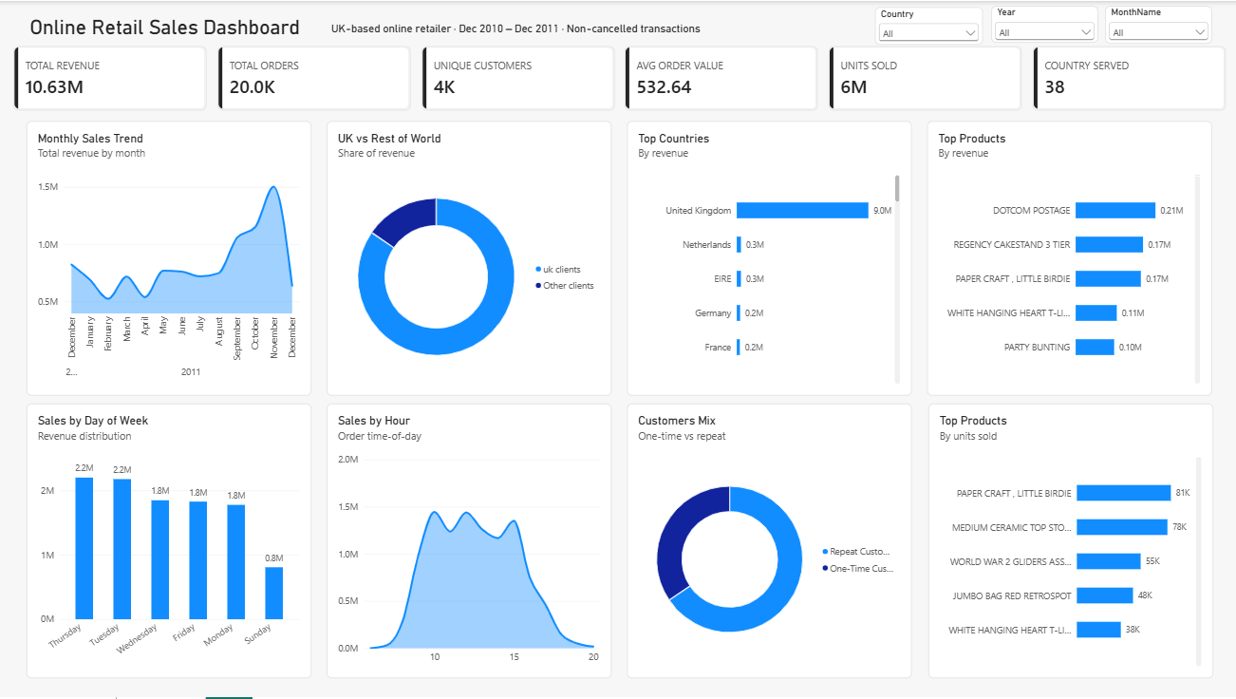

Slide 8
KEY TAKEAWAYS
Three Things to Act On
1
Protect peak-season inventory
Sep–Nov 2011 revenue nearly doubled versus the summer months — plan stock and staffing ahead of that ramp.
2
Grow beyond the UK deliberately
Netherlands, Ireland and Germany already generate over £250K each with no dedicated push — a natural next-market shortlist.
3
Convert one-time buyers
1,493 of 4,338 customers ordered only once; a follow-up offer targeted at first-time buyers is the highest-leverage retention move.
Online Retail Sales Analysis · Dec 2010 – Dec 2011
7

