Slide 1
E-FARMING MARKET
Group No. 17
​

Slide 2
AGENDA
Introduction​
Architecture
​Database Design
Technology platform used for project
User roles and responsibilities
Division of work within team
Details of contribution of each team members
File and directory structure for project
Read me file
Future extension if any
Conclusion

Slide 3
INTRODUCTION
1.Purpose of Project
The project provides an online platform for selling the Farmer’s Product to the Wholesaler.
2. Need
The main objective of this project is building a website which will help farmers from Indian villages to sell their products to different cities. Thus, any small farmer will reach to many sellers and customers.
Suppose some village farmers want to use this facility and want to learn how is it possible and how they can use e-farming market to sell their products, they must have basic knowledge of computer, then they can directly register in the site and sell their product online.
On the other side, buyers can also register and buy products as per their needs.
3.Benificiaries of Project
The Project will be beneficial for Farmer and Wholesaler due to better choices, home delivery And access to Products anywhere and anytime, as well as it will be beneficial for all the Farmer as they can sell the products without any middle person or without any Physical Markets.

Slide 4
ARCHITECTURE
Used for
User interfacing
Basic data validation
Used for
Server side validation
Response handling
Business Logic
Database operations
Report Generation
Used for
Permanent data storage
Database level validation
Database access using stored procedures
Front end Layer
Server Layer
Technologies used
HTML, CSS
JavaScript
ReactJS
JSON
Database Layer
Technologies used
Springboot
.NET
Technologies used
MySQL

Slide 5
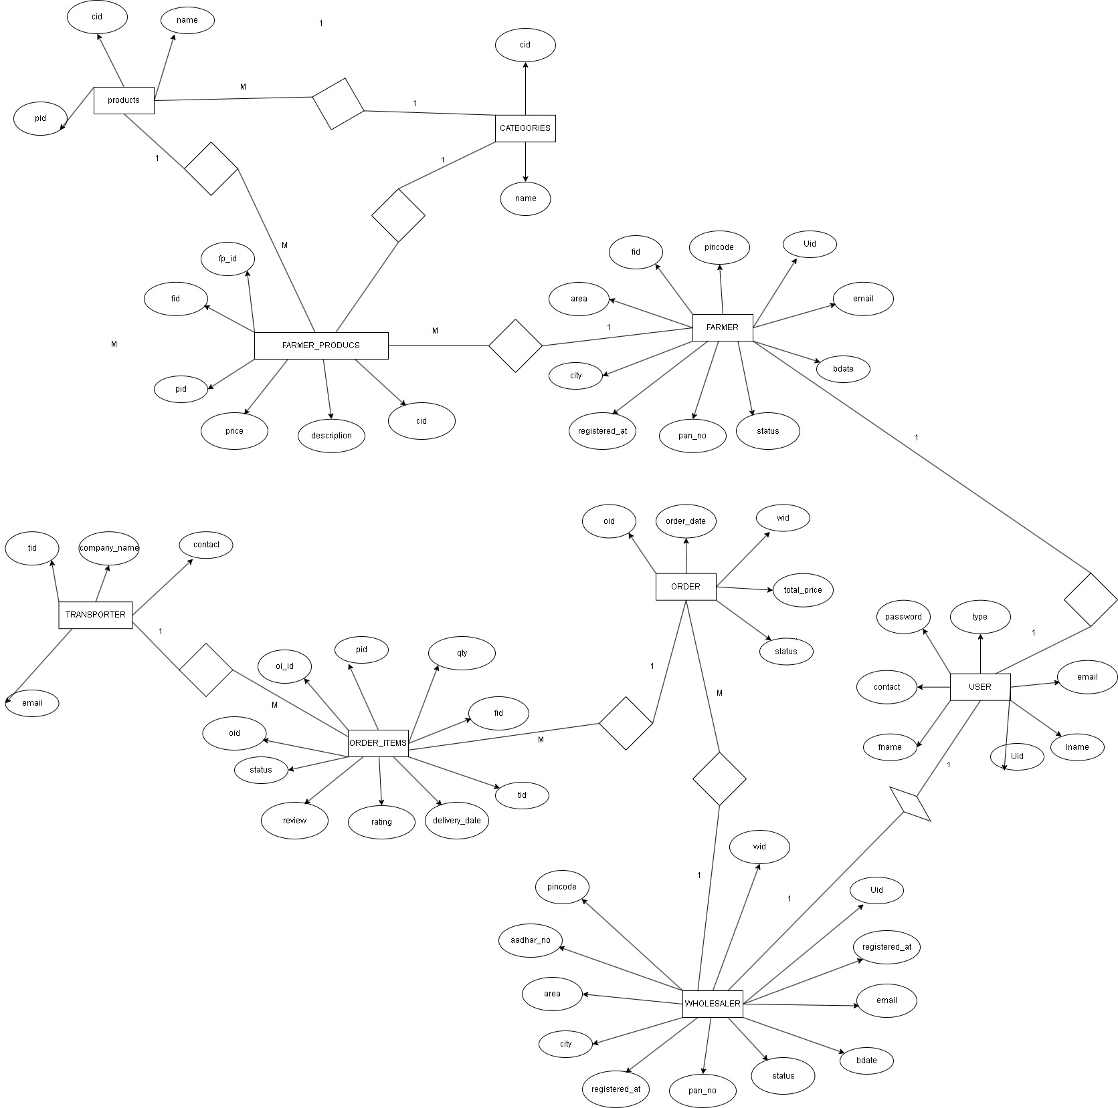
ER DIAGRAM

Slide 6
TECHNOLOGY PLATFORM USED
Technologies used :
HTML, CSS, Javascript, jQuery, ReactJS, JSON, Springoot, MySQL, .NET.
Reason :
Html, CSS and javascript are used for frontend part for static web pages.
React JS is used for rendering the dynamic web pages, form validation and to create a single page application where only particular part of web page is rendered without altering complete web page.
Springboot is used for server side processing wherein in connection with database is established from server and required data is manipulated and sent to client side.

Slide 7
USER ROLES AND RESPONSIBILITIES
User Roles :
There are three most important roles assigned to users. Like Admin, Farmer and Wholesaler.
Admin : User creation, permissions, reports generations etc.
Farmer : Will add Products for sale and will be able to see the Product sold.
Wholesaler : Will be able to see the listed Products and will be able to buy Products which they like and want to buy.
User Case According to roles :

Slide 8
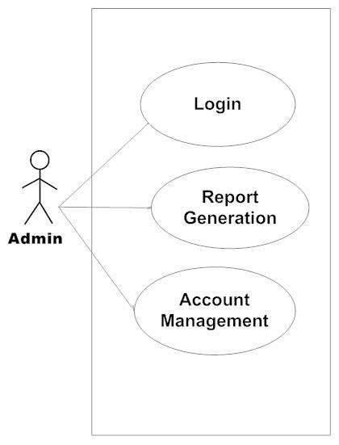
Admin : Allowing access to user, track reports etc.

Slide 9
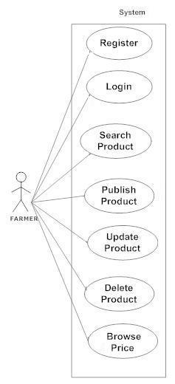
Farmer : Upload their Products for selling.

Slide 10
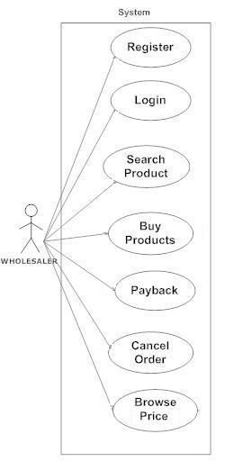
Wholesaler : Can see all the listed Products and buy the Products.

Slide 11
CONTRIBUTION FROM EACH TEAM MEMBER
Kharanshu Wanare : Implemented the Admin use case using .NET.
Gaurav Nande : Implemented the Farmer use case using ReactJS.
Shirish Ahire : Implemented Wholesaler use case ReactJS.
Anuj Bhure : Implemented Database creation, validation and REST API using Springboot.
Stages at which Coordination was needed :
Most of the coordination was needed when complete UI needed to be rendered using React and
writing, mapping entities.
Everyone coordinated when setting the relationships between the entities.

Slide 12
CONCLUSION
Challenges you faced :
We have faced few challenges throughout entire project.
Like, mapping the many to many relationship between two entities.
Maintaining the latest version of project among all our team.
Things Learnt :
We have learnt to efficiently distribute the task within the team. We have learnt to combine all the dynamic
stack of technologies together to create a fully functional software. How to work in a team with different
backgrounds.
Overall Experience :
Overall experience was very practical oriented and highly knowledgeable.

Slide 13
THANK YOU
Gaurav Nande
Anuj Bhure
Shirish Ahire
Kharanshu Wanare

