Slide 1


AMC ENGINEERING COLLEGE
(NAAC A+ Accredited and AICTE Certified Institute)
18th K.M. Bannerghatta Main Road, Bengaluru, Karnataka-560083
Phone No. Phone No. 9250376104, 9811004275
http://www.amcgroup.edu.in
DEPARTMENT OF COMPUTER SCIENCE AND ENGINEERING
Asset Tokenization: Decentralized Platform for real-World Asset Tokenization Using Blockchain
BY
Omkar Bharath Pukale - (1AM23CS127)
Sahil Kumar Mishra - (1AM23CS176)
Sandesh G.C - (1AM23CS183)
Sanjitha A - (1AM23CS186)
ASSET TOKENIZATION
Under the guidance of Prof. Premkumar M K
Assistant Professor Dept. CSE AMCEC
1

Slide 2


DEPARTMENT OF COMPUTER SCIENCE AND ENGINEERING
PRESENTATION FLOW
Abstract
Introduction
Literature Survey
Problem Statements
Objectives
Methodology
Architecture Diagram
Hardware/Software Components
Data-Flow Diagram
Dashboard UI
ASSET TOKENIZATION
2

Slide 3
DEPARTMENT OF COMPUTER SCIENCE AND ENGINEERING
ABSTRACT (1)
The project proposes a decentralized platform for tokenizing real-world assets using blockchain technology.
It enables fractional ownership, allowing investors to buy small portions of high-value assets instead of entire assets.
The solution targets traditionally illiquid assets such as real estate, commodities, and other high-value holdings.
Asset ownership rights are converted into digital tokens, which are recorded and managed on a blockchain network.
Smart contracts securely handle token minting, transfers, and ownership records without full reliance on intermediaries.
ASSET TOKENIZATION
3

Slide 4
DEPARTMENT OF COMPUTER SCIENCE AND ENGINEERING
ABSTRACT (2)
The platform uses a web-based interface for asset listing, token purchase, and transaction tracking.
The tech stack includes React.js for frontend, Node.js and Express.js for backend, and MongoDB for off-chain data.
The system is integrated with an Ethereum test network to deploy and validate blockchain functions.
The platform ensures transparency and immutability through distributed ledger technology, making records tamper-proof.
The project demonstrates the feasibility and scalability of asset tokenization as a modern, inclusive, and efficient investment model.
ASSET TOKENIZATION
4

Slide 5
DEPARTMENT OF COMPUTER SCIENCE AND ENGINEERING
INTRODUCTION
Asset tokenization is the process of converting ownership rights of a real-world asset into digital tokens recorded on a blockchain network. Traditionally, investment in assets such as real estate, gold, or fine art requires significant capital and involves complex legal procedures. These barriers restrict participation to a limited group of investors.
This project proposes the design and development of a decentralized platform that enables fractional ownership of real-world assets through blockchain technology. Each asset will be represented by digital tokens, allowing investors to purchase small portions instead of acquiring the entire asset. Blockchain ensures transparency, immutability, and secure transfer of ownership without relying entirely on intermediaries.
The platform will focus on secure smart contract implementation, transparent transaction history, and efficient asset management. The aim is to demonstrate how blockchain can modernize traditional asset ownership models and improve liquidity in illiquid markets.
ASSET TOKENIZATION
5

Slide 6
DEPARTMENT OF COMPUTER SCIENCE AND ENGINEERING
LITERATURE SURVEY
AUTHORS | YEAR | TITLE | METHODOLOGY | ADV/KEY FEATURES
NISHITH DESAI ASSOCIATES | 2025 | REAL ESTATE TOKENISATION | COMPARATIVE LEGAL FRAMEWORK STUDY | Identifies cross-border regulatory challenges and compliance issues
ITAI AGUR ET AL. | 2025 | TOKENIZATION AND FINANCIAL MARKET INEFFICIENCIES | THEORETICAL FRAMEWORK ON EXTERNALITIES | Discusses Network Effects , Market Power , Systemic Risks
WORLD ECONOMIC FORUM | 2025 | ASSET TOKENIZATION IN FINANCIAL MARKETS | DESK RESEARCH+EXPERT INTERVIEWS+WORKSHOPS | Identifies tokenization models (backed & native) and explains proof of value, ownership, and transaction concepts.
URAV SONI,OLIVIER FINES,JINMING SUN | 2025 | AN INVESTMENT PERSPECTIVE ON TOKENIZATION | QUALITATIVE ANALYSIS+CASE STUDIES+INDUSTRY INTERVIEWS | Improves operational efficiency, settlement speed, and transparency. Enables fractional ownership and access to private markets.
IFSCA | 2025 | REGULATORY APPROACH TOWARDS TOKENIZATION OF RWAS | ANALYTICAL POLICY FRAMEWORK | Highlights risk management frameworks and need for regulatory clarity in digital tokens
ASSET TOKENIZATION
6

Slide 7
DEPARTMENT OF COMPUTER SCIENCE AND ENGINEERING
PROBLEM STATEMENT
Traditional asset markets such as real estate and commodities require high capital investment, which restricts participation for small and medium investors.
Existing systems for asset ownership involve complex legal and administrative processes, making investment slow, costly, and inaccessible to a wider audience.
Many high-value assets are inherently illiquid, making it difficult for owners and investors to quickly buy, sell, or trade partial ownership.
Current asset management relies heavily on centralized intermediaries, leading to issues of trust, lack of transparency, and increased dependency on third parties.
Conventional record-keeping mechanisms for asset ownership are vulnerable to manipulation, lack immutability, and do not provide a tamper-proof audit trail.
ASSET TOKENIZATION
7

Slide 8
DEPARTMENT OF COMPUTER SCIENCE AND ENGINEERING
PROBLEM STATEMENTS (2)
There is no widely adopted, user-friendly platform that leverages blockchain and smart contracts to enable secure fractional ownership and transparent management of real-world assets.
Small investors lack access to robust technological infrastructure that can
simplify participation in asset markets while ensuring security and trust.
There is limited practical experimentation and prototyping of blockchain-based asset tokenization platforms to evaluate their real-world feasibility, scalability, and performance.
ASSET TOKENIZATION
8

Slide 9
DEPARTMENT OF COMPUTER SCIENCE AND ENGINEERING
OBJECTIVES
The primary objectives of this project are:
To design a blockchain-based system that enables fractional ownership of physical assets.
To implement smart contracts that securely manage token issuance, transfers, and ownership records.
To build a web-based interface for asset listing, token purchase, and transaction tracking.
To ensure transparency and tamper-proof record maintenance using distributed ledger technology.
To analyze the feasibility and scalability of asset tokenization in real-world applications.
Blockchain Integration The platform will be deployed on a public blockchain test network such as Ethereum test net to validate functionality.
ASSET TOKENIZATION
9

Slide 10
DEPARTMENT OF COMPUTER SCIENCE AND ENGINEERING
METHODOLOGY (1)
The development of the project will follow these stages:
Requirement Analysis Understanding the limitations of traditional asset ownership systems and identifying the need for fractional investment models.
System Design Designing the architecture consisting of: Frontend application for user interaction Backend services for data management Blockchain network for token transactions Smart contracts for asset representation
Smart Contract Development Smart contracts will be developed using Solidity. These contracts will: Mint tokens representing assets Handle ownership transfers Record transactions securely .
Frontend & Backend Development Frontend built using React.js for user-friendly interaction Backend using Node.js and Express.js Database integration (MongoDB) for storing off-chain metadata .
ASSET TOKENIZATION
10

Slide 11
DEPARTMENT OF COMPUTER SCIENCE AND ENGINEERING
METHODOLOGY (2)
Testing and Validation
Functional testing:
Verify asset listing and retrieval
Validate token purchase workflow
Check user authentication (login/signup)
Ensure correct ownership update after transactions
Security Contract Testing :
Token minting accuracy
Ownership transfer correctness
Validation of input conditions (require statements)
Prevention of invalid or duplicate transactions
Performance Testing :
API response time
System behavior under multiple users
Database query performance
Transaction processing delay
Security Testing :
Input validation (prevent invalid data)
Protection against unauthorized access
Smart contract vulnerability checks
Wallet transaction security
ASSET TOKENIZATION
11

Slide 12
DEPARTMENT OF COMPUTER SCIENCE AND ENGINEERING
METHODOLOGY (3)
Integration Testing :
Frontend - Backend communication
Backend - Blockchain interaction
MetaMask - Smart contract execution
Usability Testing :
Ease of navigation
User interface responsiveness
Clarity of transaction feedback
ASSET TOKENIZATION
12

Slide 13
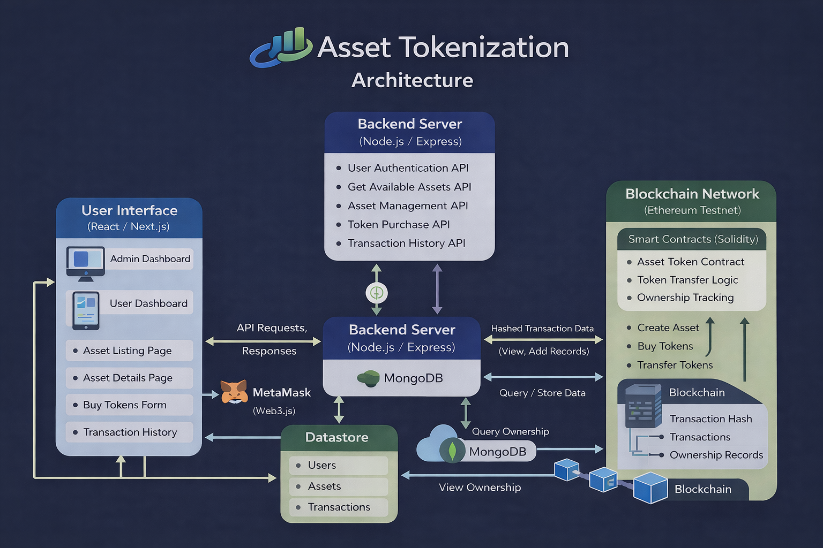
DEPARTMENT OF COMPUTER SCIENCE AND ENGINEERING
ARCHITECTURE DIAGRAM
This architecture enables asset tokenization using a React frontend, Node.js backend, MongoDB, and Ethereum blockchain. Users interact via dashboards, while smart contracts manage tokens and ownership. Backend handles APIs and stores data, ensuring secure transactions, scalability, and seamless integration between off-chain and on-chain systems.
The system connects a web interface, backend services, database, and blockchain to digitize asset ownership. Users can explore assets, purchase tokens, and track holdings. Smart contracts enforce rules, while the backend manages logic and data, ensuring transparency, efficiency, and reliable transaction processing.
This model links frontend, backend, and blockchain to tokenize assets, enabling secure ownership transfers, efficient data handling, and transparent transaction tracking.
ASSET TOKENIZATION
13

Slide 14
DEPARTMENT OF COMPUTER SCIENCE AND ENGINEERING
SOFTWARE/HARDWARE REQUIREMENTS
SOFTWARE REQUIREMENTS:
Operating System: Windows / Linux
Programming Languages: Solidity, JavaScript
Frontend Framework: React.js
Backend Framework: Node.js, Express.js
Database: MongoDB
Blockchain Platform: Ethereum (Test Network) Development
Tools: Remix IDE / Hardhat MetaMask Wallet VS Code Ganache (for local blockchain testing)
HARDWARE REQUIREMENTS:
Processor: Intel i5 or above
RAM: Minimum 8 GB Storage: 256 GB SSD or higher Stable Internet Connection.
ASSET TOKENIZATION
14

Slide 15
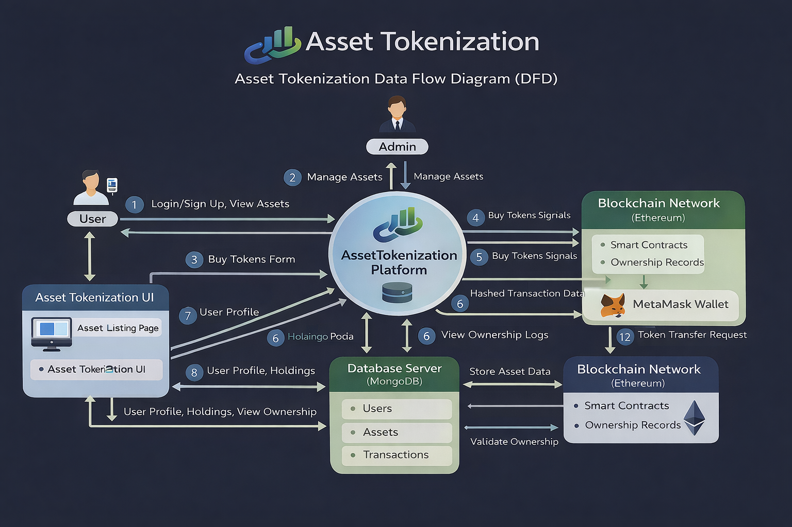
DEPARTMENT OF COMPUTER SCIENCE AND ENGINEERING
DATA-FLOW DIAGRAM
This data flow diagram shows how users and admins interact with the asset tokenization platform. It outlines processes like authentication, asset management, token purchases, and ownership tracking, integrating UI, backend server, MongoDB, MetaMask wallet, and Ethereum blockchain for secure and transparent operations.
The diagram illustrates how data moves between users, admin, and the platform during asset tokenization. It covers actions like viewing assets, managing assets, purchasing tokens, and validating ownership, while connecting frontend interfaces, backend processing, database storage, and blockchain transactions for reliable system functionality.
It illustrates interactions across UI, backend services, and blockchain, ensuring smooth processing of asset operations, secure transactions, and ownership tracking.
ASSET TOKENIZATION
15

Slide 16
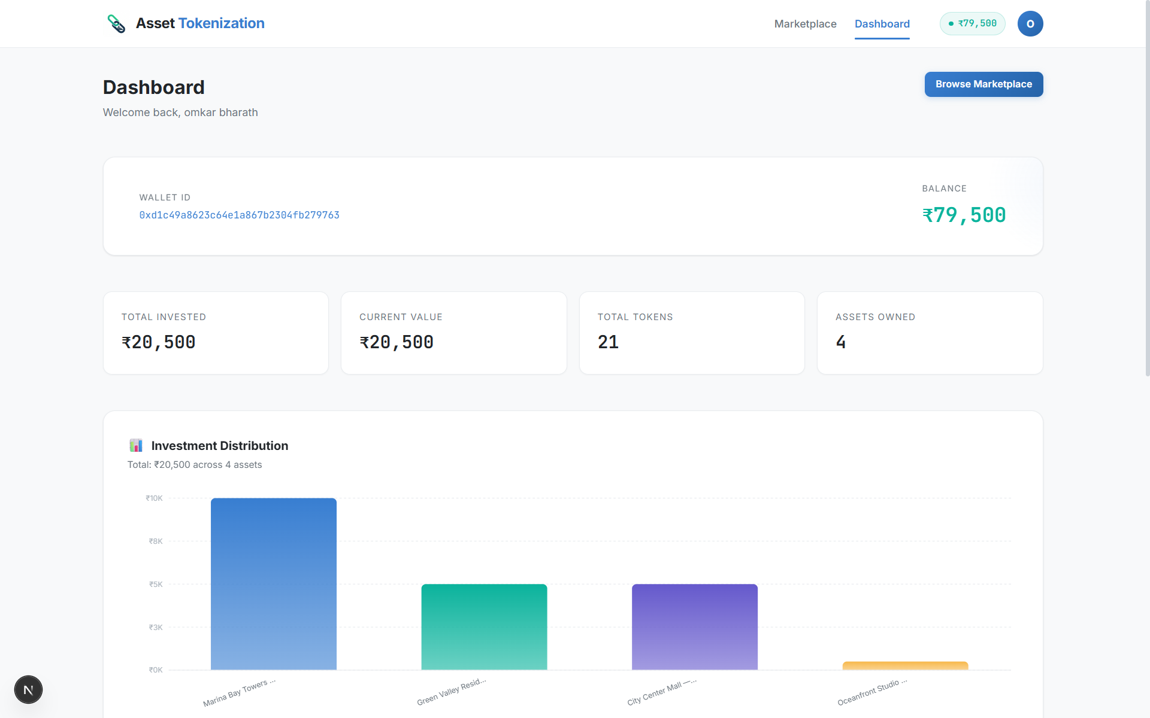
DEPARTMENT OF COMPUTER SCIENCE AND ENGINEERING
USER-DASHBOARD UI
Wallet
Balance
Unique
Wallet ID:
Total Tokens
Purchased
Portfolio
Chart:
ASSET TOKENIZATION
16

Slide 17
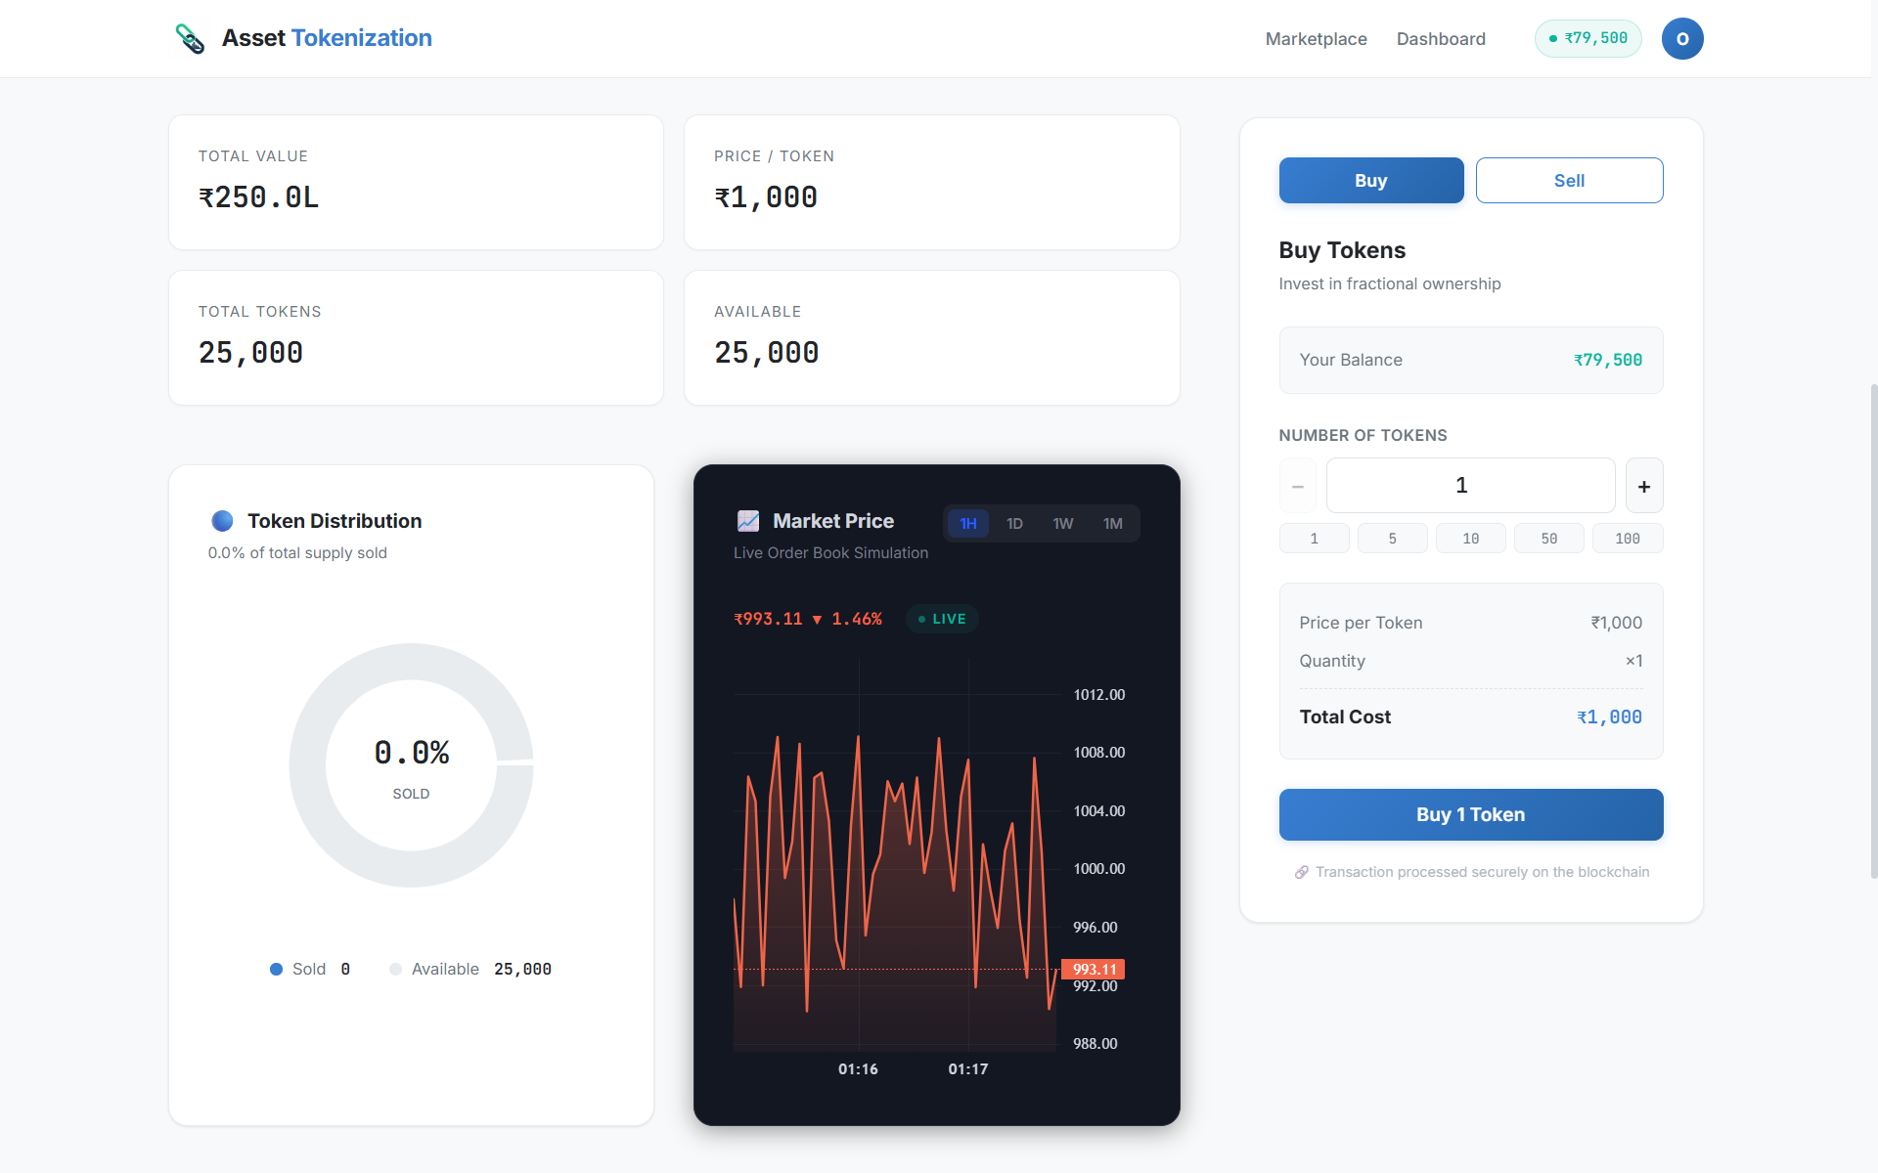
DEPARTMENT OF COMPUTER SCIENCE AND ENGINEERING
ASSET LISTED-INFO
Total Asset Value
Price of Unit Token
Available Tokens
Total Generated Tokens
Chart Simulation of Token
Token Distributed between Users
ASSET TOKENIZATION
17

Slide 18
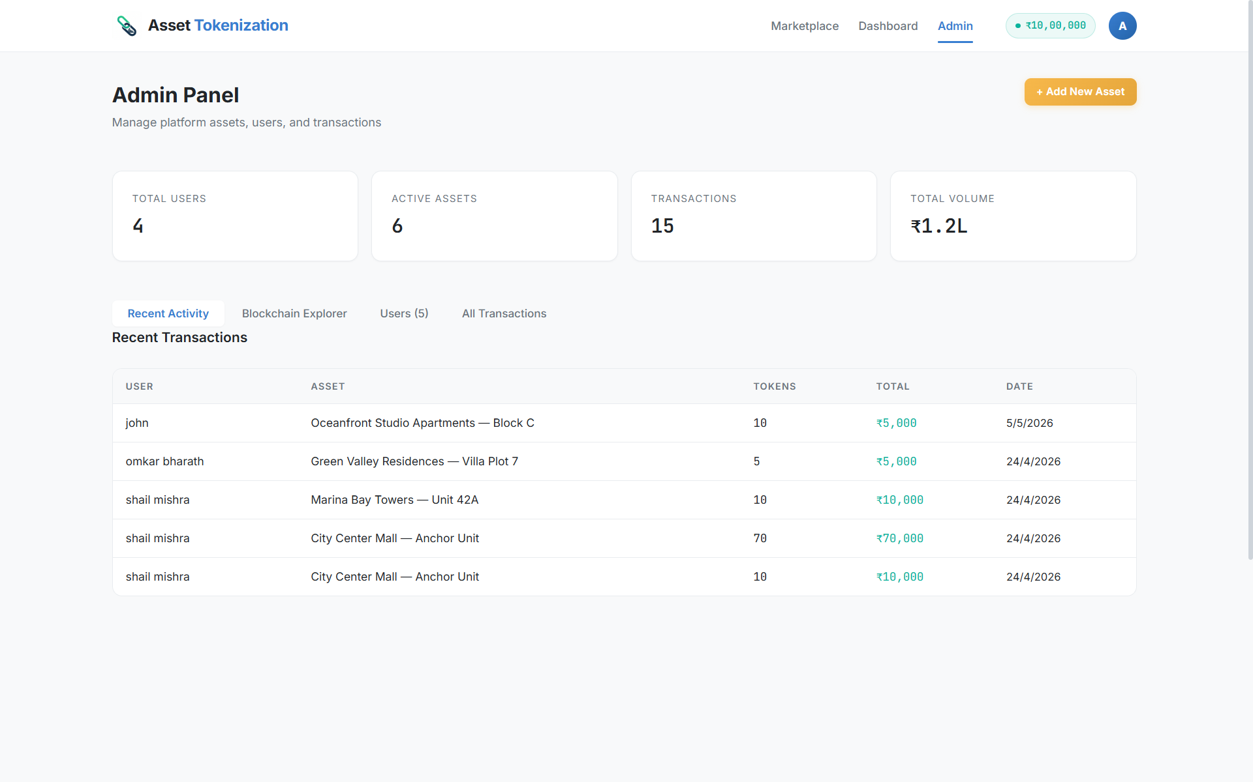
DEPARTMENT OF COMPUTER SCIENCE AND ENGINEERING
ADMIN PANEL
Total Assets Purchased
Total No. of Transactions
Transaction Records
ASSET TOKENIZATION
18

Slide 19
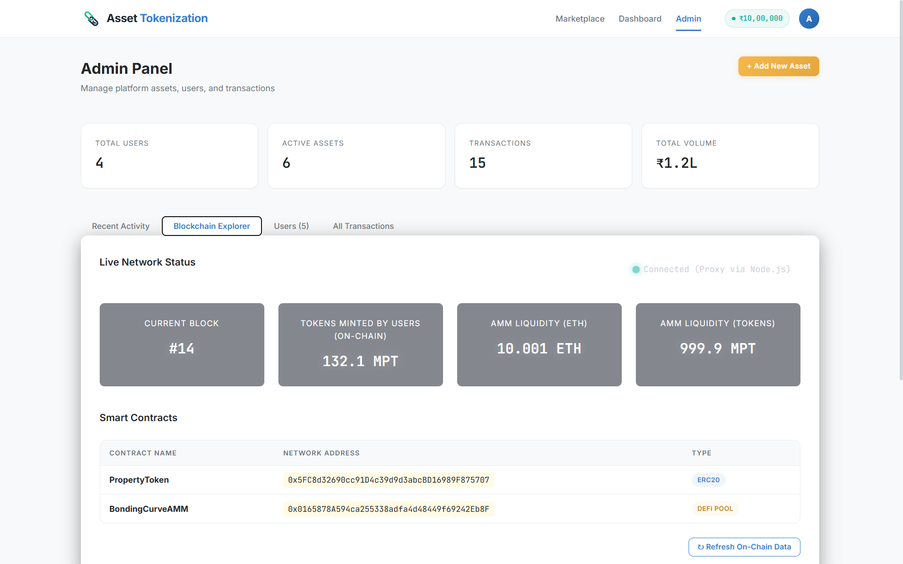
DEPARTMENT OF COMPUTER SCIENCE AND ENGINEERING
ADMIN PANEL – MINTED TOKENS
Tokens Minted by the Users
Liquidity created in Assets
Liquidity Modulator
Total Blocks Created
ASSET TOKENIZATION
19

Slide 20
DEPARTMENT OF COMPUTER SCIENCE AND ENGINEERING
Thank you!
BY
Omkar Bharath Pukale - (1AM23CS127)
Sahil Kumar Mishra - (1AM23CS176)
Sandesh G.C - (1AM23CS183)
Sanjitha A - (1AM23CS186)
ASSET TOKENIZATION
20

