Slide 1


Asset Tokenization-Decentralized platform for Real-World Asset Tokenization Using Blockchain
AMC Engineering College
Under Visvesvaraya Technological University, Belagavi
Major Project Phase – II – BCS786
Presented By
Under the guidance of
Prof.Premkumar M K
Assistant Professor, AMCEC
Omkar Bharath Pukale(1AM23CS127)
Sahil Kumar Mishra(1AM23CS176)
Sandesh G.C(1AM23CS183)
Sanjitha A(1AM23CS186)
2026–27

Slide 2
2. Project Overview
Project Introduction and problem overview
Asset Tokenization is the process of representing ownership rights of real-world assets as digital tokens on a blockchain
Our project focuses on Real-World Asset(RWA) tokenization, particularly assets such as real estate and other high-value/illiquid assets, where traditional ownership and investment can involve high capital requirements and complex processes.
Many assets are difficult to trade in small portions and also ownership records depend heavily on intermediaries, which often restricts access for smaller investors and slows down transactions.
Why is this Problem Relevant?
High-value assets are often difficult to access for small investors.
Traditional ownership involves intermediaries and complex procedures.
AMC Engineering College | Major Project Phase – II | BCS786
2

Slide 3
2. Project Overview
Many assets have low liquidity, making partial ownership difficult to transfer.
Conventional records do not provide the same level of transparent, tamper-resistant transaction tracking.
Proposed Solution
We propose a blockchain-based platform that:
Represents an asset through digital tokens, enables fractional participation instead of requiring ownership of the entire asset.
Uses smart contracts to manage token creation, transfers and ownership records.
Provides a dashboard for asset management, token purchases and ownership tracking.
Expected Users or beneficiaries of the system
Investors, asset administrators, asset owners/businesses, asset developers, auditors.
AMC Engineering College | Major Project Phase – II | BCS786
2

Slide 4
3. Problem Statement
• Traditional asset markets such as real estate and commodities require high capital investment, which restricts participation for small and medium investors.
Buying or selling assets like property or gold takes days to weeks because of manual verification, paperwork, and settlement. Deals are delayed and the process is error-prone.
Investors outside the asset's country or region often cannot buy it at all, because of local regulations and the lack of a common digital platform. This keeps the investor pool small.
Existing ownership systems involve complex legal and administrative processes, making investment slow, costly, and inaccessible to a wider audience.
Many high-value assets are illiquid, making it difficult for owners and investors to quickly buy, sell, or trade partial ownership.
AMC Engineering College | Major Project Phase – II | BCS786
3

Slide 5
3. Problem Statement
Current asset management relies on centralized intermediaries, causing trust issues, lack of transparency, and dependency on third parties.
Conventional ownership records are vulnerable to manipulation, lack immutability, and provide no tamper-proof audit trail.
There is no widely adopted, user-friendly platform that uses blockchain and smart contracts for secure fractional ownership of real-world assets, and few working prototypes exist to test feasibility, scalability, and performance.
The desired outcome is a working prototype on an Ethereum test network that splits each asset into 1,000+ tokens, confirms purchases within 60 seconds, and records 100% of transactions on-chain with zero invalid or duplicate transfers.
AMC Engineering College | Major Project Phase – II | BCS786
3

Slide 6
4. Objectives
• Tokenize - Represent real-world asset ownership through blockchain-based digital tokens.
Fractionalize - Enable users to participate in high-value assets through smaller ownership units.
Automate - Use smart contracts that securely manages token issuance, transfers and ownership records.
Increase Transparency - Maintain verifiable and tamper-resistant transaction records using distributed ledger technology.
Demonstrate Feasibility - Develop and evaluate a functional prototype for real-world asset tokenization applications.
AMC Engineering College | Major Project Phase – II | BCS786
4

Slide 7
5. Scope of the Project
FUNCTIONAL SCOPE
Asset listing and management
Token creation/generation
Token purchase
Ownership tracking
Transaction history
User portfolio and dashboard
Admin monitoring
TECHNICAL SCOPE
Blockchain-based ownership
AMC Engineering College | Major Project Phase – II | BCS786
5

Slide 8
5. Scope of the Project
Smart contracts
Wallet interaction
Web interaction
Off-chain metadata storage
USER SCOPE
Admin- Lists/manages assets and monitors transactions.
Investor/user- Views assets, purchases tokens and tracks holdings
OUT OF SCOPE
Legal transfer of physical property
Real-world regulatory compliance
AMC Engineering College | Major Project Phase – II | BCS786
5

Slide 9
5. Scope of the Project
Actual physical custody of assets
Production-scale financial transactions
AMC Engineering College | Major Project Phase – II | BCS786
5

Slide 10
6. Literature Survey
Author/Year | Journal/Source | Method | Contribution | Limitation
Nishith Desai Associates,2025 | Legal Framework Study | Comparative analysis | Identifies regulatory & cross-border challenges | Regulatory complexity
Agur et al.,2025 | Financial Market Study | Theoretical Framework | Discusses network effects, market power & systemic risks | Mainly theoretical
World Economic Forum,2025 | Industry Research | Expert interviews & workshops | Identifies tokenization models and ownership concepts | High-level industry focus
Soni et al.,2025 | Investment Perspective | Case studies & interviews | Highlights fractional ownership, efficiency & transparency | Requires practical implementation
IFSCA,2025 | Policy Framework | Analytical study | Discusses risk management & regulatory clarity | Regulatory framework still evolving
AMC Engineering College | Major Project Phase – II | BCS786
6

Slide 11
7. Existing System
Current System | Limitations
Traditional asset ownership | High capital requirement
Legal & Administrative processes | Slow and costly
Centralized Intermediaries | Dependency and trust issues
Conventional record keeping | Limited transparency
Full-asset ownership model | Difficult fractional trading
Traditional trading | Limited liquidity
Centralized verification | Slower ownership verification
Need for Improved Approach
A blockchain-based platform is needed to enable fractional ownership+ transparent records+ secure transactions.
AMC Engineering College | Major Project Phase – II | BCS786
7

Slide 12
8. Proposed System
Architecture
USER → REACT.JS + METAMASK → NODE.JS/EXPRESS → SMART CONTRACT → ETHEREUM SEPOLIA → OWNERSHIP & TRANSACTIONS
Workflow
Asset → Fractionalize → ERC-20 Token → Connect Wallet → Buy/Transfer → Validate → Blockchain → Ownership Updated
Key Improvements
Fractional Ownership + Transparency + Secure Transactions + Token Trading + Verifiable Ownership
AMC Engineering College | Major Project Phase – II | BCS786
8

Slide 13
8. Proposed System
Proposed System Component | Purpose/Improvement
Fractional Tokenization | Enables users to own smaller portions of high-value assets
Blockchain | Provides transparent and verifiable ownership records
Smart Contracts | Automates token creation, transfer and ownership management
React.js Frontend | Provides an easy-to-use platform for users
Node.js+Express.js | Handles application logic and API communication
MongoDB | Stores user profiles, asset details and other off-chain data
MetaMask Wallet | Connects user wallets and authorizes transactions
AMM/order book | Supports buying, selling and trading of asset tokens
AMC Engineering College | Major Project Phase – II | BCS786
8

Slide 14
9. System Requirements
• Hardware requirements – Intel i5 or equivalent, Minimum 8 GB RAM,256 GB SSD or higher, Stable Internet connection.
• Software requirements – React.js ,Node.js, Express.js, Next.js, Tailwind CSS, JavaScript Solidity, Hardhat, OpenZeppelin(for blockchain dev tools),ethers.js(frontend blockchain integration), JWT,Multer.
• Database/cloud/network requirements – MongoDB, Mongoose, MongoDB Atlas(Cloud DB), Infura RPC Node(Blockchain-as-a-Service), Sepolia Testnet(Decentralized Ledger), ERC-20/Smart contracts(core blockchain ledger functionality).
• Development and deployment environment – Vercel / Netlify (Frontend hosting), Render / Vercel Serverless (Backend hosting), AMC Engineering College(Project environment context).
AMC Engineering College | Major Project Phase – II | BCS786
9

Slide 15
10. System Architecture
Input/data acquisition layer
User Interface (React.js, Next.js, Tailwind CSS)
MetaMask wallet authorization for blockchain access
API requests initiated via ethers.js
2. Pre-processing & Feature Extraction Layer
JWT authentication for secure user sessions
Validation of inputs (form data, transaction requests)
Conversion of frontend actions into blockchain-compatible formats (Solidity contract calls)
3. Core Processing / Algorithm Layer
Backend Server (Node.js, Express.js) handles business logics
AMC Engineering College | Major Project Phase – II | BCS786
10

Slide 16
10. System Architecture
Smart contract executes tokenization rules using Solidity + Hardhat + OpenZeppelin
ERC‑20 standard ensures interoperability and token consistency
4. Database / Storage Layer
MongoDB + Mongoose for structured data storage (user profiles, metadata)
MongoDB Atlas for scalable cloud storage
Ethereum Sepolia Testnet for immutable blockchain records
5. Application / Output / Presentation Layer
Frontend deployment on Vercel / Netlify
Backend hosting on Render / Vercel Serverless
Output to users: dashboards, transaction confirmations, token balances, analytics.
AMC Engineering College | Major Project Phase – II | BCS786
10

Slide 17
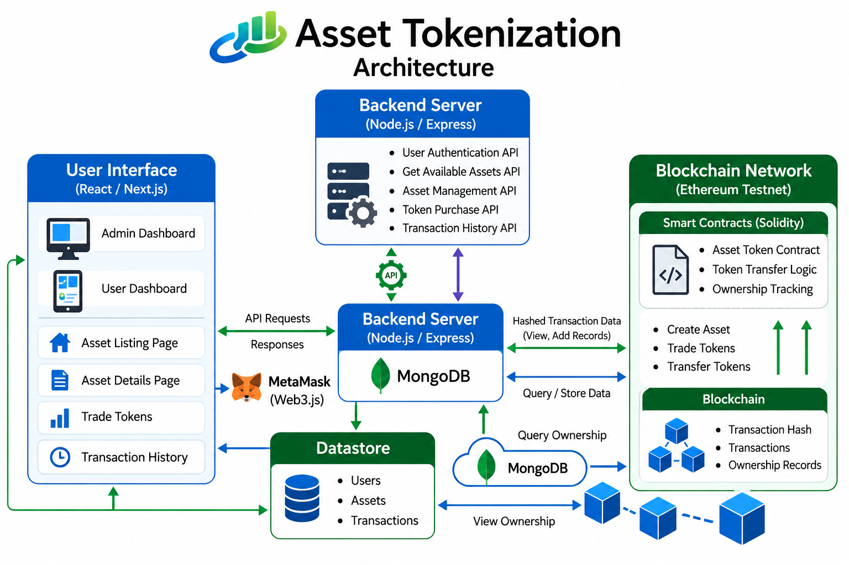
10. System Architecture
AMC Engineering College | Major Project Phase – II | BCS786
10

Slide 18
11. Methodology
Step 1 – Data/input collection.
Identify the limitations of traditional asset ownership. Collect asset details such as asset name, description, value and ownership information. Define the requirements for fractional ownership and tokenization. Identify the required user and transaction information.
Step 2 – Pre-processing and Preparation
Organize and prepare the collected asset information. Design the system architecture with Frontend, Backend, Database, Blockchain and Wallet. Store application-related information in MongoDB. Prepare the asset for tokenization by dividing it into smaller ownership units.
Step 3 –Algorithm/Model Development
Develop Solidity smart contracts for asset tokenization. Use the ERC-20 token standard to represent fractional ownership. Implement token creation, transfer and ownership
AMC Engineering College | Major Project Phase – II | BCS786
11

Slide 19
11. Methodology
Management. Implement trading mechanisms such as AMM and order book. Test and compile smart contracts using Hardhat/Remix.
Step 4 – Integration and Implementation
Develop the frontend using React.js. Develop backend services using Node.js and Express.js .Integrate MongoDB for off-chain data. Connect MetaMask for wallet authentication and transaction approval. Connect smart contracts with the Ethereum Sepolia test network. Integrate all components into one working platform.
Step 5 – Testing and Evaluation
Functional Testing: Asset listing, token purchase, transfer and ownership update.
Smart Contract Testing: Token balance, ownership transfer and transaction validation.
Integration Testing: Frontend, backend, database, wallet and blockchain communication.
AMC Engineering College | Major Project Phase – II | BCS786
11

Slide 20
11. Methodology
Usability Testing: Ease of navigation and transaction workflow.
Verify that invalid transactions are rejected correctly.
AMC Engineering College | Major Project Phase – II | BCS786
11

Slide 21
12. Technologies Used
• Programming language(s): JavaScript, Solidity
• Frameworks/libraries: React.js ,Node.js, Express.js, Next.js, Tailwind CSS, ethers.js, JWT, Multer
• Database/cloud/platform: MongoDB, Mongoose
• Development tools/IDE: Hardhat, Remix IDE
• Blockchain/Wallet: Solidity Smart Contracts, ERC-20, OpenZeppelin, MetaMask
Network: Ethereum Sepolia Testnet, Infura RPC
AMC Engineering College | Major Project Phase – II | BCS786
12

Slide 22
13. Module Description
• Module 1 – User & Asset Management:
Handles user registration/login, asset listing, asset details, and browsing available assets.
• Module 2 – Asset Tokenization:
Converts real-world assets into fractional digital tokens using Solidity smart contracts and ERC-20 tokens.
• Module 3 – Token Trading & Transactions:
Handles token purchase, transfer, marketplace transactions, wallet connection, and transaction processing.
• Module 4 – Ownership & Admin Management:
Tracks token ownership, transaction records, asset management, and provides admin monitoring and verification.
AMC Engineering College | Major Project Phase – II | BCS786
13

Slide 23
14. Workflow / Algorithm
Input
User/Admin enters asset details.
User connects MetaMask wallet.
Asset information is received through the web interface.
Pre-processing
User authentication and input validation.
Asset details are stored/retrieved from MongoDB.
Wallet connection is established.
Asset is divided into smaller ownership units.
Core processing
ERC-20 tokens are created using Solidity smart contracts.
AMC Engineering College | Major Project Phase – II | BCS786
14

Slide 24
14. Workflow / Algorithm
Tokens represent fractional ownership of the asset.
Smart contracts manage token purchase, transfer and ownership.
AMM / Order Book handles token trading
Decision / Validation
Check whether transaction conditions are valid.
Check token availability and required parameters.
User approves the transaction through MetaMask.
Smart contract accepts or rejects the transaction.
Output
Tokens are transferred to the buyer's wallet.
Ownership/token balances are updated on the blockchain.
AMC Engineering College | Major Project Phase – II | BCS786
14

Slide 25
14. Workflow / Algorithm
Transaction details and asset information are displayed.
User can view portfolio and transaction history.
Major Algorithm/Technology:
ERC-20 Tokenization + Solidity Smart Contracts with AMM-based and Order-Book trading mechanisms
AMC Engineering College | Major Project Phase – II | BCS786
14

Slide 26
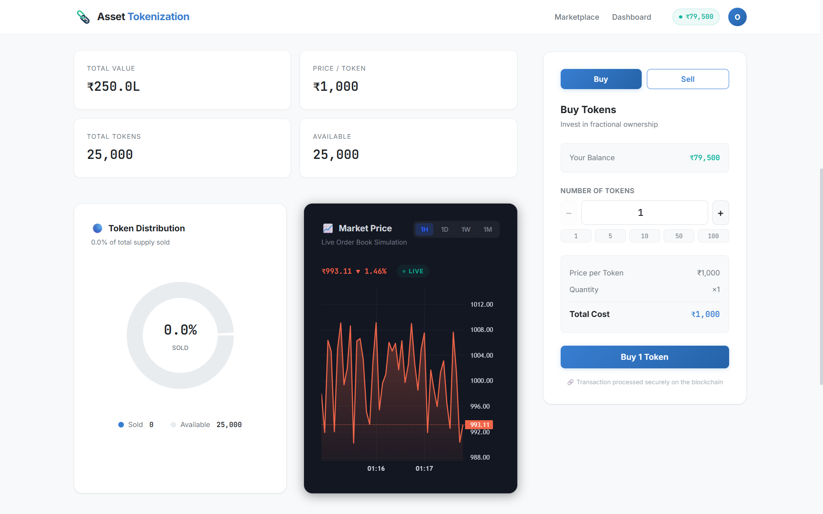
15. Implementation
Frontend
React.js / Next.js
Asset listing and details
Portfolio and transaction history
MetaMask wallet integration
Backend
Node.js + Express.js
User authentication
Asset management APIs
MongoDB integration
Blockchain
Solidity smart contracts
ERC-20 tokenization
Token purchase and transfer
Ownership verification
AMM & Order-Book trading
AMC Engineering College | Major Project Phase – II | BCS786
15

Slide 27
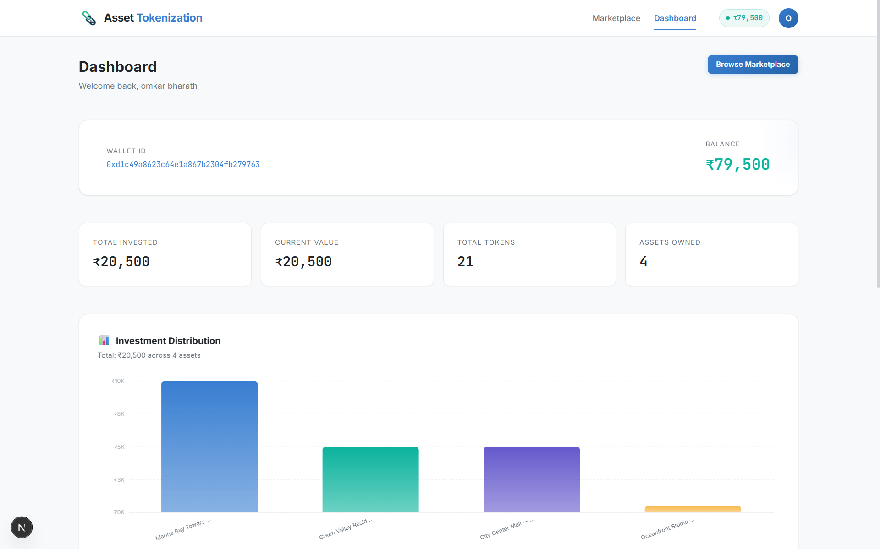
15. Implementation
Deployment
Ethereum Sepolia Testnet
MetaMask transaction authorization
Hardhat / Remix for development and testing
AMC Engineering College | Major Project Phase – II | BCS786
15

Slide 28
16. Dataset / Input Data
• Dataset/source of input: Asset details, user information, wallet details, and transaction data.
Data stored: Asset descriptions, images, user profiles and other application data are stored in MongoDB.
Blockchain data: Token balances, ownership records and transaction states are maintained through Solidity smart contracts on the Ethereum test network.
Data split/sampling: Not applicable, system uses live user inputs and application/blockchain data.
Pre-processing: User authentication, input validation, asset-data validation and smart-contract validation are performed before transactions.
Privacy/Ethical considerations: User and wallet information should be handled securely; the current prototype does not include a complete KYC/AML or regulatory-compliance framework.
AMC Engineering College | Major Project Phase – II | BCS786
16

Slide 29
17. Results & Performance
Tokenization
Real-world assets represented as ERC-20 tokens
Fractional ownership supported
Transactions
Token purchase and transfer executed successfully
Invalid transaction conditions rejected
Ownership
Blockchain token balances verified
Ownership records updated after transactions
Trading
AMM swap workflow tested
Order-book trading workflow tested
AMC Engineering College | Major Project Phase – II | BCS786
17

Slide 30
17. Results & Performance
Function | Result
User Registration | ✓ Passed
Asset Creation & Listing | ✓ Passed
Wallet Connection | ✓ Passed
Token Purchase | ✓ Passed
Token Transfer | ✓ Passed
Invalid Transaction | ✓ Passed
Ownership Verification | ✓ Passed
Order-Book Trade | ✓ Passed
AMM Swap | ✓ Passed
AMC Engineering College | Major Project Phase – II | BCS786
17

Slide 31
18. Testing
Functional Testing: Tested user registration and authentication, Verified asset creation and listing, Tested wallet connection, Checked token purchase and transfer, Verified ownership updates.
Smart Contract Testing: Tested token balances and ownership changes, Verified token minting and transfer, Checked transaction validation conditions, Invalid transactions were rejected by the smart contract.
Integration Testing: Tested communication between:
React.js → Node.js/Express → MongoDB, Tested MetaMask → Smart Contract, Verified that frontend transactions correctly reached the blockchain.
4. Usability Testing: Checked the user workflow:
Select Asset → Connect Wallet → Approve Transaction → Verify Portfolio
Checked ease of navigation and transaction feedback.
AMC Engineering College | Major Project Phase – II | BCS786
18

Slide 32
18. Testing
Test Case | Expected Outcome | Result
User registration/login | User successfully authenticated | Passed
Asset listing | Asset details displayed correctly | Passed
Wallet connection | MetaMask connects successfully | Passed
Token Purchase | Tokens transferred to buyer | Passed
Token transfer | Ownership/balance updated | Passed
Invalid transaction | Transaction rejected | Passed
Ownership verification | Blockchain balance matches application | Passed
AMC Engineering College | Major Project Phase – II | BCS786
18

Slide 33
19. Advantages, Conclusion & Future Scope
Advantages:
Fractional ownership – users can own a smaller portion of high-value assets.
Transparency – blockchain provides a verifiable record of token transactions.
Secure ownership management – smart contracts manage token creation and transfers.
Reduced dependence on intermediaries – ownership and transactions are managed through blockchain.
Easy access through web platform – users can list assets, purchase tokens and track their portfolio.
Conclusion:
The project successfully demonstrates a prototype platform for converting real-world assets into fractional digital tokens using blockchain technology.
AMC Engineering College | Major Project Phase – II | BCS786
19

Slide 34
19. Advantages, Conclusion & Future Scope
React.js, Node.js/Express, MongoDB and Solidity were integrated into one platform.
Smart contracts manage token ownership and transactions.
MetaMask enables users to authorize blockchain transactions.
Testing demonstrated the main asset, token and ownership workflows.
Future Scope:
Perform independent smart-contract security auditing & large-scale testing.
Improve wallet usability.
Add support for more asset categories.
Introduce stronger identity and compliance mechanisms.
Deploy on a production blockchain.
Add more advanced secondary-market trading features.
AMC Engineering College | Major Project Phase – II | BCS786
19

Slide 35
20. References & Thank You
REFERENCES
Nishith Desai Associates (2025) – Real Estate Tokenisation — Legal, Tax and Regulatory Considerations.
Agur et al. (2025) – Tokenization and Financial Market Inefficiencies.
World Economic Forum (2025) – Asset Tokenization in Financial Markets.
Soni, Fines & Sun (2025) – An Investment Perspective on Tokenization.
IFSCA (2025) – Regulatory Approach towards Tokenization of Real-World Assets.
Benedetti & Rodriguez-Garnica (2021) – Tokenized Assets and Securities.
THANK YOU
AMC Engineering College | Major Project Phase – II | BCS786
20

