Slide 1



Slide 2
LED BLINK

Slide 3
WHAT IS LED?
In the simplest terms, a light-emitting diode (LED) is a semiconductor device that emits light when an electric current is passed through it.
It is a light sensor which emits light that is reflected from surface which further helps in sensing the environment.

Slide 4
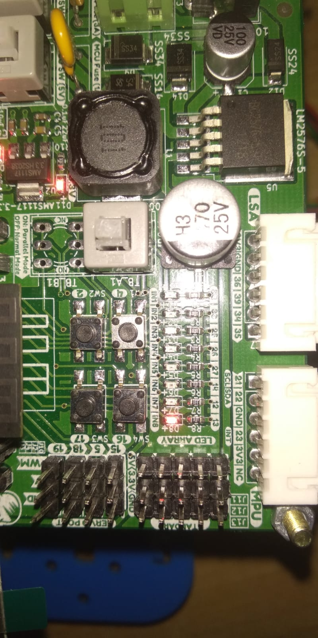
0 0 0 0 0 0 0 1 –> The position of bits corresponds to the position of LEDS in the series and the
value at the corresponding position
shows the state of the LED
8th ………………….. . . .1st led
0 -> LED is OFF
1 -> LED is ON
Eg. If I want only 5th and 6th LED to stay ON, I’ll write 00110000

Slide 5
Task 1. Blink all the 8 LEDs once.
Algorithm:
Turn ON all the 8 LEDs i.e. 11111111
Turn OFF all the 8 LEDs i.e. 00000000
Task 2. Blink all the 8 LEDs thrice.
Algorithm:
repeat 3 times {
Turn ON all the 8 LEDs i.e. 11111111
Turn OFF all the 8 LEDs i.e. 00000000
}

Slide 6
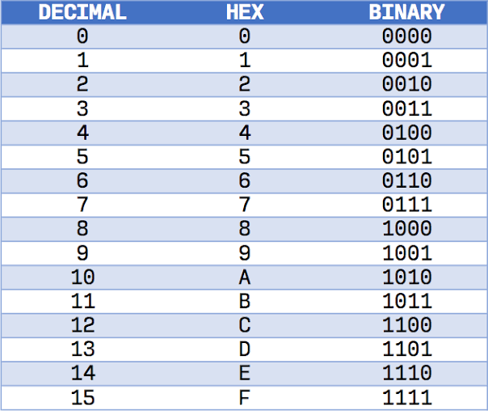
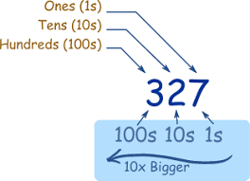
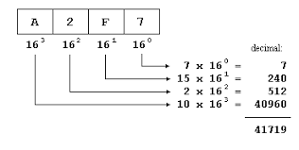
Hexadecimal to Decimal Conversion
Decimal number System :
A number system which uses digits from 0 to 9 to represent a number with base 10 is the decimal system number.
Hexadecimal number System :
It is a numbering system that is base 16. This system, therefore, has numerals 0, 1, 2, 3, 4, 5, 6, 7, 8, 9, 10, 11, 12, 13, 14, and 15.

Slide 7
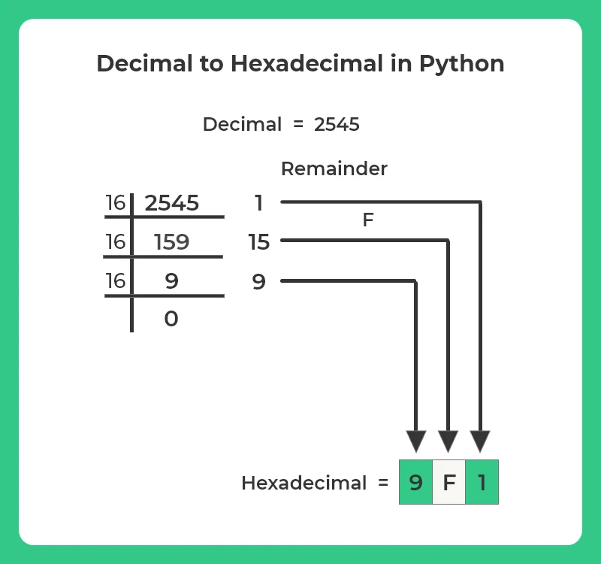
Decimal to Hexadecimal Conversion
Convert 960 into hexadecimal number :
Divide by 16 | Quotient | Remainder | Hex Value
960 / 16 | 60 | 0 | 0
60 / 16 | 3 | 12 | C
3 / 16 | 0 | 3 | 3
(960)₁₀ = (3C0)₁₆

Slide 8
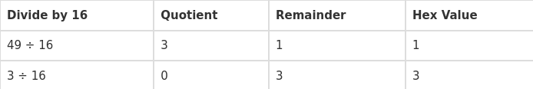
Quiz :
Convert (4A)₁₆ into decimal number:
(4A)₁₆ = 4x16¹ + Ax16⁰
= 4x16 + 10x1 = (74)₁₀
Convert (49)₁₀ into hexadecimal number:
(49)₁₆ = (31)₁₆

Slide 9
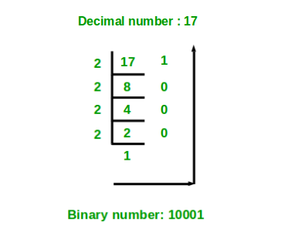
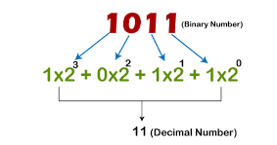
Binary to Decimal Conversion
A method of representing numbers that has 2 as its base and uses only the digits 0 and 1. Each successive digit represents a power of 2.

Slide 10
Binary to Hexadecimal
(11111111)₂ = (FF)₁₆
1111 1111
F F
(10001)₂ = (11)₁₆
0001 0001
1 1

Slide 11
Binary To Decimal
(111) ₂= ( x )₁₀
(111)₂ = ( 1 x 2² ) + ( 1 x 2¹ ) + ( 1 x 2⁰ )
= 4+2+1
= (7)₁₀
Decimal To Binary
(14)₁₀ = ( x )₂
Division Remainder (R)
14 / 2 = 7 0
7 / 2 = 3 1
3 / 2 = 1 1
1 / 2 = 0 1
(14)₁₀ = ( 1110)₂

Slide 12
Left shift Operator
Task 3 : Blink all the LEDs one by one starting from the right hand side
syntax: var << y
0000 0001
0000 0010
.
.
.
.
1000 0000
var = 00000010
Eg 1. var = var << 2
explanation:
00000010 -> 00001000
Value stored at var is: 00001000
Eg 2. var = 11111111
var = var << 2
explanation:
11111111 -> 11111100
Value stored at var is: 11111100

Slide 13
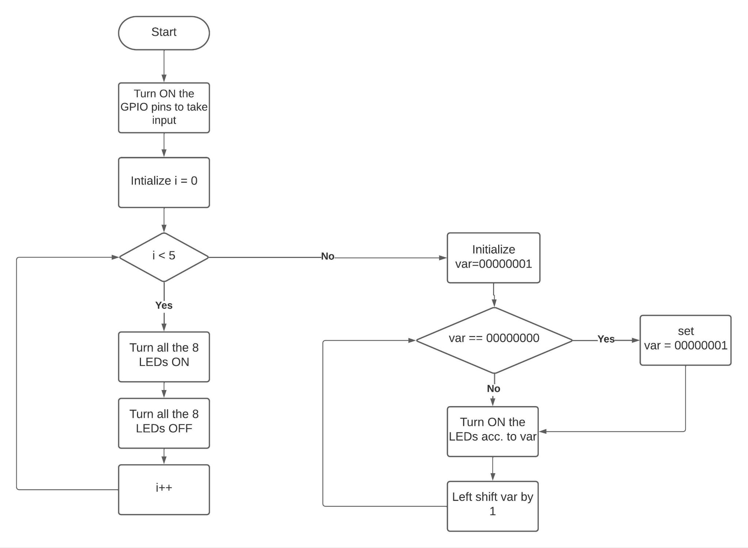

Slide 14
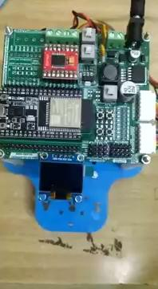

Slide 15
References
Number systems
Left Shift Operator

Slide 16

