Slide 1

Hospitality Analysis

Slide 2
CONTENTS :
Why Hospitality Analysis ?
Metrics
KPI’s
Excel Dashboard
Power Bi Dashboard
Conclusion
Tableau Dashboard

Slide 3
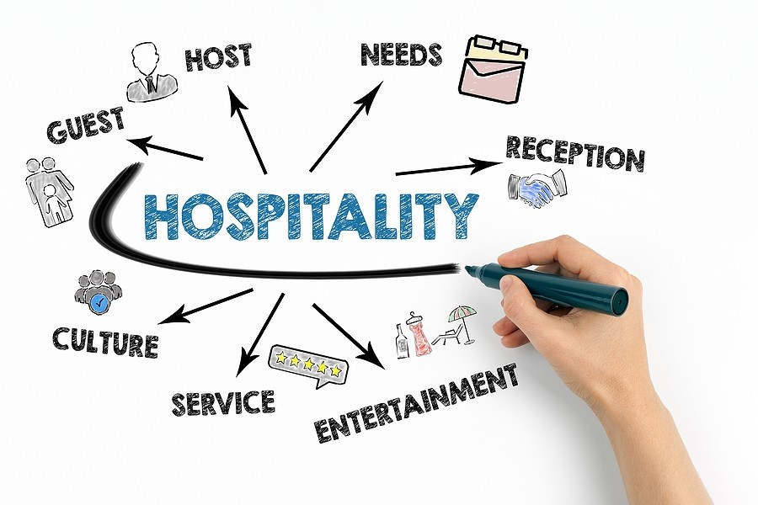
Why Hospitality Analysis ?
Data analytics in hospitality helps hoteliers make data driven decisions that boost efficiency. Use it to improve the customer experience and drive profitability by accurately Forecasting demand. It also gives your F&B department the necessary data to make optimal purchasing decisions.

Slide 4
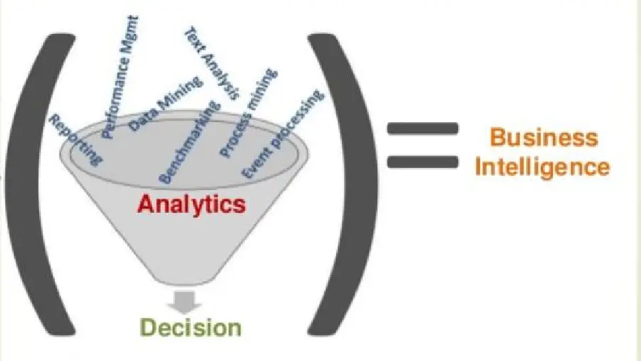
METRICS :
Hotel Performance metrics are crucial for evaluating a hotel’s operational efficiency, financial performance, and guest satisfaction. Occupancy rate and ADR assess demand and pricing strategies, while RevPAR and TRevPAR offer a comprehensive view of revenue generation.

Slide 5

KPI’s
Total Revenue
Occupancy
Cancellation Rate
Total Booking
Utilize Capacity
Trend Analysis
Weekday & Weekend revenue and bookings
Revenue by state & hotels
Class wise revenue
Checked out cancel no show
Weekly trend key trend ( Revenue, Total booking, occupancy )

Slide 6
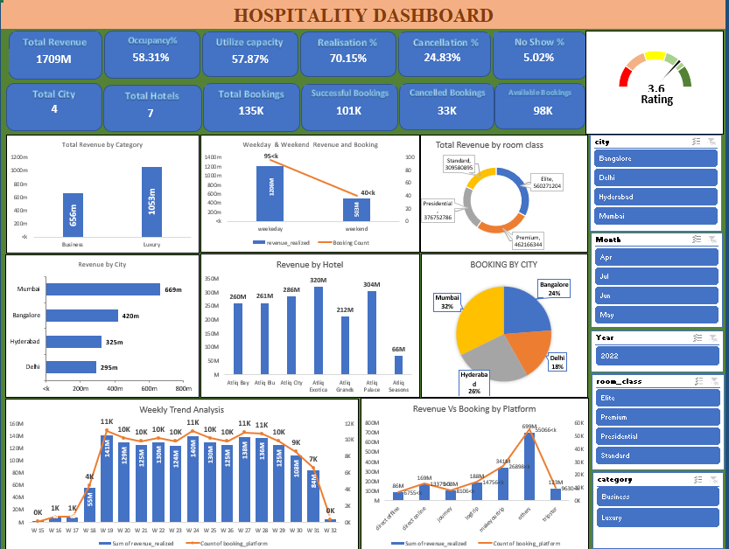
EXCEL DASHBOARD
Excel dashboard" is a visual representation of key data points and metrics designed to provide a concise overview of information for easy analysis and decision-making.

Slide 7
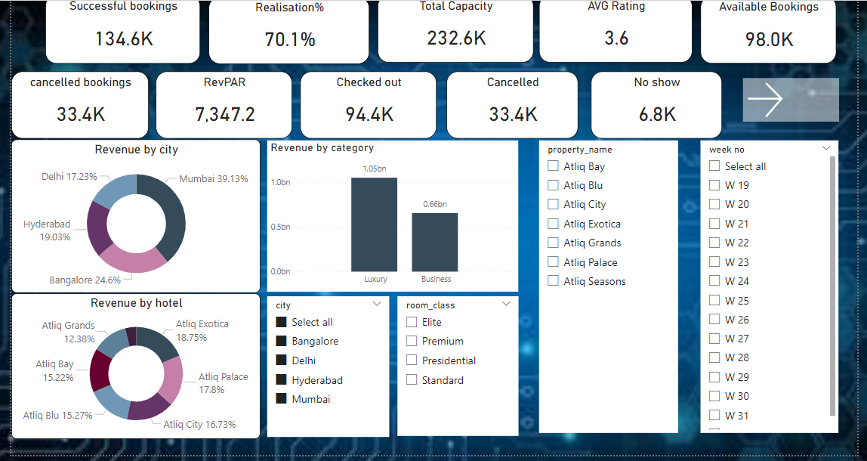
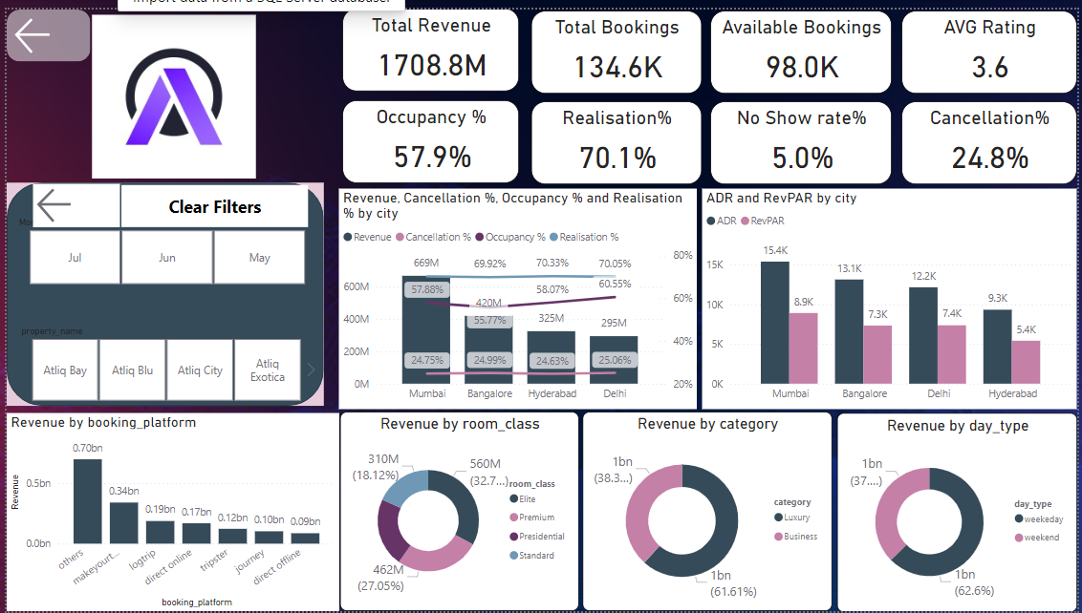
POWER BI DASHBOARD
A Power BI dashboard is a dynamic and interactive platform for visualizing and analyzing data from multiple sources.

Slide 8
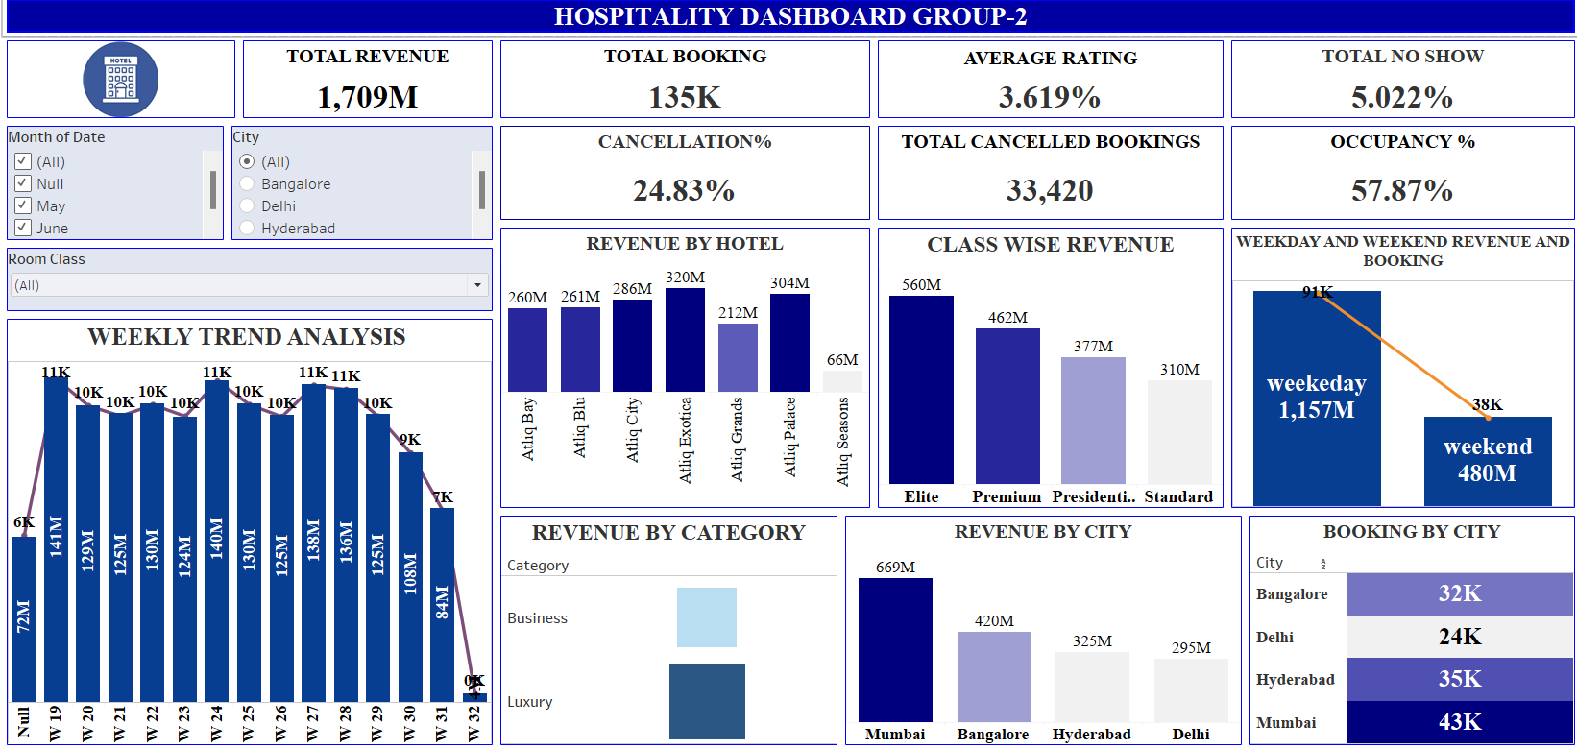
TABLEAU DASHBOARD
A Tableau dashboard serves as a dynamic and visual representation of data, enabling users to gain insights and make informed decisions.

Slide 9

CONCLUSIONS:
Delhi Has the highest occupancy % and Rating.
Mumbai earns the most revenue.
Mumbai hosts the most guests compared to other city.
The room type which is most preferred by the guest is Elite.
The property which generates the maximum revenue is Atliq Exotica.
The maximum revenue is generated in the month of may.
Luxury category rooms/suites are preferred by the guests over the business category room.
Atliq Blu has the highest occupancy rate.
Most of the guest prefer a one day stay at the hotels.
The maximum numbers of bookings are done through miscellaneous or other platform direct offline mode of booking is preferred the least.

Slide 10
Thank You!

