Slide 1
secure data hiding in images using steganography
CAPSTONE PROJECT
Presented By
Student Name : Omkar S. Khanolkar
College Name & Department : Vidyavardhini’s college of Engineering and Technology
Department of Computer Engineering

Slide 2
OUTLINE
Problem Statement
Technology used
Wow factor
End users
Result
Conclusion
Git-hub Link
Future scope

Slide 3
Problem Statement
Sharing sensitive files securely can be challenging. StegoShadow solves this by hiding encrypted files inside images using steganography. This ensures safe and discreet data transfer without drawing attention.

Slide 4
Technology used
Programming Language: Python 3
Libraries:
OpenCV (opencv-python-headless) – Image processing
hashlib – Used to generate a SHA-256 hash from the password
base64 – Used to encode the hashed key in a URL-safe format.
Cryptography (Fernet encryption) – Secure file encryption
Steganography Technique: Least Significant Bit (LSB) embedding
Command-Line Interface (CLI): User interaction via terminal
Operating System Support: Windows & Linux (e.g., Kali Linux)
System Requirements:
Processor: Minimum Intel i3 or AMD equivalent (Recommended: i5/i7 for faster processing)
RAM: Minimum 4GB (Recommended: 8GB for handling larger images)
Storage: At least 200MB free space

Slide 5
Wow factors
Strong Security – Uses encryption (Fernet) to protect hidden files, ensuring only authorized users can retrieve them.
Invisible Data Hiding – Embeds files in images using the Least Significant Bit (LSB) technique, making the modifications undetectable.
Cross-Platform Support – Runs smoothly on both Windows & Linux (Kali Linux), making it accessible for different users.
User-Friendly CLI – Simple command-line interface that allows easy hiding and extraction of files with step-by-step guidance.
Supports Any File Type – Can hide text, images, videos, audio, PDFs, and more within images without affecting the overall appearance.

Slide 6
End users
Privacy-Conscious Individuals – Users who want to securely share confidential files or messages without detection.
Intelligence & Law Enforcement Agencies – Organizations that require discreet communication and secure file transfer.
Businesses & Corporations – Companies needing to protect sensitive data, trade secrets, or internal communications.
Digital Content Creators – Individuals embedding watermarks or hidden messages in images for digital rights management.
Journalists & Activists – People operating in high-risk environments who need to securely share information without censorship risks.
Ethical Hackers & Cybersecurity Experts – Professionals working in cybersecurity for testing and research on secure data transmission

Slide 7
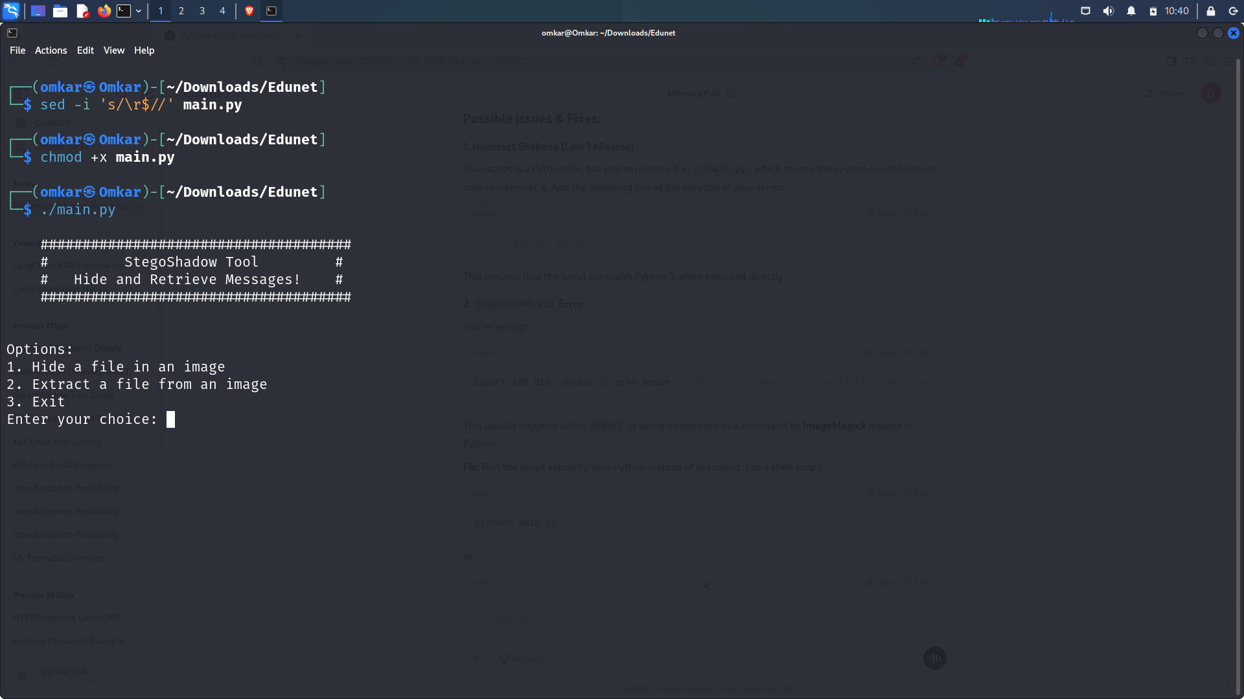
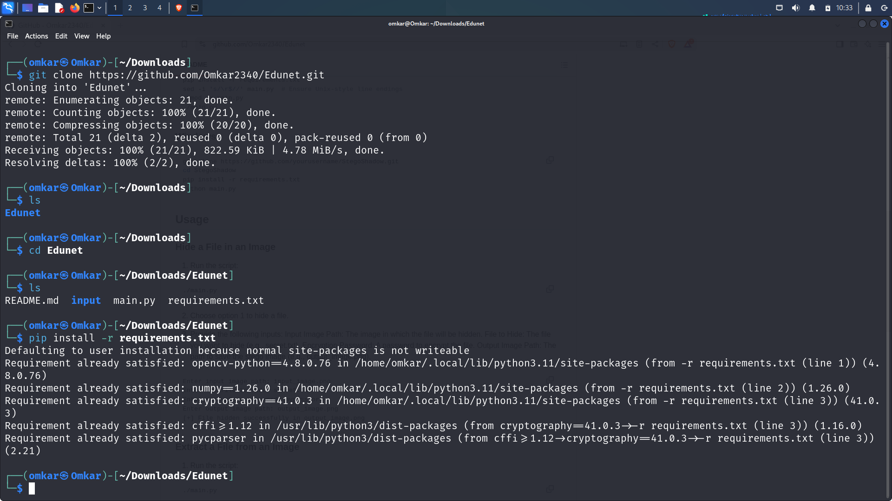
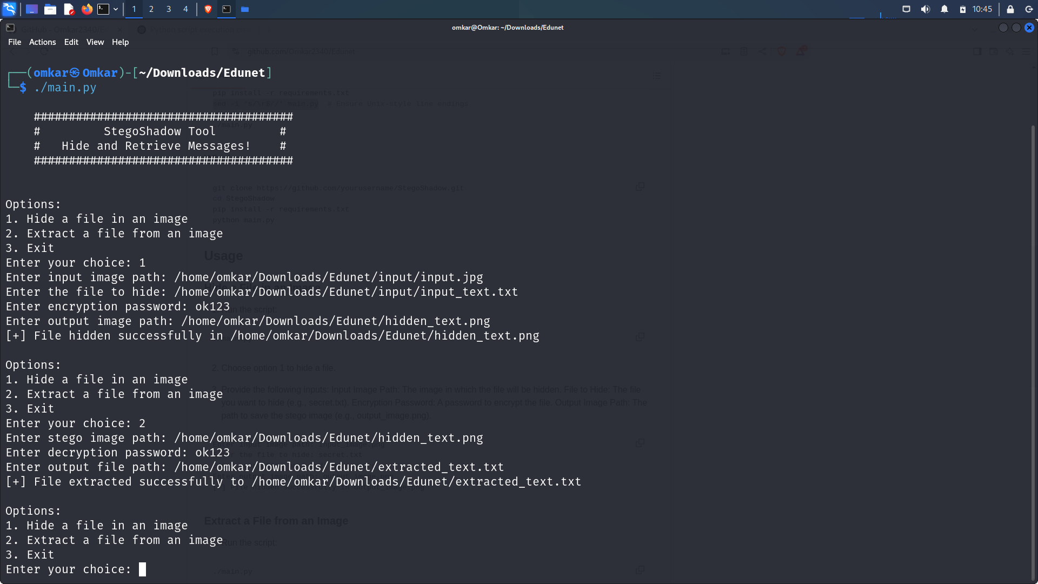
Results
For Linux

Slide 8
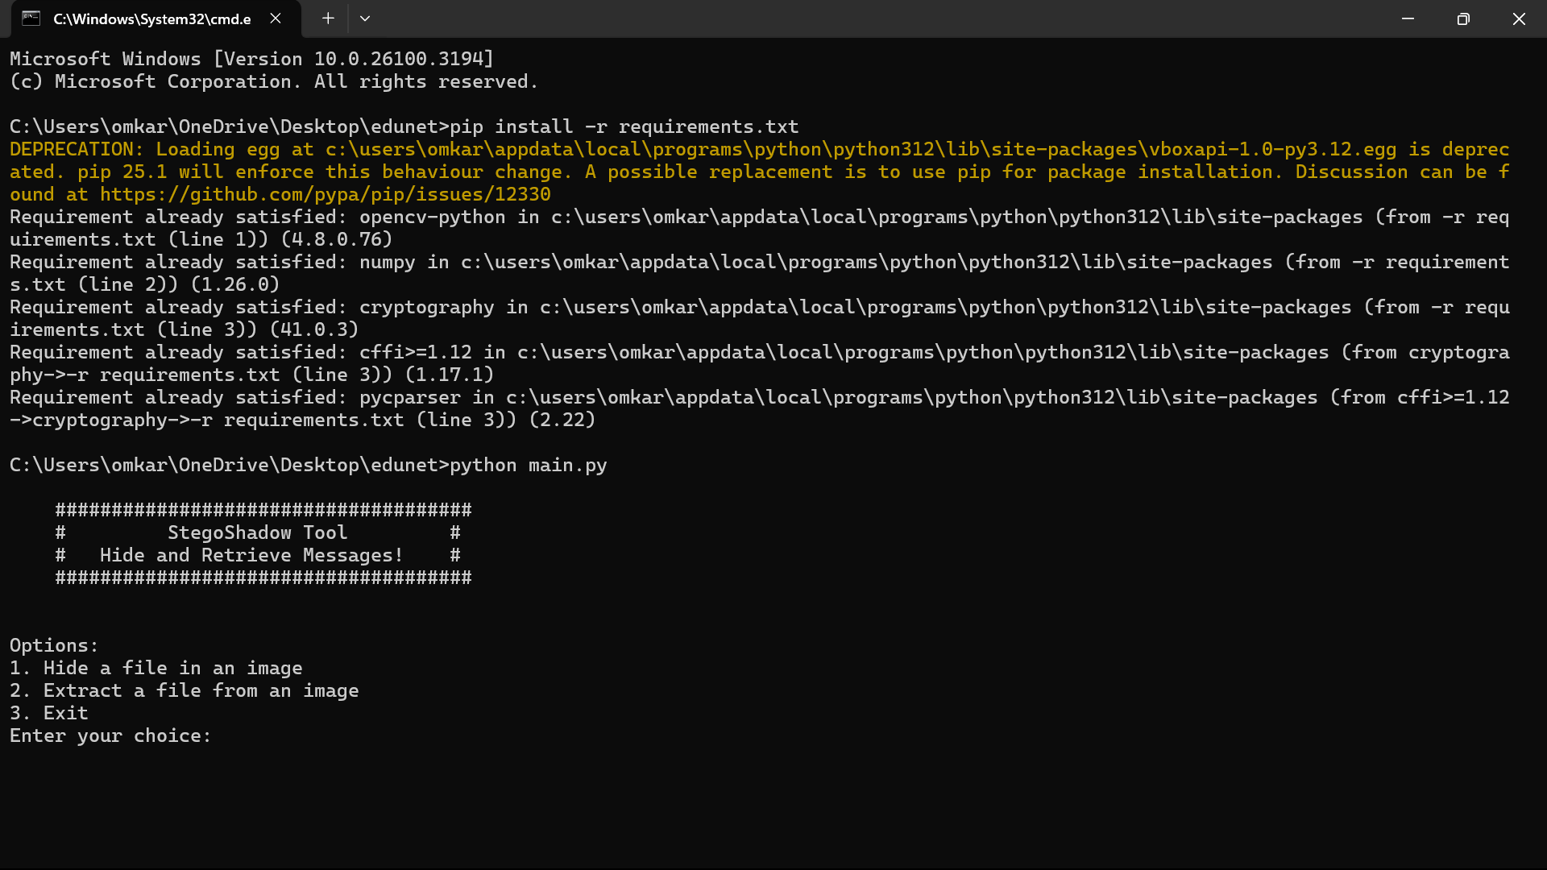
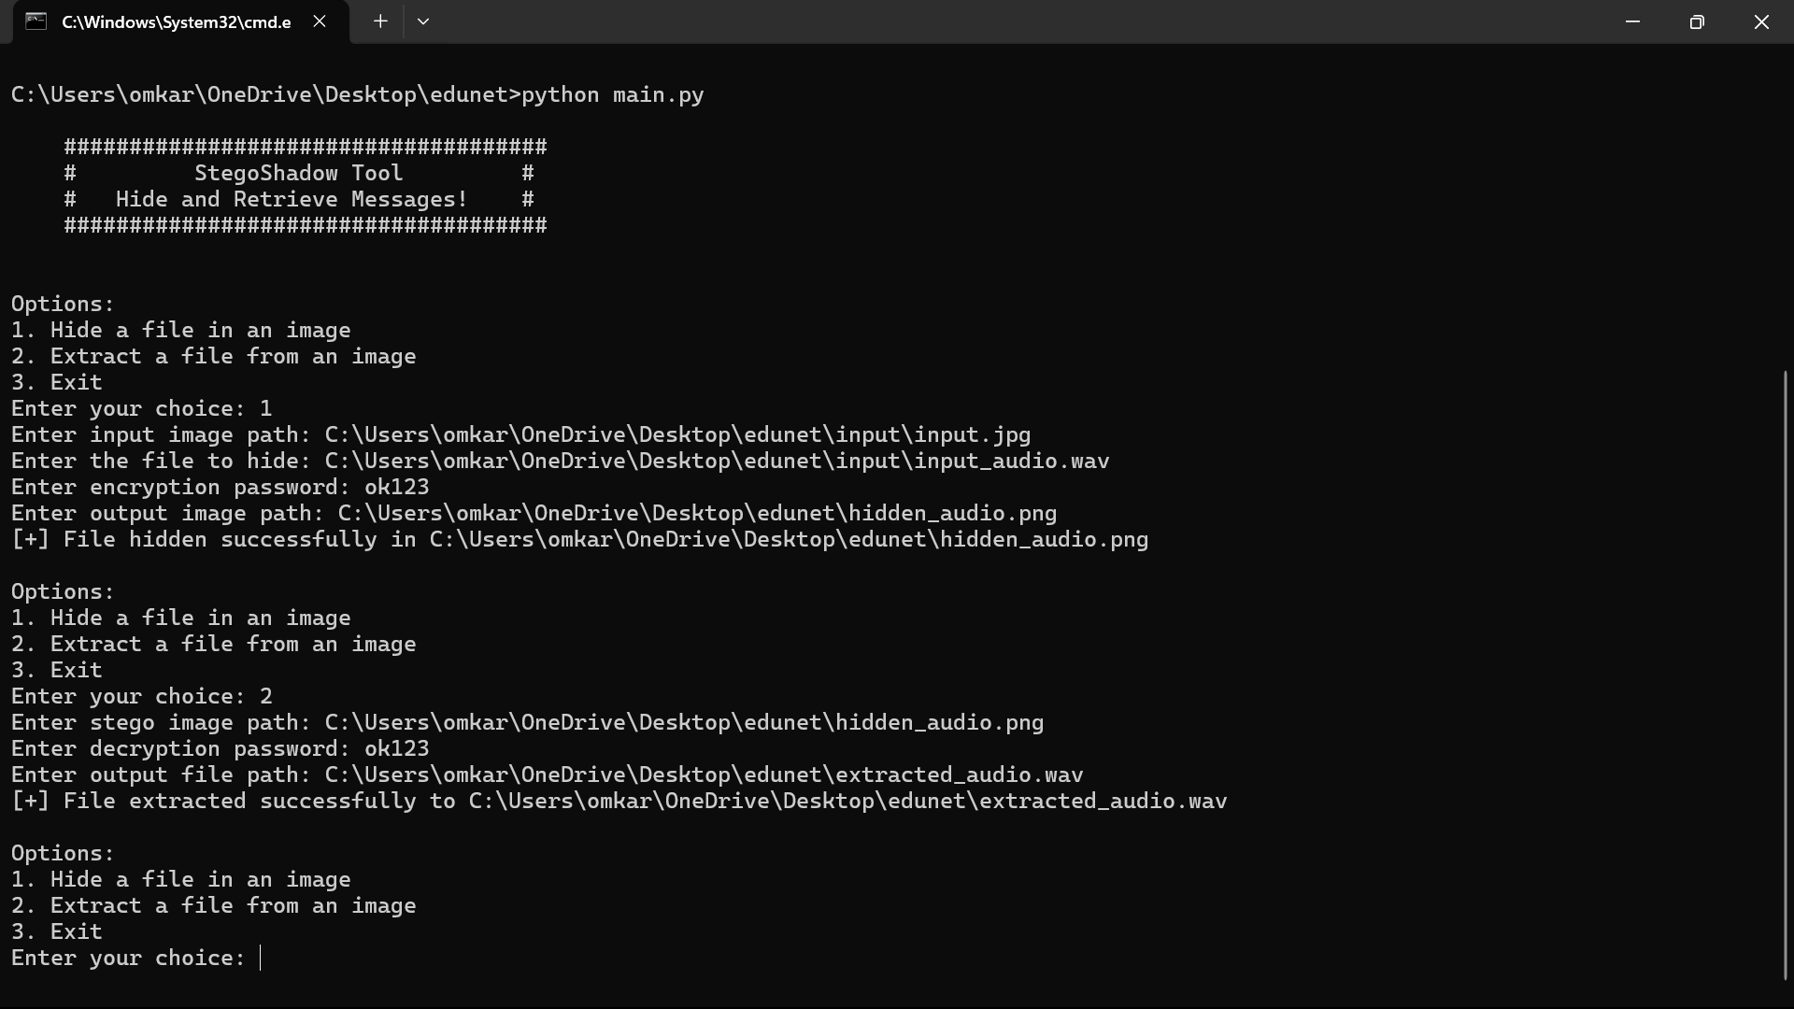
Results
For Windows

Slide 9
Conclusion
StegoShadow is a powerful and secure steganography tool that enables users to hide and retrieve files within images using encryption. By leveraging the Least Significant Bit (LSB) technique, it ensures that hidden data remains undetectable while maintaining image quality. With its simple command-line interface, cross-platform support, and strong encryption, StegoShadow is ideal for privacy-conscious individuals, cybersecurity experts, businesses, and digital content creators.
This tool not only enhances data security and confidentiality but also provides a seamless way to share sensitive information without attracting attention. As an open-source project, it can be further improved and customized to meet evolving security needs.

Slide 10
GitHub Link
https://github.com/Omkar2340/AICTE.git

Slide 11
Future scope
GUI Integration – Develop a user-friendly Graphical User Interface (GUI) for easier file hiding and extraction.
Web-Based Version – Create a web application to enable online steganography without requiring local installation.
Advanced Encryption – Enhance security by integrating stronger encryption algorithms for improved data protection.
AI-Powered Detection Prevention – Implement AI techniques to avoid steganalysis and improve data concealment methods.
Cloud Integration – Enable secure cloud storage options for uploading and retrieving stego images.
Steganography Over Networks – Implement features for hiding data in network packets, making it useful for secure communications.

Slide 12
THANK YOU

