Slide 1
Student Details
Name: Omkar Ankush Saraf
Gmail: omkarsaraf18@gmail.com
College: Deogiri Institute of Engineering and Management Studies
College State: Maharashtra
Domain: Artificial Intelligence [From 12 June 2023 to 24 July 2023]

Slide 2
Mental Health Fitness Tracker
An instrument or software programme known as a "mental fitness tracker can be od sock ind keep tabs on a person's mental health and wellbeing over time. These trackers can be used to record and keep track of a range of things, including mood, sleep, exercise, food, medication use, and stress levels, that can have a pact on mental health.
Monitoring changes in mood and behaviour as well as patterns and trends in mental health over time can all be done with the use of mental fitness trackers, which can also be used to track the effectiveness of therapy or medication. Additionally, they can assist people in establishing and monitoring objectives for bettering their mental health, such as increasing their physical activity or practising mindfulness.
Trackers for mental fitness come in a variety of designs, including sophisticated smartphone apps. For instance, some applications for mental health provide features like guided meditations, CBT exercises, and mood tracking tools. The usage of mental fitness trackers should not be mistaken for professional medical advice or treatment, despite the fact that they can be an effective tool for enhancing mental health.

Slide 3
Agenda Of Mental Fitness Tracker
Depending on the exact features and tools that the tracker offers, the agenda for a mental fitness tracker can change. But some typical items that might be on an agenda for a mental fitness tracker are as follows:
Setup: This could involve making a user profile, deciding on mental health objectives, and choosing the metrics to monitor (such as stress, mood, sleep,and exercise).
Data logging: This process entails recording details about everyday activities, including how much you slept, what you ate, how much you exercised, and how you felt emotionally.
Data analysis: The tracker may examine the data you've submitted and offer perceptions into patterns or trends in your mental health, such as detectingstress or anxiety causes.
Goal-tracking: The tracker may help you establish and follow objectives for bettering your mental health, such as increasing your physical activity or incorporating mindfulness into your daily life.
Tools and resources: The tracker may include tools and resources to improve mental health, including stress-reduction exercises, guided meditations, and cognitive behavioural therapy activities.
Reminders and notifications: The tracker could send you notifications or reminders to assist you stay on track with your mental health objectives and tomotivate you to enter data frequently.
Progress evaluation: The tracker may offer periodic progress reports or summaries to assist you in evaluating your mental health over time and identifying areas that want improvement.
The goal of a mental fitness tracker is to assist users manage their mental health by giving them the tools and resources necessary for monitoring, analysing, and managing their mental health.

Slide 4
PROJECT OVEVIEW
By tracking several aspects of their mental health, a user of a mental fitness tracker is able to monitor and enhance their mental well-being. The following elements would normally be included in the project overview for a tracker of mental fitness:
Goals: The goal of the mental fitness tracker for tracking and monitoring many elements of their mental health, loading mood sleep, exercise, food, medication use, and stress levels. The tracker's users can establish and monitor objectives for beg resources for managing mental health and well-being and uncover patterns and trends in their mental Seals over time. health access tools and Features. The features of the mental fitness tracker can range from data logging to data analysis goal tracking to tools and resources, remindersand notifications, and progress reviews to give users a tool.
According to the needs of the intended audience and the project's objectives, the tracker's exact features will vary.
Target market People of all ages who are interested in keeping tabs on and enhancing their meal health and market for the mental fitness tracker. The tracker may be particularly helpful for people who are tested as well as those who suffer from mental health issues including anxiety, depression, or bipolar disorder ng excellent mental health be.
Technology: A mix of technologies, such as used in the creation of mobile apps, websites, data analytics, and machine learning, will probably used to create the mental fitness tracker. Depending on the tracker's features and the project's objectives, several technologies will be employed.
Timing: Depending on the project's scale, the size of the development team, and the resources available, the timing for the mental fitness tracker project will vary. The project might be completed in a number of phases, each of which would concentrate on a particle set of characteristics or objectives.
Reminders and notifications: The tracker could send you notifications or reminders to assist you stay on track with your mental health objectives and to motivate you to enter data frequently.
Progress evaluation. The tracker may offer periodic progress reports or summaries to assist you in evaluating your mental health over time and identifying areas that want improvement.
The goal of a mental fitness tracker is to assist users manage their mental health by giving them the tools and resources necessary for monitoring, analysing, and managing their mental health.

Slide 5
Who Are The End Users Of This Project?
People of all ages who want to improve their mental health and well-being might be the final consumers of a mental fitness tracker. People who have been diagnosed with mental health issues like depression, anxiety, bipolar disorder, or post-traumatic stress disorder (PTSD), as well as those who are motivated to preserve excellent mental health, can fall under this category.
A mental fitness tracker may be advantageous for the following particular groups of people : People who are struggling with mental illness A mental fitness tracker can be used by people who have been disposed with mental health disorders to keep tabs on their symptoms, pinpoint the causes of those symptoms, and create coping mechanisms to deal with those symptoms.
Athletes and fitness devotees: Athletes and fitness devotees can use a mental fitness tracker to track their levels of physical activity, observe their sleep patterns, and establish objectives for enhancing their general well-being Students and professionals: By keeping track of their mood, sleep, and exercise routines, students and professionals can reduce stress and increase productivity.
Carers and professionals in mental health Carers and professionals in mental health can use a mental fitness tracker to monitor the mental health of their patients or clients and offer tailored assistance and interventions as necessary.
In general, a mental fitness tracker can be used by anyone who wants to monitor and enhance their mental health and well-being, regardless of age or background.

Slide 6
YOUR SOLUTION AND ITS VALUE PROPOSITION
A mental fitness tracker can help users uncover patterns and trends in their mental health over time by monitoring several components of all like mood, sleep, exercise, and stress levels.
After learning this information, one can adjust their lifestyle for the better and create coping mechas to deal with stre, axity, and other mental health issues.
Personalised insights and recommendations: Based on the information users enter into the tracker, a mental fitness tracker can offer personalised and suggestions, For instance, if a user's mood is typically low in the morning, the tracker can advise them to try getting more sleep or starting an spirits in the morning to lift their.
Defining and monitoring objectives: A mental fitness tracker can assist users in defining and monitoring goals for bettering thermal beach as increasing exercise or engaging in mindfulness exercises. Users can maintain motivation and make modifications as necessary to attain their intended outcomes by tracking progms towards these targets.
Access to mental health resources: A lot of mental fitness trackers give users access to a range of mental health tools, mncluding guided meditation CBT exes, and stress reduction methods. These tools can aid users in creating good coping mechanisms and enhancing their general mental health.
Convenience and simplicity: A mental fitness tracker may be a simple and straightforward tool for keeping tabs on mental wellness Users can submit information about their mental health into a straightforward mobile app or web-based platform and instantly obtain personalised insights and recommendations.
A mental fitness tracker can, in general, provide its users with a variety of advantages, such as enhanced mental health, tailored insights and goal-setting and tracking, access to mental health resources, convenience, and ease of use. recommendations,

Slide 7
How Did You Customize The Project And Make It Your Own
Here are some points on how one could customize the mental fitness tracker.
1. User Interface and Design: Customize the user interface to make it visually appealing. intuitive, and user-friendly. Consider different color schemes, layouts, and interactive elements to create a pleasant and engaging experience.
2. Goal Setting and Tracking: Allow users to set personalized mental fitness goals, such as daily mindfulness practice, weekly stress reduction targets, or monthly cognitive training objectives. Implement tracking mechanisms that display progress over time, motivating users to stay on track.
3. Activity Selection: Offer a wide range of mental fitness activities to suit different preferences and needs. This could include mindfulness exercises, meditation sessions, cognitive puzzles, journaling prompts, or even mood tracking features.
4. Personalized Recommendations: Utilize machine learning algorithms to analyze user activity and preferences, then provide tailored recommendations for mental fitness exercises that are likely to resonate with each individual user.
5. Reminder System: Include a customizable reminder system to prompt users to engage with mental fitness activities regularly. Users should be able to set their own schedule for receiving reminders via push notifications or emails.

Slide 8
Modelling
Designing a mental fitness tracker project involves various aspects to consider. Below are some essential points so keep in mind during the modelling phase:
1. User Interface and Experience (UI/UX): Focus on creating an intuitive and user-friendly interface. Ensure than the design comic and appealing of all ages backgrounds.
2. Features and Functionality: Define the core features of the mental fitness tracker, such as mood tracking, stress level string, meditation gades, galing
3. Data Collection and Privacy: Determine the data points to be collected, such as mood ratings, activities, and habits. Address user pracy cons comply with data petici regulations
4. Machine Learning Integration: Explore incorporating machine learning algorithms to provide personalized insights and recomendations bed on
5. Goal Setting and Reminders: Allow users to set mental health goals and receive reminders to practice mindfulness exercises or eping actress
6. Notification System: Implement an optional notification system that alerts users of their mental fitness progress and encourages consistent age
7. Social Interaction: Consider adding social features, like support groups or the option to share achievements, to create a sense of community andbon among users
8. Data Visualization: Create clear and visually appealing graphs or charts to help users understand their mental fitness trends over time
9. Third-party Integration: Explore integrating with other health apps or wearable devices to gather more comprehensive data, like sleep patterns or playcal activity
10. Gamification Elements: Introduce gamification aspects like rewards, badges, or challenges to make the app engaging and motivate users to contingit
11. Testing and Feedback: Conduct extensive usability testing and gather user feedback to refine the app and make necessary improvements
12. Accessibility: Ensure the app is accessible to users with disabilities, such as providing text-to-speech features or accommodating colorblind indus
13. Scalability and Performance: Design the application architecture to handle a potentially large user base and ensure smooth performace under hecy age
14. Security: Implement robust security measures to protect user data and prevent unauthorized access or data breaches
15. Marketing and Monetization: Develop a clear marketing strategy and decide on the app's monetization model such as in-app purchases, subscription pins, or advertent
16. Continuous Improvement: Plan for regular updates and enhancements to keep the app relevant and competitive in the mental finess market.

Slide 9
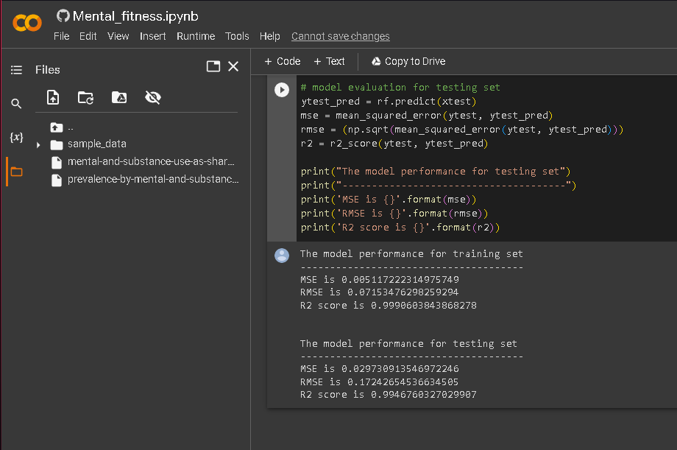
Results

Slide 10
Links
GitHub:
https://github.com/Omkar2509/Mental-fitness-tracker
Google Colab:
https://colab.research.google.com/drive/Mental_fitness

