Slide 1


Tech Championship
Program
2025
Idea Title: Eco Compute -Allianz Sustainable GenAI Optimizing Energy Consumption and Reducing Carbon Footprint in AI Operations
Presenter: Omkar Gondkar
College Name: Vishwakarma Institute of Technology
Location :- Pune Month 01, 2026

Slide 2




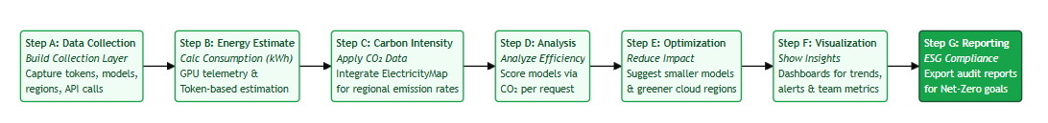

Problem Statement: ESG:​​​​​​​​​​​​​​- Environmental Impact of Generative AI
Idea Description:
The concept is to build an intelligent platform that helps Allianz and its customers understand and manage the environmental impact of Generative AI. The system tracks the energy consumed and CO₂ emitted by AI workloads—whether they run on cloud GPUs or through external LLM APIs—and translates this into clear, verifiable sustainability metrics. It combines real-time usage data, carbon-intensity information, and model-efficiency insights to show exactly how AI operations contribute to an organization’s ecological footprint. Along with measurement, the platform provides practical recommendations such as choosing greener compute regions, using more efficient models, optimizing prompts, and reducing unnecessary workloads. By making AI usage transparent and actionable, the tool supports more responsible technology adoption and strengthens ESG and net-zero initiatives across the organization.
Tool/Coding Language/Platform/Application to be used & How?:
Frontend | Backend | Database | DevOps | Testing | Security | Collaboration
Purpose: Interactive dashboards, CO₂ charts, model comparisons, ESG reports. React.js Next.js TypeScript | Purpose: Track API usage, calculate carbon emissions, deliver reports, run recommendations. Node.js + Express Python (FastAPI) REST API’S | Purpose: Store logs, emission metrics, model metadata, user settings. PostgreSQL TimescaleDB AWS S3 | Purpose: Deployment, scalability, observability, monitoring. AWS Docker Kubernetes | Purpose: Ensure the platform works correctly, from API calls to emission calculations. Jest Pytest Locust | Purpose: Protect usage logs, prevent tampering, secure API calls. OAuth 2.0 API Gateway Encryption AES-256 at REST | Purpose: Documentation, tracking tasks, sharing design work. Jira Figma Miro
Recommended or Best Possible Solution(s):
The AI and Analytics is recommended because it accurately measures the environmental impact of any AI workload and goes beyond reporting by offering practical, automated ways to reduce emissions. By combining real-time energy estimation, carbon data, model efficiency analysis, and smart optimization features like greener region routing and prompt improvement, it solves the problem end-to-end and provides a unique, actionable approach to making AI usage truly sustainable
Accurate — Measures real energy and CO₂ across all AI workloads.
Comprehensive — Supports both in-house models and third-party LLM APIs.
Actionable — Provides optimization tips, not just reporting.
Smart — Recommends efficient models, prompts, and greener regions.
Sustainable — Directly reduces the environmental footprint of AI usage.
Solution Implementation Plan:
Potential Benefits:

Slide 3
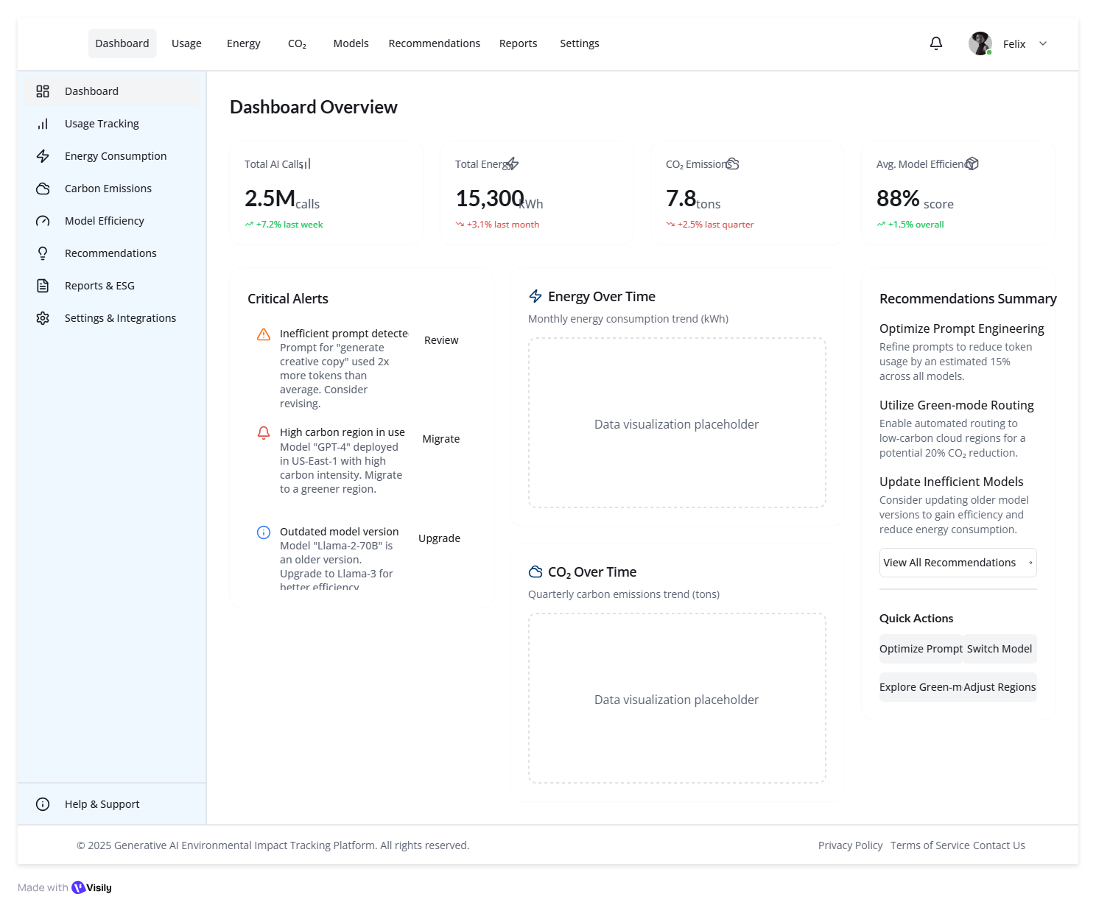
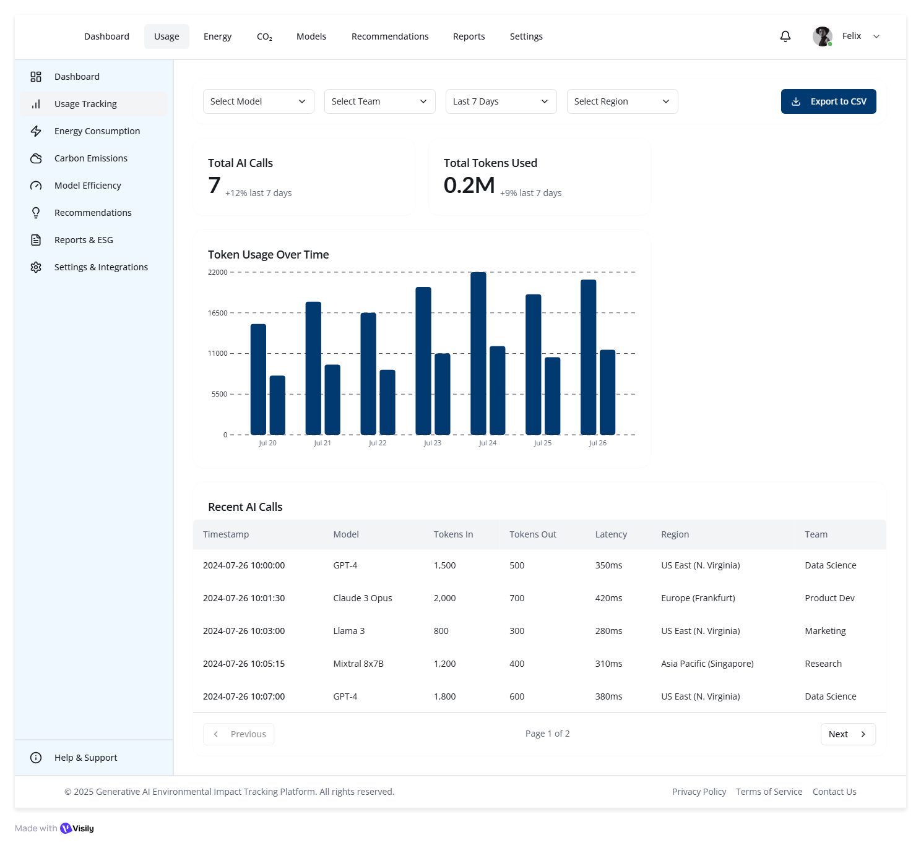

Wireframe Design for Eco-Compute
Main Dashboard
AI Usage Tracking
Login & Auth

Slide 4
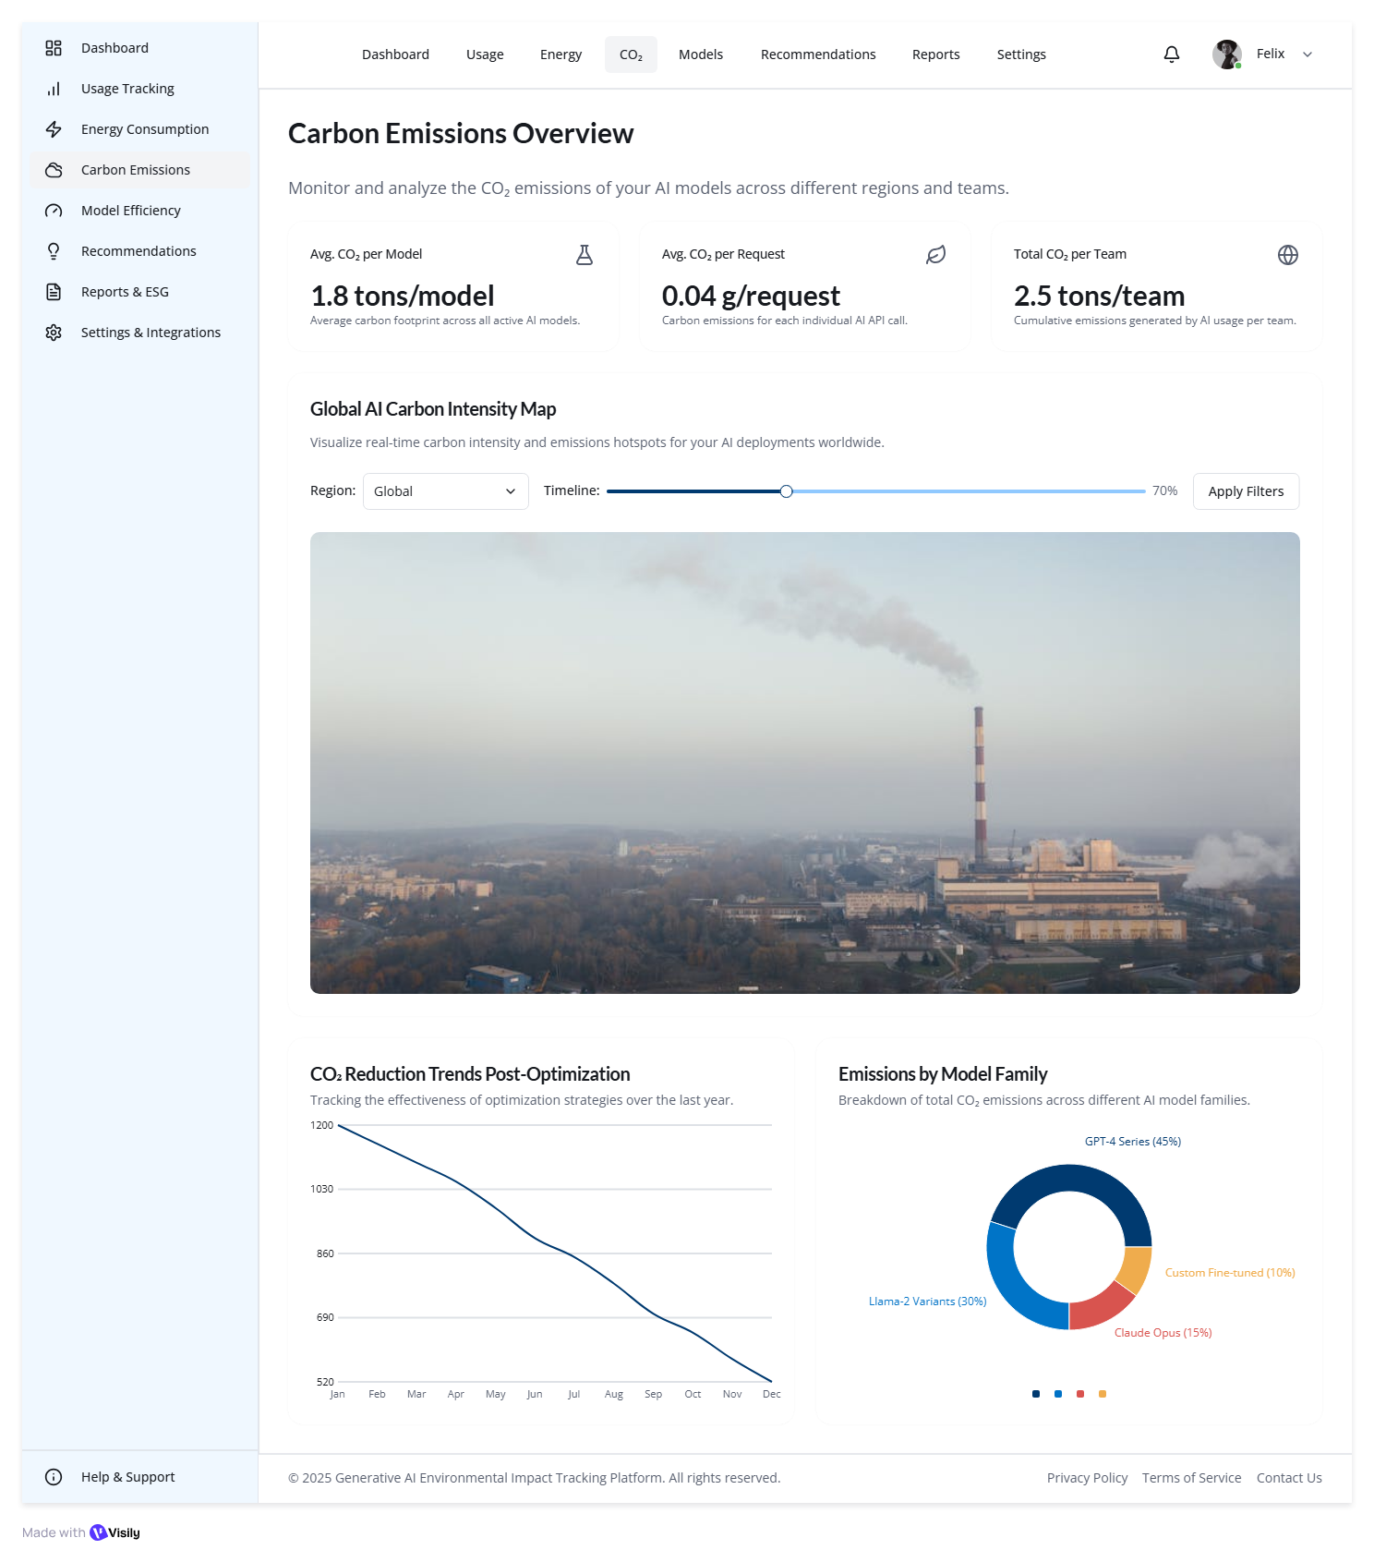
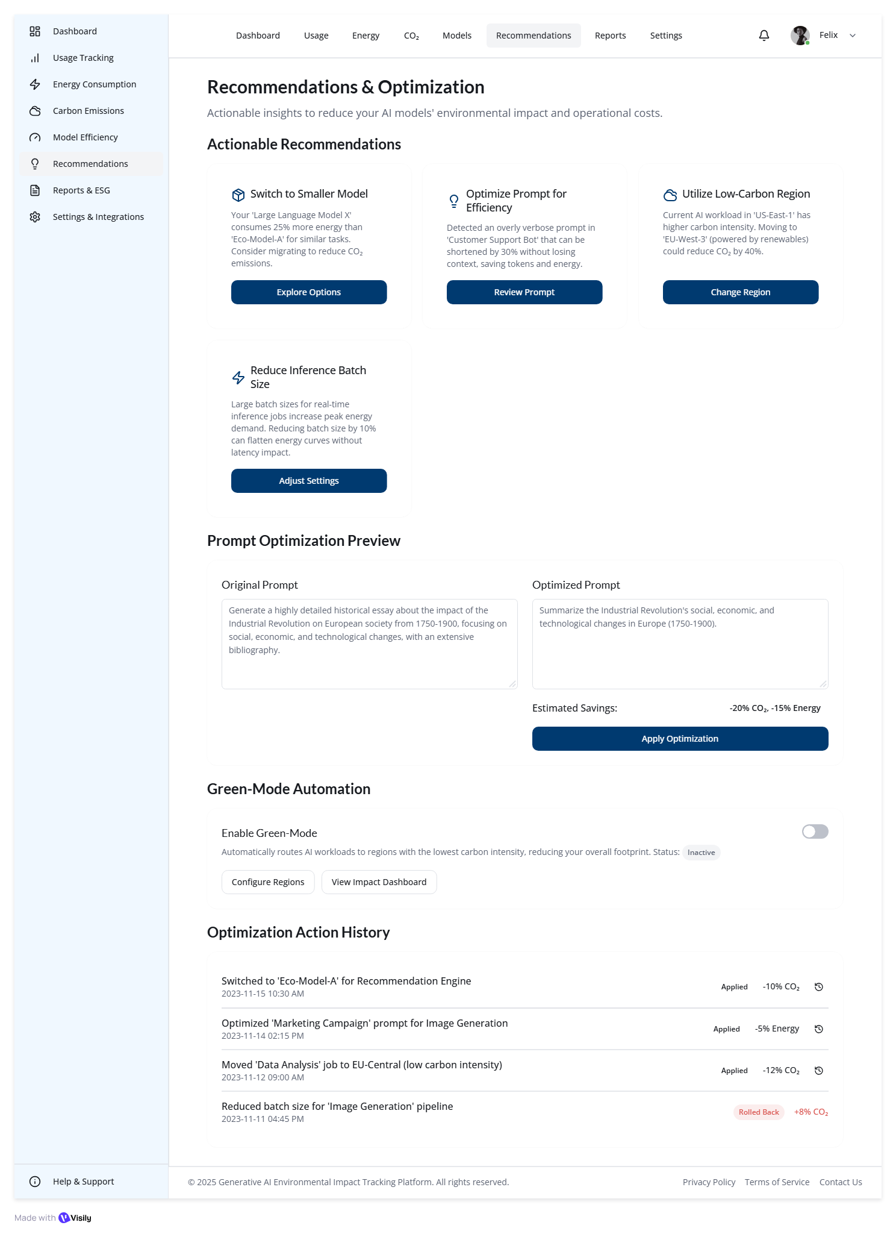
Wireframe Design for Eco-Compute
Carbon Emission Dashboard
Recommendation & Optimization

Slide 5
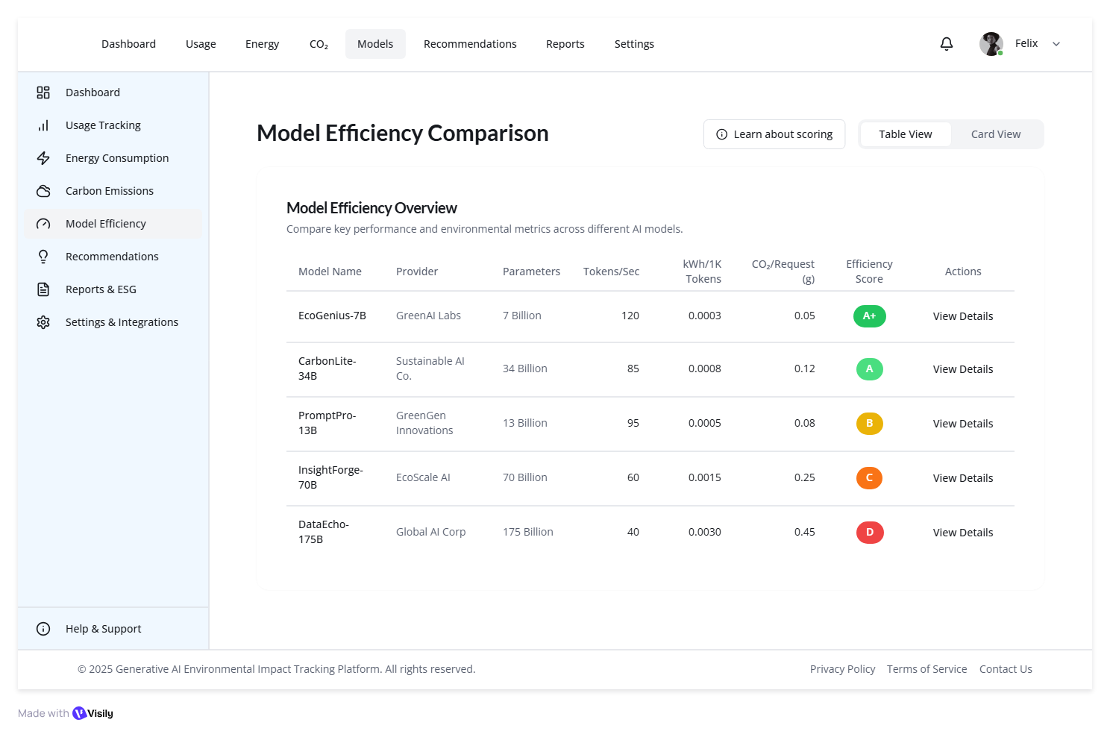
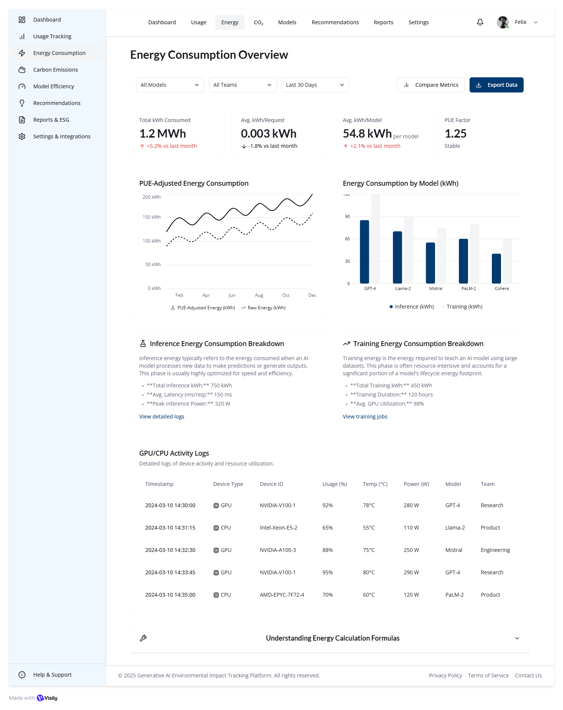
Wireframe Design for Eco-Compute
Model Efficiency Comparison
Energy Consumption

Slide 6
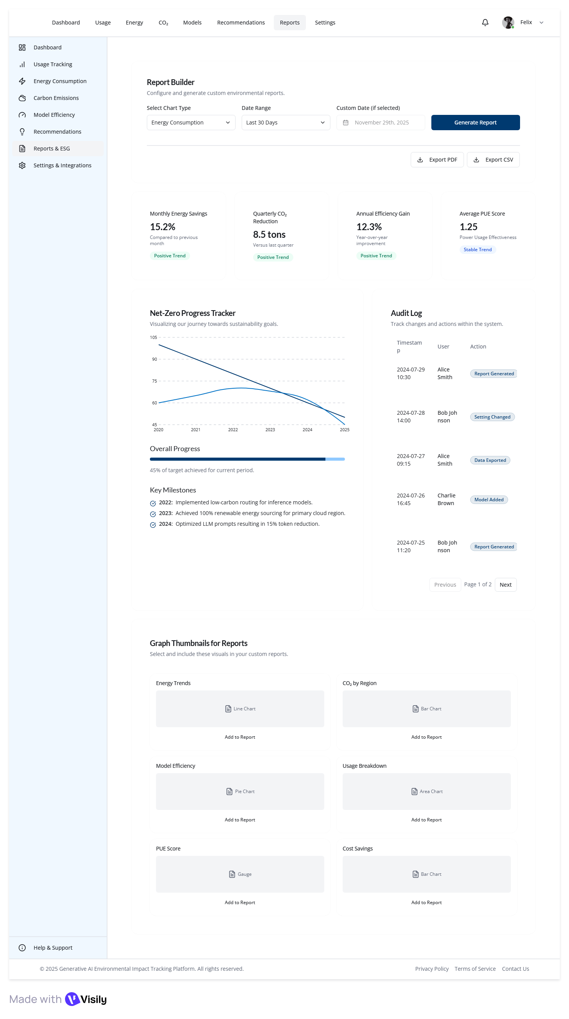
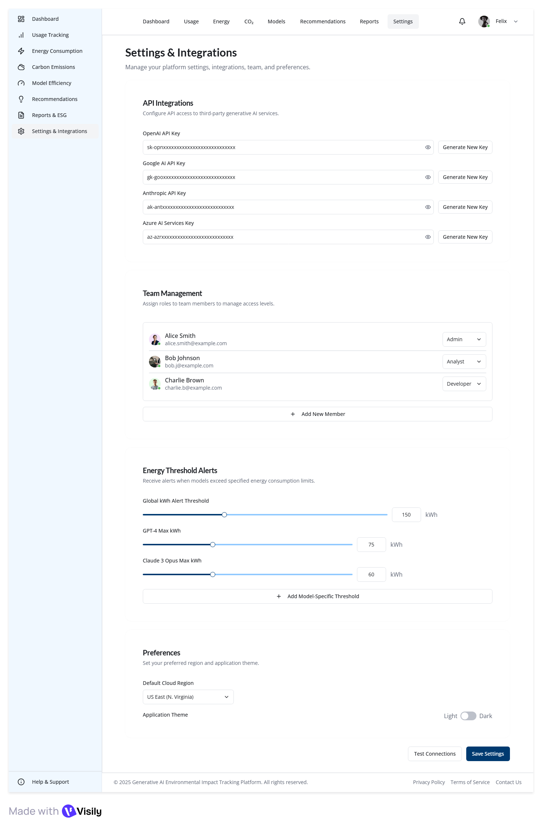
Wireframe Design for Eco-Compute
Reports
Settings & Integration

Slide 7
Thank You..!!

