Slide 1
JALADURG
( Information About Major Sea Forts In Maharashtra )
OMKAR SHELAR 14411
SANKET PATIL 14460

Slide 2
Information About Website
As part of this project, a website has been conceptualized and designed to provide complete information about the JALADURG . The aim of this website is to create an interactive digital platform where users can learn about the historical and cultural aspects of various sea forts along the coast of Maharashtra.

Slide 3
Purpose of the Website
To educate visitors about the importance of Maharashtra’s sea forts.
To provide detailed information about each fort – history, location, architectural style, and images.
To promote cultural tourism and spread awareness about the need for conservation.
To make historical content easily accessible to students, researchers, and tourists.

Slide 4
Website Features
Home Page: A welcoming introduction with a background image of a famous sea fort, showcasing Maharashtra's coastal beauty.
Interactive Map: A clickable map of Maharashtra highlighting the location of major sea forts like Sindhudurg, Vijaydurg, Murud-Janjira, and more.
Gallery: A collection of high-quality images and drone views of the forts.
Video Section: Embedded documentaries of short videos about Maratha naval power and fort construction.
About Us: A page where visitors can see the short information about website.

Slide 5
Forts Details:
Separate pages for each fort with detailed content including:
History of the fort
Year of construction and ruler who built it
Strategic significance
Architectural details
Current condition and tourist information

Slide 6
Target Audience
Students studying history or architecture
Tourists planning to explore Maharashtra’s heritage sites
History researchers and educators
General public interested in Indian maritime history

Slide 7
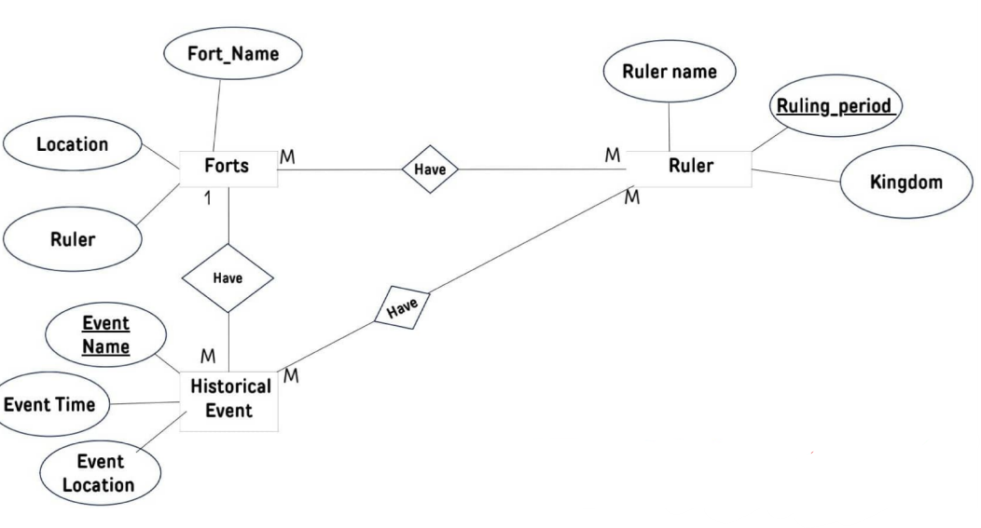
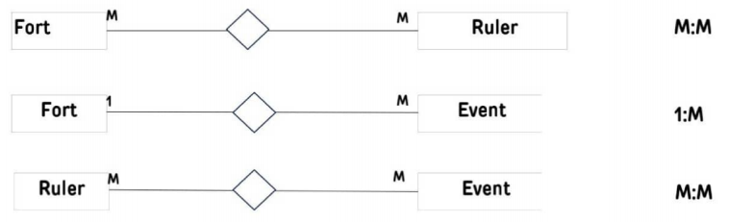
ERD(Entity Relationship Diagram)

Slide 8
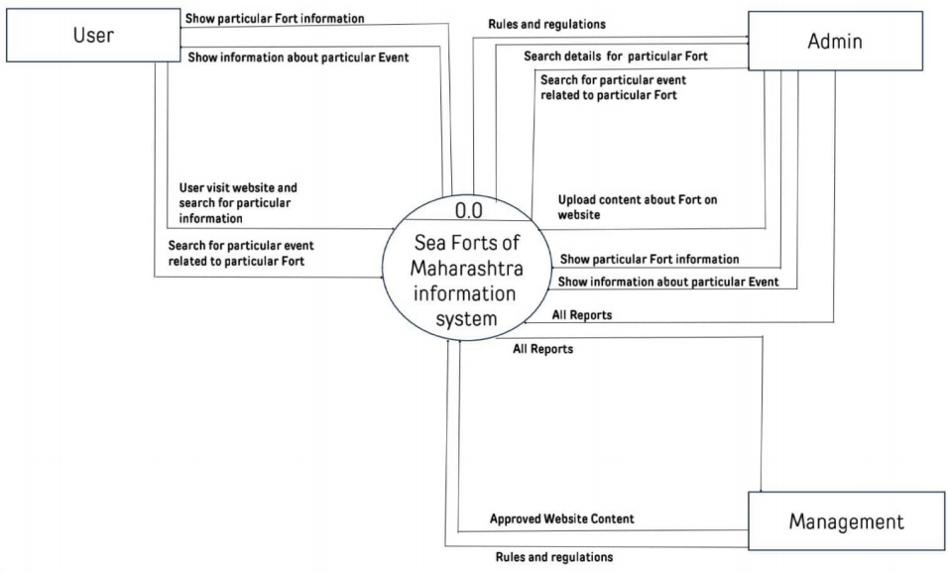
Context level DFD

Slide 9
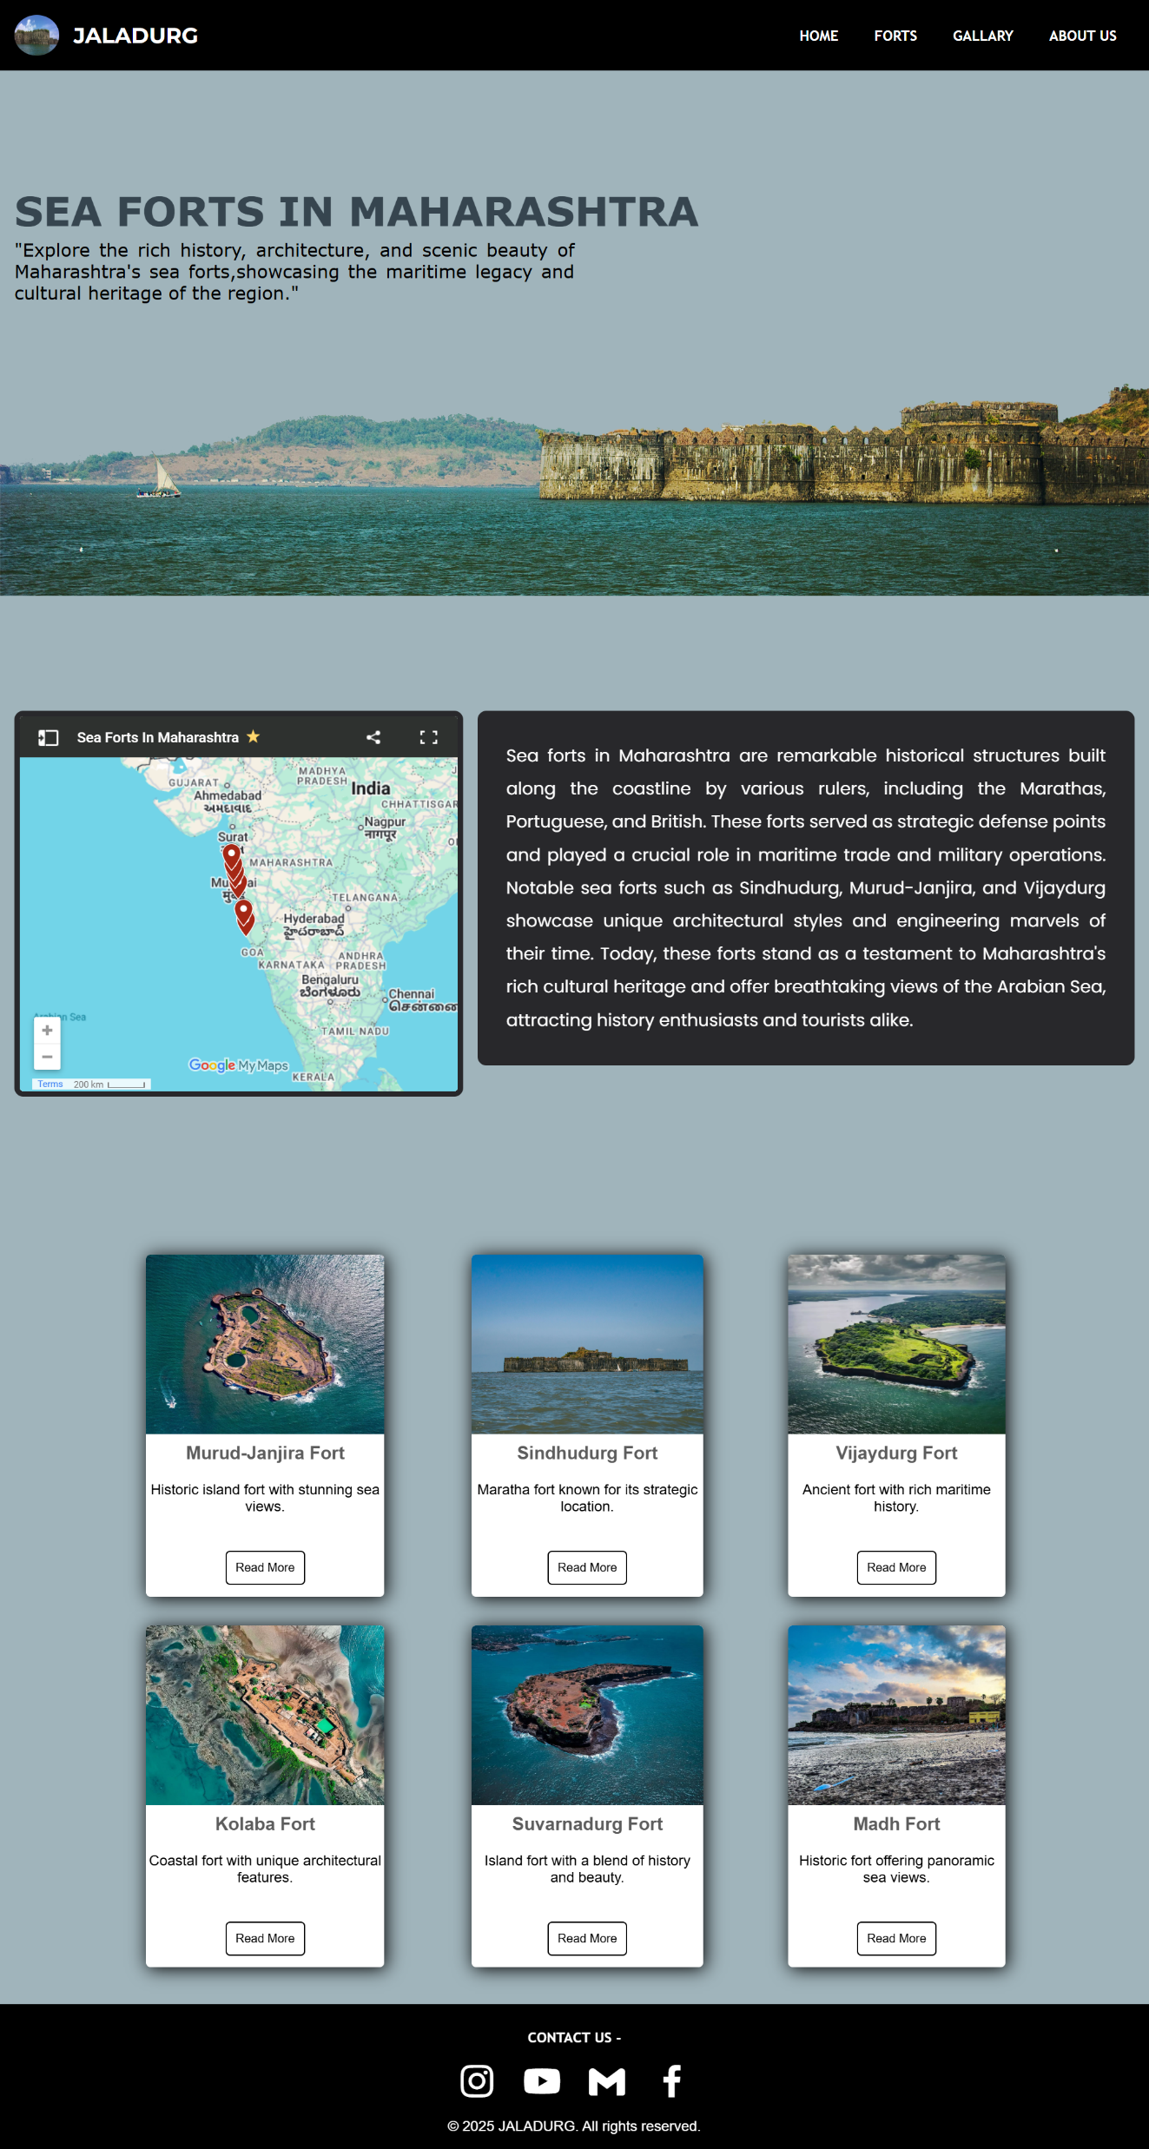
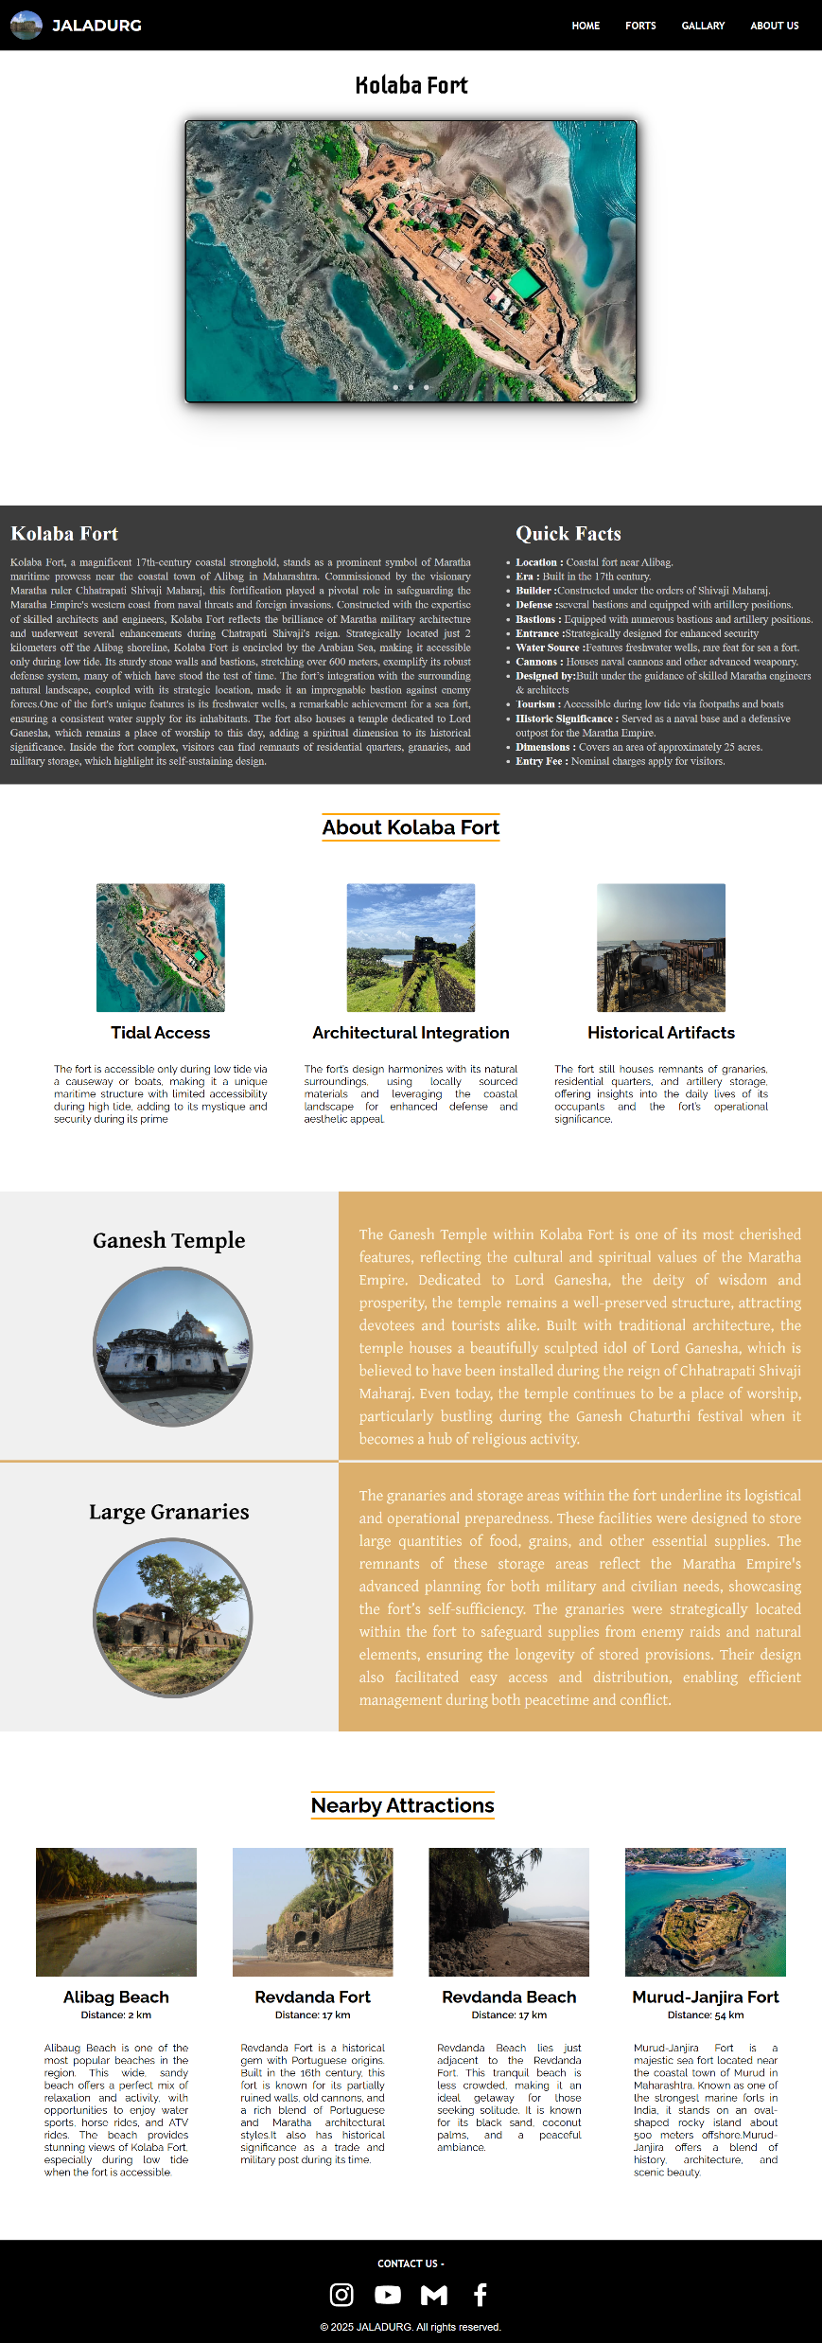
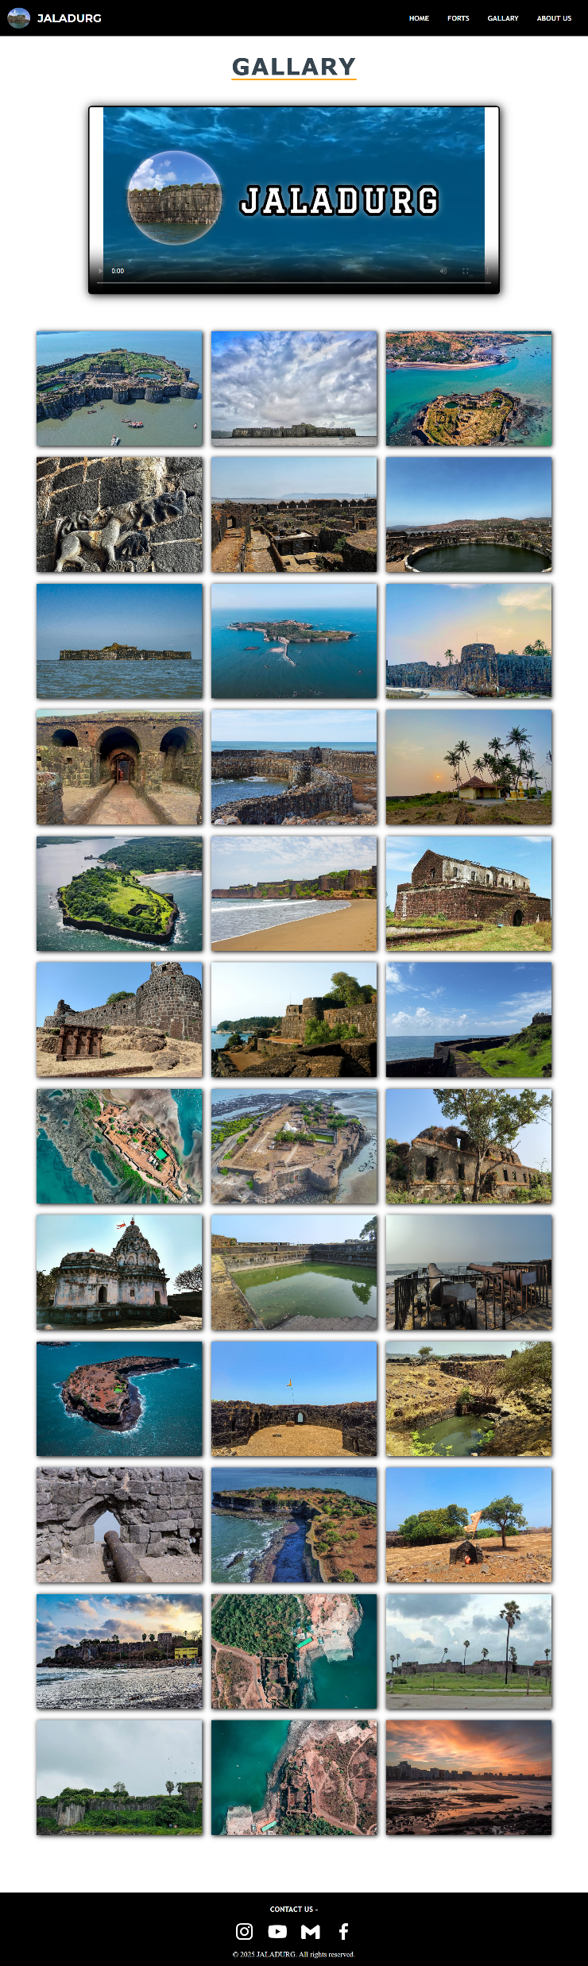
Screenshot of Major Pages of Website

Slide 10
THANK
YOU

