Slide 1
NEURAL MACHINE TRANSLATION
By – SAIRAM LOHITH NALLURI
Omkar avinash Durgasi

Slide 2
introduction
Neural Machine Translation – A benchmark for Machine Translation since 2017.
Ex: Google Translate – using NMT since a long time in backend.
It uses deep learning based complex algorithms.
It learns both-
Semantic meaning of sentences in different languages
Different word mapping in different languages

Slide 3
Objective
To build a Neural Machine Translation Model which can handle Complex Machine Translations using Deep Learning Models.
Model to be used – Encoder Decoder Recurrent Neural Model
Source Language – French
Output Language – English
Model Validation Metrics – BLEU Score

Slide 4
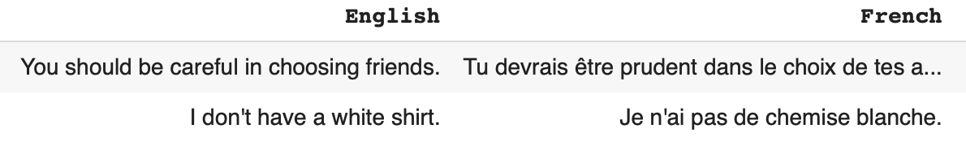
ABOUT DATA
Number of sentence present – 190206
Example:

Slide 5
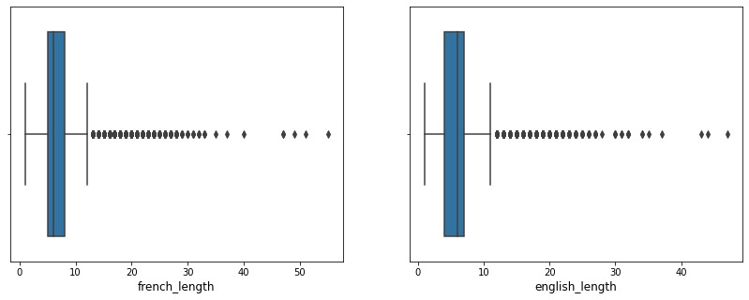
ABOUT DATA (CNTD.)
The sentence length varies between 2 words to 60 words.
From percentile analysis I found out 99.9 percentile number of sentence has only max 22 words.
Selected Max Length - 22

Slide 6
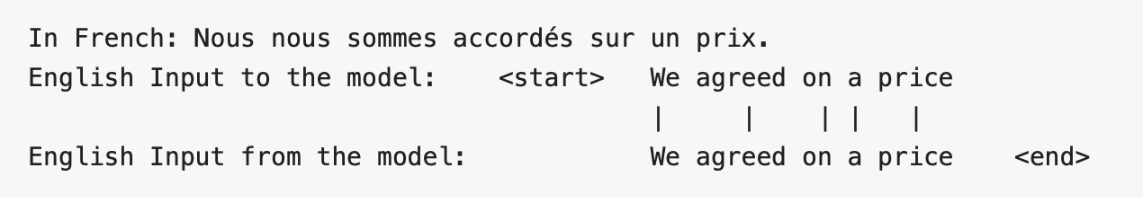
ABOUT DATA (CNTD.) – ADDING teacher FORCING
Teacher forcing is a common technique used in Neural Machine Translation.
It is a method for quickly and efficiently training recurrent neural network models that use the ground truth from a prior time step as input.

Slide 7
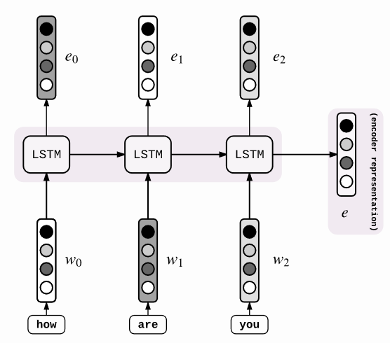
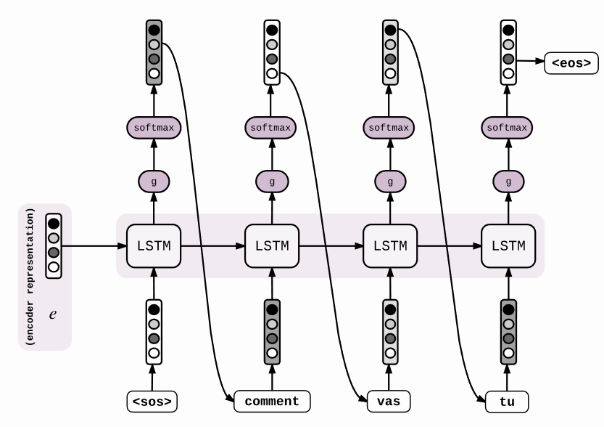
OVERVIEW OF ENCODER DECODER MODEL

Slide 8
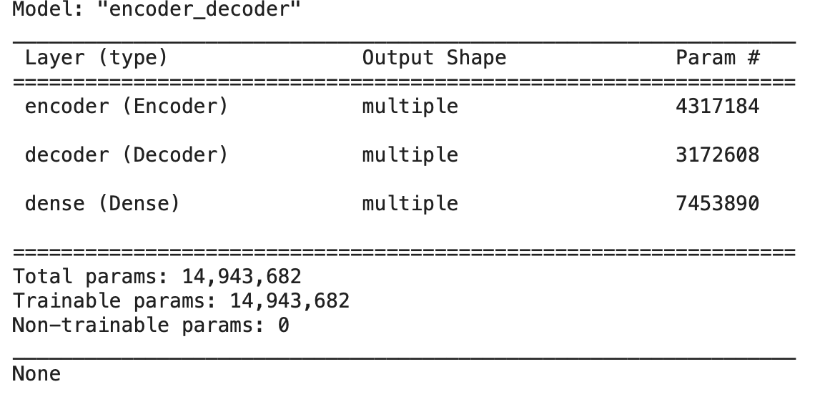
Model building
An encoder decoder model is being implemented from scratch written in TensorFlow.
LSTM layer size – 512
Self Trained word embedding size – 128
Batch Size - 1024

Slide 9
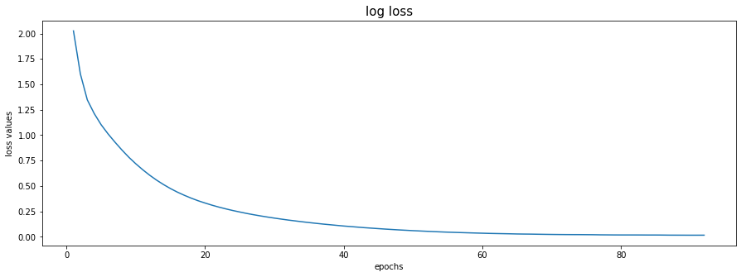
model VALIDATION
The model has been trained for 92 epochs, after that it started overfitting.
Optimal Log Loss – 0.0154
Optimal BLEU Score – 68%

Slide 10
Conclusion
Model translation is good for short sentences, but can be better in case of sentences having more than 15 words.
Model validation scores can be improved by trying out –
Attention based deep learning models
Neural Transformers
for longer sentences.

