Slide 1
Packages and Use
We used the pytrends, streamlit, google-images-download, bs4 packages using the following commands for core functionality.
pip install pytrends
pip install git+https://github.com/Joeclinton1/google-images-download.git
pip install streamlit
pip install bs4
The functionality of the above packages are
pytrends- pytrends is used to get the most searched skin conditions in USA in the last one year.
streamlit - We used streamlit package for building the app to download the images and display them.
google_images_download – we used the google_images_download package to download images from google.
bs4- we used the bs4 package to get information about the skin condition from the WebMD website

Slide 2
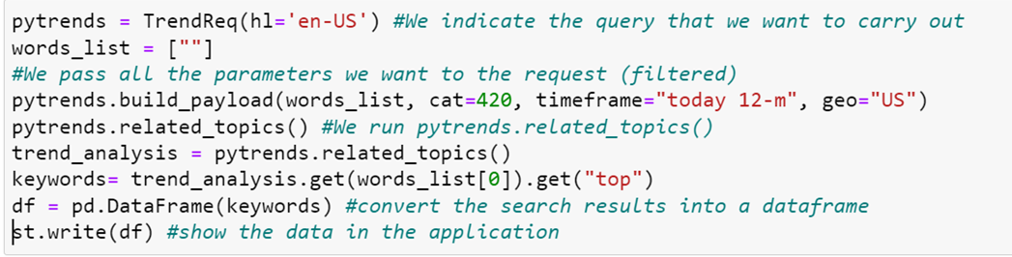
Google trends data Collection
We used the pytrends package to get the most searched skin conditions in the US in last one year.
We define the following parameters for our search query
To obtain search results in English : hl='en-US’
To search for trends in last one year : timeframe=“today 12-m”
To search for trends in USA : geo=“US”
To search for skin conditions category : cat = 420
words_list = [""]
pytrends.build_payload(words_list, cat=420, timeframe="today 12-m", geo="US")
pytrends.related_topics()
trend_analysis = pytrends.related_topics()
keywords= trend_analysis.get(words_list[0]).get("top")
df = pd.DataFrame(keywords) st.write(df)

Slide 3
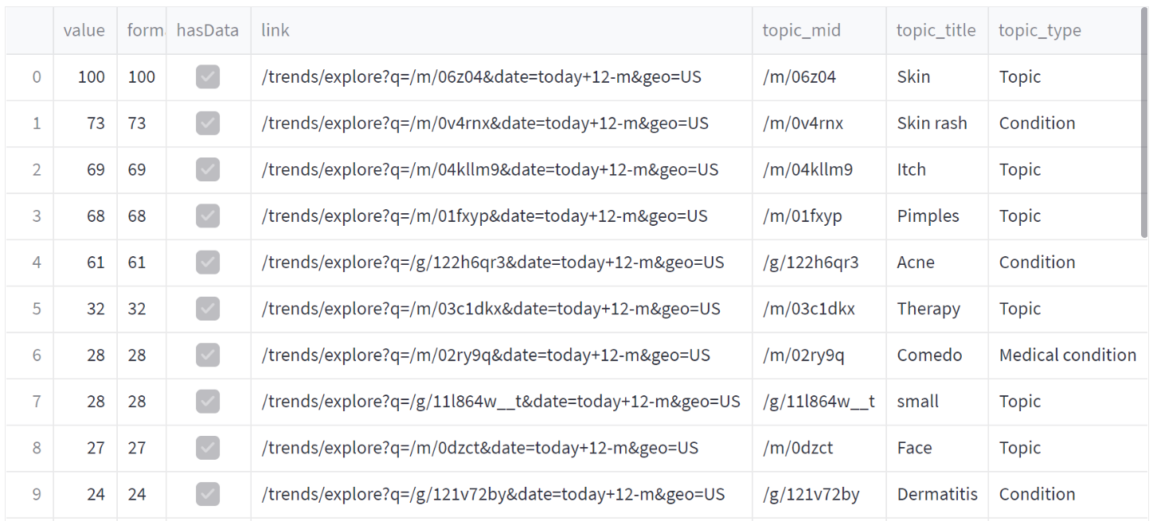
Output from pytrends query

Slide 4
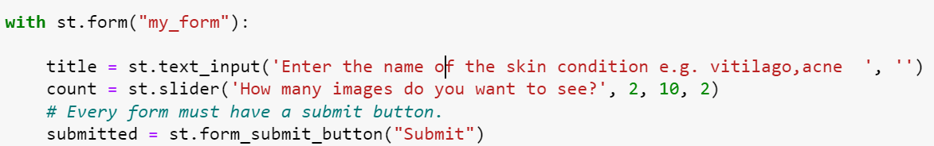
Application to search for images and information
We created a simple application using the following steps.
We created a form that takes the text input for the skin condition
We created a slider that helps us specify the number of images to download
We created a submit button that searches for the images and information about the skin condition after we click it.

Slide 5
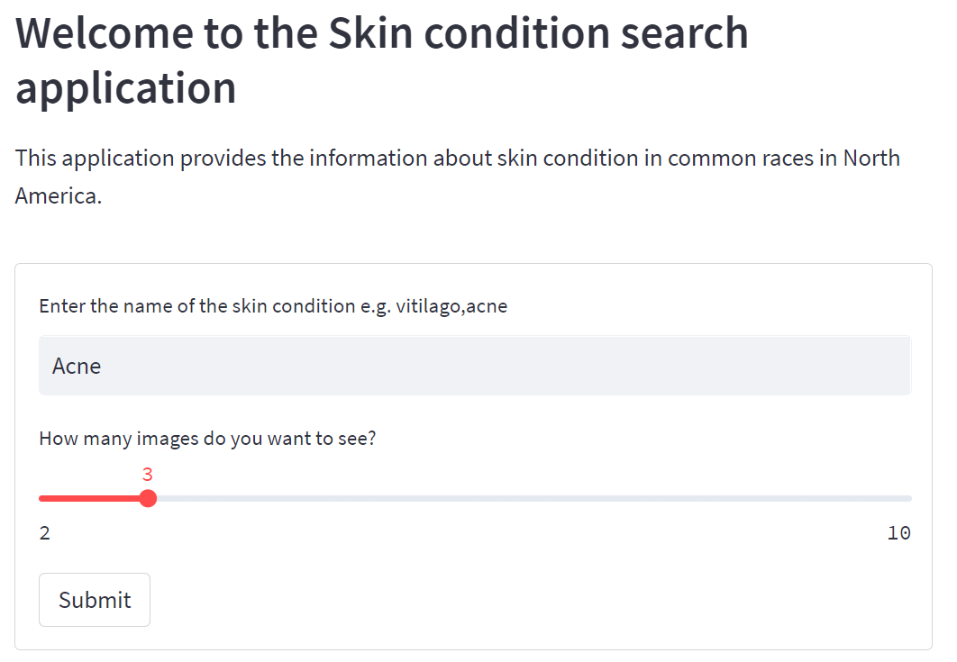
Application to search for images and information

Slide 6
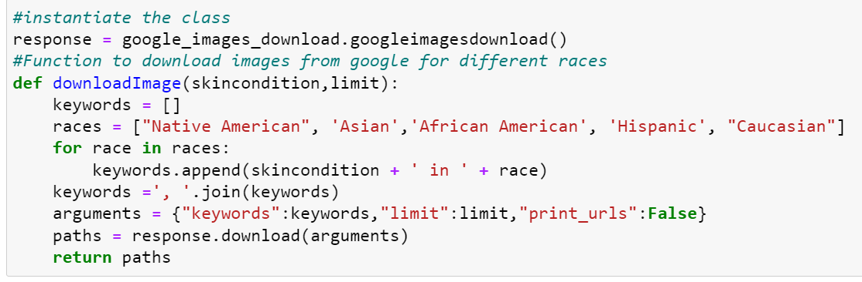
Downloading Google images for skin conditions
To download images from the internet corresponding to skin conditions from different races, we did the following steps
We instantiated the “googleimagesdownload” class as “response”
We created a list of the races, ["Native American", 'Asian’, 'African American', 'Hispanic', "Caucasian"]
We combined our skin condition with each of the race in the races list to create a string.
We specified a limit variable to specify the number of images to download.
We downloaded the images using the instance of “response” and stored the paths of these images in a “paths” variable

Slide 7
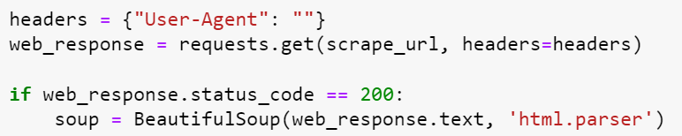
Download general information for skin condition
We downloaded the general information related to the skin condition from the WebMD website by following steps:
Generate a search url using the skin condition and web address
Instantiate the BeautifulSoup class from bs4 package that will get the html response of the web page from searching the “url”

Slide 8
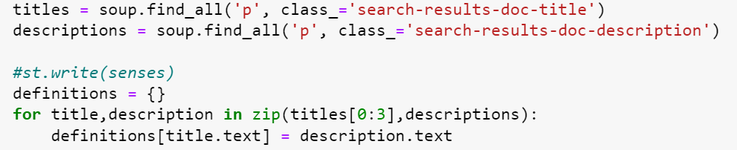
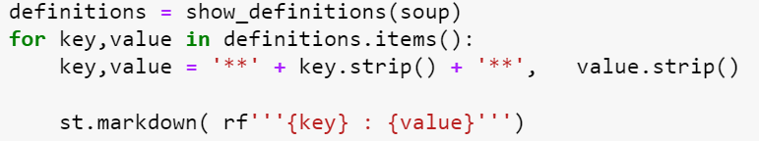
Download general information for skin condition
Search the html response from the “url” to get the required information about the skin condition
Show the required information in the application we developed using streamlit.

