Slide 1

YOUTUBE COMMERCIAL EXPLORING AUDIENCE’S PERSPECTIVE OF COMMERCIALS
Group D:
Farah Al Saif, Ivan Calderoni, and Omkar Saiswaroop Varma Chekuri
5/1/17

Slide 2

Overview
Abstract
Introduction
Literature review
Methods
Results
Discussion
Limitations and future research
Reference list
2

Slide 3
Abstract
An experiment was designed to explore audience’s perspective of online commercials.
The audience was asked to watch a short YouTube commercial and their data was collected using an eye tracking device and a questionnaire.
Quantitative and qualitative analyses were performed on the data collected.

Slide 4

Introduction
Internet has become the source of information, entertainment and social connectivity.
Digital content like videos and pictures are easy to share.
YouTube has become the most popular video sharing website.
Companies are using online commercials to reach more customers.

Slide 5
Literature Review
Pikas, B., & Sorrentino, G. (2014)
Most users visit and have active accounts on Facebook, Twitter, and YouTube, the three most popular social networking sites of today.
Ciolli, A. (2007)
Online ads increased YouTube’s revenues.
Galleta, D., Goodrich, K., & Schiller, S. Z. (2015)
Some factors that are believed to affect the consumer directly:
1) The length of the commercial 2) The content of the ad 3) The intrusiveness of the ad.

Slide 6
Methodology
Participants:
20 college students were recruited and divided into two groups.
10 participants per group, based on a between-subject design.
Apparatus:
A Tobii pro TX300 eye tracker (rate of 200 Hz).
A 19-inch monitor (1600*1024 pixels).

Slide 7
Methodology
Scenarios: subjects were asked to watch the same video
1) with a countdown function only.
2) with a skip button and a countdown function.
Task and Procedure:
Subjects were asked to watch a video. Then, they were asked to answer a questionnaire regarding an online commercial that was shown before the video.

Slide 8
Methodology
Variables (experiment):
Independent variable: Function of the commercial
Two levels: {countdown only, skip and countdown}
Dependent variables: Subject’s eye movement measurements and
questionnaire responses.

Slide 9
Methodology
Variables (questionnaire):
Independent variable: Subjects’ experiences, feelings, and memory.
Dependent variables: Subjects’ responses to questions.

Slide 10
Methodology: Data Analysis
Both quantitative and qualitative analyses were used.
Descriptive statistics were calculated for each AOI.
Shapiro-Wilk test was performed to test for normality.
T-test was performed on the data that follows a normal distribution.
Mann-Whitney Wilcoxon test was performed on the data the does not follow a normal distribution.

Slide 11
Descriptive Statistics (Durations)
For Scenario 1: Countdown Only.
For Scenario 2: Skip and Countdown.
AOI | Mean | S.D. | Error
Slogan | 0.57 | 0.51 | 0.16
Title-Bottom | 0.55 | 0.35 | 0.11
Title-Center | 1.29 | 0.64 | 0.20
Video Screen | 10.39 | 1.14 | 0.36
Countdown | 0.56 | 0.75 | 0.24
AOI | Mean | S.D. | Error
Slogan | 1.05 | 1.46 | 0.46
Title-Bottom | 0.93 | 1.40 | 0.44
Title-Center | 1.10 | 0.86 | 0.27
Video Screen | 9.00 | 3.50 | 1.11
Countdown | 0.59 | 1.18 | 0.37
Skip | 0.45 | 0.47 | 0.15
The skip feature was seen for a total eye fixation duration of 4.49 seconds for the 10 subjects.

Slide 12

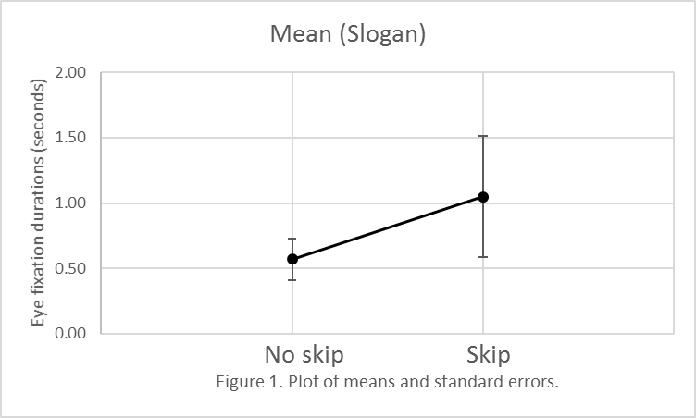
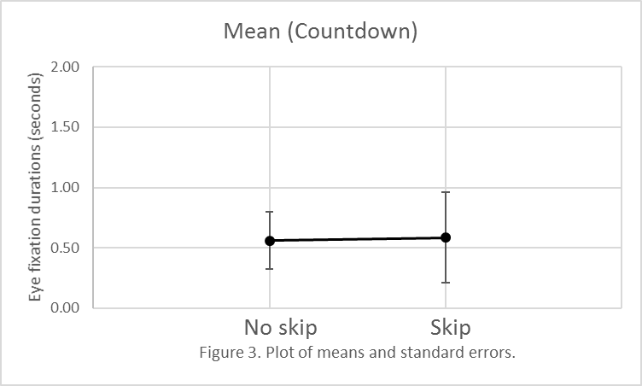
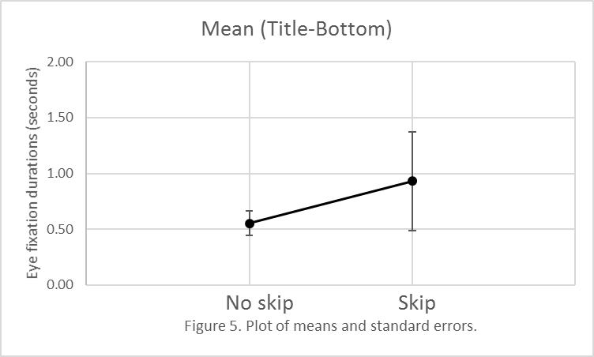
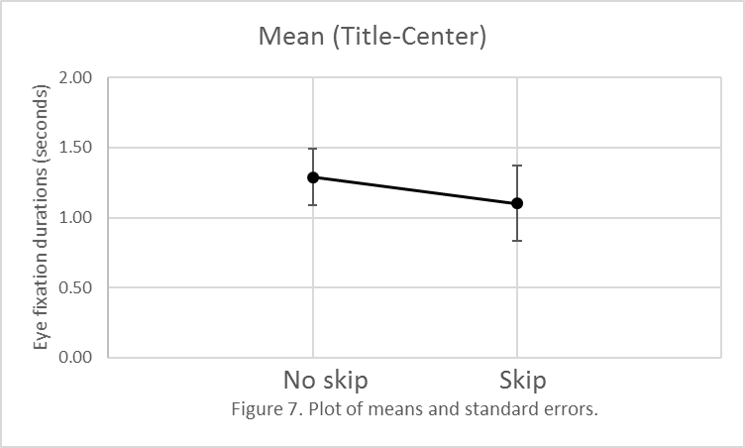
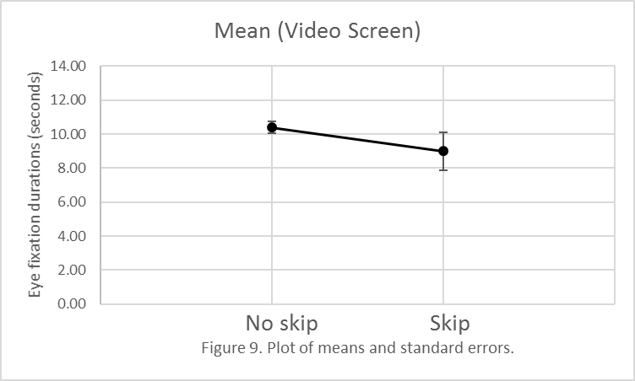
Descriptive Statistics (Durations)

Slide 13
Descriptive Statistics (Counts)
For Scenario 1: Countdown Only.
For Scenario 2: Skip and Countdown.
AOI | Mean | S.D. | Error
Slogan | 1.50 | 1.18 | 0.37
Title-Bottom | 2.10 | 1.29 | 0.41
Title-Center | 4.20 | 1.55 | 0.49
Video Screen | 32.50 | 5.42 | 1.71
Countdown | 2.50 | 3.66 | 1.16
AOI | Mean | S.D. | Error
Slogan | 3.00 | 4.16 | 1.32
Title-Bottom | 2.50 | 3.27 | 1.04
Title-Center | 3.70 | 2.63 | 0.83
Video Screen | 26.90 | 12.29 | 3.89
Countdown | 2.10 | 4.09 | 1.29
Skip | 1.70 | 1.70 | 0.54
There were a total of 17 eye fixations for the 10 subjects.

Slide 14
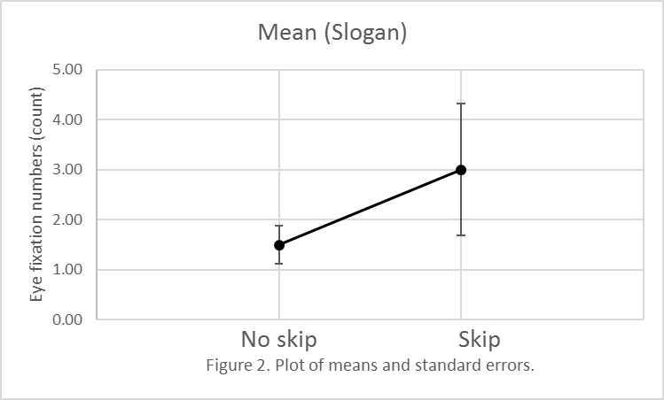
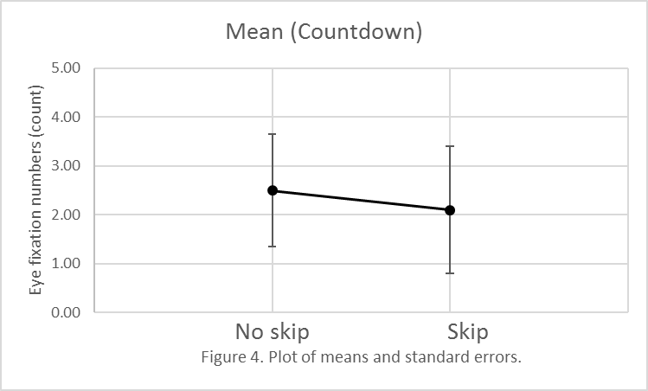
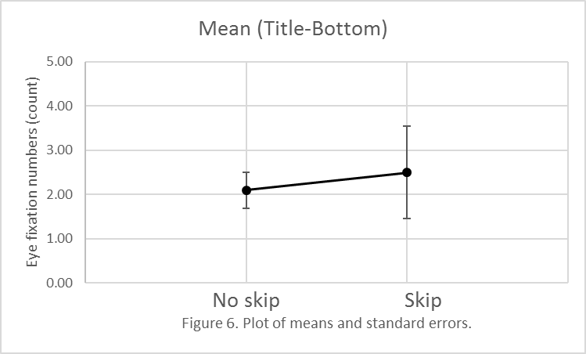
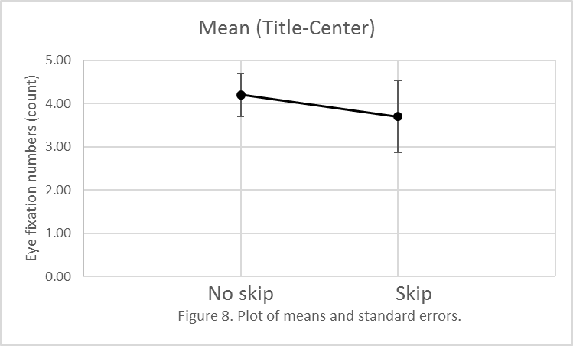
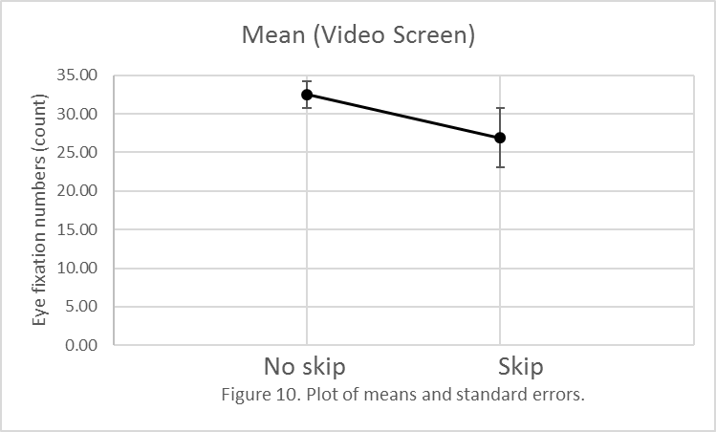
Descriptive Statistics (Counts)

Slide 15
Objectives
1- Analyze the effect of function used in an online commercial on what humans observe while watching it.
2- Analyze visual scanning behaviors when watching online commercials.
3- Determine if scanning behaviors can be affected by human experiences, feelings, and memory.

Slide 16
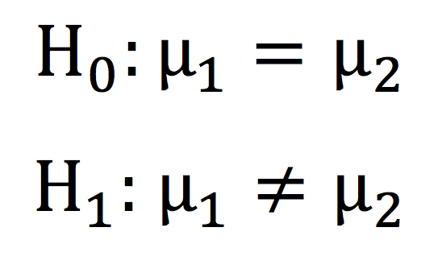
Results: Objective 1
Hypothesis: Same hypothesis test was applied for each one of the 5 AOI
Where:
μ1 is the mean of eye fixation counts for scenario 1, countdown only.
μ2 is the mean of eye fixation counts for scenario 2, skip button and countdown function.

Slide 17
Results: Objective 1
Hypothesis: Same hypothesis test was applied for each one of the 5 AOI
Where:
μ1 is the mean of eye fixation durations for scenario 1, countdown only.
μ2 is the mean of eye fixation durations for scenario 2, skip button and countdown function.

Slide 18
Results: Objective 1
Comparing the mean of eye fixation durations and counts between scenario 1 (countdown only) and 2 (skip and countdown)
AOI | P-Value (Durations) | P-Value (Counts)
Slogan | 0.8490 | 0.5882
Title-Bottom | 0.9696 | 0.6113
Title-Center | 0.5891 | 0.6163
Video Screen | 0.8501 | 0.2039
Countdown | 0.5579 | 0.2008
Since the p-value > 0.05 for all AOI, do not reject the null and conclude that there is no significant difference between the means for both scenarios.

Slide 19
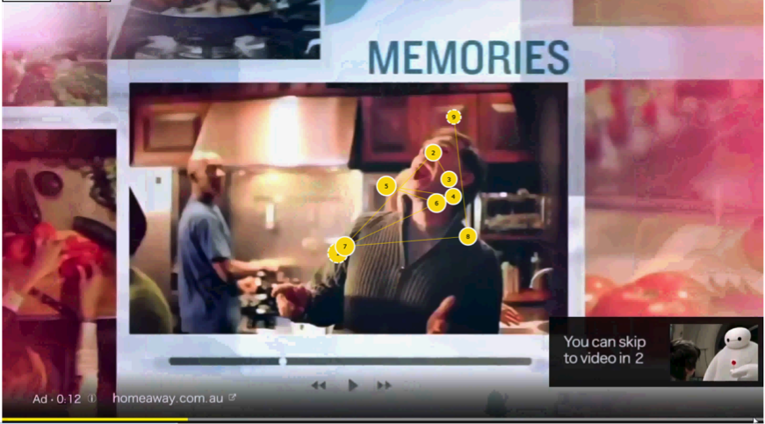
Results: Objective 2 Visual Scanning Behavior
Subjects who did not get distracted by the skip button were able to recall the brand name.
A scan path for subject 3 (scenario 2: with skip and countdown)

Slide 20
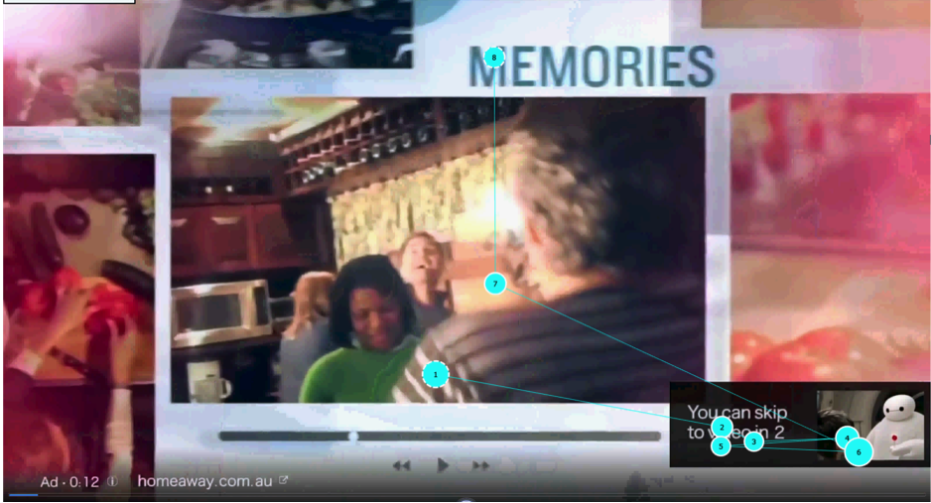
Results: Objective 2 Visual Scanning Behavior
Subjects who got distracted by the skip button were not able to recall the brand name.
A scan path for subject 8 (scenario 2:with skip and countdown)

Slide 21
Results: Objective 3
Question A10: “The online commercial I saw was important.”
On average, subjects who participated in scenario 1 (skip) answered 2.7.
On average, subjects who participated in scenario 2 (countdown) answered 3.1.
Observation(s): Both groups did not feel the commercial and its contents were important. As a result, only 3 out of 20 subjects were able to recall the brand name.

Slide 22
Discussion
The quantitative analysis result only showed that there is no significant difference between the means of eye fixation among both scenarios.
- The sample size is small.
- Non-parametric test was performed.

Slide 23
Discussion
By performing qualitative analysis, we were able to consider individuals’ behaviors in order to draw a better conclusion.
- Some subjects were given wrong instructions to answer the questionnaire.
- Some subjects answered the questionnaire randomly.
- Subjects who had a longer eye fixation duration on Title-Center were able to recall the brand name.

Slide 24
Discussion
The “Title-Bottom” button being close to the “Skip” button might have created a simultaneous masking effect which prevented the subjects from remembering the brand name.
The content of the advertisement was not presented effectively which makes it seem irrelevant and hard to associate with brand name.

Slide 25
Limitations
From the data collected, one cannot determine if the subjects were consciously watching something during the commercial.
Subjects could be looking at functions and/or features with their peripheral vision without the eye-tracking device measuring it.

Slide 26

Future Research
Use different kinds of commercials to further analyze if the content of commercials has an impact on the cognitive behavior.
Evaluate individual subject behavior and take these results into consideration while analyzing their data.
Evaluate more physiological parameters
Pupil diameter
Eye blinking frequency

Slide 27
References
Galletta, D., Goodrich, K., & Schiller, S. Z. (2015). Consumer Reactions to Intrusiveness of Online –Video Advertisements. Journal of Advertising Research, 55(1), 37-50.
Miller, C. C. (2010). YouTube Ads Turn Videos into Revenue. New York Times, 2.
Pikas, B., & Sorrentino, G. (2014). The Effectiveness of Online Advertising: Consumer’s Perceptions of Ads on Facebook, Twitter and YouTube. Journal of Applied Business and Economics, 16(4), 70-81.

Slide 28
Questions?

