Slide 1

Deconstructing Transformers
From Core Architecture to Full Lifecycle

Slide 2
The Problem: What Transformers Solve
Before Transformers, models (like RNNs & LSTMs) processed text one word at a time.
Sequential & Slow: This was very slow for long sentences. You couldn't process all words at once (no parallelism).
The "Forgetting" Problem: Models struggled to remember information from the *beginning* of a long sentence by the time they reached the *end*.
Vanishing Gradients: The "signal" or importance from early words would get weaker and weaker as it passed through each step, making it hard to train.

Slide 3
The Big Idea: Self-Attention
Stop processing words one by one. Instead, look at all words in the sentence at the same time and decide which ones are most important.
"
"
— The core idea of "Attention Is All You Need"

Slide 4

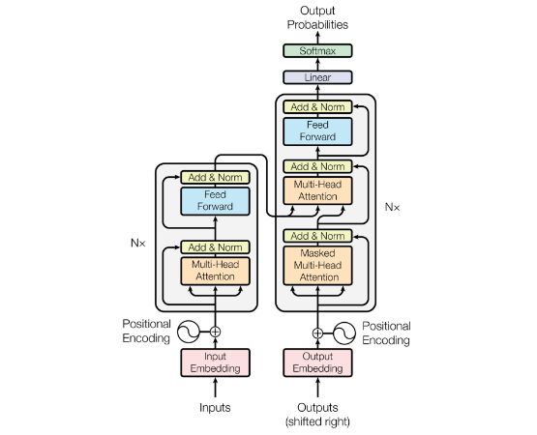
The High-Level Architecture
Two Main Parts
The Transformer is an Encoder-Decoder model. Think of it like a translator:
•
1. The Encoder (Left): Reads and "understands" the entire input sentence (e.g., English). Its job is to build a rich, contextual representation of every word.
•
2. The Decoder (Right): Takes the Encoder's "understanding" and generates the output sentence (e.g., French), one word at a time.

Slide 5


Inside the Encoder
1. Self-Attention Layer
2. Feed-Forward Network
This is the magic. For every word, this layer lets it "look at" all other words in the *input* sentence.
After the attention layer, the output for each word is passed through a simple, identical neural network.
It then decides which other words are most relevant to *this* word's meaning. For example, in "The animal didn't cross the street because **it** was too tired," this layer helps "it" know it refers to "animal".
This network processes each word's representation individually and adds more computational depth, helping the model learn more complex patterns from the attention output.

Slide 6






Inside the Decoder
Masked Self-Attention
Encoder-Decoder Attention
Feed-Forward Network
This is like the Encoder's self-attention, but it's "masked." When generating word #3, it can only look at words #1 and #2. It's blocked from "cheating" by looking at future words.
Just like in the Encoder, this is a simple neural network that processes the final representation after all the attention steps are done.
This is the key! The Decoder "pays attention" to the Encoder's output. It looks at all the input words to decide which ones are most relevant for generating the *current* output word.

Slide 7
The Magic: How "Attention" Works
Attention is calculated using three vectors for each word: Query, Key, and Value.
Query (Q): This is the word's "search query." It asks: "What am I looking for?"
Key (K): This is the word's "label" or "ID." It says: "This is what I am." The Query is compared against all the Keys.
Value (V): This is the word's actual "content" or "meaning."
The model finds the best-matching Key for a Query, then returns the corresponding Value.

Slide 8
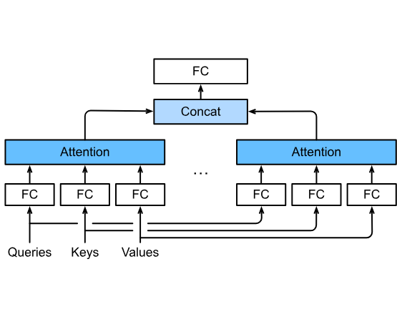
What is "Multi-Head" Attention?
Asking 8 Experts
Instead of calculating attention just once, "Multi-Head" attention runs it multiple times in parallel (e.g., 8 "heads").
It's like asking 8 different experts to look at the sentence:
•
One "head" might focus on "who did what."
•
Another might focus on "what action was taken."
•
Another might focus on grammatical relationships.
This gives a much richer, more nuanced understanding of the sentence.

Slide 9
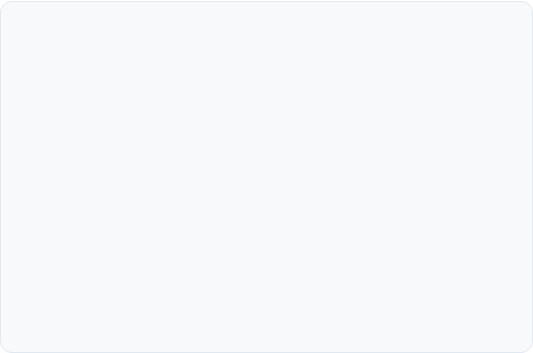

Explaining Key Terminology (Part 1)
Positional Encodings
Layer Normalization ("Norms")
The Problem: Since the model sees all words at once (unlike an RNN), it has no idea what their *order* is. "Man bites dog" and "Dog bites man" would look the same.
The Problem: As data flows through many layers (like attention and feed-forward), the numbers (vectors) can become too large or small, making training unstable and slow.
The Solution: We add a "vector" (a list of numbers) to each word that gives it a unique "ZIP code" based on its position (e.g., 1st word, 2nd word, 3rd...). This injects the word's position into its meaning.
The Solution: After each sub-layer, we "normalize" the numbers. This "resets" the data's scale (mean=0, variance=1) and helps the model train much faster and more reliably.

Slide 10
Explaining Key Terminology (Part 2)
You will always see "Add & Norm" after each sub-layer. Here's what it means:
"Add" (Residual Connection): We take the *original input* to the layer and add it to the *output* of the layer. This "shortcut" prevents the model from "forgetting" the original information and makes it easier to train very deep networks.
"Norm" (Layer Normalization): This is the step we just discussed. It's applied *after* the "Add" step to re-stabilize the data before it goes to the next layer.

Slide 11
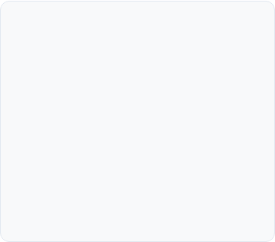




Why Transformers Won
Parallelism
Scalability
Better Performance
Unlike RNNs, all input words are processed at once. This makes it *massively* faster to train on modern hardware like GPUs.
The design is highly scalable. We can stack more layers and add more data to create *massive* models (like BERT, GPT, and LLMs).
Self-attention is more effective at capturing long-range dependencies, leading to new state-of-the-art results in almost every NLP task.

Slide 12
Beyond the Model
The Full Lifecycle of a Deployed Language Model

Slide 13
The ML Model Lifecycle: A High-Level View
2. Data Preparation
4. Deployment
Cleaning, tokenizing, and filtering.
Serving the model via an API.
1. Data Collection
3. Model Training
5. Monitoring
Gathering raw text data.
Pre-training & Fine-tuning (SFT/RLHF).
Watching for drift and new patterns.

Slide 14
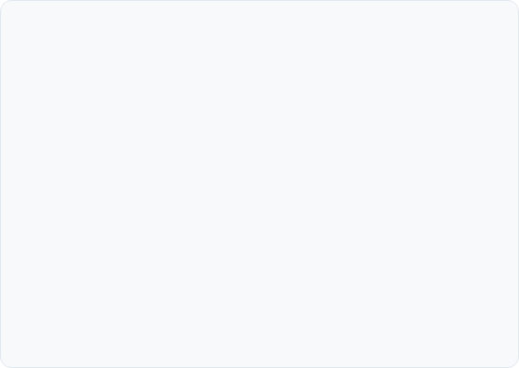

Phase 1: Data Collection & Preparation
Data Collection
Data Preparation
The model's "knowledge" comes from its data. We source text from:
Raw data is messy. This is the most time-consuming step:
•
Cleaning: Removing duplicates, spam, and low-quality text.
•
The open internet (e.g., Common Crawl)
•
Books and academic papers
•
Tokenization: Splitting text into "tokens" (words or sub-words).
•
Code repositories (like GitHub)
•
Filtering: Removing toxic content or private information (PII).
•
High-quality curated datasets

Slide 15
What is Data Governance?
A set of rules to ensure data is secure, accurate, and ethical.
Data Security & Privacy: Anonymizing or removing all Personally Identifiable Information (PII) like names, emails, and phone numbers.
Data Quality: Ensuring the data is accurate, consistent, and not full of junk. Bad data leads to a bad model.
Compliance: Adhering to laws like GDPR (Europe) or CCPA (California) that give users rights over their data.
Data Lineage: Keeping a record of where data came from and how it was changed. This is crucial for debugging and auditing.

Slide 16
Phase 2: Model Training (Pre-training)
Creating the "Base Model"
This is the part we discussed earlier. We feed the massive, cleaned dataset (terabytes of text) into our Transformer architecture.
•
The model learns language, facts, and reasoning by predicting the next word or filling in masked words.
•
This process takes weeks or months and costs millions in cloud computing.
•
The result is *not* a chatbot. It's a "base model"—a powerful but generalist engine.

Slide 17






Phase 3: Fine-Tuning the Base Model
What is Fine-Tuning?
Supervised Fine-Tuning (SFT)
The Result
The base model is a generalist. We now "specialize" it for a task (like being a helpful assistant) using a small, high-quality dataset.
The model learns to follow instructions, adopt a specific persona (e.g., "helpful assistant"), and answer questions in the desired format.
We "show" the model good examples. We create thousands of high-quality "Prompt-Response" pairs, and train the model to match them.

Slide 18
Phase 3 In-Depth: Pre-training vs. SFT
Pre-training (General)
•
Goal: Learn language, facts, & reasoning.
•
Data: Massive, unlabeled internet text.
•
Task: "Predict the next word." (e.g., "The capital of France is...")
Supervised Fine-Tuning (Specific)
•
Goal: Learn to follow instructions.
•
Data: Small, high-quality (Prompt, Response) pairs.
•
Task: "Given this *instruction*, produce this *exact response*."

Slide 19
Phase 4: Making the Model 'Safer' (RLHF)
Step 1: Train a "Reward Model"
Step 2: RLHF
How do we teach a model what's "good"? First, we ask humans to rank several of the model's answers to a prompt from best to worst.
This stands for Reinforcement Learning from Human Feedback. We now "freeze" our AI Judge.
The Transformer (LLM) generates an answer. The AI Judge scores it. The LLM then updates itself to try and get a *higher* score next time. This process steers the model to be more helpful, honest, and harmless.
We then train a *separate model* (the Reward Model) to predict this human ranking. It becomes our "AI Judge."

Slide 20

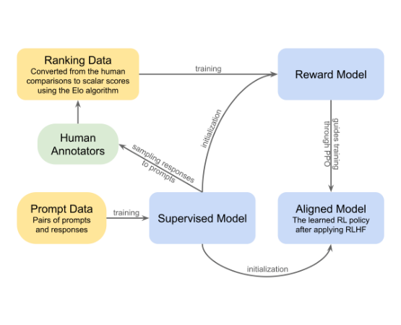
Phase 4 In-Depth: Training the Reward Model
1. Generate Data
Take the SFT model and a list of prompts. Generate 3-4 different answers for each prompt (A, B, C, D).
2. Human Ranking
Human labelers review the answers and rank them from best (A) to worst (D) based on helpfulness and safety.
3. Train the "Judge"
This ranked data is used to train a separate Reward Model (RM). Its only job is to read a (Prompt, Response) pair and output a single score (e.g., "7.5") predicting how much a human would like it.

Slide 21
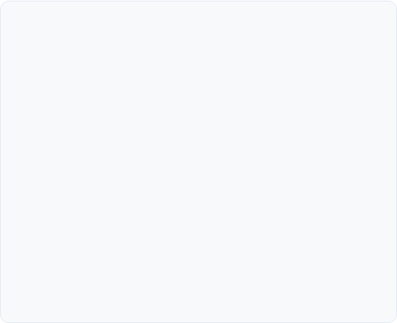

Phase 4 In-Depth: The Reinforcement Learning Loop
1. Get a Prompt
A new prompt is sampled from the dataset.
2. Model Responds
The SFT model (now called the "Policy") generates a response.
3. Judge Scores
The "frozen" Reward Model (our AI Judge) reads the (Prompt, Response) and assigns a score (the "reward").
4. Model Updates
Using an RL algorithm (like PPO), the SFT model's parameters are slightly updated to make it *more likely* to produce responses that will get a *high score* in the future.

Slide 22
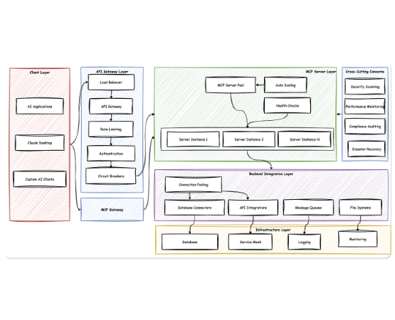
Phase 5: Deployment & Serving
Making it Usable
The final model is still massive (100s of GB). To make it fast and accessible:
•
Quantization: Making the model smaller by using lower-precision numbers.
•
Inference Optimization: Using tools to make the model run efficiently on specific hardware (GPUs/TPUs).
•
Serving Infrastructure: Putting the model behind an API (Application Programming Interface) on a server so apps can send it requests.

Slide 23


Phase 6: Monitoring & The Feedback Loop
Monitoring for Drift
Capturing Feedback
Retraining (The Loop)
We watch the model's performance. Is it getting worse? Are users asking new kinds of questions we didn't expect? (This is "model drift").
We log new prompts and (with user permission) capture "thumbs up/down" signals. This identifies where the model is failing or succeeding.
This new data is used to create new SFT examples and new RLHF preferences. We then re-tune the model, deploy the new version, and the cycle begins again.

Slide 24
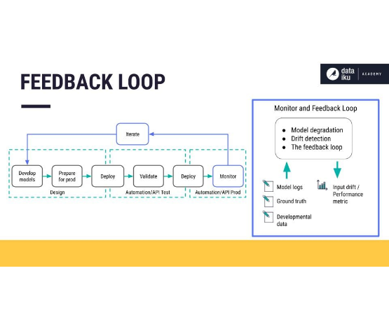
Phase 6 In-Depth: What We Track
1. Model & Data Drift
Are users asking about *new topics* (e.g., a new movie) we haven't trained on? Is the *meaning* of words changing? This is "drift."
2. Model Quality & Bias
Are a lot of "thumbs down" responses coming in? Is the model showing bias (e.g., in gender, race)? We track these "soft" quality metrics.
3. Operational Health
Is the model fast? (Latency). Is it expensive to run? (Cost). Is the API failing? (Error Rate). These are "hard" engineering metrics.

Slide 25
Questions?
Thank you.

Slide 26
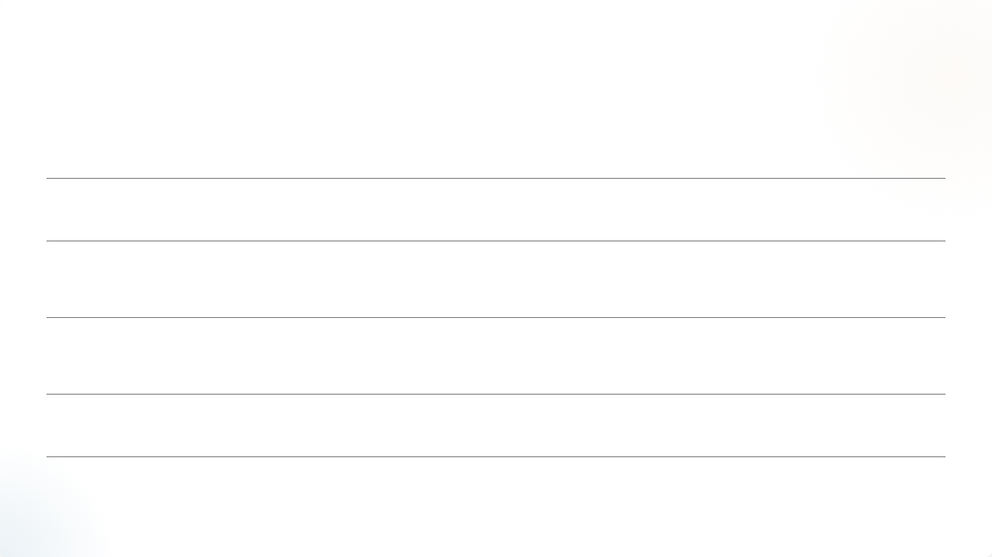








Image Sources
https://www.practicalai.io/wp-content/uploads/2023/02/encoder-decoder.png
Source: www.practicalai.io
https://d2l.ai/_images/multi-head-attention.svg
Source: d2l.ai
https://substackcdn.com/image/fetch/f_auto,q_auto:good,fl_progressive:steep/https%3A%2F%2Fsubstack-post-media.s3.amazonaws.com%2Fpublic%2Fimages%2Fc3e159bd-1228-4205-b1eb-5898ab9172d3_1600x856.png
Source: www.understandingai.org
https://substackcdn.com/image/fetch/$s_!wEtP!,f_auto,q_auto:good,fl_progressive:steep/https%3A%2F%2Fsubstack-post-media.s3.amazonaws.com%2Fpublic%2Fimages%2F4c51db77-8d97-45a9-bd2c-d71e930ff0b8_2292x1234.png
Source: cameronrwolfe.substack.com
https://upload.wikimedia.org/wikipedia/commons/thumb/b/b2/RLHF_diagram.svg/1200px-RLHF_diagram.svg.png
Source: en.wikipedia.org
https://miro.medium.com/v2/resize:fit:1400/1*iLsD4Nnh_lGbgq941CS72A.png
Source: abvijaykumar.medium.com

Slide 27

Image Sources
https://knowledge.dataiku.com/latest/_images/monitor-feedback-loop.jpg
Source: knowledge.dataiku.com

