Slide 1

Bidirectional Language Translation with a Transformer
A Toy dataset model approach to understand the intricacies

Slide 2
Executive Summary
Objective: Build and train a single Transformer model for bidirectional translation between English and Sanskrit.
Achievement: Trained 200 epochs, final loss = 0.8774. BLEU score reached ~0.20, indicating initial learning of correct sequences.
Impact: Demonstrates reproducible methodology for character-level NLP models.

Slide 3
Problem & Methodology
Problem: Efficient translation with a single model across multiple directions.
Approach:
- Custom Transformer with unified vocabulary
- Direction tokens: <eng_to_sanskrit>, <sanskrit_to_eng>
- Dataset: Aligned English–Sanskrit sentence pairs
- Training: 200 epochs, Adam optimizer

Slide 4
Performance Results
Observations:
- Loss decreased from 3.71 → 0.88 over 200 epochs.
- BLEU score fluctuated, peaking at ~0.20, showing gradual translation learning.
- Both curves indicate stable convergence and learning patterns.

Slide 5
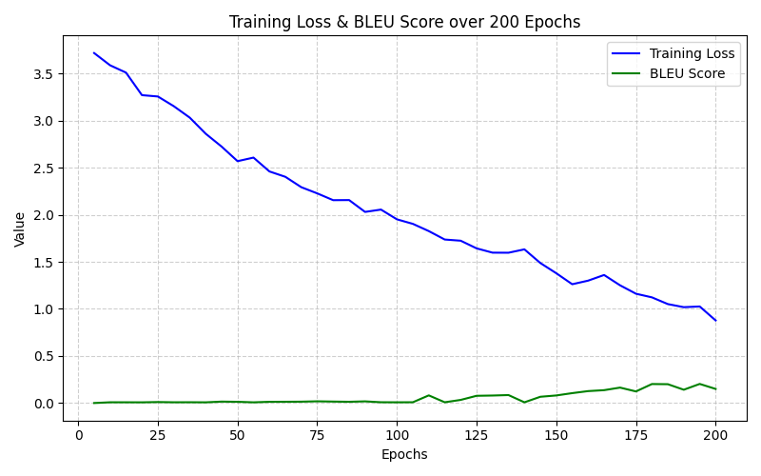
Performance Results

Slide 6
Bidirectional Translation Examples
English → Sanskrit:
- 'hello' → 'नमस्ते' ✅
- 'cat' → 'बिल्ली' ✅
- 'I am a student.' → 'अहं छात्रोऽस्मि।' (minor errors)
Sanskrit → English:
- 'नमस्ते' → 'hello' ✅
- 'बिल्ली' → 'cat' ✅
- 'अहं छात्रोऽस्मि।' → 'I am a student.' (partial match)

Slide 7
Key Challenges & Lessons Learned
1. Unicode issues when printing Sanskrit text.
2. Small dataset (15 pairs) led to memorization.
Lesson: Larger and more diverse datasets improve generalization.

Slide 8
Future Work & Recommendations
- Train on larger datasets to improve BLEU scores.
- Introduce evaluation metrics (BLEU, ROUGE, METEOR).
- Explore subword tokenization (BPE) for better generalization.

