Slide 1
Vision Transformer for CIFAR-10: An MLOps Approach
A Project Report on a Reproducible Deep Learning Pipeline

Slide 2
Executive Summary
Objective: To fine-tune a compact Vision Transformer (vit_tiny_patch16_224) for image classification on the CIFAR-10 dataset.
Achievement: Achieved a 96.67% test accuracy after 3 epochs of training.
Impact: Developed a complete, reproducible MLOps pipeline using Docker and GitHub Actions, ensuring consistent performance and a solid foundation for future projects.
Key Takeaway: Transfer learning with efficient architectures is highly effective and scalable, even on consumer-grade hardware.

Slide 3
Problem & Methodology
Problem: Building a reliable and efficient image classifier for a standard benchmark.
Dataset: CIFAR-10 (60,000 images, 10 classes). Data was split into a training set (40k), a validation set (10k), and a test set (10k).
Approach:
- Model: Pre-trained vit_tiny_patch16_224 from the timm library.
- Training: AdamW optimizer, Cosine Annealing LR scheduler, and mixed-precision (bfloat16) for efficiency.
- Evaluation: Monitored performance on a validation set to save the best model. Final evaluation on a held-out test set.

Slide 4
Performance Results: Loss Curve
Training and Validation Loss over 3 Epochs
Key Points:
- The training loss consistently decreased with each epoch, indicating the model was learning effectively.
- The validation loss also steadily decreased, showing that the model was generalizing well to unseen data.
- This downward trend for both metrics suggests the model is not overfitting.
[Insert the plot of Training and Validation Loss]

Slide 5
Performance Results: Accuracy Curve
Training and Validation Accuracy over 3 Epochs
Key Points:
- Training accuracy steadily increased, reaching almost 90% by the end.
- Validation accuracy showed a strong, consistent increase, ending at 89.33%.
- The consistent performance gain confirms the efficacy of the transfer learning approach on this dataset.
[Insert the plot of Training and Validation Accuracy]

Slide 6
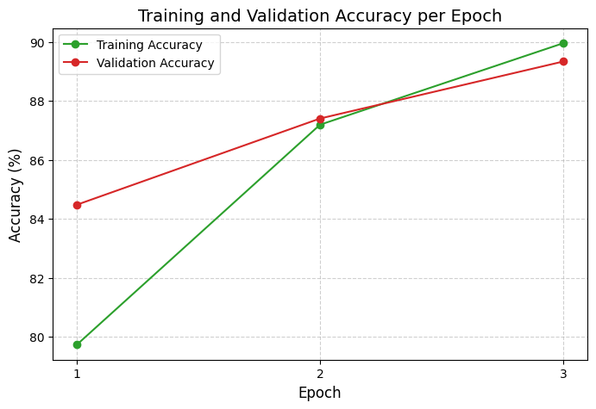
Performance Results: Accuracy Curve

Slide 7
MLOps & Reproducibility
Challenge: Ensured the project was fully reproducible, addressing common issues that arise in development.
Solutions:
- Docker: Containerized the entire environment with a Dockerfile, guaranteeing that the code runs the same way on any machine. Solved shared memory errors with the --shm-size flag.
- CI/CD: Implemented a GitHub Actions workflow to automatically test the training script and lint the code on every push, maintaining code quality.
- Logging: Integrated a robust logging system to capture all metrics, creating an auditable record for every training run.

Slide 8
Key Challenges & Lessons Learned
1. Version Mismatches: A version conflict between the Docker base image's CUDA version and PyTorch's required CUDA version was a major roadblock.
Lesson: Explicitly matching library versions with the environment is crucial for reproducibility.
2. Shared Memory: The DataLoader failed in Docker due to insufficient shared memory.
Lesson: The docker run --shm-size flag is necessary for multi-worker tasks.
3. Library Bugs: An OverflowError was traced to a bug in a specific version of torchvision's ColorJitter transformation.
Lesson: Constant testing and being aware of library-specific bugs are essential.

Slide 9
Future Work
- Optimization: Explore different hyperparameters and advanced augmentation techniques to push performance even further.
- Multi-View Project: Complete the training and analysis for the multi-view adapter project and compare its performance to the standard fine-tuning approach.
- Production Deployment: Build a full deployment pipeline using the provided Jenkinsfile to serve the trained model as a web service.

