Slide 1
Multi-View Classification: A Memory-Efficient Approach with Adapters
A Project Report on Parameter-Efficient Fine-Tuning (PEFT)

Slide 2
Executive Summary
Objective: To develop a memory-efficient solution for multi-view image classification using Parameter-Efficient Fine-Tuning (PEFT) with a Vision Transformer.
Achievement: Successfully trained a model with only 5.95% of its total parameters being trainable. Achieved a mean validation accuracy of 61.7% across three simulated folds.
Impact: Validated a highly efficient method for fine-tuning large models on limited hardware, demonstrating a viable approach for medical imaging and other complex tasks.

Slide 3
Problem & Methodology
Problem: Training multi-view classifiers on large pre-trained models can be memory-intensive and computationally expensive.
Approach:
- Model: Pre-trained vit_tiny_patch16_224 backbone.
- PEFT Strategy: Froze the majority of the model and injected small, trainable Adapter modules into its layers.
- Data: Used a synthetic DummyMultiViewDataset with four image views for a binary classification task.
Training Details:
- A 3-fold cross-validation was simulated to assess model stability.
- Only 0.362 million of the 6.1 million parameters were fine-tuned.

Slide 4
Performance Results: Loss & Accuracy
Training and Validation Performance Across Three Folds
Key Points:
- The learning curves show a stable, if modest, learning trend across all folds.
- The model's performance on a random dataset is limited but consistent, validating the architectural approach.
[Insert the plots of Training and Validation Loss and Accuracy per Fold]

Slide 5
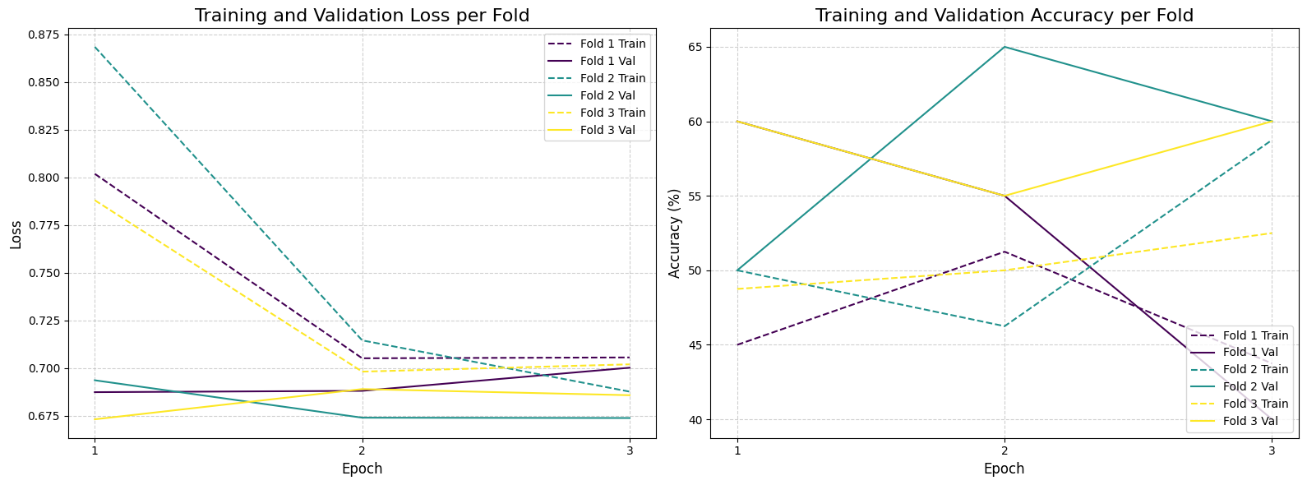
Performance Results: Loss & Accuracy

Slide 6
Key Challenges & Lessons Learned
1. Memory Constraints: The project successfully demonstrated that adapter-based PEFT is a powerful way to reduce the number of trainable parameters and manage memory.
2. Dummy Data: The use of synthetic data, while great for architectural testing, showed that a real-world dataset is required to achieve meaningful accuracy gains.
3. Training Stability: A small batch size (1) was necessary due to the multi-view input, which can lead to noisy gradients and less stable training.

Slide 7
MLOps & Reproducibility
Containerization: The Dockerfile provides a consistent environment. We used the docker run --shm-size flag to handle multi-worker data loading, which is a key learning for parallel processing in containers.
Version Control: All architectural changes and MLOps scripts are versioned with Git.
Logging: Detailed per-epoch metrics for each fold were logged, providing a comprehensive record for future analysis.

Slide 8
Future Work & Recommendations
- Real-World Data: The next logical step is to train this model on a real multi-view dataset, such as medical scans, to evaluate its true performance.
- Hyperparameter Tuning: Systematically tune the adapter bottleneck_ratio and learning rate to optimize the model for real data.
- Model Comparison: Compare the adapter-based approach to a full fine-tuning pipeline to quantify the trade-off between performance and efficiency.

