Slide 1


DESKTOP VOICE ASSISTANT
Under the Guidance: Prof. S.D.PERUR
BATCH MEMBERS:
OMKAR DESHPANDE-2GI20IS019
RAHUL KULKARNI -2GI20IS053
PRANAV PATIL-2GI20IS061
SUDARSHAN KAJMANI-2GI21IS413

Slide 2
CONTENTS
Introduction.
Problem Definition.
Objectives.
System Architecture.
Module Description.
Functional Requirements.
Non-Functional Requirements.
Results.
Conclusion.
References.

Slide 3
INTRODUCTION:
The PC voice-activated assistant project draws inspiration from popular virtual assistants like Siri and Google Assistant, aiming to bring the convenience and efficiency of voice-activated interactions to a Python-based implementation. By emulating features found in these widely used virtual assistants, PC assistant provides users with a familiar and intuitive way to engage with technology using natural language.
Inspired by the convenience of voice-activated control over various applications and services, Jarvis enables users to open and close specific programs seamlessly, resembling the functionality found in virtual assistants integrated into modern operating systems.

Slide 4
PROBLEM DEFINITION:
The development of Voice-Controlled Personal Assistant, arises from the need for an advanced, user-friendly virtual assistant that leverages Python, various libraries to address the growing demand for efficient and hands-free digital interactions. Traditional interfaces, while functional, often require manual input and lack the immersive experience provided by voice-controlled systems.

Slide 5
OBJECTIVES:
Develop voice assistant to accurately interpret and understand user commands in natural language.
Design functionalities for PC assistant to perform various tasks, including opening web browsers, navigating the file system, and executing system commands through voice commands.
Enable PC assistant to interact with the file system, facilitating tasks such as open audio, video and other files through voice-controlled commands.
Develop modules to provide users with real-time information about other relevant metrics through voice-activated queries.
Prioritize user experience by designing intuitive and user-friendly interactions, ensuring that Jarvis is accessible and easy to use for individuals with varying technical expertise.

Slide 6
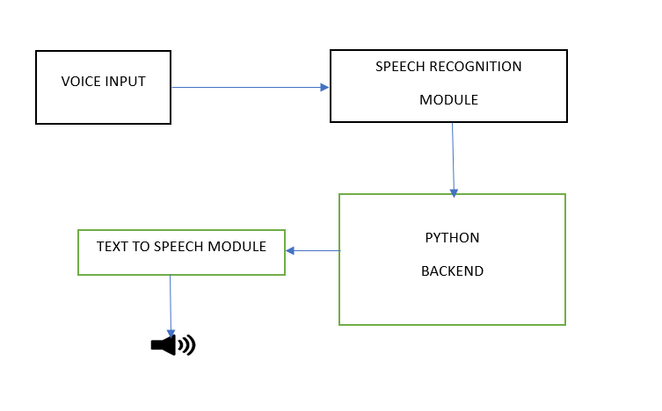
SYSTEM ARCHITECTURE:

Slide 7
MODULE DESCRIPTION:
1.pyttsx3:
This module is used for text-to-speech conversion. It allows Jarvis to respond to user commands with synthesized speech.
2.speech_recognition:
The `speech_recognition` library enables Jarvis to capture and interpret user speech, converting it into text for command processing.
3.datetime:
The `datetime` module is used to obtain the current time and date, allowing PC assistant to provide personalized greetings.
4.wikipedia:
The `wikipedia` module is utilized for searching and retrieving information from Wikipedia based on user queries.
5.webbrowser:
The `webbrowser` module enables Jarvis to open specific websites in a web browser.

Slide 8
6.os:
The `os` module is used for interacting with the operating system, allowing Jarvis to open folders, applications, and perform file-related tasks.
7.pyautogui:
The `pyautogui` module is employed for simulating keyboard and mouse actions. In this project, it's used for volume control and taking screenshots.
8.speedtest:
The `speedtest` module allows Jarvis to perform internet speed tests.
9.platform:
The `platform` module is used to retrieve information about the operating system.
10.psutil:
The `psutil` module provides access to system-related information, such as CPU usage and disk space.
11.subprocess:
The `subprocess` module is utilized for running external programs from within the Python script.

Slide 9
FUNCTIONAL REQUIREMENTS
1. Speech Recognition:
The system should be able to accurately recognize and understand natural language commands spoken by the user.
2. Command Processing:
The assistant should interpret and process voice commands to perform various tasks.
3. System Integration:
Provide seamless integration with popular platforms and services to enhance functionality.

Slide 10
4. Context Awareness:
Implement a system that understands context and maintains a conversational context over multiple interactions.
5. Feedback and Confirmation:
Provide feedback to users through voice responses or visual cues to confirm successful execution of commands.
6. Compatibility:
Ensure compatibility with a variety of devices, operating systems, and applications.
7. Continuous Improvement:
Implement mechanisms for updating the assistant with new features, improvements, and bug fixes.

Slide 11
NON FUNCTIONAL REQUIREMENTS
Performance:
Response Time: The assistant should respond to user commands within a reasonable time frame, ensuring a smooth and responsive user experience.
Scalability: The system should handle an increasing number of users or commands without a significant degradation in performance.
Reliability:
Availability: The assistant should be available for use whenever the user wants to interact with it, minimizing downtime.

Slide 12
Usability:
Speech Recognition Accuracy: Strive for a high level of accuracy in speech recognition to enhance the user experience.
Natural Language Processing (NLP): Implement NLP techniques to improve the system's understanding of natural language and user intent.
Scalability:
Concurrency: Ensure that the assistant can handle multiple user requests concurrently without performance degradation.
Resource Management: Optimize resource usage to accommodate a growing user base.
User Interface:
Voice Synthesis Quality: Strive for clear and natural-sounding voice synthesis to enhance the user experience.

Slide 13
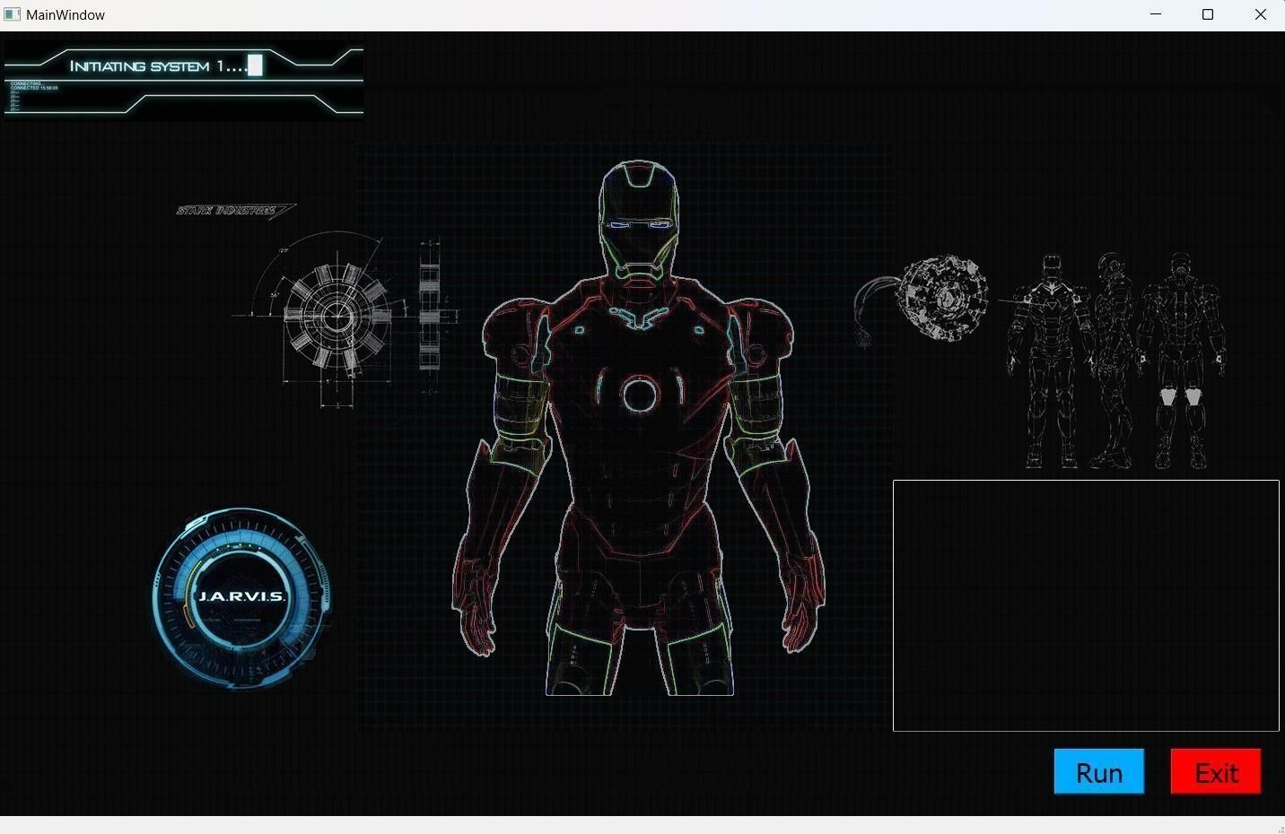
RESULTS:

Slide 14
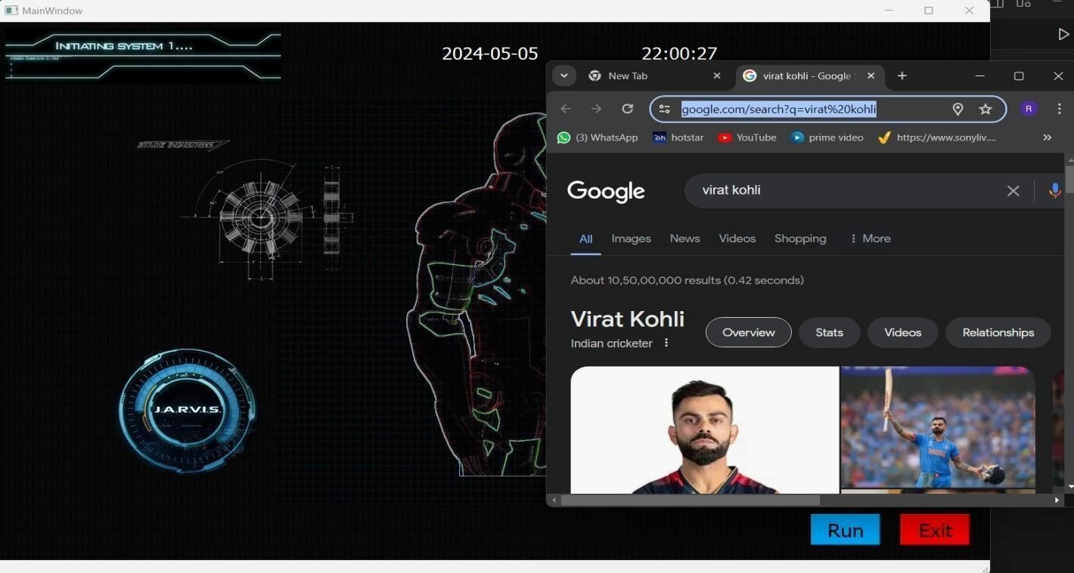

Slide 15
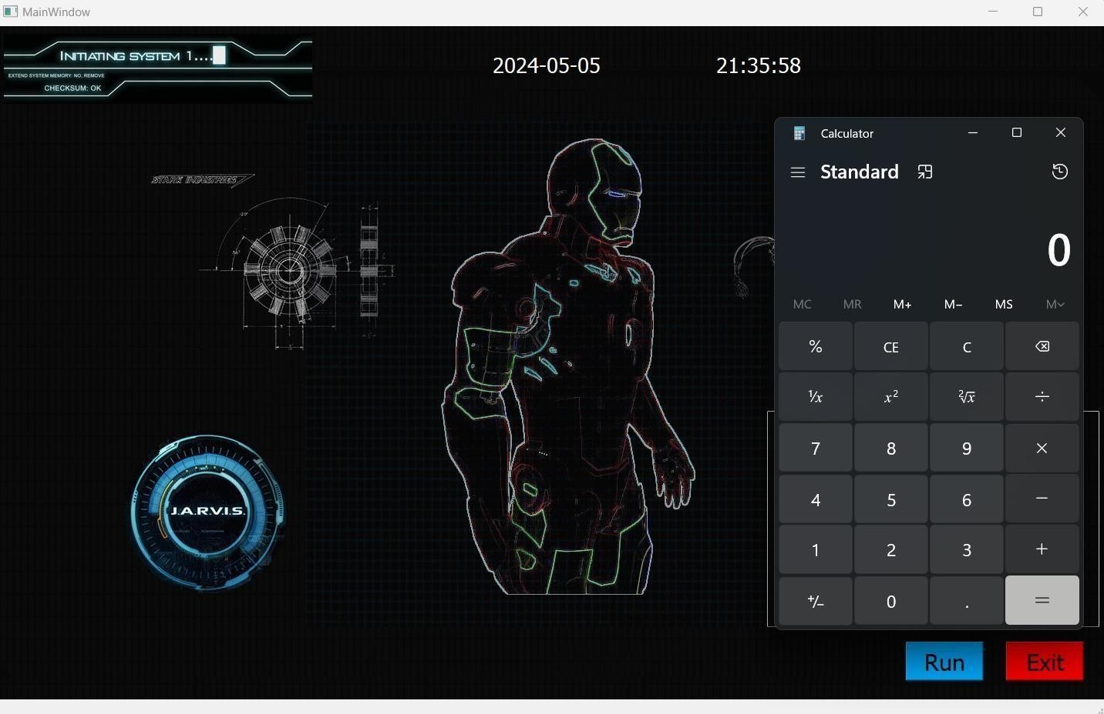
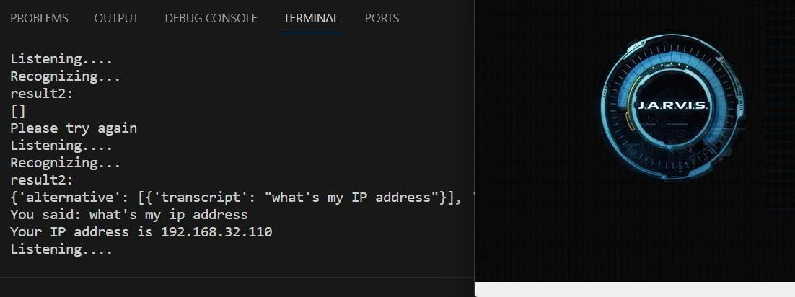

Slide 16
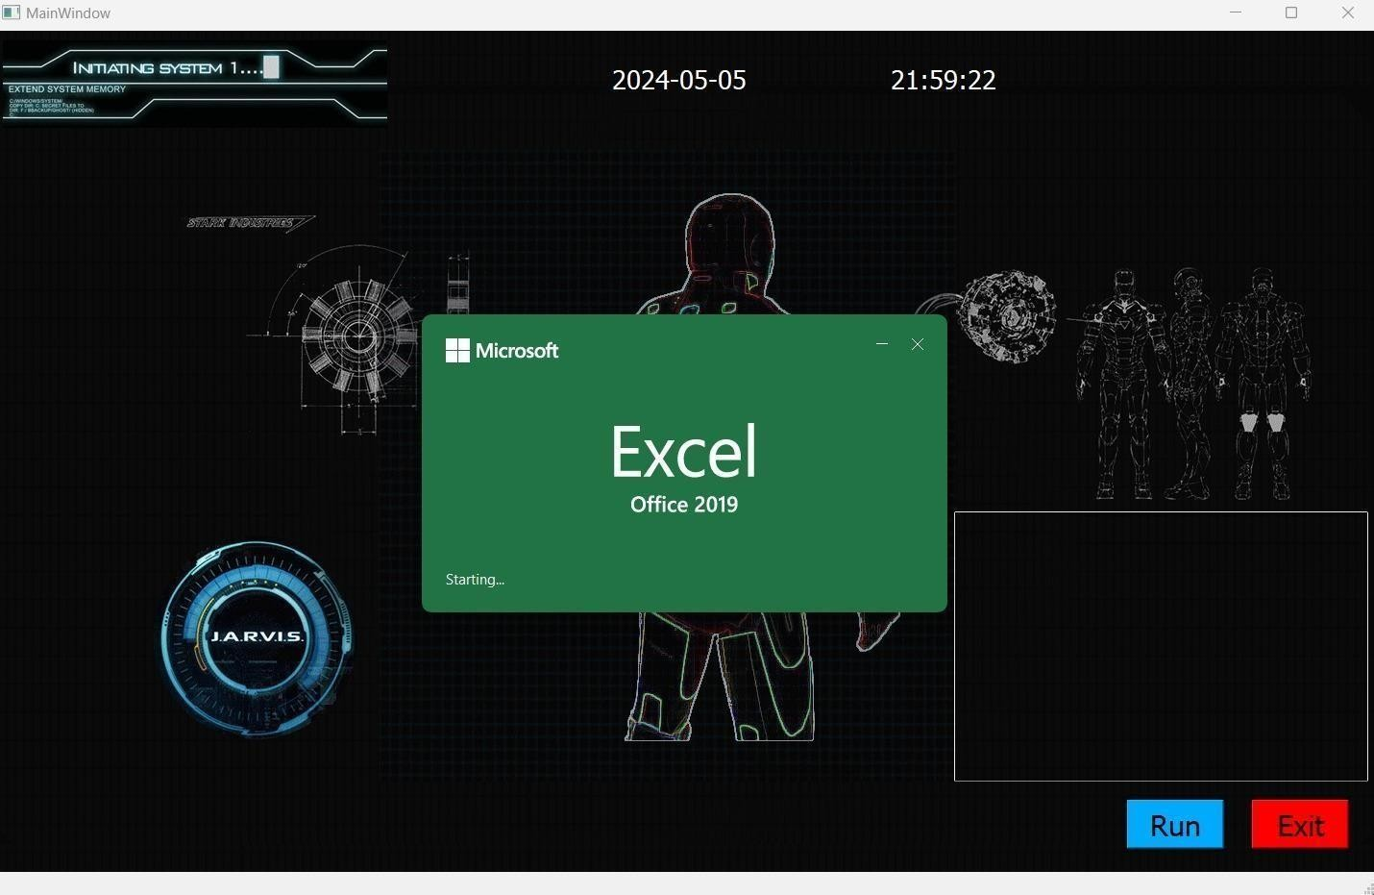

Slide 17
CONCLUSION:
The Jarvis Voice-Activated Assistant Project is a Python-based venture modeled after popular virtual assistants such as Siri and Google Assistant. The project makes use of modules such as 'pyttsx3' for voice synthesis,'speech_recognition' for speech recognition, and others for activities ranging from web browsing and information retrieval to system monitoring and multimedia control. Jarvis provides a personalized experience, greeting users based on time of day and responding to a variety of voice commands. Jarvis allows users to open webpages, search Wikipedia, control media playback, and access system information, among other things. The project's goal is to provide a hands-free and engaging user experience, which will let researchers investigate voice-activated technologies and their possible incorporation into regular computing habits.

Slide 18
REFERENCES
[1. N Umapathi, G Karthick on Desktop’s Virtual Assistant using PythonJ. Meng, “Research on thecost of agricultural products circulation and its control under the new normal economic development,” Commercial Times, no. 23, pp. 145147, 2016.]
[2. Dhiraj Pratap Singh, Deepika Sherawat, Sonia. “Voice Activated Desktop Assistant Using Python”2020.]
[3. Automatic Speech Recognition (ASR) for Everyday Users (2021, June). Microsoft Research. https://www.microsoft.com/en-us/research/publication/automatic-speech-recognition-a- deep-learning-approach/]
[4. Speech Recognition with Python: A Practical Guide (2023, February 10). Real Python.https://realpython.com/courses/speech-recognition-python/]
[5. Speech Recognition Using Deep Learning (n.d.). TensorFlow. https://www.tensorflow.org/tutorials/audio/simple_audio]

Slide 19
THANK YOU

