Slide 1
Theatre management system
By: Rahul kulkarni (2gi20is053)
Omkar deshpande (2gi20is019)
Pranav patil (2gi20is061)

Slide 2
Contents:
ER-DIAGRAM
SCHEMA DIAGRAM
FUNCTIONAL DEPENDENCIES
NORMALIZATION
CREATION OF TABLES
DESCRIPTION OF TABLES.

Slide 3
Abstract:
This system deals with a single branch of a theatre. It keeps track of the various halls, currently showing movies, show timings, booked tickets, and price listings in the theatre as well as the associated attributes. It is possible for the management of the theatre to use the database to fully understand all parts of the system without use of additional software.

Slide 4
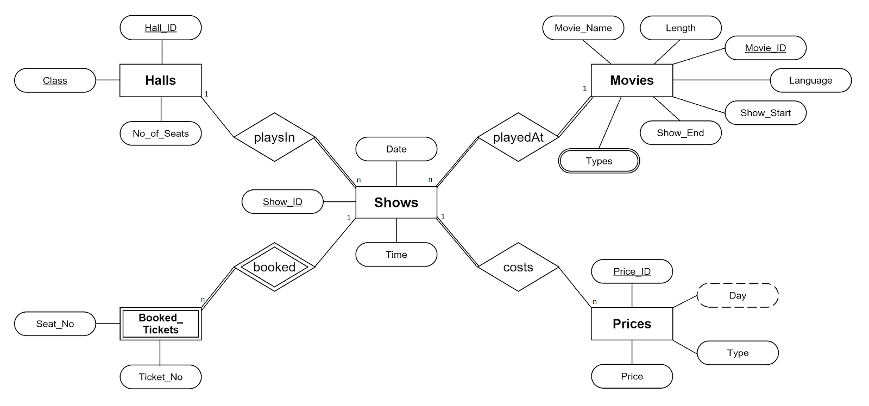
Er diagram:

Slide 5
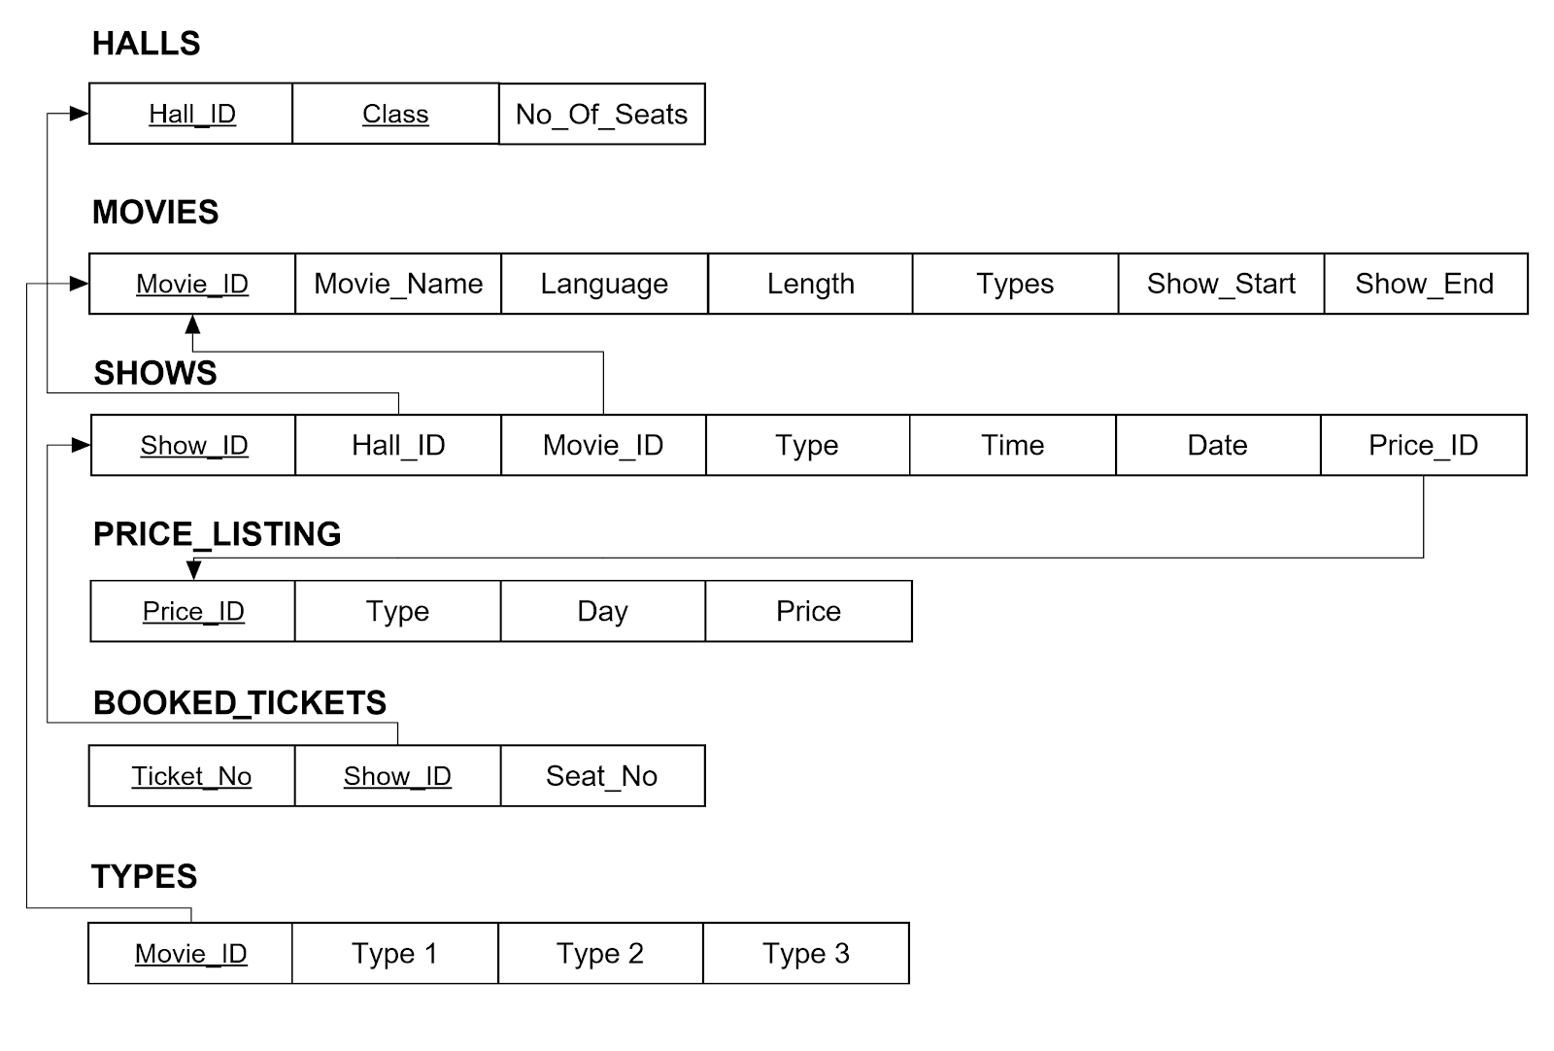
Schema diagram:

Slide 6
JUSTIFICATION TABLE:
ENTITIES INVOLVED | RELATIONSHIP | DESCRITION | CARDINALITY RATIO | PARTICIPAT-ON RATIO | JUSTIFICATION
SHOWS & MOVIES | PLAYES AT | MOVIES ARE PLAYED AT THE SHOWS | N:1 | T:T | EVERY SHOW HAS MOVIES AND EVERY MOVIES ARE PLAYED AT SHOWS
SHOWS & PRICE | COSTS | EVERY SHOW COSTS PRICE | 1:N | T:P | ALL SHOWS HAVE PRICE BUT ALL PRICE DOSEN’T HAVE SHOWS
SHOWS & HALLS | PLAYS IN | SHOWS ARE PLAYED IN HALLS | N:1 | T:P | ALL SHOWS ARE PLAYED AT HALLS BUT ALL HALLS DOSENT HAVE SHOWS
SHOWS & BOOKED TICKETS | BOOKED | TICKETS ARE BOOKED FOR SHOWS | 1:N | P:T | ALL TICKETS THAT ARE BOOKED HAVE SHOWS BUT ALL SHOWS NEED NOT HAVE ALL TICKETS BOOKED

Slide 7
Functional dependencies:
HALLS
FD: Hall_ ID, Class → No_ Of_ Seats
MOVIES
FD: Movie_ ID → Movie_ Name , Language, Length, Types, Show_ Start, Show_ End
SHOWS
FD: Show_ ID → Hall_ ID, Movie_ ID, Type, Time, Date, Price_ ID
PRICE LISTS
FD: Price_ ID → Type, Day, Price
FD: Type, Day → Price
( Type, Day forms a Super Key, hence it does not violate Third Normal Form)
BOOKED TICKETS
FD: Ticket_ No , Show_ ID → Seat_ No
TYPES
FD: Movie_ ID → Type_1, Type_2, Type_3

Slide 8
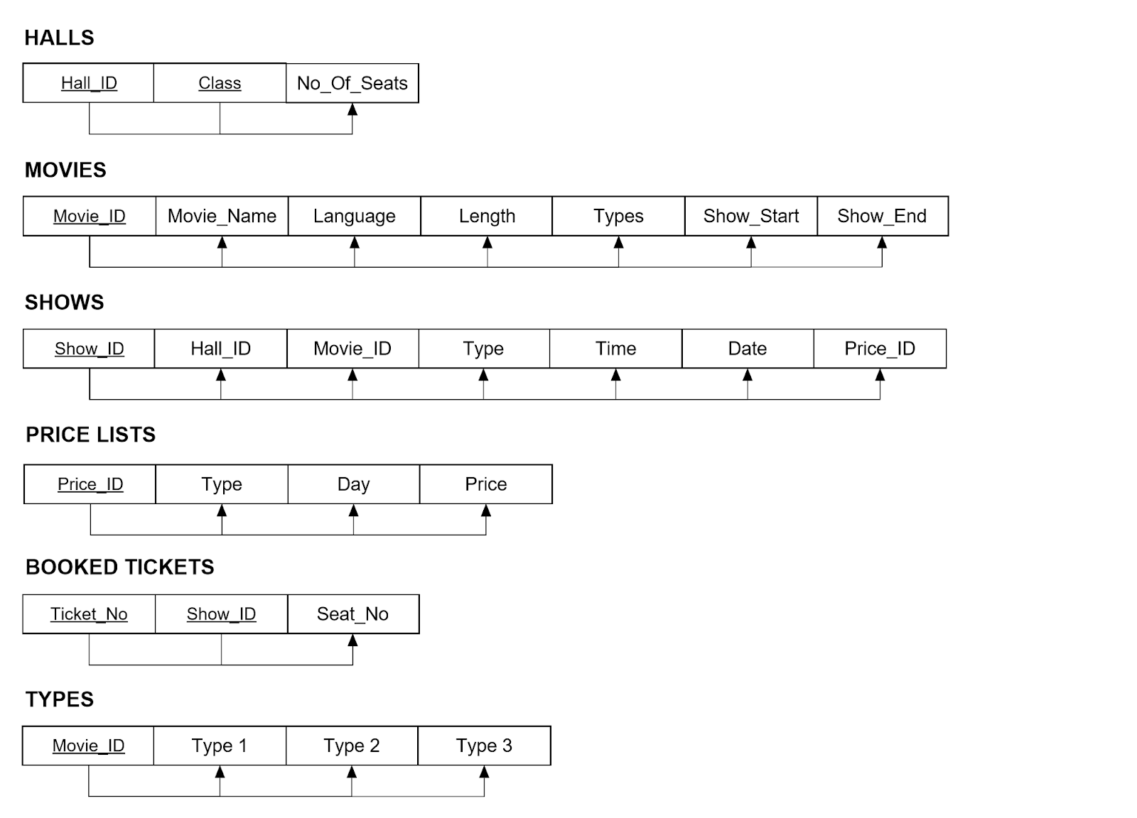
Normalized to 3rd normal form:

Slide 9
Creation of tables:
HALL:
create table halls (
hall_id int,
class varchar(10),
no_of_seats int,
primary key(hall_id,class));
MOVIES:
create table movies (
movie_id int primary key,
movie_name varchar(40),
length int, language varchar(10),
show_start date,
show_end date);

Slide 10
Creation of tables:
PRICE LISTING:
create table price_listing (
price_id int primary key,
type varchar(3),
day varchar(10),
price int);
SHOWS:
create table shows (
show_id int primary key,
movie_id int,
hall_id int, type varchar(3), time int,
Date date,
price_id int,
foreign key(movie_id) references movies(movie_id),
foreign key(hall_id) references halls(hall_id),
foreign key(price_id) references price_listing(price_id) on update cascade);

Slide 11
CREATION OF TABLES:
BOOKED TICKETS:
create table booked_tickets (
ticket_no int, show_id int,
seat_no int, primary key(ticket_no, show_id), foreign key(show_id) references shows(show_id) on delete cascade);
TYPES:
create table types(
movie_id int primary key,
4DX varchar(3),
3D varchar(3),
2D varchar(3),
foreign key(movie_id) references movies(movie_id) on delete cascade);

Slide 12
DESCRIPTION OF TABLES:
Halls: This table is used to hold the information about the halls in the theatre. The entry of data to this table can only be done by admin, and is not done by manager or cashier.
Movies: This table holds any movies currently playing in the theatre. It also holds the length of the movie, which is used for scheduling, and the showings start and end dates, out of whose range movies cannot be shown.
Shows: This table holds the individual showings of the movie. Price_ID is used to refer to the price listings, which holds the price of the show considering type and day. Each show is also of a specific type.
Price_Listing: This table holds a list of prices, which are defined by Day of the showing and Type of the movie, such that 4DX costs more than 3D which costs more than 2D and weekdays cost less than weekends including Friday.
Booked_Tickets: This table holds the tickets booked by cashier on behalf of customer. It has ID of the showing as well the seat number, which starts from 1 in case of Standard seats and from 1001 in case of Gold seats.
Types: This table holds the showing types available for any movie. These types are 2D, 3D, and 4DX

Slide 13
CONCLUSION:
In this project we come to know about how theatre management system works and what are the attributes are required to design the database model for theatre to work smoothly

Slide 14
THANK YOU

