Slide 1
Risk Adjustment Accuracy Review
Medicare Advantage & ACA | Payment years 2023-2025 | Synthetic data demo

Slide 2
Key insights
Highest average RAF in 2025: D-SNP (0.852), +7.5% vs prior year.
MA average RAF ranges 0.818-0.852 across plans.
Lowest HCC recapture: ACA Silver at 85.7%; highest: D-SNP at 90.6%.
Each un-recaptured chronic HCC understates risk scores and revenue; recapture gaps are the largest controllable driver of RAF accuracy.

Slide 3
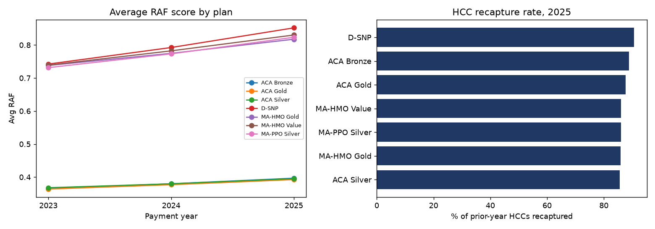
RAF trend and HCC recapture by plan

Slide 4
Most prevalent MA conditions, 2025
HCC19 Diabetes without Complication: 22.4% of members (coef 0.105)
HCC18 Diabetes with Chronic Complications: 17.9% of members (coef 0.302)
HCC138 Chronic Kidney Disease, Moderate (Stage 3): 15.4% of members (coef 0.069)
HCC111 Chronic Obstructive Pulmonary Disease: 14.1% of members (coef 0.335)
HCC96 Specified Heart Arrhythmias: 13.0% of members (coef 0.268)

Slide 5
Data quality and method
5 validation checks run before reporting; 25 records quarantined (missing_county, invalid_raf_score).
Recapture rate = prior-year HCCs documented again this year / prior-year HCCs, per member and HCC.
YoY RAF change tested with Welch's t-test; RAF drivers estimated with OLS regression.
Data is synthetic and CMS-structured; HCC coefficients are illustrative, not official CMS rates.

Slide 6
Recommended next steps
Prioritize chart reviews and annual wellness visits for ACA Silver members with un-recaptured HCCs.
Add a monthly recapture tracker to the operational dashboard by provider group.
Validate RAF movement against finance and actuarial revenue forecasts each quarter.

