Slide 1
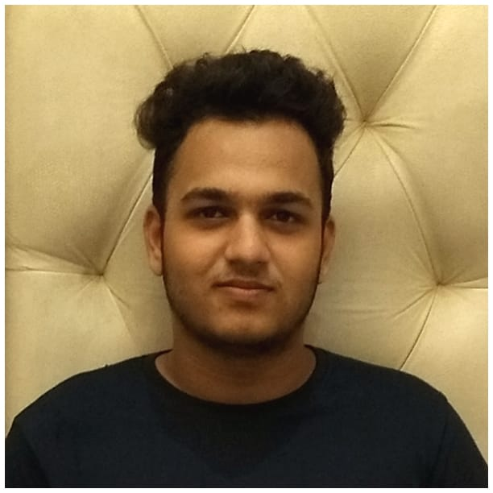



Omkar D Dumbhare
Bachelor of Engineering
Electronics and Telecommunications : 2018- 2022
Skills
omkar.d.dumbhare@capgemini.com
Java 8 /J2EE | Java Basics, OOPS, Generics, Collections, Arrays, Loops, Lambda Exp, Stream API Junit, Mockito, Servlets
Spring core | IOC & Dependency Injection, Autowire
Spring REST | REST controllers, Implementation of GET, POST, PUT & DELETE, Bean Validation & Exception Handling, Testing Services, Controller & Repository layer
Spring Data JPA | Implement DAO layer using spring Data repositories, Transaction Management
Spring Boot Microservices | Spring Boot Starters, annotations, Messaging Service, Sync/Async comms, Swagger API documents
Spring Cloud | Eureka, Netflix Ribbon, Feign Client, Netflix Hystrix, Netflix Zuul & Config Server
Angular | Components, Services, Modules, Routing, Forms & Validation, Testing using Jasmine & Karma
Database | MongoDB No Sql Basics My SQL Basics
UI Tech | HTML 5 & CSS 3,JavaScript, ES6 & TypeScript
Tools | Git, Postman, Maven, IDE
Add On skills | Communications, Team management. Peer learning
+91 9604495347
Full Stack Developer
Hands on experience in creating microservices with Springboot, Spring Security, Spring Cloud API Gateway, Eureka server, resilience 4J, load balancing and Swagger.
Proficient in creating Single page Web Application in Angular with Authentication with route guards, Angular reactive forms, angular routing
Experience in creating documentation with Java docs and swagger and in unit testing using Junit and Mockito
On Demand Car Wash Application
Completed end to end case study of On Demand Car Wash along with JWT authentication, Swagger and payment testing using Razorpay, responsive UI with Angular used for user interface.
Backend(MongoDB),Middleware(Spring Boot) and Frontend(Angular) at Adapt
Completed ”Programming for Everybody“ course at Coursera
Check out my work on GitHub & Video Profile

