Slide 1
Online Art Gallery
Group member:-
Pooja Bolkar 220343020019
Ashwini Mule 220343020053
Omkar Ganjave 220343020057
Prajwal Patil 220343020064

Slide 2
Agenda
1. Project Introduction
2. Project Architecture
3. Technology platform used for project
4. User Roles and responsibilities
5. Division of work within team
6. Use Case Diagram
7. Future extensions if any
8. Conclusion

Slide 3
1.Project Introduction:-
The project provides an online platform for help the artist to showcase their art work and sell their paintings,scluptures,sketches online. This website will provide more options for customer to choose the artwork as per their requirements. Also customer can buy the artworks from the website directly.
Nowadays art lovers are not getting enough time to go to the galleries and collect art and paintings. Online Art Gallery is to provide the facility of displaying and selling artworks of artists. Artists can register for being a member of the art gallery and each artist can upload a digital copy of their artwork under the respective categories. Customers can also register and they can browse artworks in different categories. This web application software is very helpful for art lovers.

Slide 4
2. Project Architecture:-
Used for
Server side validations, if needed Response handling
Business logic
Database operations
Used for
• User interfacing
Basic data validation
Used for
Permanent data storage
Database level validations
Database access
Front End
Layer
Database Layer
Server Layer
Technologies used:
HTML,CSS
JavaScript,
JQueryReact
JSON
Technologies used:
Springboot
Hibernate
Technologies used:
MySQL

Slide 5
3. Technology platform used for project:-
1.Java:-
Java Web Application is used to build dynamic websites. Java offers support for the web application through JSPs and Servlets. We can build a website with static HTML web pages but when we want data to be dynamic, we require the web application.
2.Spring Boot REST API:-
Spring boot to develop REST web services and microservices.Spring Boot has taken the Spring framework to the next level. It has drastically reduced the configuration and setup time required for spring projects. It is used in Back-End side.

Slide 6
3.JPA:-
A JPA (Java Persistence API) is a specification of Java which is used to access, manage, and persist data between Java object and relational database in back end.
4.React JS:-
React is used to build user interfaces (UI) on the front end.
Advantages Of React js:-
Build Rich User Interfaces
React JS Is Very Flexible
Makes JavaScript coding easier
Excellent cross-platform support
Provides amazing developer tools
UI focused designs
Easy to adopt

Slide 7
5.Bootstrap:-
Bootstrap is a flexible and powerful front-end framework that provides a free collection of tools for creating websites and web applications. With HTML, CSS, and JavaScript components Bootstrap makes front-end web development faster and easier for responsive, mobile first projects.
6.MySQL:-
MySQL is provide features such as complete atomic, consistent, isolated, durable transaction support for database in middle end.

Slide 8
4. Roles and responsibilities:-
1.Admin:-
Online Art Gallery should provide all function to admin how to handle the System.
Admin has controls of all the functionalities of customer and Artist module.
Admin can Delete the Customer and Artist.
Admin can view all register Customer and Artist.

Slide 9
2.Artist:-
Artist can register and create his own account.
Artist can add the art work.
Artist can update their art work.
Artist can view their art work.
Artist can delete art work.
Artist can review rating.

Slide 10
3.Customer :-
Customer can register and create his own account.
Customer can buy the products.
Customer can review art galleries by category wise.
Customer can give rating for artist art work .
Customer can add/remove product from cart.
Customer can place order.

Slide 11
5. Division of work within team
Role | Sr. No. | Use Cases | Description | Developer
Artist | 1 | Registration | Registration of artist using Registration form | Prajwal and Ashwini
 | 2 | Login | Login artist using user id and password | Prajwal
 | 3 | Send mail | send mail after succesful registration | Omkar
 | 4 | Add Product | Artist will add new product using add product form | Prajwal
 | 5 | Update Product | Artist will Update product using update product form | Omkar
 | 6 | Delete Product | Artist will delete product using delete product form | Omkar
customer | 7 | Registration | Registration of Customer using Registration form | Prajwal and Ashwini
 | 8 | Login | Login Customer using user id and password | Prajwal
 | 9 | Search Product | customer will search the products using category table | Pooja
 | 10 | Add/Remove to Cart | customer can add or Remove product to the cart and cart will be saved into the database | Pooja and Ashwini
 | 11 | Rating | customer give rating to artist art work | Omkar and Prajwal
 | 12 | Buy Product | Customer order will be placed and order added to order table and cart table will be cleared | Ashwini
Admin | 13 | Login | Login Admin using user id and password | Prajwal
 | 14 | Add new category | Admin can add new category of artist art work | Ashwini
 | 15 | Account Management | Add or remove account | Pooja

Slide 12
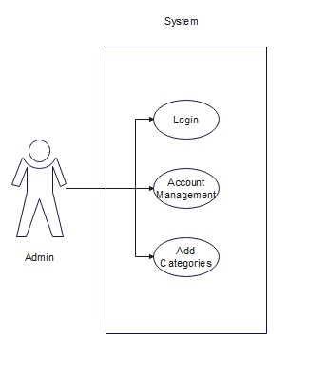
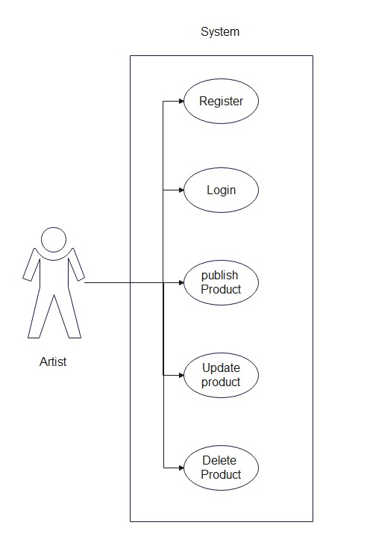
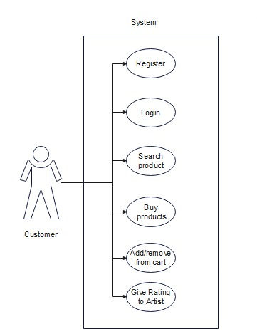
Use Case Diagram
1.Admin
2.Artist
3.Customer

Slide 13
Future Extensions
Online art galleries are the future scope of selling, exhibiting the art works market. Gradually it will be more and more improved and grow throughout the world. Now they had also started using the 360 degree view and panoramic image for better feel of the online art gallery experience.
Only one possible restriction is faced by that when the reduced the size of image of particular art works they should be sure for the quality and clarity should not be compromised. At the last I should say that technology is the future of everything so as soon the artists adapt it will be beneficial for art world. The Information era also gives opportunity to online art gallery to develop.

Slide 14
Conclusion
Online Art Gallery System provides artwork platform to get connected with different Artist and Customer efficiently.
Our System provides a very user-friendly platform where Artist can promote their artwork .Customer can register on website and find list of all the Artwork offered by Artist. Customer can see artwork and also Customer can give rating to Artist.
Thank You

Slide 15
Thank-You...

