Slide 1
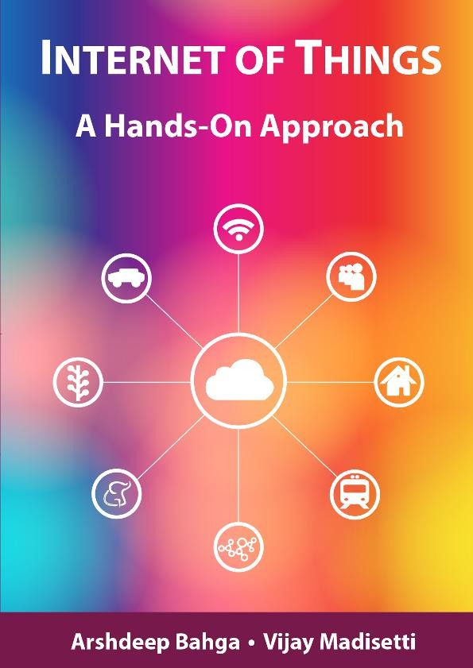
Unit -2: Machine to Machine Communication
2.1 Introduction to IoT
Book website: http://www.internet-of-things-book.com
Bahga & Madisetti, © 2015

Slide 2
Introduction
IoT consists things that have unique identifiers and are connected to internet(e.g networked computers,4G enabled mobile phones)
The focus of IoT is to configure, control and connect devices to internet that are not already associated with internet such as home appliances, utility meters, irrigation pumps, control circuits of electric car engine ,etc
The scope of IoT is not limited to just connecting things (devices ,appliances, machines) to internet but IoT allows these things to communicate and exchange data with each other.
Data-The raw data is obtained from IoT devices
Information-Information is obtained from data by filtering, processing and categorizing data
Knowledge-Knowledge is obtained from information by organizing and structuring information

Slide 3
Deﬁnition of IoT
The Internet of Things (IoT) is a system of interrelated computing devices, mechanical and digital machines, objects, animals or people that are provided with unique identifiers (UIDs) and the ability to transfer data over a network without requiring human-to-human or human-to-computer interaction.
In simple term IoT means connecting all kind of physical objects to internet especially ones that you might not except such as refrigerators, tube lights , air conditioners, medical devices, irrigation pumps and so on.
The term “Things” in IoT refers to anything or everything in day to day life which is accessed or connected through the internet

Slide 4
Characteristics of IoT
Dynamic & Self-Adapting: IoT devices and systems may have capability to dynamically adapt with changing context and take actions based on their operating conditions or sensed environment.
Self-Configuring: IoT devices may have self configuring capability, allowing large no. of devices to work together to provide certain functionality(such as weather monitoring).
Interoperable Communication Protocols: oT devices may support number of Interoperable Communication Protocols and can communicate with other devices and also with the infrastructure.
Unique Identity: Each IoT device has a unique identifier such as IP address, that allows user to query devices, monitor their status and control them remotely.
Integrated into Information Network: IoT devices are integrated into information network that allows them to communicate and exchange data with other devices and system
Enormous Scale:

Slide 5
Features of IoT
Connectivity: Connectivity refers to establish a proper connection between all the things of IoT to IoT platform it may be server or cloud.
Analyzing: After connecting all the relevant things, it comes to real-time analyzing the data collected and use them to build effective business intelligence.
Integrating: IoT integrating the various models to improve the user experience as well.
Artificial Intelligence: IoT makes things smart and enhances life through the use of data.
Sensing: The sensor devices used in IoT technologies detect and measure any change in the environment and report on their status.
Active Engagement: IoT makes the connected technology, product, or services to active engagement between each other.
Endpoint Management: It is important to be the endpoint management of all the IoT system otherwise; it makes the complete failure of the system

Slide 6
Advantages of IoT
Efficient resource utilization: If we know the functionality and the way that how each device work we definitely increase the efficient resource utilization as well as monitor natural resources.
Minimize human effort: As the devices of IoT interact and communicate with each other and do lot of task for us, then they minimize the human effort.
Save time: As it reduces the human effort then it definitely saves out time. Time is the primary factor which can save through IoT platform.
Reduced Waste: IoT makes areas of improvement clear. Current analytics give us superficial insight, but IoT provides real-world information leading to more effective management of resources.
Enhanced Data Collection: Modern data collection suffers from its limitations and its design for passive use. IoT breaks it out of those spaces, and places it

Slide 7
Disadvantages of IoT
Security: As the IoT systems are interconnected and communicate over networks. The system offers little control despite any security measures, and it can be lead the various kinds of network attacks.
Privacy: Even without the active participation on the user, the IoT system provides substantial personal data in maximum detail.
Complexity: The designing, developing, and maintaining and enabling the large technology to IoT system is quite complicated.
Less Flexibility: Many are concerned about the flexibility of an IoT system to integrate easily with another.

Slide 8
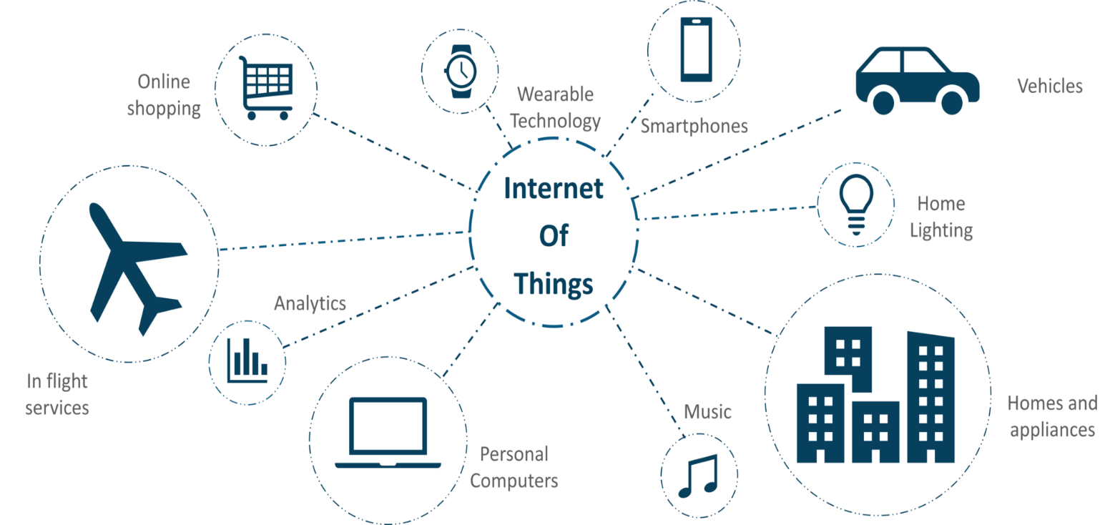
IoT Applications

Slide 9
Home Automation
Smart lighting: it helps in saving energy by switching ON/OFF lights when needed
-internet connected lights cab be controlled remotely from IoT applications such as mobile or web application
Smart appliances: home appliances such as TV, refrigerator, music system, washing machine can be controlled remotely by IoT applications.
-smart refrigerator keep track of items stored (RFID tags) and sends update to user when item is low on stock
-smart TV allows users to search and stream videos and movies from internet
Intrusion detection: Home Intrusion detection systems uses security cameras and door sensors to detect intrusion and send alerts(SMS or email) to users or send image or short video clip of intruder .

Slide 10
Home Automation
Smoke/gas detectors : Smoke detectors installed in home &buildings detects smoke(i.e early sign of fire) in a air and send SMS or email to users or local fire safety department.
-Gas detector can detect presence of harmful gases in air such as carbon monoxide , nitrogen monoxide , nitrogen dioxide using gas sensor and send SMS or email to users

Slide 11
Cities
Smart parking : In Smart parking sensors are used for each parking slot to detect whether parking slot is empty or occupied and send this information over smart parking application to car drivers.
Smart lighting: for roads , parks and buildings can help in saving energy
Smart Roads : In smart roads sensors can collect traffic information and send alert in case of traffic congestion or accidents .
-such information helps reducing traffic jams.

Slide 12
Environment
Weather monitoring : Weather monitoring system collect data from no. of sensors such as temperature, humidity and send data to cloud based application
-data collected in cloud can be analyzed and alert send to subscribed users
Air pollution monitoring : system can monitor and collect harmful gases in air such as carbon monoxide , nitrogen monoxide , nitrogen dioxide using gaseous sensor
-collected data can be analyzed to make informed decisions on pollution control approaches.
Forest fire detection : Forest fire can causes damage to natural resource and human life .
early detection of fire can help in minimizing damage
River flood detection: River flood can causes damage to natural resource and human life .
-IoT based river flood monitoring system uses no. of sensors that monitor water level and flow rate of water and gives early warning of flood.

Slide 13
Agriculture
Smart Irrigation: IoT based Smart irrigation system uses soil moisture sensors to determine amount of moisture(water contents) in soil and if soil moisture level is low then sends alert to irrigation pump to turn ON and gives water to plants
-also Smart irrigation system helps in saving water

Slide 14
Physical Design of IoT
Things in IOT
The "Things" in IoT usually refers to IoT devices which have unique identities and can perform remote sensing, actuating and monitoring capabilities.
The "Things" in IoT can be any object that has unique identifier and which can send or receive data over network (for example such as smart phone, smart TV,computer,printer, surveillance camera,refrigerator,etc.)
IoT devices can:
Exchange data with other connected devices and applications (directly or indirectly),or
Collect data from other devices and process the data locally or
Send the data to centralized servers or cloud-based application back-ends for processing the data or
Perform some tasks locally and other tasks within the IoT infrastructure, based constraints.

Slide 15
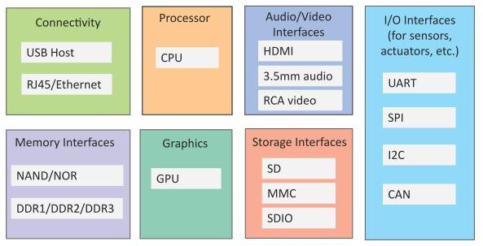
Generic block diagram of an IoT Device
An IoT device may consist of several interfaces for connections to other devices, both wired and wireless.
I/O interfaces for sensors
Interfaces for Internet connectivity
Memory and storage interfaces
Audio/video interfaces.
Fig .Generic block diagram of an IoT Device
An IoT devices can collect various types of data from attached sensors such as temperature, humidity, light intensity and sensed data can be communicated either to other devices or cloud based server/storage.
For e.g soil moisture sensor sense(detect) water content in soli and when processed to determine watering schedule

Slide 16
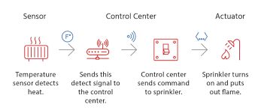
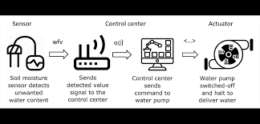
Examples of IoT devices

Slide 17
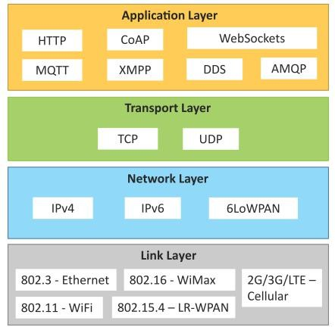
IoT Protocols
Link Layer
802.3 – Ethernet
802.11 – WiFi
802.16 – WiMax
802.15.4 – LR-WPAN
2G/3G/4G
Network/Internet Layer
IPv4
IPv6
6LoWPAN
Transport Layer
TCP
UDP
Application Layer
HTTP
CoAP
WebSocket
MQTT
XMPP
DDS
AMQP

Slide 18
IoT Protocols
Link Layer :it determines how data is physically send over networks physical layer or medium
802.3-Ethernet:
-IEEE 802.3 is a collection of wired standards for link layer,
-It provides data rates from 10 Mb/s to 40 Gb/s
for e.g. 802.3 is a standard for 10BASE5 Ethernet that uses coaxial cable
802.3.i is a standard for 10BASE-T Ethernet that uses twisted pair cable
802.3.j is a standard for 10BASE-F Ethernet that uses fiber optic cable
802.3.ae is a standard for 10 Gbit/s Ethernet that uses fiber optic cable
802.11-WiFi:
- IEEE 802.11 is a collection of WLAN standards, it provides data rates from 1 Mb/s to 6.75 Gb/s
for e.g 802.11a and 802.11ac operates in the 5 GHz bands,
802.11b and 802.11g operates in the 2.4 GHz bands,
802.11ad operates in the 60 GHz bands,

Slide 19
IoT Protocols
Link Layer :it determines how data is physically send over networks physical layer or medium
802.16 WiMax:
-IEEE 802.16 is a collection of wireless broadband standards,
-It provides data rates from 1.5 Mb/s to 1 Gb/s
802.15.4-LR-WPAN: :
-IEEE 802.15.4 is a collection of standards for low rate wireless personal area networks,
-It provides data rates from 40 Kb/s to 250 Kb/s
- These standards provides low cost and low speed communication for power constrained devices
2G/3G/4G-Mobile Communication:
-There are different generations of mobile communication standards,
-2G(including GSM and CDMA),
-3G(including UMTS and CDMA2000),
-4G(including LTE)
-IoT devices based on these standard can communicate over cellular networks

Slide 20
IoT Protocols
Network/Internet Layer:
It is responsible for sending of IP datagrams from source to destination network
This layer also performs the packet routing and host addressing(using IP addressing schemes such as IPv4 or IPv6
IPv4: it is used to identify device on network using 32 bit addresses
IPv6: it is used to identify device on network using 128 bit addresses
6LoWPAN: 6LoWPAN(IPv6 over Low power WPAN) used to identify low power devices have limited
processing capability
Transport Layer:
It is responsible for error free, end to end delivery of data from source host to destination host.
transport layer provides functions such as segmentation, error control, flow control and congestion control
TCP: TCP is a connection oriented, reliable and stateful transport layer protocol used by web browsers
(HTTP,HTTPS),email programs(SMTP) and file transfer(FTP)
UDP: UDP is a connectionless, unreliable and stateless transport layer protocol useful for time sensitive
applications that have small data units to exchange(DNS,DHCP)

Slide 21
IoT Protocols
Application Layer: It consists protocols that focus on process to process connections using ports
(e.g port 80 for HTTP, port 22 for SSH)
HTTP:It is used to transfer and access files and other data on web , HTTP uses request-response model, HTTP uses Universal Resource Identifiers(URIs) to identify web resources
CoAP: Constrained Application Protocol(CoAP) is a specialized web transfer protocol used by constrained devices and constrained networks in the IoT.
it allows constrained devices to join the IoT even through constrained networks with low bandwidth and low availability .
CoAP uses request-response model, however it runs on top of UDP instead of TCP
Web Socket: It allows full duplex communication over single socket connection for sending messages between client and server. WebSocket is based on TCP.
MQTT: Message Queue Telemetry Transport(MQTT) is light weight messaging protocol based on publish subscribe model ,where publishers generates data and subscribers consumes data.
,

Slide 22
IoT Protocols
XMPP: Extensible Messaging and Presence protocol(XMPP) is a protocol for real time communication between IoT devices and streaming XML data between network entities
DSS: Data Distribution Services( DDS) is a data centric middleware standard for device to device and machine to machine communication,
DDS uses a publish subscribe model
AMQP: Advanced Message Queuing protocol(AMQP) is an open application layer protocol for business messaging .
AMQP supports both point to point and publish subscribe models
,

Slide 23
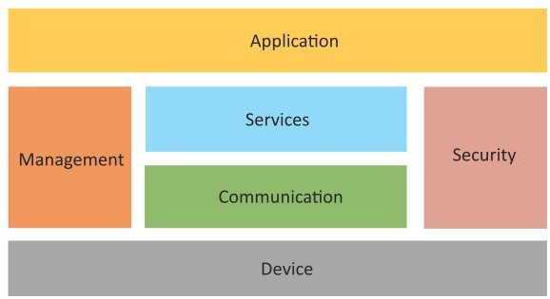
Logical Design of IoT
Logical design of an IoT system refers to an abstract representation of the entities and processes without going into the low-level specifics of the implementation.
An IoT system comprises of a number of functional blocks that provide the system the capabilities for identification, sensing, actuation, communication and management.

Slide 24
IoT Communication Models:
1.Request-Response communication model
2.Publish-Subscribe communication model
3. Push-Pull communication model
4. Exclusive Pair communication model

Slide 25
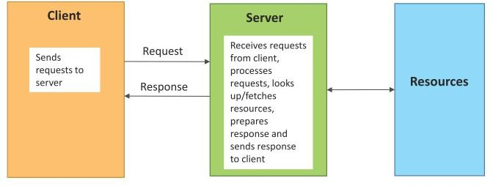
Request-Response communication model
Request-Response is a communication model in which the client sends requests to the server and the server responds to the requests.
When the server receives a request, it decides how to respond, fetches the data, retrieves resource representations ,prepares the response, and then sends the response to the client.

Slide 26
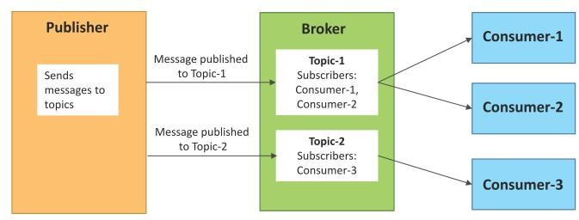
Publish-Subscribe communication model
Publish-Subscribe is a communication model that involves publishers, brokers and consumers.
Publishers are the source of data. Publishers send the data to the topics which are managed by the broker. Publishers are not aware of the consumers.
Consumers subscribe to the topics which are managed by the broker.
When the broker receives data for a topic from the publisher, it sends the data to all the subscribed consumers.

Slide 27
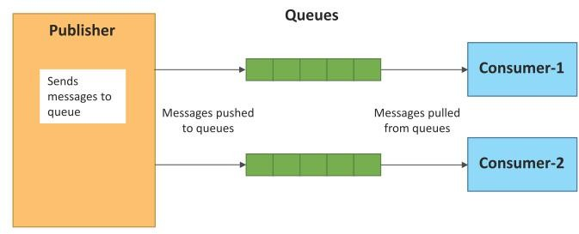
Push-Pull communication model
Push-Pull is a communication model in which the data producers push the data to queues and the consumers pull the data from the queues. Producers do not need to be aware of the consumers.
Queues help in decoupling the messaging between the producers and consumers.
Queues also act as a buffer which helps in situations when there is a mismatch between the rate at which the producers push data and the rate rate at which the consumers pull data.

Slide 28
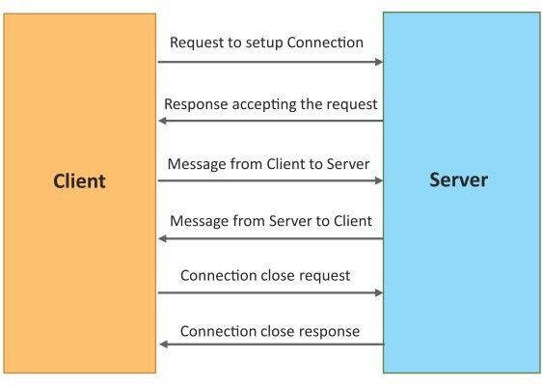
Exclusive Pair communication model
Exclusive Pair is a bidirectional, fully duplex communication model that uses a persistent connection between the client and server.
Once the connection is setup it remains open until the client sends a request to close the connection.
Client and server can send messages to each other after connection setup.

Slide 29
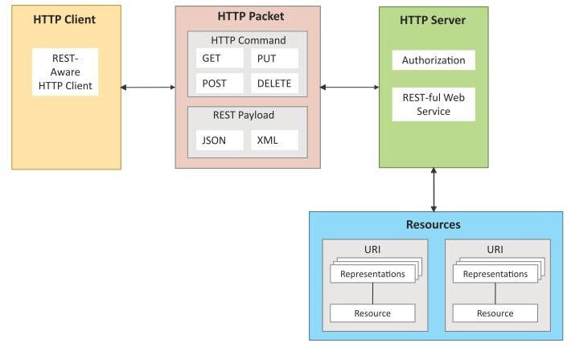
REST-based Communication APIs
Representational State Transfer (REST) is a set of architectural principles by which you can design web services and web APIs.
REST APIs follow the request- response communication model.
The REST architectural constraints apply to the components, connectors, and data elements, within a distributed hypermedia system.

Slide 30
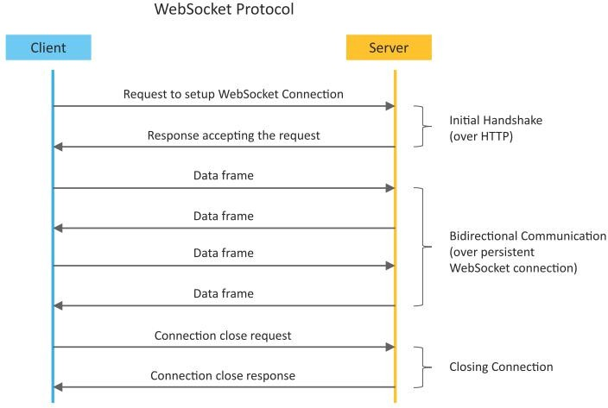
Web Socket-based Communication APIs
Web Socket APIs allow bi-directional, full duplex communication between clients and servers.
Web Socket APIs follow the exclusive pair communication model

Slide 31
How IoT Works?
ENVIRONMENT
Surroundings or conditions in which a person, animal, or plant lives or operates.
A device whose purpose is to detect events or changes in its environment and send the information to other electronic device
EMBEDDED HARDWARE
SENSOR
It uses a Microcontroller/Microprocessor to perform a single Job. Contains few or all the peripherals inside the module, i.e. SOC (System On Chip).
Properties:
Sense.
Send/Receive.
Analyze.
Control
ACTUATORS
Receives a control signal and performs action. Responsible for moving and controlling a system.
PEOPLE
INTERNET

Slide 32
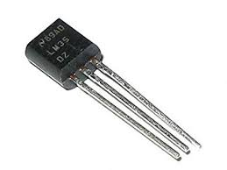
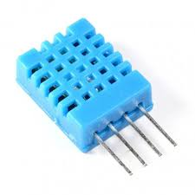
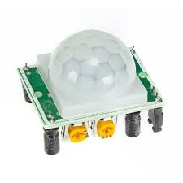
Sensors: Sensor detects input information from physical environment(Input can be light, heat, moisture,motion,pressure ,etc.) and transmit this information to IoT system through network.
Temperature sensor :
it measure temperature of air, liquid or gas.
It can be used in refrigerators ,air conditioners, computers, aircraft, greenhouses ,etc.
Humidity sensor :
it detect level of water vapors in air.
It can be used in wide range of industries including agriculture, manufacturing, data centers, air conditioning ,etc.
Motion sensor :
it detect movement of near by objects or people.
It can be used in automatic door controls, automatic parking systems, automated sinks, automated toilet flushers, hand dryers,

Slide 33
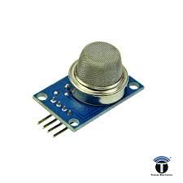
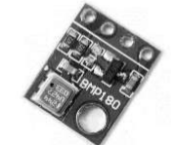
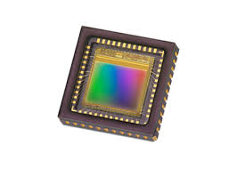
Sensors:
Gas/Smoke sensor :
it detects harmful gases in air.
It can be used in chemical factories to identify gas leaks.
It can detect smoke and carbon monoxide in homes
It can be used in fire alarm system, monitoring indoor air quality ,etc
Pressure sensor :
it detect pressure of liquids or gases.
It can be used in machinery , aircrafts, automobiles.
In vehicle, tyre pressure monitoring system (TPMS) is used to alert the driver when tyre pressure is too low and could create unsafe driving conditions.
Image sensor :
it convers light received on camera lens into digital images.
It can be used in digital cameras, biometric systems , medical imaging
systems, night-vision equipment, thermal imaging devices, radars, etc

Slide 34

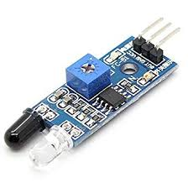

Sensors:
Accelerometer sensor :
it measures objects acceleration , making its possible to measure tilt, vibration and motion,etc
These sensors are used in vehicles, aircrafts, smartphones to detect orientation of an object, shake, tap, tilt, motion, positioning or vibration
IR sensor :
It detects infrared radiations in its surrounding environment.
Its used in various IoT projects including healthcare to monitor blood pressure, smartphones to use as remote control and wearable devices to detect amount of light.
Proximity sensors:
It detects the presence or absence of a nearby object .
They are used in elevators ,parking lots.

Slide 35
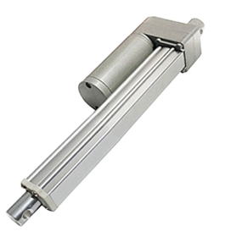
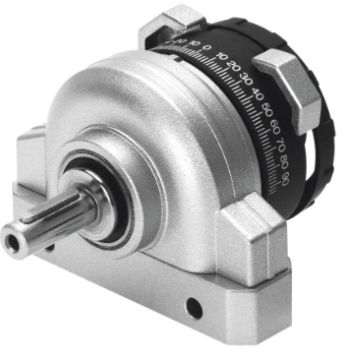
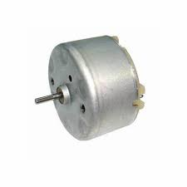
Actuators: Actuator is a device that converts input energy into motion(physical movement). -input energy it may be electrical, hydraulic fluid or compressed air and motion it may be linear or rotary Actuator is a device that allows something to move or operate
Linear Actuator : Actuator that create motion in a straight line
Linear actuator can move forward or backward on a set linear plane.
In shopping mall door open automatically with linear actuator.
Linear actuators used in applications such as robotics , medical equipment , industrial automation,
in computer peripherals such as hard disk, printer, etc.
Rotary Actuator : Actuator can move something in circular motion.
Rotary actuators used in applications such as valves, turbines and pumps.
DC Motor : It convert electrical energy into rotary mechanical energy.
It allows rotor to continuously rotate(move) in one direction.
It is used in applications such as fan, pump, compressor, wheel, etc.

Slide 36
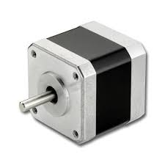

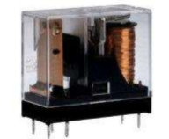
Actuators
Stepper Motor : It convert electrical energy into mechanical movement .
It allows rotor to move in forward or reverse direction, rotates in steps and holds position.
It allow very precise movement.
It is used in applications such as 3D printer, CNC machine ,etc.
Servo Motor : It is used to rotate or push parts of machine with great precision.
servo motor is used to rotate object at some specific angle or distance.
It is used in applications such as automatic packaging machine, toy cars, robotics, automobiles, etc.
Relay : It is electrically operated switch.
It can be turned ON/OFF using application.
It is used in applications such as heaters, lamps, AC circuits etc.

Slide 37

Actuators:
Solenoid Actuator : It is a specially designed electromagnet.
Solenoid actuators are simple ON/OFF actuators used in applications such as latching, locking, automatic car doors locks, etc.

Slide 38
Introduction to 5G Network

Slide 39





Introduction to 5G Network
Mobile networks having history of 40 years.
1G and 2G supports voice and text.
3G defining a transition to broadband access, supporting data rates with hundreds of kilobits-per-second.
4G supporting data rates with the few megabits-per-second and now transitioning to 5G, with the increase in data rates
5G is a new kind of network that is designed to connect virtually everyone and everything together including machines, objects, and devices

Slide 40
Characteristics of 5G
High Data Transfer speed :A data transfer rate of up to 10Gbps which is 10 to 100 times better than the 4G networks
Low latency: -Low latency of 1 millisecond will be used in remote control, games and the Internet of Things.
Massive devices are the Internet of Things. Compared with traditional 4G networks, 5G networks can accommodate more devices.
Broadband 1000 times faster per unit area
Availability of 99.999%
Reduction of 90% in the energy consumption of the network
Up to 10 years of battery life on low-power IoT (Internet of Things) devices

Slide 41
Application areas of 5G Network
High-speed mobile network
Entertainment and multimedia
Internet of Things that Connecting
Satellite Internet

Slide 42
High-speed mobile network:
Can support up to 10 to 20 GBPS of data download speed which is equivalent to a fiber-optic and internet connection accessed wirelessly.
Voice and high-speed data can be simultaneously transferred efficiently in 5G.
Due to low latency of 5G technology, it is significant for autonomous driving and mission-critical applications.
The small cell concept used in 5G will have multiple advantages of better cell coverage, maximum data transfer, low power consumption, cloud access network, etc.…

Slide 43
Entertainment and multimedia
High-speed streaming of 4K videos and crystal clear audio clarity.
Live events streaming via a wireless network with high definition.
HD TV channels can be accessed on mobile devices without any interruptions.
Augmented reality and virtual reality with HD video with low latency.
HD virtual reality games

Slide 44
Internet of Things that Connecting
Internet of Things will connect every object, appliance, sensor, device, and application to the Internet.
IoT applications will collect huge amounts of data from millions of devices and sensors. It requires an efficient network for data collection, processing, transmission, control, and real-time analytics.
5G is the most efficient technology for the Internet of Things due to its flexibility, unused spectrum availability, and low-cost solutions for deployment.
IoT can benefit from 5G networks in many areas like:
Smart Home
Logistics and shipping
Smart cities
Industrial IoT
Smart farming
Healthcare and mission-critical applications
Autonomous Driving
Drone Operation
Security and surveillance

Slide 45
Satellite Internet
Satellite internet technology with High-speed 5G network connectivity offers connectivity in urban and rural areas across the globe with the help of a constellation of thousands of small satellites

Slide 46
Introduction to NGN (Next Generation Network)
Next Generation Network (NGN) is a new concept .
More and more important for future telecommunication networks.
Next Generation Network (NGN) is a packet-based network.
Able to provide telecommunication services
Able to make use of multiple broadband, Quality of service (QoS)-enabled transport technologies.
It supports mobility.
In NGN service related functions are independent from underlying transport-related technologies.
It enables unfettered access for users to networks and to competing service providers.
It supports generalized mobility which will allow consistent and ubiquitous provision of services to users.
The general idea behind the NGN is that one network transports all information and services (voice, data, and all sorts of media such as video) by encapsulating these into IP packets.
Internet NGNs are commonly built around the Internet, and therefore the term all IP is also sometimes used to describe the transformation of formerly telephone-centric networks toward NGN.

Slide 47
NGN Features
NGN Support for a wide range of converged services between fixed/mobile and ability to deliver a wide variety of services.
It may be voice, video, audio and visual data, via session and interactive based services in unicast, multicast and broadcast modes.
NGN provides End-to-end QoS (Quality of Service): The NGN aims to provide high quality broadband communication by controlling the quality of service (QoS) on end to end basis.
QoS enabled services as it define:
a) Bearer service QoS classes;
b) QoS control mechanisms;
c) QoS control functional architecture;
d) QoS control/signaling.
end-to-end Packet-based Transfer

Slide 48
NGN Features
Technologies used at access and transport are broadband in nature. 3G WCDMA, 4 G LTE Advance is used at wireless access whereas FTTH, xDSL technology used at wire line access
MPLS use at transport technology
Separation of control functions (routing of payload) among bearer (payload: voice,data) capabilities, call/session
Decoupling of service provision: One of the main characteristics of NGN is the decoupling of services and transport.
In the NGN architectures, there shall be a clear separation between
-The functions for the services
- The functions for the transport.
NGN allows the provisioning of both existing and new services independently of the network and the access type used.
The separation is represented by two distinct blocks or stratum of functionality.
The transport functions reside in the transport stratum
The service functions related to applications reside in the service stratum as shown in Fig. 2.20

Slide 49
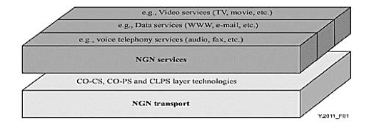
NGN Features
Fig. Separation of services from transport in NGN

Slide 50
NGN Features
Interworking with legacy (old) networks via open interfaces : Many services have to be operated across a hybrid combination of NGN and non NGN technologies.
In such cases interworking between NGNs of different operators and between NGN and existing networks such as PSTN (Public Switched Telephone Network), ISDN (Integrated Services Digital Network) and GSM (Global System for Mobile communications) is provided by means of gateways.
NGN Provides Generalized mobility is the ability for the user or other mobile entities to communicate and access services irrespective of changes of the location (anywhere in world) or technical environment. (technology independent)
Unrestricted access by users to different service providers, User can access services of different service providers along with own service provider.
Variety of identification schemes: Since the NGN consists of interconnected heterogeneous networks, using heterogeneous user access and heterogeneous user devices and that the NGN should provide a seamless capability, independent of access method and network, the NGN should address Numbering, Naming and Addressing. NGN can identify different naming and numbering scheme such as: telephone scheme, IPV4, IPV6, E.164, Enum

Slide 51
NGN Features
NGN compliant with all regulatory requirements, for example concerning emergency communications, security, privacy, lawful interception, etc.
Reliability: To improve reliability, every communication device is highly reliable. Provision of redundant configuration for communication circuits and equipment’s is maintained
NGN is Layered Architecture having four layers:
a) Access & Transport /Core Layer
b) Media Layer.
c) Control Layer
d) Service Layer

Slide 52
NGN Architecture
Diagram shows the functional block diagram of the NGN architecture.
The NGN functional architecture supports the UNI, NNI, ANI and SNI reference points.
The NGN architecture supports the delivery of multimedia services and content delivery services, including video streaming and broadcasting.
An aim of the NGN is to serve as a PSTN and ISDN replacement.
The NGN architecture defines a NNI, UNI, and ANI.
The NGN functions are divided into:
Service stratum (layer) functions
Transport stratum (layer) functions.
To provide services, several functions in both the service stratum and the transport stratum are needed.
The delivery of services/applications to the end-user is provided by utilizing the application support functions and service support functions, and related control functions.

Slide 53
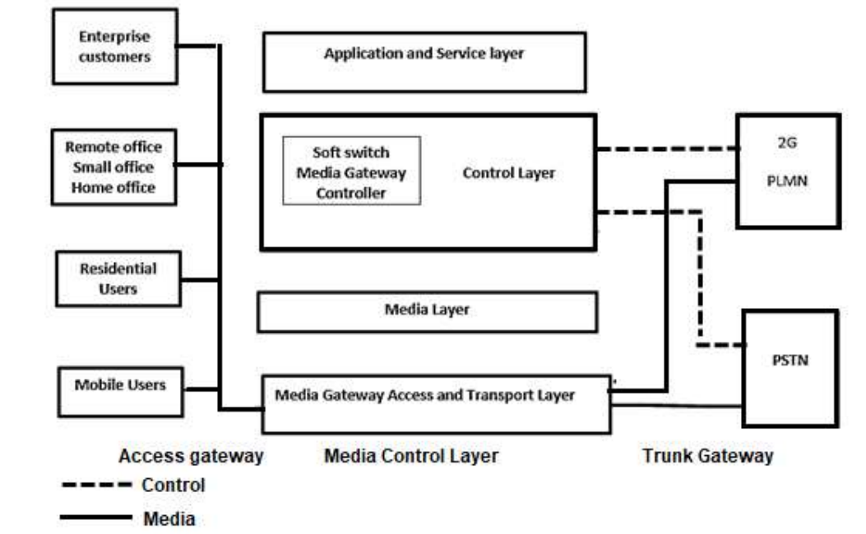
NGN Architecture
Fig. NGN Architecture

Slide 54
Transport stratum functions
The transport stratum functions include:
1)Transport functions:
The transport functions provide the connectivity for all components and physically separated functions within the NGN
These functions provide support for unicast and/or multicast transfer of media information, as well as the transfer of control and management information.
Transport functions include access network functions, edge functions, core transport functions, and gateway functions.
2) Transport control functions:
The transport control functions include resource and admission control functions, network attachment control functions as well as mobility management and control functions.
3)Access network functions:
The access network functions take care of end-user’s access to the network as well as collecting and aggregating the traffic coming from these accesses towards the core network.
These functions also perform QoS control mechanisms dealing directly with user traffic, including buffer management, queuing and scheduling, packet filtering, traffic classification, marking, policing, and shaping.
The access network includes access-technology dependent functions, e.g., for W-CDMA technology and xDSL access.
c) Wireless access
d) Optical access.

Slide 55
Transport stratum functions
4)Gateway functions:
The gateway functions provide capabilities to interwork with end-user functions and/or other networks, including other types of NGN, many existing networks such as the PSTN/ISDN, the public Internet, and so forth.
Gateway functions can be controlled either directly from the service control functions or through the transport control functions.
5)Resource and admission control functions (RACF):
Within the NGN architecture, the resource and admission control functions (RACF) act as the arbitrator between service control functions and transport functions for QoS.
The RACF provides an abstract view of transport network infrastructure to service control functions (SCF) and makes service stratum functions agnostic to the details of transport facilities such as network topology, connectivity, resource utilization and QoS mechanisms/technology.

Slide 56
Transport stratum functions
6) Network attachment control functions (NACF):
The network attachment control functions (NACF) provide registration at the access level and initialization of end- user functions for accessing NGN services.
They also announce the contact point of NGN functions in the service stratum to the end user.
The NACF provides the following functionalities:
Dynamic provisioning of IP addresses and other user equipment configuration parameters.
By endorsement of the user, auto-discovery of user equipment capabilities and other parameters.
Authentication of end user and network at the IP layer.
Authorization of network access, based on user profiles.
Access network configuration, based on user profiles.

Slide 57
Service stratum functions
1) Service control functions (SCF):
The service control functions (SCF) include:
Resource control registration and authentication- authorization functions at the service level for both mediated and non-mediated services.
They can also include functions for controlling media resources, i.e., specialized resources and gateways at the service-signaling level.
2) Content delivery functions (CDF):
The content delivery functions (CDF) receive content from
-the application support functions and
-service support functions,
then store, process, and deliver it to the end-user functions using the capabilities of the transport functions, under control of the service control functions.

Slide 58
Service stratum functions
3)Application support functions and service support functions (ASF&SSF):
The application support functions, and service support functions (ASF&SSF) include functions such as the
-Gateway,
-registration,
-authentication and
- authorization functions at the application level.
These functions are available to the "applications" and "end-user" functional groups. Through the UNI, the application support functions and service support functions provide reference points to the end-user functions. Application interactions with the application support functions and service support functions are handled through the ANI reference point
4) End-user functions:
No assumptions are made about the diverse end-user interfaces and end-user networks that may be connected to the NGN access network. End-user equipment may be either mobile or fixed.
5) Management functions:
These functions provide the capabilities to manage the NGN in order to provide NGN services with the expected quality, security, and reliability. All the NGN components are centralized controlled.

Slide 59
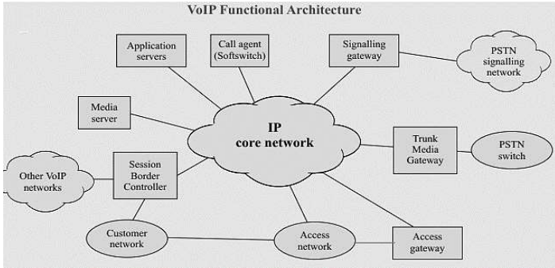
NGN Network components
Fig. NGN Network Components

Slide 60
NGN Network components
1)Media Gateway Controller (MGC):
Media gateway controllers are also known as Soft switches and Call controllers, Wireless Call Server or Call Agents.
The MGC is located in the service provider's network in control layer and provides call logic and call control functions, typically maintaining call state for every call in the network.
Many MGCs interact with application servers to supply services that are not directly hosted on MGCs
2)Media Gateway
-Media Gateways are located in access layer of NGN.
Media Gateway performs following functionality
i. Access gateway (AG)
ii. Trunk Media gateway (TMG)
iii. Signaling gateway (SG)
iv. Border Gateway (BGW)/ Session Border Controller(SBC)

Slide 61
NGN Network components
3)Access gateway (AG) The AG is located in the service provider's network.
It supports the line side interface to the coreIP network for use by phones, devices, and PBXs.
This element provides functions such as media conversion (circuit to Packet, Packet to circuit) and echo control
4) Trunk Media gateway (TMG)
The TMG supports a trunk side interface to the PSTN and/or IP routed flows in the packet network.
It supports functions such as packetisation, echo control etc.
5) Signaling gateway (SG):
The SG provides the signaling interface between the VoIP network and the PSTN signaling network.
It terminates SS7 links and provides Message Transport Part (MTP) Level 1 and Level 2 functionality.
Each SG communicates with its associated CA to support the end-to-end signaling for calls

Slide 62
NGN Network components
6) Border Gateway (BGW)/ Session Border Controller (SBC)
It is deployed at the edge and core of a service provider's network to control signaling and media streams as they enter and exit the network.
i-The “edge” is any IP-IP network border such as between a service provider and a customer or between a service provider and an enterprise network.
ii-The “core” is any IP-IP network border such as those between two service providers.
SBC provides functions such as security, denial of Service attacks, overload control, Network Address Translation and Firewall Traversal, Lawful Interception, Quality of Service (QoS) management, Protocol Translation, call accounting etc
7)Access network (AN): The access network provides connectivity between the customer premises equipment and the access gateways in the service provider's network.
There are various access methods:
-TDMdirect access,
-Switched TDM,
-Broadband access (cable, DSL),
-IP managed Internet service, etc

Slide 63
NGN Network components
8) IP core network
The primary function of the IP core network is to provide routing and transport of IP packets.
The IP core also has the added value of architecturally isolating the gateways, and their associated access networks, from the MGC and associated service intelligence
9) Media Server:
The Media Server is located in the service provider's network and uses a control protocol such as H.248 or SIP, under the control of the MGC or application server, to provide announcements and tones, and collect user information.
10)Application Server
The Application Server is located in the service provider’s network and provides the service logic and execution for one or more applications or services that are not directly hosted on the MGC.
Typically, the MGC routes calls to the appropriated AS for features the MGC does not support.

Slide 64
NGN Wireless Technology
Telecom network Spectrum - Licensed and Unlicensed Radio Bands:
The radio spectrum is the part of the electromagnetic spectrum with frequencies from 30 hertz to 300 GHz.
Electromagnetic waves in this frequency range, called radio waves, are widely used in modern technology, particularly in telecommunication.
Radio Spectrum, in general, can be categorized into two types:
i) Licensed radio bands
ii) Unlicensed radio bands

Slide 65
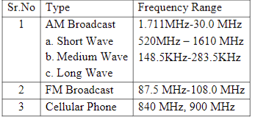
NGN Wireless Technology
i) Licensed radio bands:
To use this radio bands, a license must be obtained from a government agency.
This requirement is true of all users of these radio spectrums
Table: Licensed radio bands

Slide 66
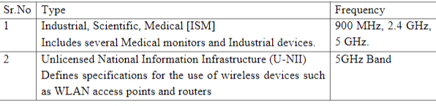
NGN Wireless Technology
ii) Unlicensed radio bands:
Unlicensed radio bands have been allocated to certain users by the government or any individual can use it,
but to be able to use and broadcast on these bands, you do not need to have a license;
you only need to create compliant devices that are to be used
Table: Unlicensed radio bands

Slide 67
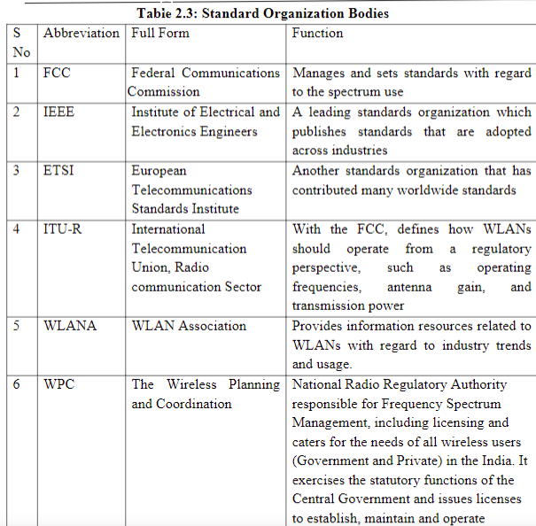
NGN Wireless Technology
Standard Bodies: Following groups and standards bodies have helped to develop standards so that all users can be good neighbours with others who use those radio bands.

Slide 68
Mobile Network Evolution (1G to 5G):
The mobile wireless Generation (G) generally refers to a change in the nature of the system, speed, technology, frequency, data capacity, latency etc.
Each generation have some standards, different capacities, new techniques and new features which differentiate it from the previous one.
The first generation (1G) mobile wireless communication network was analog used for voice calls only.
The second generation (2G) is a digital technology and supports text messaging.
The third generation (3G) mobile technology provided higher data transmission rate, increased capacity and provide multimedia support.
The fourth generation (4G) integrates 3G with fixed internet to support wireless mobile internet, which is an evolution to mobile technology and it overcome the limitations of 3G. It also increases the bandwidth and reduces the cost of resources.
5G stands for 5thGeneration Mobile technology and is going to be a new revolution in mobile market which has changed the means to use cell phones within very high bandwidth.

Slide 69
1G – First generation mobile communication system
The first generation of mobile network was deployed in Japan by Nippon Telephone and Telegraph company (NTT) in Tokyo during 1979.
In the beginning of 1980s, it gained popularity in the US, Finland, UK and Europe.
This system used analogue signals and it had many disadvantages due to technology limitations.
Disadvantages of 1G system
Poor voice quality due to interference
Poor battery life
Large sized mobile phones (not convenient to carry)
Less security (calls could be decoded using an FM demodulator)
Limited number of users and cell coverage

Slide 70
1G – First generation mobile communication system
Most popular 1G system during 1980s
Advanced Mobile Phone System (AMPS)
Nordic Mobile Phone System (NMTS)
Total Access Communication System (TACS)
European Total Access Communication System (ETACS)
Key features (technology) of 1G system
Frequency 800 MHz and 900 MHz
Bandwidth: 10 MHz (666 duplex channels with bandwidth of 30 KHz)
Technology: Analogue switching
Modulation: Frequency Modulation (FM)
Mode of service: voice only
Access technique: Frequency Division Multiple Access (FDMA)

Slide 71
2G – Second generation communication system GSM
Second generation of mobile communication system introduced a new digital technology for wireless transmission also known as Global System for Mobile communication (GSM).
This standard was capable of supporting up to 14.4 to 64kbps (maximum) data rate which is sufficient for SMS and email services.
Code Division Multiple Access (CDMA) system developed by Qualcomm also introduced and implemented in the mid-1990s.
CDMA has more features than GSM in terms of spectral efficiency, number of users and data rate.

Slide 72
2G – Second generation communication system GSM
Disadvantages of 2G system
Low data rate
Limited mobility
Less features on mobile devices
Limited number of users and hardware capability
Key features of 2G system
Digital system (switching)
SMS services is possible
Roaming is possible
Enhanced security
Encrypted voice transmission
First internet at lower data rate

Slide 73
3G – Third generation communication system
Third generation mobile communication started with the introduction of UMTS – Universal Mobile Terrestrial / Telecommunication Systems.
UMTS has the data rate of 384kbps and it support video calling for the first time on mobile devices.
After the introduction of 3G mobile communication system, smart phones became popular across the globe.
Specific applications were developed for smartphones which handles multimedia chat, email, video calling, games, social media and healthcare.

Slide 74
3G – Third generation communication system
Disadvantages of 3G system
Expensive spectrum licenses
Costly infrastructure, equipment and implementation
Higher bandwidth requirements to support higher data rate
Costly mobile devices
Key features of 3G system
Higher data rate
Video calling
Enhanced security, more number of users and coverage
Mobile app support
Multimedia message support
Location tracking and maps
Better web browsing
TV streaming
High quality 3D games

Slide 75
4G – Fourth generation communication system
4G systems are enhanced version of 3G networks developed by IEEE, offers higher data rate and capable to handle more advanced multimedia services.
LTE and LTE advanced wireless technology used in 4th generation systems.
Simultaneous transmission of voice and data is possible with LTE system which significantly improve data rate.
All services including voice services can be transmitted over IP packets.
Complex modulation schemes and carrier aggregation is used to multiply uplink / downlink capacity.
Wireless transmission technologies like WiMax are introduced in 4G system to enhance data rate and network performance

Slide 76
4G – Fourth generation communication system
Disadvantages of 4G system
Expensive hardware and infrastructure
Costly spectrum in most countries, frequency bands are too expensive
Key features of 4G system
Higher data rate up to 1Gbps
Improved security and mobility
Reduced latency for mission critical applications
High definition video streaming and gaming
Voice over LTE network VoLTE

Slide 77
5G – Fifth generation communication system
5G network is using advanced technologies to deliver ultra-fast internet and multimedia experience for customers.
Existing LTE advanced networks will transform into supercharged 5G networks in future.
In earlier deployments, 5G network will function in non-standalone mode and standalone mode.
In non-standalone mode both LTE spectrum and 5G-NR spectrum will be used together.
Control signalling will be connected to LTE core network in non standalone mode.

Slide 78
5G – Fifth generation communication system
Key features of 5G technology
Ultra-fast mobile internet up to 10Gbps
Low latency in milliseconds significant for mission critical applications
Total cost deduction for data
Higher security and reliable network
Uses technologies like small cells, beam forming to improve efficiency
Forward compatibility network offers further enhancements in future
Cloud based infrastructure offers power efficiency, easy maintenance and upgrade of hardware

Slide 79
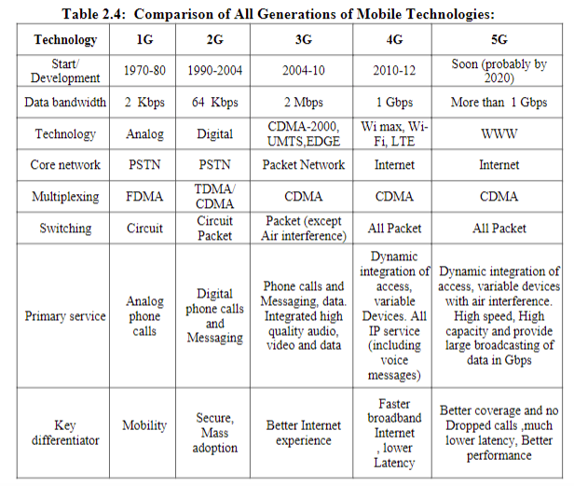

Slide 80
NGN Core: MPLS Concept
MPLS (Multi-protocol label switching) is used at core transport layer in NGN network. MPLS provides faster switching, propagation delay is less.
MPLS Concept
In NGN, a packet of a connectionless network layer protocol travels from one router to the next, each router makes an independent forwarding decision for that packet.
That is, each router analyzes the packets header, and each router runs a network layer routing algorithm.
Each router independently chooses a next hop for the packet, based on its analysis of the packet's header and the results of running the routing algorithm.
Packet headers contain considerably more information than is needed simply to choose the next hop.
Choosing the next hop can therefore be thought of as the composition of two functions.
The first function partitions the entire set of possible packets into a set of Forwarding Equivalence Classes (FECs).
The second maps each FEC to a next hop.

Slide 81
NGN Core : MPLS Basics
Fig. MPLS Architecture

Slide 82
NGN Core : MPLS Basics
Three kinds of LSRs exist in an MPLS network: a. Provider Edge [PE] Router/Ingress LSRs: Ingress LSRs receive a packet that is not labelled yet, insert a label (stack) in front of the packet, and send it on a data link.
b. Provider Edge [PE] Router/Egress LSRs: Egress LSRs receive labelled packets, remove the label(s), and send them on a data link. Ingress and egress LSRs are edge LSRs.
c. Core Edge [CE] Router/Intermediate LSRs: Intermediate LSRs receive an incoming labelled packet, perform an operation on it, switch the packet, and send the packet on the correct data link.

Slide 83
NGN Core : MPLS Basics
d. Upstream and Downstream LSRs: An LSR can do the three operations: PUSH/adding labels, POP/remove labels, or SWAP/interchanging labels.
e. Label Switch path: A label switched path (LSP) is a sequence of LSRs that switch a labeled packet through an MPLS network or part of an MPLS network. Basically, the LSP is the path through the MPLS network or a part of it that packets take. The first LSR of an LSP is the ingress LSR for that LSP, whereas the last LSR of the LSP is the egress LSR. All the LSRs in between the ingress and egress LSRs are the intermediate LSRs. LSP is unidirectional. The flow of labeled packets in the other direction right to left between the same edge LSRs would be another LSP.

Slide 84
MPLS Features
MPLS Features:
1. QoS enabled MPLS transport network will provide real time and data transport application.
2. MPLS increases operator revenue.
3. MPLS offers high transport efficiency by using hybrid technology (packet switching and circuit switching)
4. MPLS offers high reliability and operational simplicity.
5. MPLS provide control and deterministic usage of network resources, end-to-end control to engineer network paths and to efficiently utilize network resources.
6. In MPLS network management is simple
7. It ensures smooth interworking of the packet transport network with other existing/legacy packet networks.
8. MPLS header length is of 32 bits, in which label length is 20 bits, 3 bits for service quality and 8bits for Time to live (no of hops in network) and 1 bit for stacking the labels.

Slide 85
MPLS Advantages
1. Consistent Network Performance: The MPLS allows different Class of Service classifications to be applied to packets, to help ensure that data loss (packet loss), transmission delays (latency) and variations in transmission delay (jitter) are kept without appropriate limits.
2. Obscures Network Complexity: MPLS can effectively hide the underlying complexity of the network from devices and users that don't need to know about it.
3. Reduced Network Congestion: The MPLS can support Traffic Engineering having many uses, including the re-routing of comparatively delay-tolerant traffic to slower, circuitous, under-utilised routes, freeing up capacity on quicker (lower-latency) overcrowded paths.
4. Increased Uptime: MPLS is that it has the potential to increase uptime as Fast Reroute that enables traffic to be switched to an alternative path very rapidly
5. Scalability: According to the needs, the MPLS can be scaled up and down
6. Efficiency: MPLS offers much higher quality connections without packet loss and jitter using it along with VoIP may lead to increased efficiency
7. Reliability: Since MPLS uses labels for forwarding packets, it can be assured that the packets will be delivered to the right destination.

