Slide 1

Unit-3

Slide 2
Backstory of Blockchain
1991: The blockchain technology was defined in 1991 by the research scientist Stuart Haber and W. Scott Stornetta.
They wanted to introduce a computationally practical key for time-stamping digital documents so that no one can tamper document.
Hence both scientists together developed a system using Cryptography where, the time-stamped documents are stored in a Chain of Blocks.
1992: In 1992, Merkle Trees adds additional features in blockchain technology which was developed in 1991. Hence, Blockchain Technology became efficient to store several documents to be collected into one block.
Merkle used a Secured Chain of Blocks that stores multiple data records in a sequence.

Slide 3
Backstory of Blockchain
2000: In the year 2000, Stefan Konst published theory of cryptographic secured chains, plus ideas for implementation.
2004: In the year 2004, Cryptographic activist Hal Finney presented a system for digital cash known as “Reusable Proof of Work” which was the game-changer in the history of Blockchain and Cryptography.
This System helps to solve the Double Spending Problem.
2008: In the year 2008, Satoshi Nakamoto conceptualized the concept of “Distributed Blockchain” called as A Peer to Peer Electronic Cash System (i.e. Bitcoin)
2010: Bitcoin starting with price of $0.0008 in 2010.
2014: Block chain Technology is separated from currency and Block chain 2.0 is born.

Slide 4
Backstory of Blockchain
2015: In 2015, Ethereum Frontier Network was launched, thus enabling developers to write smart contracts and dApps that could be deployed to a live network.
2017: In the year 2017, Japan recognized Bitcoin as a legal currency.
2018: The Bitcoin value continued to drop, reaching the value of $3,800 at the end of the year. Online platforms like Google, Twitter, and Facebook banned the advertising of cryptocurrencies.
2019: In the year 2019, Ethereum network transactions exceeded 1 million per day.
2020: Ethereum launched Beacon Chain in preparation for Ethereum 2.0.
2021: Price of single Bitcoin reached all time high of $64,000 in April 2021 after Tesla announced that it had acquired $1.5 billion worth of Bitcoin.

Slide 5
What is Blockchain?
Blockchain can be defined as a chain of blocks that contains transaction information.
The technique is intended to timestamp digital documents so that it’s not possible temper them.
The purpose of blockchain is to solve the double records problem without the need for a central server.
The blockchain is used for the secure transfer of items like money, property, contracts, etc, without requiring a third-party intermediary like a bank or government.
Once data is recorded inside a blockchain, it is very difficult to change it.
Blockchain can’t be run without the Internet.
Blockchain also called meta-technology as it affects other technologies.
Blockchain consists of several components: a database, software application, some connected computers, etc.
Blockchain is not Bitcoin, but it is the technology behind Bitcoin.
Bitcoin is the digital token, and the blockchain is the ledger to keep track of who owns the digital tokens.
A blockchain is a decentralized digital ledger made up of blocks that record data across a peer-to-peer (P2P) network. Once information is stored on this ledger, it becomes near impossible to delete, alter and hack.

Slide 6
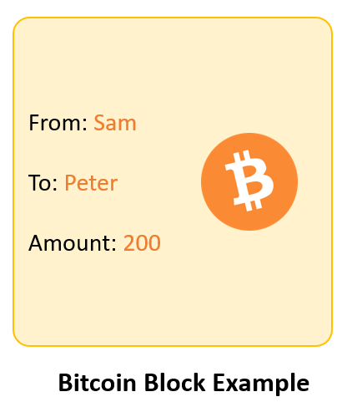
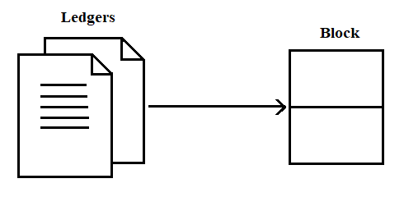
Blockchain Architecture
What is a Block?
Block- Block contains transaction information that have taken place within 10 minutes such as money transfer, house transfer, gadget transfer, etc.
For Example: Bitcoin block contain information about sender, receiver and number of coin transferred.
Each block consists multiple ledgers.
Ledger is database that stores transaction information.
Ledger is a blockchain diary.
Each block has its capacity: once block is full, then new block is created and that
is connected to previous block with Hash values.

Slide 7
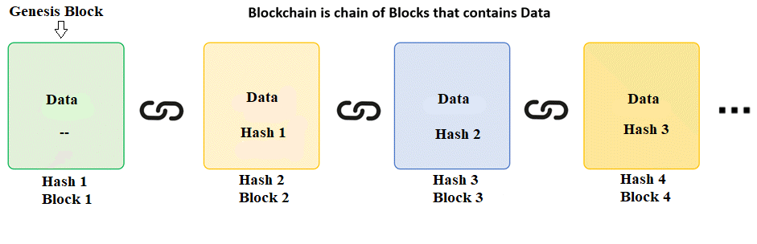
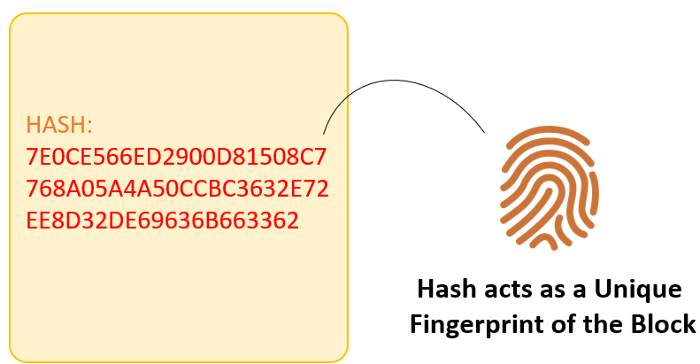
Blockchain Architecture
Figure. Blockchain
How data stored in block?
In Bitcoin there is a window of 10 minutes. Whatever transaction executed in 10 minutes are stored into block and after every 10 minutes a new block is created and each new block is chained (connected) with previous block using Hash value.
The first block of chain is called as Genesis block.
What is Hash?
Each person fingerprint is unique similarly each block hash value is unique.
Hash is used to uniquely identify block and its contents in a block chain.
How to find Hash value?
The hash value of 1st block is calculated by taking all data of 1st block and applying hashing algorithm(such as SHA-3 or SHA-56) on first block data , then Hash value of 1st block is stored into 2nd block.
Similarly, Hash value of 2nd block is calculated by taking all data of 2nd block , Hash value 1st block and applying hashing algorithm on second block and so on.
.

Slide 8
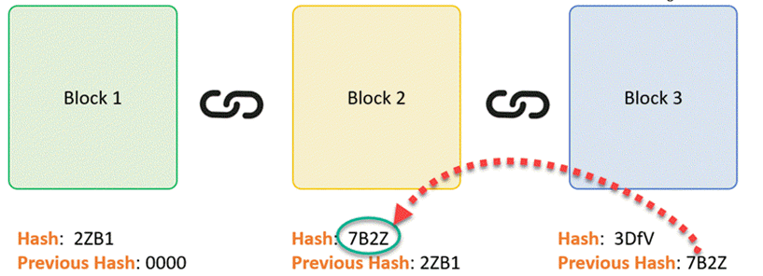
Blockchain Architecture
Who is Responsible for adding block into Blockchain?
Miner is full node that verifies all transaction and add block into blockchain and gets some rewards.
For example: In Bitcoin network , Bitcoin miner will get $10 for adding block in Blockchain.
In Blockchain network there will be multiple miners. Everyone wants to add block in Blockchain and get rewards. So to get reward, miner need to solve puzzle.
The node that solves puzzle first will get chance to add block in Blockchain and earn reward.

Slide 9
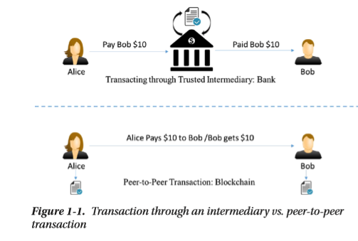
Blockchain Architecture
Blockchain is a peer-to-peer system of transacting values with no trusted third parties in between.
It is a shared, decentralized, and open ledger of transactions. This ledger database is replicated across a large number of nodes.
This ledger database is an append-only database and cannot be changed or altered.
There is no need for trusted third parties to serve as intermediaries to verify, secure, and settle the transactions.
Blockchain technology was designed to enable true decentralization.
Every node on the blockchain network has an identical copy of the blockchain

Slide 10
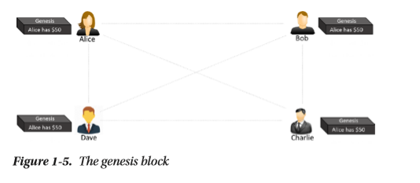
Example of Transaction on blockchain network
Assume that there are three candidates—Alice, Bob, and Charlie—who are doing some money transfer transactions with each other on a blockchain network.
Let us go through the transactions step by step to understand blockchain open and decentralized features.
Step-1: Let us assume that Alice had $50 with her, which is the genesis of all transactions and every node is aware of it, as shown in Figure 1-5.

Slide 11
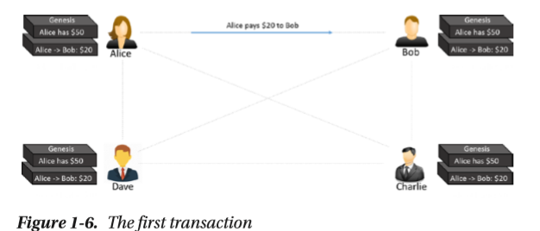
Example of Transaction on blockchain network
Step-2: Alice makes a transaction by paying $20 to Bob. Observe how the blockchain gets updated at each node, as shown in Figure 1-6

Slide 12
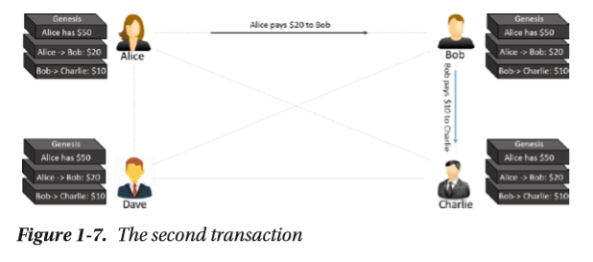
Example of Transaction on blockchain network
Step-3: Bob makes another transaction by paying $10 to Charlie and the blockchain gets updated as shown in Figure 1-7.

Slide 13
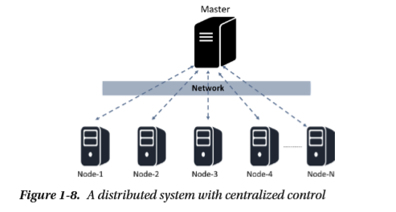
Centralized versus Decentralized System
Blockchain is designed to be decentralized design, instead of the centralized design.
Whether a system is centralized or decentralized, it can still be distributed.
A centralized distributed system is one in which there is a master node also sometime called as server responsible for breaking down the tasks or data and distribute the load across nodes.
On the other hand, a decentralized distributed system is one where there is no “master” node as such and yet the computation may be distributed.
Blockchain is example decentralized distributed system.

Slide 14
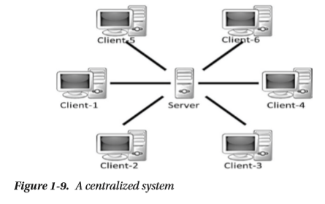
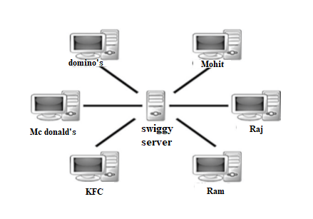
Centralized Systems
Centralized System has a centralized control with all administrative authority.
In Centralized System all operations are controlled and managed by central server.
Centralized systems are easy to design, maintain, impose trust, and govern, but suffer from many inherent limitations, as follows:
They have a central point of failure, hence they are less stable.
They are more vulnerable to attack and hence less secured.
Centralization of power can lead to unethical operations.
Most of the time , Scalability is difficult
User need to pay service charges.
Nowdays applications runs on internet uses centralized architecture.
For example: online banking, online food delivery , social media apps, etc
Example of Online food delivery uses Centralized System

Slide 15
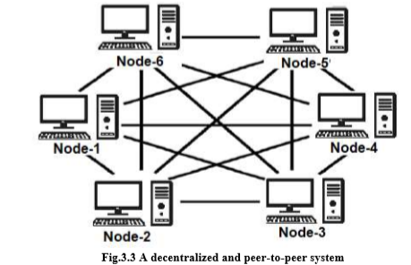
Decentralized System
Decentralized system does not have a centralized control and every node has equal authority.
All nodes in decentralized system are connected with each other in peer to peer network.
Decentralized systems are difficult to design, maintain, govern, or impose trust.
Decentralized systems offer the following advantages:
A decentralized system is more stable and fault tolerant as they do not have a central point of failure.
Attack resistant, as no central point to easily attack and hence more secured
Symmetric system with equal right to all nodes, so less scope of unethical operations
No service charges.
A distributed system may also be decentralized system,
for example, blockchain. But, the task is not subdivided and delegated to nodes unlike common distributed systems, because there is no master that in blockchain.

Slide 16
Limitations of Centralized Systems
Limitations of Centralized Systems
Trust issues
Security issue
Privacy issue i.e. data sale privacy is being undermined
Cost and time factor for transactions
Can’t scale up vertically after a certain limit.
Bottlenecks can appear when the traffic spikes.

Slide 17
Advantages of decentralized systems over centralized systems:
Advantages of decentralized systems over centralized systems:
Elimination of intermediaries
Easier and genuine verification of transactions
Increased security with lower cost
Greater transparency
Decentralized and immutable

Slide 18
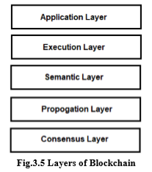
Layers of Blockchain
1.Application Layer:
It is made up of smart contracts and decentralized applications (DApps).
This layer acts as the front end of the blockchain through which user interact with blockchain network.
2. Execution Layer :
The Execution Layer execute the instructions of application on all the nodes in a blockchain network.
3.Semantic Layer:
Semantic Layer also called as logical layer and it deals with validation of the transactions done in the blockchain network
When a transaction initiated by a node, the set of instruction are executed on the execution layer and validated by the semantic layer.
4. Propagation Layer(Network Layer):
This layer facilitates communication between the different nodes within the blockchain network.
When new transaction is done, then its broadcasted to all other nodes in the network by propagation Layer

Slide 19
Layers of Blockchain
5. Consensus Layer :
Once a new block is created, the block is propagated to all the other nodes to check if the new block is valid or not with the transactions in it and based on the consensus from all other nodes the new block gets added on to the blockchain.
This layer is the one responsible for the validation of a block and adding block in blockchain.
Let us understand the consensus layer by example.:
Let’s say John and Mark are two validators on the blockchain.
John receives transactions : A and B
Mark receives transactions : B and C
If both John and Mark validate the transactions and add them to the blockchain, then transaction B will be written two times on the blockchain. This means double record problem will occurs.
To avoid this problem John and Mark need to solve a cryptic mathematic puzzle and the one who solves puzzle first will get chance to add the block in a blockchain. This form of consensus mechanism is known as Proof of Work.

Slide 20
Importance of Blockchain
Blockchain helps in the verification and traceability of multistep transactions.
Blockchain can provide secure transactions, reduce compliance costs, and speed up data transfer processing.
Blockchain technology can help contract management and audit the origin of a product.
Blockchain can be used in voting platforms and managing titles and deeds.
The transactions are done instantly and transparently, as the ledger is updated automatically.
As Blockchain is a decentralized system, no intermediary fee is required
In Blockchain, the authenticity of a transaction is verified and confirmed by participants
Blockchain is an immutable public digital ledger, which means when a transaction is recorded, it cannot be modified

Slide 21
Blockchain Adoption So Far
1. Blockchain came along with Bitcoin, a digital cryptocurrency, in 2009 via a simple mailing list.
2. Some companies started with various flavors of blockchain offerings such as Ethereum, Hyperledger, etc.
3. Microsoft and IBM came up with SaaS (Software as a Service) offerings on their Azure and Bluemix cloud platforms, respectively.
4. Various start-ups and established companies took blockchain initiatives that motivated on solving some of the business problems that were not easily solved before.
5. Financial market, media and entertainment, energy trading, prediction markets, retail chains, loyalty rewards systems, insurance, logistics and supply chains, medical records, government and military applications have adopted Blockchain technology

Slide 22
Blockchain Uses and Use Cases
1. Any type of property or asset transactions:
for example: laptops, mobile phones, diamonds, automobiles, real estate, digital files, etc. can be registered on blockchain.
Blockchain technology can enable these asset transactions from one person to another, maintain the transaction log, and check validity or ownerships.
2. Many financial use cases being developed on blockchain:
for example: cross border payments, share trading, loyalty and rewards system, Initial Coin Offering (ICO)
3. In IoT :
with billions of IoT devices it is difficult to have a centralized system to control the devices and provide a common data exchange platform.
This is also an area where blockchain can be used to build a decentralized peer-to- peer system for the IoT devices to communicate with each other
ADEPT (Autonomous Decentralized Peer-To-Peer Telemetry) is a joint initiative from IBM and Samsung that has developed a platform-a decentralized IOT.
ADEPT uses three protocols: BitTorrent for file sharing, Ethereum for smart contracts, and TeleHash for peer-to-peer messaging in the platform.
4.In the government sector:
for example: Land registration, vehicle registration , e-Voting, etc. are some of the active use cases.

